Slide 1
Golf Companion Package
Dhun & Tim

Slide 2
Purpose
To assist golfers play their most enjoyable round of golf
01
Score Tracking
02
Club selection
Play a game and track round score based on handicap
Help players pick the right club for various yardages
Additional
03
Load Custom Courses
Add multiple players

Slide 3
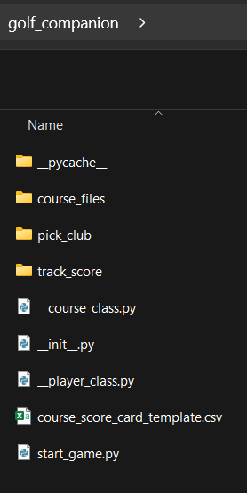
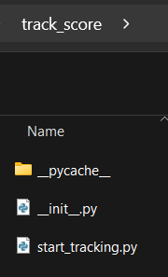
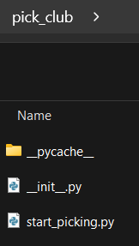
Package Structure
golf_companion
start_game.py
1
track_score
start_tracking.py
track_score()
2
pick_club
start_picking.py
start_picking()
3

Slide 4
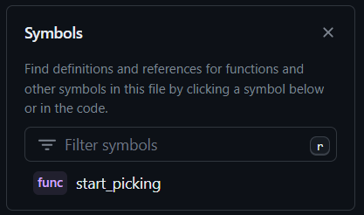
Pick_club Sub-package
TO UPDATE….

Slide 5
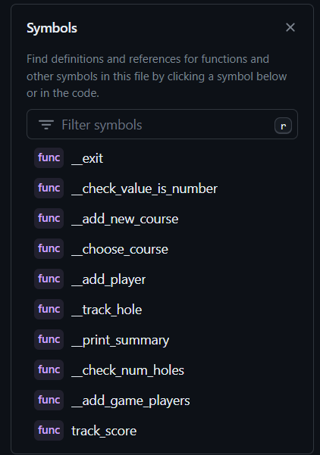
Track_score Sub-package
track_score.py (module)
Main function: track_score()
Helper functions:
__add_player()
__choose_course()
__add_new_course()
__start_tracking(players, course, num_holes)
__print_summary(players, course)

Slide 6
Start_game.py
The main module will simulate playing a round of golf and will function by repeatedly calling the 2 sub-packages.

Slide 7
Thank You
Why did the golfer bring two pairs of pants?
In case he got a hole in one!

