Slide 1



Chainlink Fall Hackathon
DataFi
清华大学学生区块链协会区块链系列课程
张奥 2021/11/13

Slide 2

Contents
1
Backgrounds
2
DataFi
3
Future Visions

Slide 3
Background - The World of Data
Data is everywhere
People have no control of their data
People disclose their privacy and should get corresponding service or payoff

Slide 4
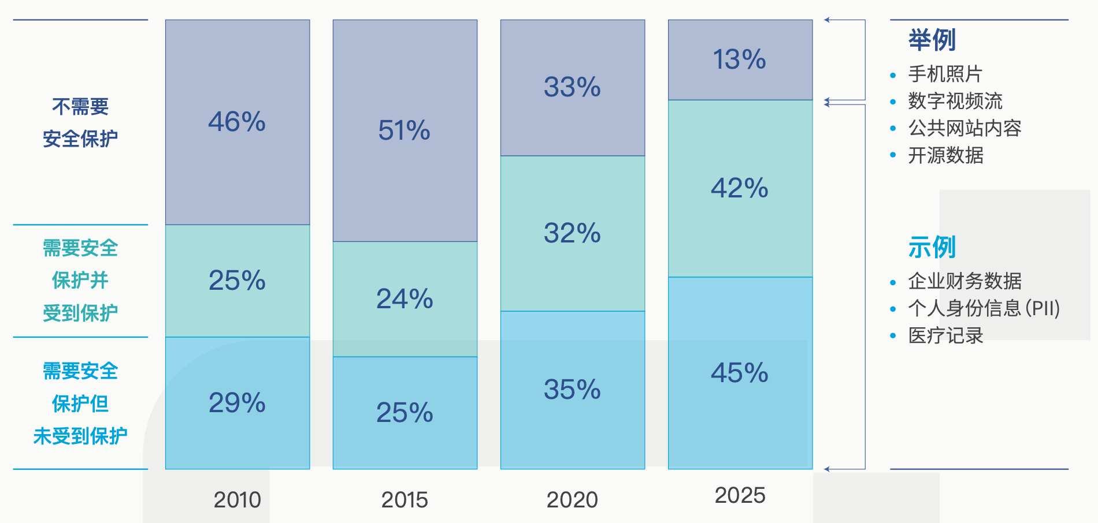
Background - Trends
Algorithm everywhere
人工智能系统改变格局，提高生产力
Privacy & Security
安全成为一种重要的基础，保护生产力
Global Trends on Data Security

Slide 5
Contents
1
Backgrounds
2
DataFi
3
Future Visions

Slide 6
DataFi – make data worth
Our Goals
We will provide service on building Data markets and searching for its equilibrium.
To be more specific, DataFi allows individuals to have control of their data, make best use of their data and get appropriate payoff – including enjoying better and secured service, and getting paid.
DataFi
Data Owner
Data User

Slide 7
ERC - x
ERC 721
approveuse()
~~~~
read() / write()
~~~

Slide 8
An Example – Scholarship Verification
Data
The student’s private personal information, such as GPAs, IDs, etc.
DataFi
Data Owner- students
Data User- schools
Services
Verifying the data and handing out the scholarship.

Slide 9
Scholarship Verification Con’t
1. Mint
Mint the data as ERC-x using Chainlink
2. Verification
The school creates a scholarship verification contract
Students aprrove the contract to read their data
As user of the ERC-x data, the contract read and verify student’s GPAs, IDs, etc.
The contract hands out the scholarships according to the verification results.

Slide 10
Scholarship Verification Con’t
Code

Slide 11
Contents
1
Backgrounds
2
DataFi
3
Future Visions

Slide 12
Application Scenarios
Data Owner
Data User
Platforms
App users
Governments
Devices owners
Data Scientists
…
…

Slide 13
THANKS
张奥 2021.11.13

