Slide 1


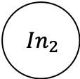


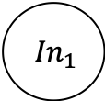







1. 协商阶段
3. 确认阶段
$${ In}_{1}$$
$${ T}_{1}$$
$${Out}_{π\left(1\right)}$$
$${ In}_{2}$$
$${ T}_{2}$$
$${Out}_{π\left(2\right)}$$
……
……
……
$${ In}_{3}$$
$${ T}_{n}$$
$${Out}_{π\left(n\right)}$$
$${ ⟦{Out}_{1}⟧}_{K_{1}:K_{n}}$$
$${ ⟦{Out}_{2}⟧}_{K_{1}:K_{n}}$$
${Out}_{π\left(1\right)},{Out}_{π\left(2\right)}$,…, ${Out}_{π\left(n\right)}$
2. 混淆阶段
……
$${ ⟦{Out}_{n}⟧}_{K_{1}:K_{n}}$$

