Slide 1




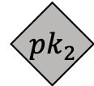
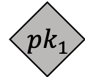
$${ pk}_{1}$$
1.32 BTC
05/05/2011 14:10:54
$${ pk}_{2}$$
$$u_{2}$$
$$u_{1}$$
$${ pk}_{1}$$
$${ pk}_{2}$$

