Slide 1
MediScan: AI-Powered Medical Image Analysis for Disease Diagnosis
COORDINATOR: Ms. Madhupriya Mam
MENTOR : Mr.Deepak Sir
PRSENTED BY : Dhurbo Kumar Patra(GROUP A)

Slide 2
Introduction of the Project
Innovative AI-powered system designed to revolutionize medical image analysis for eye disease detection and diagnosis.
Utilizes cutting-edge artificial intelligence and machine learning algorithms to analyze medical images for early disease detection and diagnosis.
BACKGROUND
Prevalence of Eye Diseases
Diagnostic Challenges
Image Processing Capabilities
Early and Accurate Diagnosis

Slide 3
IMPORTANCE OF THE PROJECT
Timely Diagnosis
Proactive Treatment
Reduced Human Error
Efficiency
Advanced Analytics
Deliverables
Automated Image Interpretation Module
Quantitative Analysis Tools
Integration Capabilities:

Slide 4
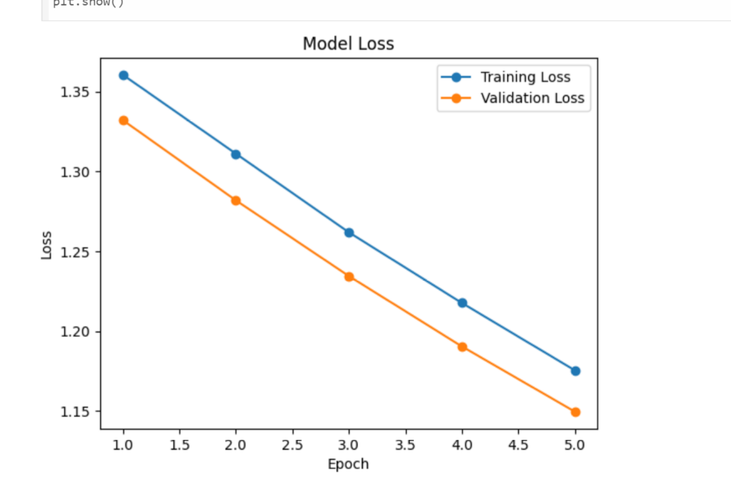
Results
Accuracy and loss plot

Slide 5
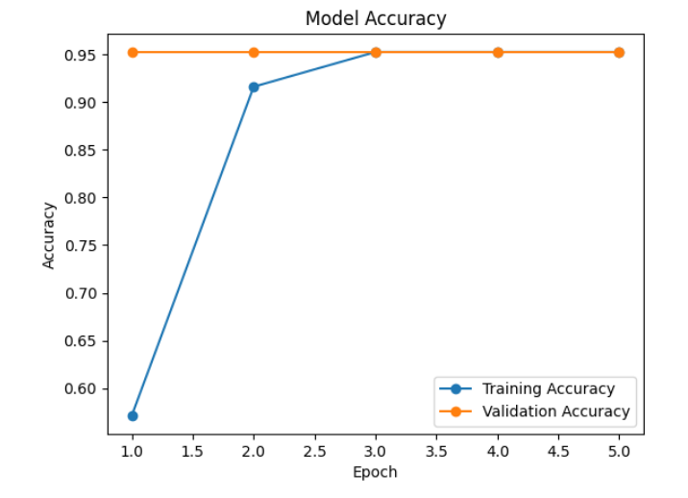
Graphs:

Slide 6
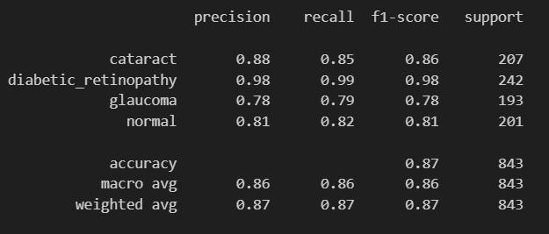
Demonstration of Project
CLASSIFICATION REPORT

Slide 7
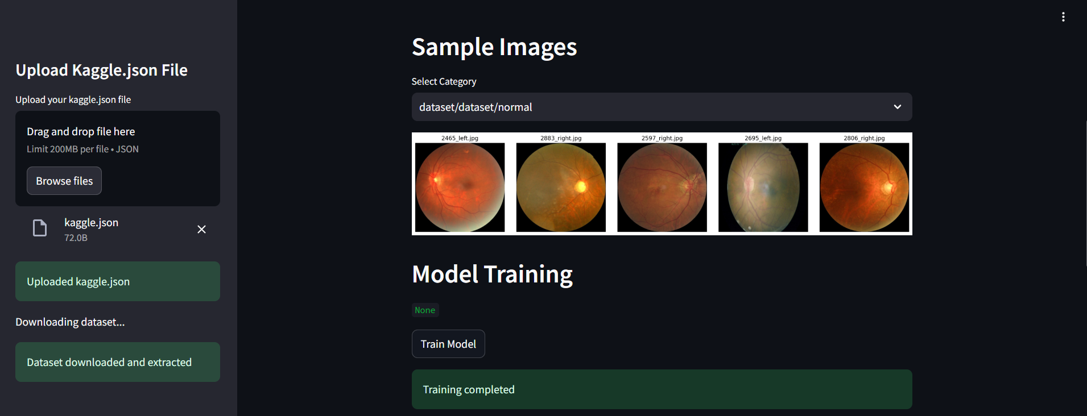
USER INTERFACE

Slide 8
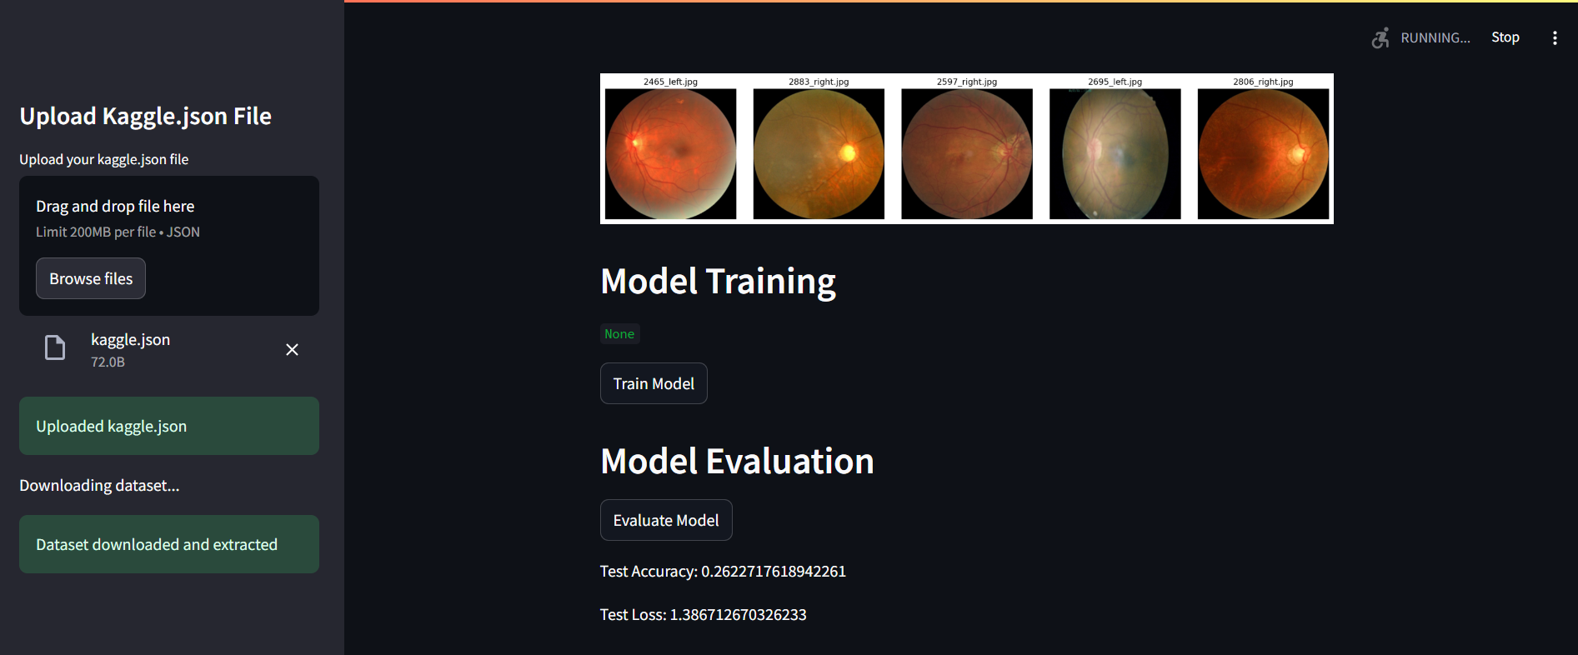
RESULT MODEL

Slide 9
Conclusions
Enhanced Diagnostic Accuracy
Early Detection Capabilities
Improved Clinical Workflows
Achieved objectives of the project
Accurate Eye Disease Detection
Early Diagnosis
Automated Image Interpretation
Quantitative Analysis
Scalable Deployment

Slide 10
We want to take this opportunity to acknowledge and thank everyone who contributed to the success of the MediScan project.
Our dedicated project team, whose expertise and hard work made this project possible.
Special thanks to our coordinator and mentor for their unwavering support and belief in the project.
Your questions and feedback are highly valued and will help us continue to improve and innovate

