Slide 1


NAAN MUDHALVAN
DIGITAL
MARKETING
INSTAGRAM REEL

Slide 2


TEAM MEMBERS
01
DINESHKRISHNA H
02
HANANIAH SHADRACH D
03
VASAN V
04
MOHANA KRISHNAN H

Slide 3
INSTAGRAM REEL
Aim:
Create an Instagram reel for our business brand “ProGreeners” and promoted. It attracted a more than 248 Likes so for.

Slide 4
STEP 1
Text to mp3
• we converted our text content into Mp3 format
using https://ttsmp3.com/
• Download and saved it, For future use.
LoLogo
• Logo was prepared using canva
Elements
•Dowlod video elements from Pinterest.com

Slide 5

CREATION
INSTAGRAM
go to canva.com and sign up
upload all your elements
rearrange it in orderly
add your audio
add logo
add video elements
apply effects
save and download it
create new Instagram account
make it as a public
convert it into professional
upload your video with keywords and hashtags
post it
wait until it reaches the desired likes and views collect the insights of that reel

Slide 6
PROGREENERS THINKING
The Ultimate aim of the “ProGreeners” was to solve the current problems of farmers by
Creating the communication between the farmers and agricultural experts for solve the crop problems and converting it into a value added products.
Send their products without any intermediators ,so that they can fix their own cost for their products.
It can create a communication between the other farmers , so that deficiency and over cultivation should be avoided

Slide 7
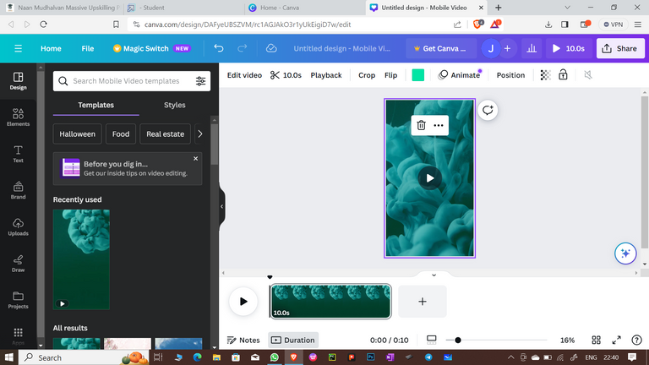
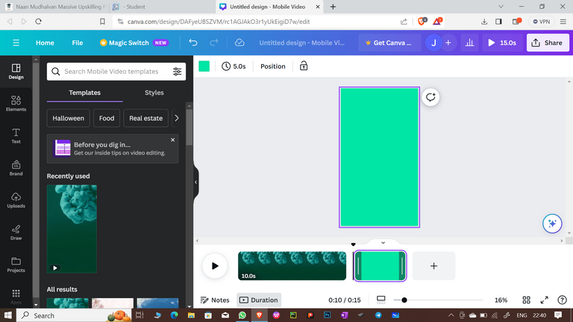

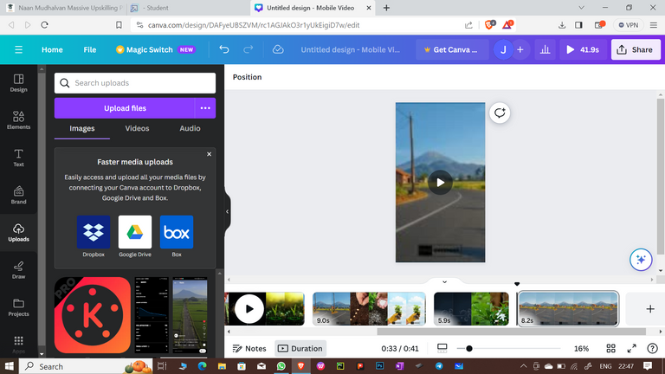
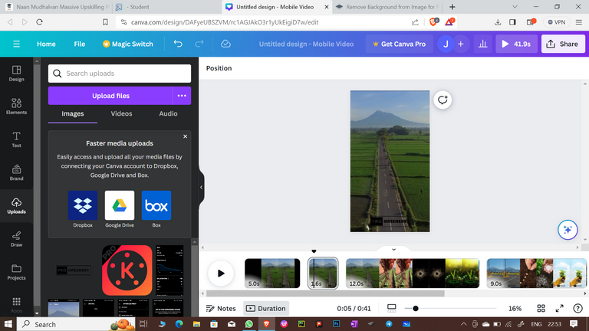

Slide 8
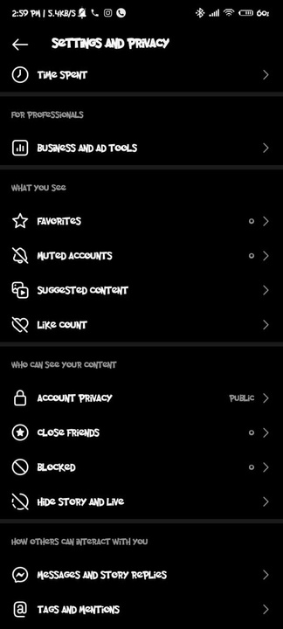
Creating a brand
and make a video for it
Create a public
account

Slide 9
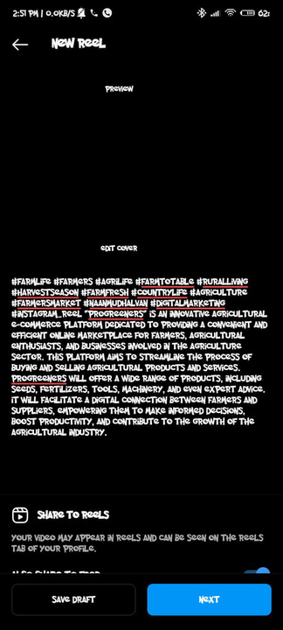
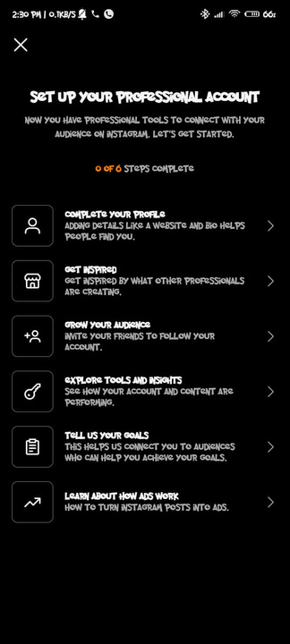
make the account as a
professional
upload the video and post it
in reels section

Slide 10
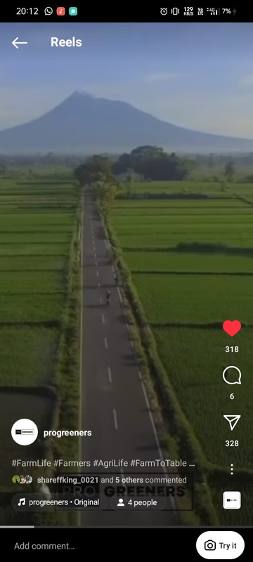
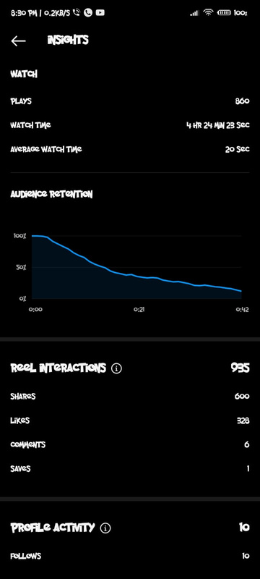
We reached 850+ viwers
and more than 300+ liked the video

Slide 11

BRAND NAME: PROGREENERS
Category: agriculture based e-commerce site
Target Audience: All (Men, Women and Kids)
Email : decidersCreations@gmail.com
PROGREENERS

Slide 12
THANKS
A LOT
BY TEAM MEMBERS

