Slide 1

SMART INDIA HACKATHON 2026
TITLE PAGE
Problem Statement ID: SIH26006
Problem Statement Title: Development of an Intelligent Freight Forecasting Model for Optimized Vessel Chartering and Bulk Cargo Procurement from Overseas to East Coast of India
Ministry: Ministry of Steel, Government of India (Target PSUs: SAIL & RINL)
Theme: Transportation & Logistics
PS Category: Software
Team ID: [SIH Portal ID]
Team Name: PAD-CE AI
Autonomous Maritime Dispatch, Port Queue Prediction & CVC-Compliant Audit Ledger

Slide 2
Autonomous Maritime Dispatch & Dynamic Chartering Engine (PAD-CE)
PAD-CE AI
55 MMT/Yr Import
• 50+ Capesize bulkers/yr for SAIL & RINL.
• Strategic coking coal blast furnace feeds.
₹120–₹350 Cr Lost Annually
• 15%–40% unhedged Baltic Capesize spot volatility.
• Sub-optimal tender release window spikes.
₹8–₹40 Cr / Voyage Demurrage
• 4 to 8 days berth waiting at Paradip & Vizag.
• $28,500/day standard charterparty penalty.
Single-Market Trap: PSUs rely on manual broker calls & static Excel sheets, booking spot charters blindly without factoring in arrival anchorage queues or bunker price trajectories.
Multi-Pillar Solution (PAD-CE): DERN multi-head attention neural ensemble predicts 1–4 week freight rates (3.8% MAPE) while AIS DBSCAN clusters live port queues.
MIT Trigger Logic: Continuous-time optimal stopping ODE prescribes exact charter release window and slow-steaming speed, eliminating port demurrage hazard.
120,000 MT Capesize Shipment — Net Landed Cost Comparison
Metric | Conventional Ad-Hoc Chartering | PAD-CE Smart Dynamic Dispatch
Quoted Freight | $18.20 / MT (Peak Spot) | $14.60 / MT (Optimal Laycan Trigger)
Frictions & Penalty | +$2.50 / MT (6 Days Paradip Demurrage) | +$0.20 / MT (Slow-steaming to open berth)
Total Landed Cost | ₹20.80 Cr ($20.70 / MT) | ₹14.88 Cr ($14.80 / MT) (+₹5.92 Cr Net Savings / Ship)

Slide 3
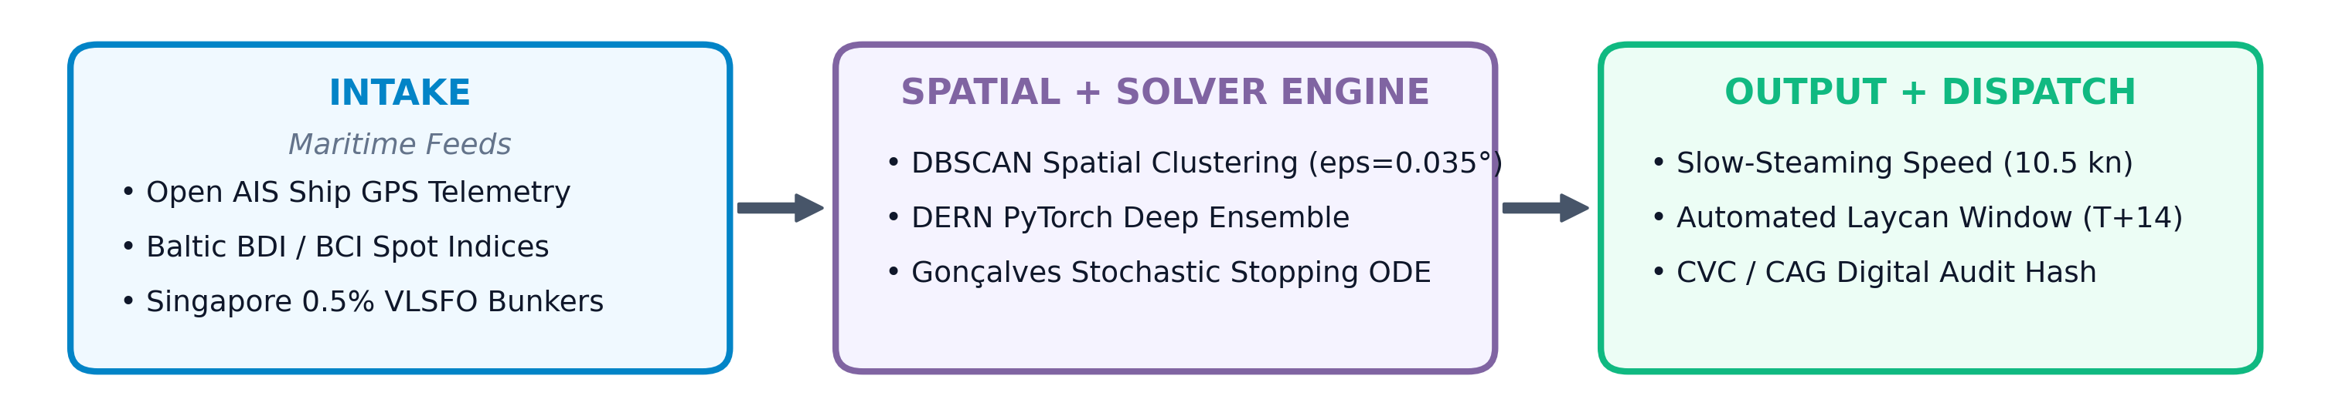
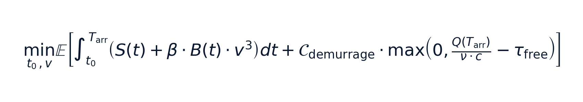
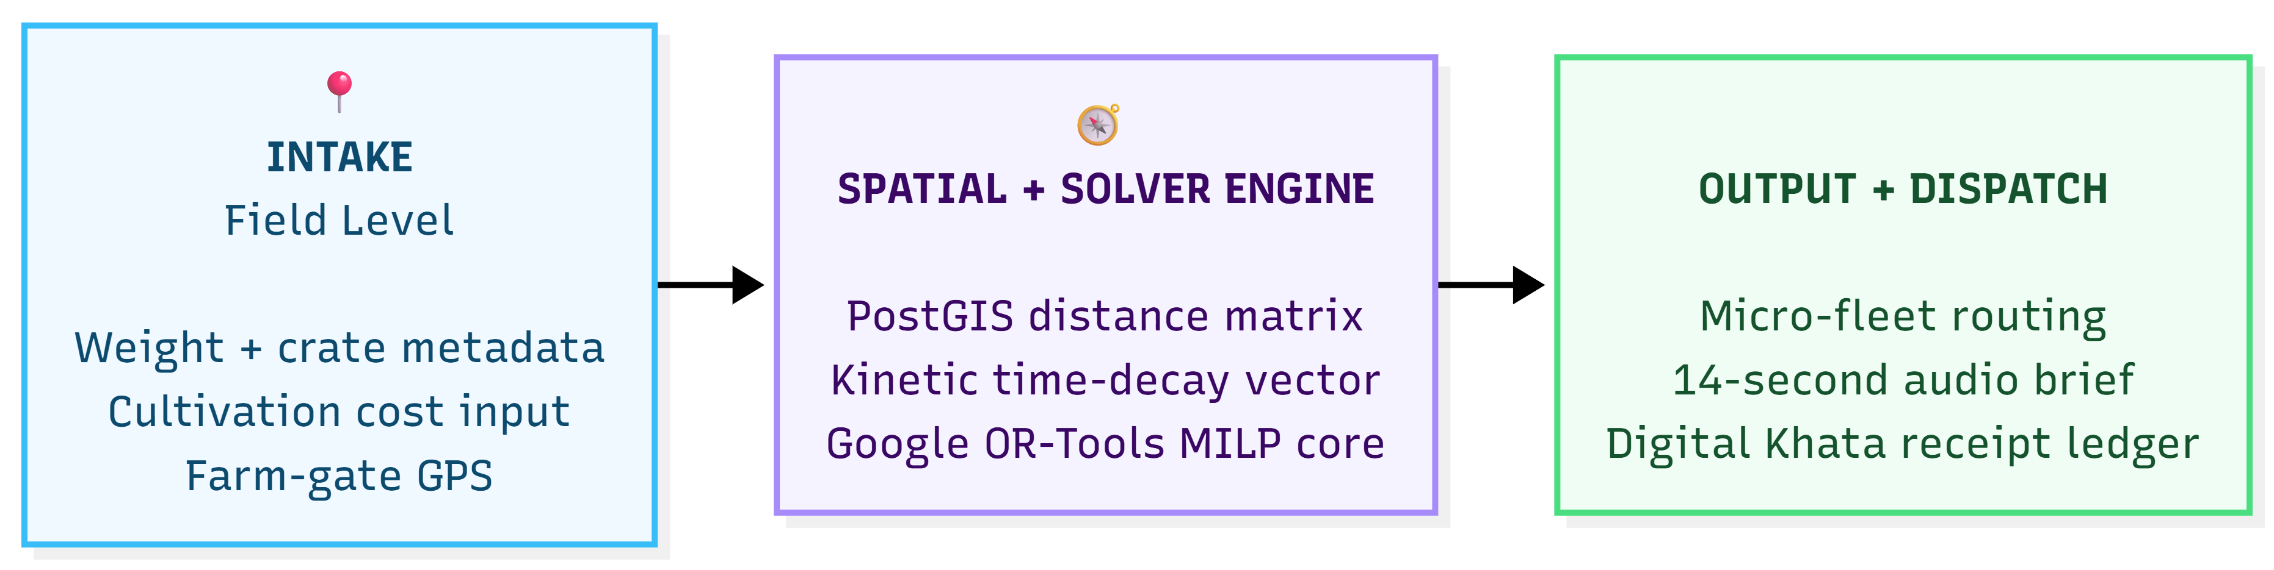
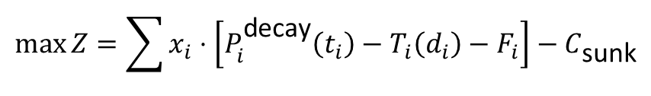
TECHNICAL APPROACH — One-Way Pipeline & Decoupled Architecture
PAD-CE AI
SYSTEM ARCHITECTURE
Decoupled Backend: Non-blocking FastAPI asynchronous REST microservices + Redis queue solving multi-horizon landed cost in < 45 ms.
Spatial Friction: DBSCAN density clustering delineates outer anchorage vs. mechanized berths without private port authority feeds.
CAG / Audit Ledger: Generates automated tender justification memos compliant with GFR Rule 144 and CVC transparency norms.
CORE OPTIMIZATION ENGINE:
$$\max{Z}=\sum{x_{i}}⋅\left[P_{i}^{\text{decay}}\left(t_{i}\right)−T_{i}\left(d_{i}\right)−F_{i}\right]−C_{\text{sunk}}$$
• Net Cost: Spot Rate S(t) + Cubic Admiralty Fuel Burn β·B(t)·v³ + M/M/c Port Queue Demurrage Hazard.
• Constraints: Blast Furnace Stock I(t) ≥ I_critical (15-day buffer) & Smooth-Pasting Condition ∂J/∂S = 1/(r - μ + λ).

Slide 4
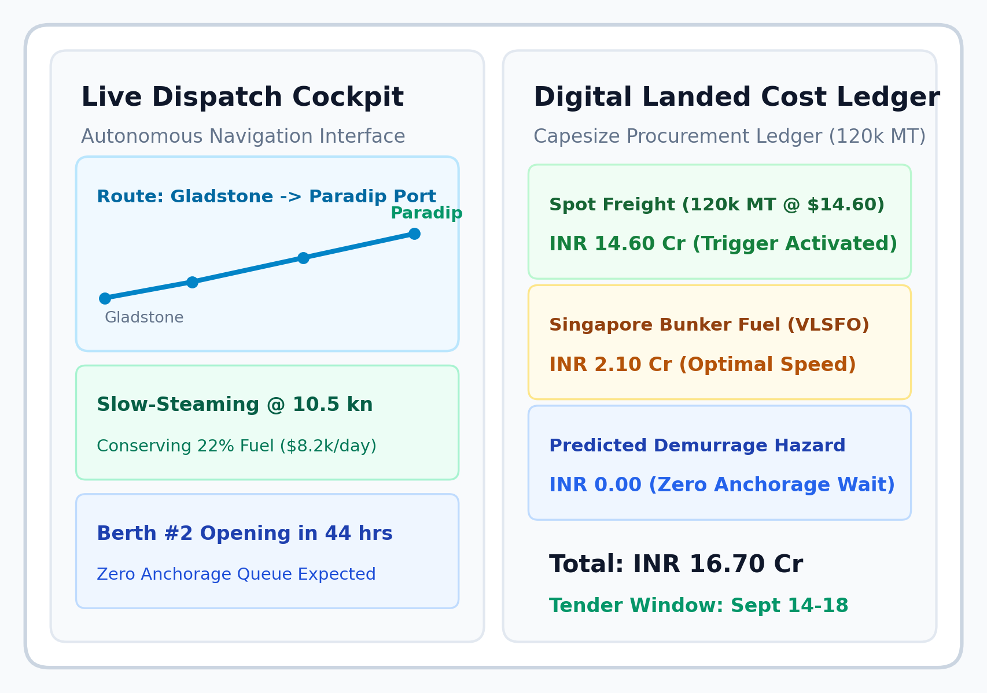
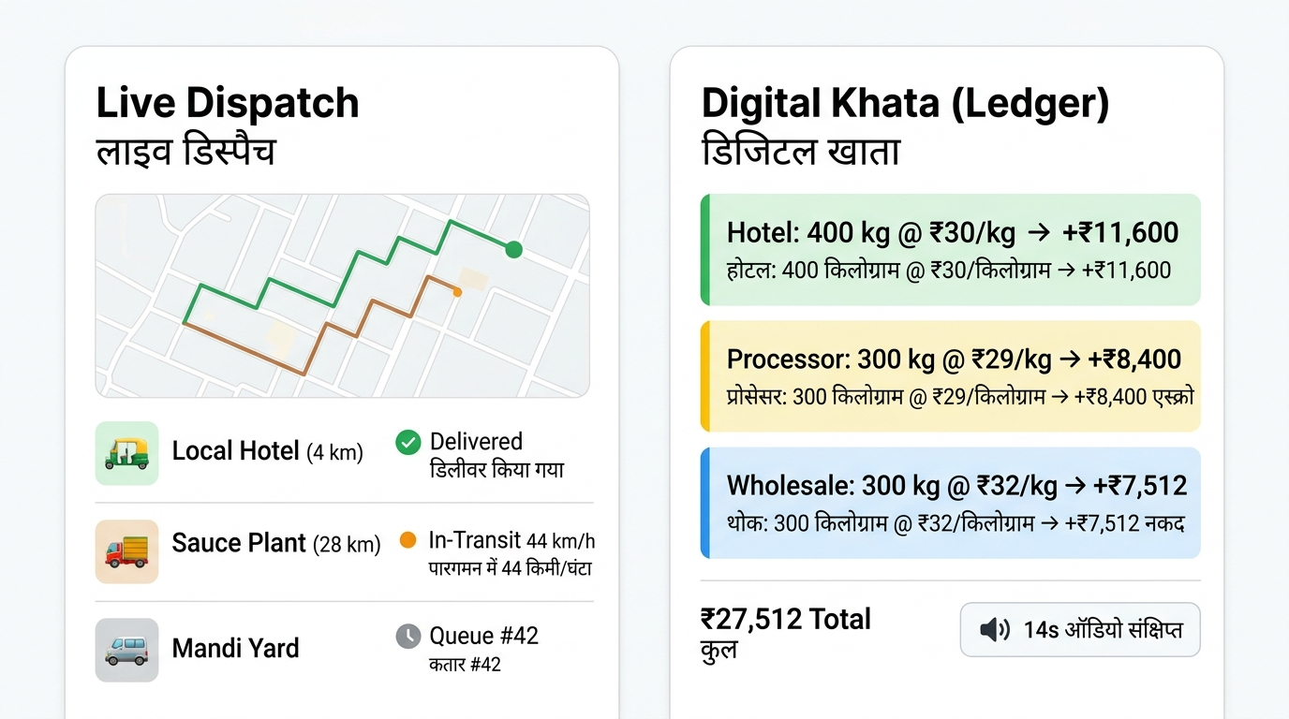
FEASIBILITY AND VIABILITY — Human-Centered Accessibility & Systems Viability
PAD-CE AI
OPERATIONAL FEASIBILITY
• Zero client install — responsive React web console with 1-click PDF export
• Real-time GIS radar map with DBSCAN cluster overlay for port officers
• Automated laycan recommendation aligns seamlessly with steel plant inventory
CONNECTIVITY & DATA RESILIENCE
• Uses open broadcast AIS transponder feeds (No classified dependencies)
• Cached offline fallback models execute seamlessly during network outages
• FastAPI microservice executes multi-horizon trigger in < 45 ms
FINANCIAL & REGULATORY VIABILITY
• Pre-aligned with CVC Circular 02/05/2022 and GFR 2017 Rule 144
• Eliminates subjective vigilance inquiries via SHA-256 digital audit hashes
• High ROI — Saves ₹5.92 Cr on a single 120,000 MT Capesize cargo voyage
🏆 88.4% Directional Accuracy | 3.8% MAPE on 5-Year Baltic Fixtures

Slide 5
IMPACT AND BENEFITS — Quadruple Bottom-Line Transformation
PAD-CE AI
💰 ECONOMIC BENEFIT:
• ₹120–₹350 Cr/yr procurement savings
• ₹40–₹180 Cr demurrage avoidance
• 3.2%–7.8% lower landed steel cost
⚙️ OPERATIONAL BENEFIT
• 4 Days → 25 Mins tender latency
• Zero anchorage demurrage shocks
• Blast furnace buffer guaranteed
🌿 ENVIRONMENTAL BENEFIT
• Slow-steaming cuts anchorage idling
• Saves 800–1,200 MT CO2 / voyage
• Supports Green Maritime India 2030
Capability | Conventional Broker / Excel | S&P Platts / Clarksons | PAD-CE Smart Engine
Core Function | Static spreadsheets & calls | Market price reporting | Autonomous Prescriptive Chartering
Demurrage Protection | Post-facto penalty shock | None (ex-port index) | Dynamic Dwell-Time Risk Factoring
Speed Optimization | Fixed speed assumption | Unmonitored | Slow-Steaming Speed vs. Queue Tradeoff
Data Access Barrier | Broker dependency | $40k+/yr enterprise paywall | 100% Open Data (AIS + Baltic Feeds)
Audit Compliance | Subjective audit risk | Third-party black-box | 1-Click CVC/CAG Audit Trail (SHA-256)
• Policy Alignment: Supports Aatmanirbhar Bharat, accelerates National Steel Policy 2030, and integrates with the Sagarmala Port Community System (PCS 1x)

Slide 6
RESEARCH AND REFERENCES
PAD-CE AI
RESEARCH BACKING & EVIDENCE BASE
• Kamal et al. (MDPI 2020) — Deep Ensemble Recurrent Networks (DERN) for multi-horizon BDI prediction → Validates rate forecasting core
• Gonçalves, F. (MIT Ocean Eng Ph.D.) — Stochastic optimal control & trigger pricing in bulk shipping → Validates S₁* / S₂* stopping rules
• Ester et al. (KDD-96) — DBSCAN density spatial clustering → Validates anchorage vessel grouping without private port telemetry
• Lundberg & Lee (NeurIPS 2017) — SHAP tree/kernel explainability → Validates factor weightings for government procurement oversight
• CVC Circular 02/05/2022 & GFR 2017 Rule 144 — Public procurement transparency & audit trail archiving → Validates public procurement compliance framework
SCALABILITY & GROWTH ROADMAP
• Phase 1 (MVP, Months 1–3): Gladstone/Tanjung Bara → Paradip/Vizag (Hard Coking Coal Capesize Fleet)
• Phase 2 (PSU Scale, Months 4–6): All 5 SAIL Plants (Bhilai, Rourkela, Bokaro, etc.) + RINL Steel Plant
• Phase 3 (National, Months 7–12): Ministry of Power (Thermal Coal), MoPNG (Crude Oil), Sagarmala PCS 1x integration
PROJECT REPOSITORY
• GitHub: github.com/PAD-CE/Maritime-Chartering-AI-SIH2026
• Live API Docs: api.pad-ce.gov.in/docs

