Slide 1

HACKATHON

Slide 2
TITLE
TITLE : QR-CODE BASED CITIZEN FEEDBACK SYSTEM FOR GUJARAT POLICE
P-ID : 084
DEPARTMENT NAME : HOME

Slide 3
TEAM INTRODUCTION
COLLEGE NAME : GOVERNMENT POLYTECHNIC FOR GIRLS
MENTOR NAME : PRIYA MALI
TEAM LEADER : DHVANI MAKTUPORIA (206150307138)
MEMBER 2 : ARCHI ZADAFIYA (206150307192)
MEMBER 3 : RIDDHI VEKARIYA (206150307193)
MEMBER 4 : HEER PHADKE (206150307161)
MEMBER 5 : KHUSHI MENDAPARA (206150307147)
MEMBER 6 : ZEEL BAROT (206150307196)

Slide 4
ABSTRACT
Service satisfaction surveys have become an important tool for Government to measure their service effectiveness, i.e. the feedback system. When a citizen gives feedback at a bottom level using a conventional paper-based system, it is so difficult to reach a higher official in time. Quick Response (QR) code based feedback system has been introduced that opens up the possibility of conducting public service satisfaction at a lower cost and the way feedback is directly routed to the police department according to their hierarchical level and get real-time feedback using a specific smartphone application. It is an android application that provides the facility to scan a QR code that has been put for a particular police station, through the phone’s camera. Then it displays a feedback form and citizens can fill it up and submit it using OTP received on phone number. After the submission, there is information about the citizen service app and the contact number of the police control room.

Slide 5
CURRENT SCENARIO
The paper base feedback system are takes more time to reaching the head department
It is waste of papers and it is not eco-friendly.
It takes more time to reaching it place so the problems are not solved at their time.
Delhi police has already developed a system to take feedback using QR code. We are trying to make such system for our state also.
Android based feedback system provides low cost and effective feedback system that can reach to the higher authorities at correct time which is not possible in existing paper- based feedback system.

Slide 6
OUR APPROACH TO SOLVE THE PROBLEM
We are making a system in which QR-code is provided to each police station.
Citizen who have been served can provide feedback by Scanning the QR code available at that station. First the feedback form is displayed. Citizen fill that feedback form and then while submitting OTP is sent to his/her phone number. After entering the OTP, citizen is allowed to submit the form.
The final data is derived such as total number of feedbacks and police-station, district wise feedback.
All the responses are summarized and will be sent to the higher authority.

Slide 7
MODULES
USER : Enters to login page -→ enters details → scans the QR-code → receives email (for OTP)→ enters OTP (to get verified) → receives feedback form → gives feedback
ADMIN : The admin panel receives feedbacks from all over Gujarat.
OFFICER : The feedbacks of a particular city can be viewed in this panel.

Slide 8
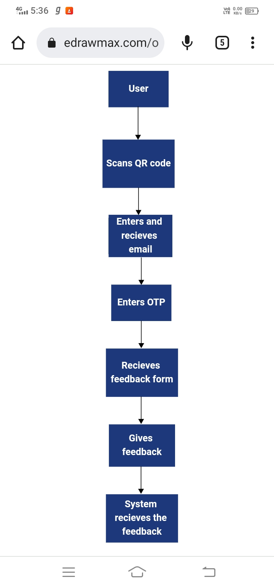

Slide 9
THANK YOU !

