Slide 1

Sugar Cosmetics Instagram Performance Analytics
Subtitle : Performance Evaluation & Insights using Tableau
PRESENTED BY – DHVANI ARODIYA

Slide 2
Introduction
Sugar Cosmetics is a leading beauty brand with a vibrant online presence.
To optimize marketing effectiveness, this project analyzes their Instagram performance using Tableau.
The study focuses on engagement metrics, content types, hashtags, and audience behavior to support data-driven decision-making.

Slide 3
Problem Statement
Manual Instagram performance tracking is time-consuming.
No clear visibility into which post type or campaign performs best.
Lack of an interactive dashboard for quick business insights.
Need for a data-driven approach to improve engagement strategy.

Slide 4
Objectives
Evaluate Instagram performance using KPIs (Likes, Comments, Reach, etc.).
Compare post types (Image, Reel, Carousel, Video) to find the most effective format.
Analyze campaign success and engagement rates.
Identify high-performing hashtags and posting trends.
Provide actionable recommendations for growth.

Slide 5
Scope of the Project
Platform: Instagram (Sugar Cosmetics official handle)
Tools Used:
Microsoft Excel: For data cleaning, formatting, and preprocessing
Tableau Public: For data visualization and dashboard creation.
Dataset Source: Social Media Analytics Dataset
Metrics: Likes, Comments, Shares, Saves, Reach, Impressions, Engagement Rate, Profile Visits, Follows

Slide 6
Dataset Description
Post Type: Format of the content (Image, Video, Reel, Carousel)
Campaign Type: Type of marketing activity (Tutorial, Giveaway, Festive Offer, etc.).
Hashtags1–3: Keywords used to improve discoverability and engagement.
Impressions: Total number of times the post was viewed.
Reach: Unique users who saw the post.
Likes, Comments, Shares, Saves: Indicators of audience engagement and interaction.
Profile Visits: Number of users who visited the brand’s Instagram page after seeing the post.
Follows: New followers gained as a result of the post.

Slide 7
Methodology
Data Cleaning: Removed null values and formatted dates in Excel.
Feature Creation: Calculated new fields in Tableau: Engagement, Engagement Rate (%), Month-Year, Weekday ,etc.
Visualization Design: Created charts for KPIs, trends, engagement, and hashtags.
Dashboard Integration: Combined visuals into an interactive Tableau dashboard with filters.
Insight Generation: Analyzed results to recommend strategies for higher engagement.

Slide 8
Visual Analysis Summary
Dashboards & Charts Created in Tableau:
KPI Overview
Monthly Posting Trend (Line Chart)
Top 10 Posts by Likes (Bar Chart)
Top 10 Posts by Engagement Rate (Bar Chart)
Post Type Comparison (Grouped Bar Chart)
Weekday Engagement Analysis (Bar Chart)
Follows vs Profile Visits (Dual Axis Combo Chart)
Reach vs Likes (Scatter Plot)
Hashtag Analysis (Pie Chart)
Campaign Type Impact (Treemap)
Final Interactive Dashboard

Slide 9
Key Insights
Reels and Tutorials achieved the highest engagement rate.
Posting frequency was consistent during festive campaigns.
Peak engagement days: Wednesday and Thursday.
Top hashtags: #CrueltyFree, #VeganBeauty, #MakeupGoals.
Festive and tutorial campaigns contributed most to new followers.

Slide 10
Business Recommendations
Focus on Reels & Tutorials — highest engagement and follower conversion.
Post mid-week (Wed–Thu) for maximum visibility.
Use hashtags consistently to reach new audiences.
Incorporate clear CTAs (e.g., “Save this look”, “Tag a friend”).
Repurpose high-performing posts for paid promotion campaigns.

Slide 11
Conclusion
Tableau visualizations helped simplify and interpret Instagram data.
The dashboard provides actionable insights for marketing decisions.
Data-driven planning can increase audience retention and conversion.
Sugar Cosmetics can now focus resources on high-engagement strategies.

Slide 12
Future Enhancements
Integrate Instagram API for live performance tracking.
Add sentiment analysis for audience reactions on comments.
Expand analysis to cross-platform performance (Facebook, YouTube, etc.).
Automate monthly reporting for faster marketing insights.

Slide 13
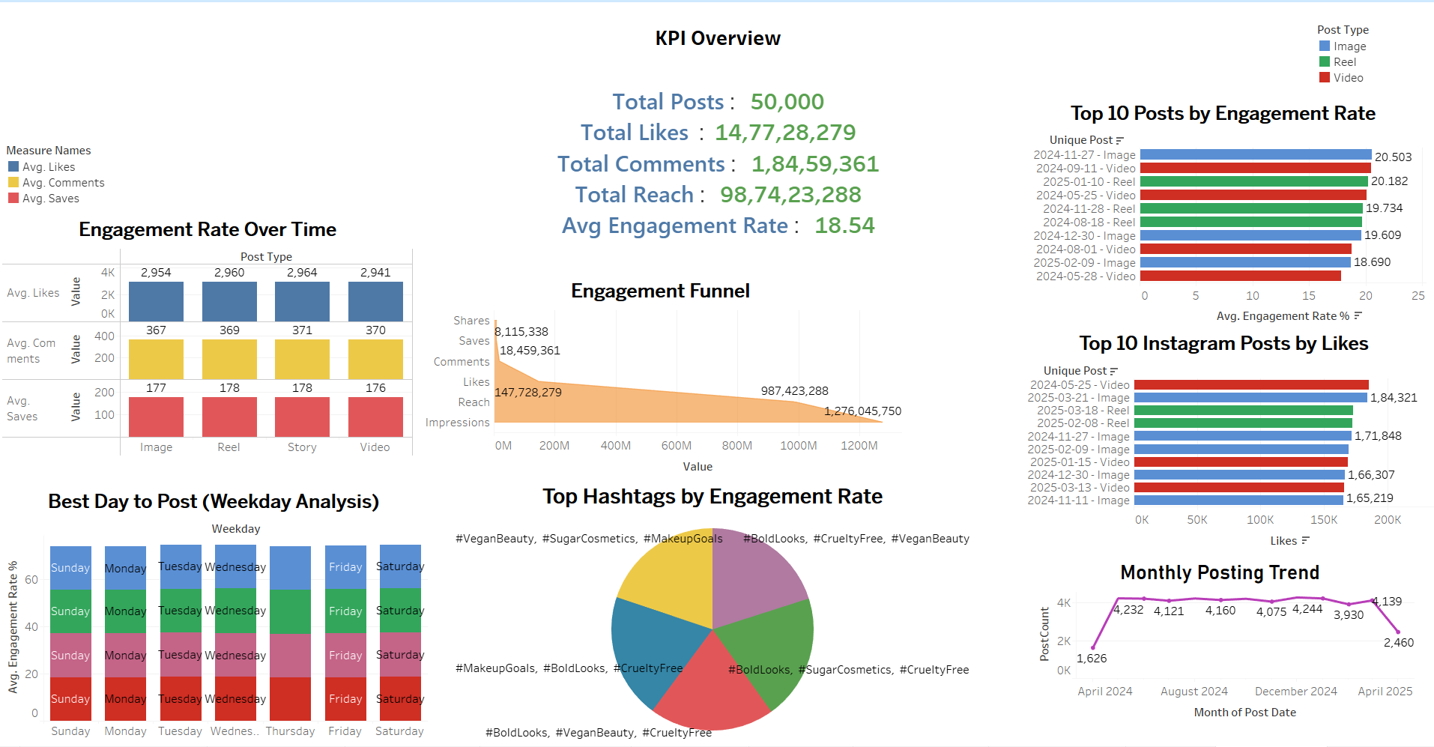
FINAL DASHBOARD

Slide 14
THANK YOU
--------------------------------------------------------------------------------------------------------------------------------
PRESENTED BY : DHVANI ARODIYA
BATCH : DATA ANALYSIS

