Slide 1

ECE310 Wireless Communication
  ASCEND: Adaptive Self-supervised Continual Expert Network for Domain-Incremental Wifi Sensing
Student: Dhvanit Mahesuriya
(AU2440039)
Programme: B.Tech CSE
Domain: WiFi Sensing
Date: 11th October 2026
B.Tech Computer Science Engineering, School of Engineering and Applied Sciences

Slide 2
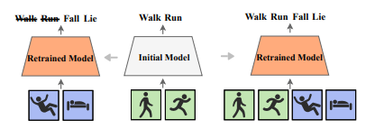
Motivation for the Problem Statement
Domain
Wi-Fi Sensing using CSI for Human Activity Recognition
Continual Domain Adaptation
Challenges
Limited Label Data
Domain Incremental Learning
Catastrophic Forgetting
Objective
Domain Incremental Learning based Model
Preventing Catastrophic forgetting
Self-Supervised learning based model
Fig. 1: Catastrophic forgetting [1]
Can we teach a Wi-Fi sensing model to learn new environments continuously, without forgetting old ones, through Self-Supervised learning?
[1] R. Li, T. Deng, S. Feng, M. Sun, and J. Jia, "ConSense: Continually sensing human activity with WiFi via growing and picking," in Proc. AAAI Conf. Artif. Intell., vol. 39, no. 22, 2025, pp. 14292–14300.
.
| 2

Slide 3
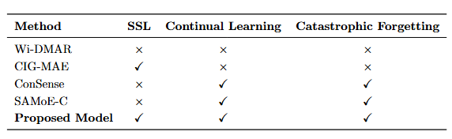
Literature Summary & Problem Formulation
[2]
[3]
[1]
[4]
Key Observations:
Catastrophic Forgetting is Universal
Labels are the Bottleneck
Exemplar Storage has Privacy Risk
Continual learning in Domain adaptation in Wifi HAR unexplored
[1] R. Li, T. Deng, S. Feng, M. Sun, and J. Jia, "ConSense: Continually sensing human activity with WiFi via growing and picking," in Proc. AAAI Conf. Artif. Intell., vol. 39, no. 22, 2025, pp. 14292–14300.
[2] C. Tang, P. Tang, H. Zhang, J. Jin and S. Mao, "Wi-DMAR: Cross-Domain Human Activity Recognition via an Enhanced Conditional Diffusion Model," in IEEE Internet of Things Journal, vol. 13, no. 11, pp. 25343-25353, 1 June1, 2026, doi: 10.1109/JIOT.2026.3676817.
[3] G. Liu, Y. Hao and Y. Zou, "CIG-MAE: Cross-Modal Information-Guided Masked Autoencoder for Self-Supervised WiFi Sensing," in IEEE Internet of Things Journal, doi: 10.1109/JIOT.2026.3696504.
[4] W. Zheng, Y. Mao, and I. W. H. Ho, "Scene-adaptive continual learning for CSI-based human activity recognition with mixture of experts," arXiv preprint arXiv:2605.06447, 2026.
| 3

Slide 4
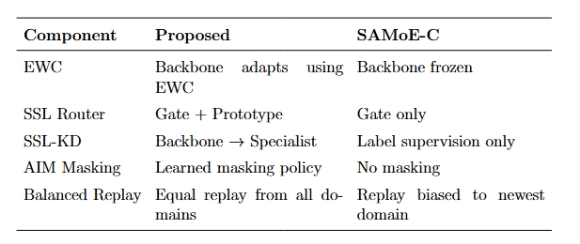
Proposed Innovation
[4]
EWC: Mitigates catastrophic forgetting across domains.
SSL Router: Improves domain-aware expert selection.
SSL-KD: Enhances representation alignment between backbone and specialists.
AIM Masking: Generates more informative self-supervised signals.
Balanced Replay: Reduces bias toward recently learned domains.
| 4
[4] W. Zheng, Y. Mao, and I. W. H. Ho, "Scene-adaptive continual learning for CSI-based human activity recognition with mixture of experts," arXiv preprint arXiv:2605.06447, 2026.

Slide 5
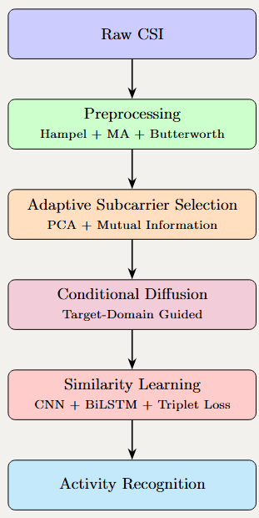
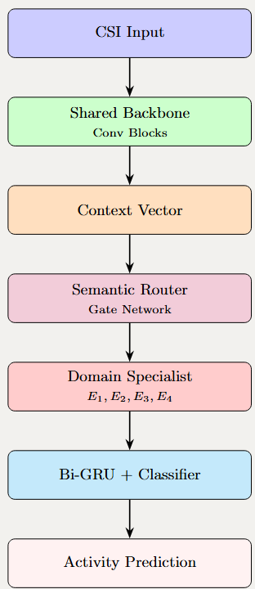
Related papers
[2]
WI-DMAR
[4]
SAMoE-C
[2] C. Tang, P. Tang, H. Zhang, J. Jin and S. Mao, "Wi-DMAR: Cross-Domain Human Activity Recognition via an Enhanced Conditional Diffusion Model," in IEEE Internet of Things Journal, vol. 13, no. 11, pp. 25343-25353, 1 June1, 2026, doi: 10.1109/JIOT.2026.3676817.
[4] W. Zheng, Y. Mao, and I. W. H. Ho, "Scene-adaptive continual learning for CSI-based human activity recognition with mixture of experts," arXiv preprint arXiv:2605.06447, 2026.
| 5

Slide 6
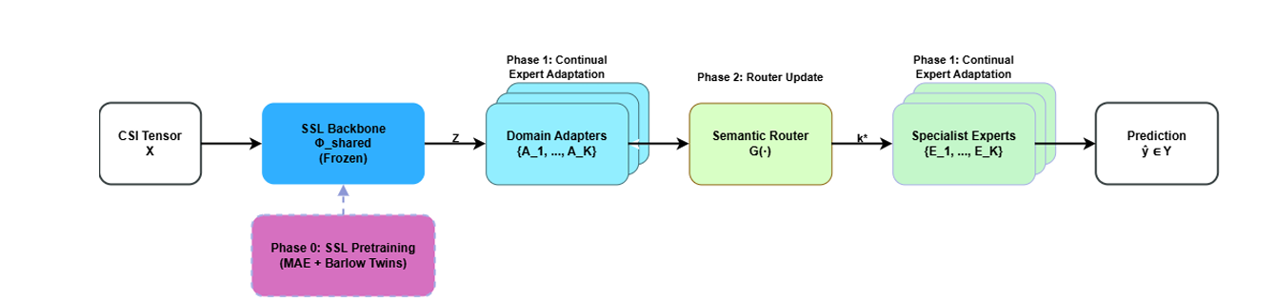
New Algorithm / Workflow / System Design
| 6

Slide 7
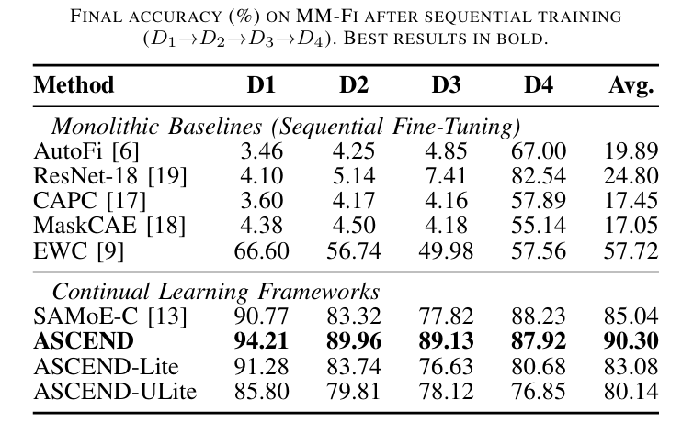
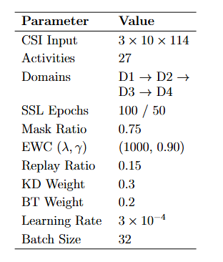
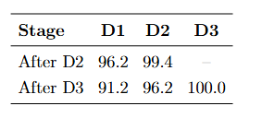
Preliminary New Results in Comparison with Base Papers
Key Hyperparameters of Run
Run on Synthetic Data
Dataset: MM-Fi
CSI shape: 3 × 10 × 114 (antennas × time × subcarriers)
Activities: 27 classes
Subjects: 40 humans
Domains: 4 rooms (2 living + 2 meeting)
| 7

Slide 8
Next Final Two-Week Research Plan
Extract all KPIs
Run ablation study
Draft full manuscript in parallel
| 8

Slide 9
References
[1] R. Li, T. Deng, S. Feng, M. Sun, and J. Jia, "ConSense: Continually sensing human activity with WiFi via growing and picking," in Proc. AAAI Conf. Artif. Intell., vol. 39, no. 22, 2025, pp. 14292–14300.
[2] C. Tang, P. Tang, H. Zhang, J. Jin and S. Mao, "Wi-DMAR: Cross-Domain Human Activity Recognition via an Enhanced Conditional Diffusion Model," in IEEE Internet of Things Journal, vol. 13, no. 11, pp. 25343-25353, 1 June1, 2026, doi: 10.1109/JIOT.2026.3676817.
[3] G. Liu, Y. Hao and Y. Zou, "CIG-MAE: Cross-Modal Information-Guided Masked Autoencoder for Self-Supervised WiFi Sensing," in IEEE Internet of Things Journal, doi: 10.1109/JIOT.2026.3696504.
[4] W. Zheng, Y. Mao, and I. W. H. Ho, "Scene-adaptive continual learning for CSI-based human activity recognition with mixture of experts," arXiv preprint arXiv:2605.06447, 2026.
[5] “MMFi Dataset,” Google Drive. [Online]. Available: https://drive.google.com/drive/folders/1zDbhfH3BV-xCZVUHmK65EgVV1HMDEYcz.
[6] A. Nigam, “IIT Mandi Deep Learning Course,” YouTube playlist. [Online]. Available: https://youtube.com/playlist?list=PLKvX2d3IUq586Ic9gIhZj6ubpWV-OJfl4. [Accessed: Jul. 12, 2026].
[7] K. Thakral, S. Mittal, U. Uppal, B. Giddwani, M. Vatsa, and R. Singh, “Self-Supervised Continual Learning,” submitted to Tiny Papers @ ICLR 2023, Mar. 2023, revised Jun. 2023. [Online]. Available: https://openreview.net/forum?id=udl9OobOxZu. [Accessed: Jul. 12, 2026].
| 9

Slide 10
Thank you

