Slide 1

Student: Dhvanit Mahesuriya
(AU2440039)
Programme: B.Tech CSE
Domain: WiFi Sensing
Date: 13th September 2026
ECE310 Wireless Communication
  ASCEND: Adaptive Self-supervised Continual Expert Network for Domain-Incremental Wifi Sensing
B.Tech Computer Science Engineering, School of Engineering and Applied Sciences

Slide 2
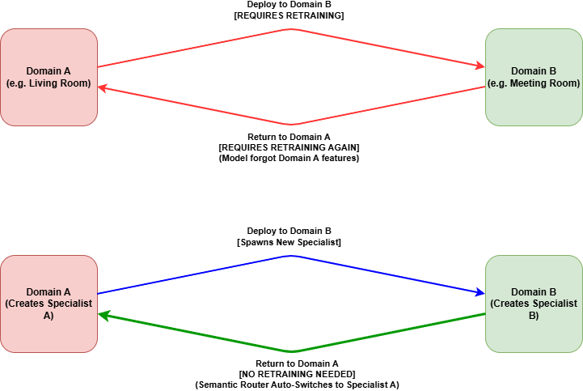
Motivation & the Problem Statement
Domain
Wi-Fi Sensing using CSI for Human Activity Recognition
Continual Domain Adaptation
Challenges
Limited Label Data
Domain Incremental Learning
Catastrophic Forgetting
Fig.1 Comparison of Model with and without Continual Learning
Can we teach a Wi-Fi sensing model to learn new environments continuously, without forgetting old ones, through Self-Supervised learning?
| 2

Slide 3
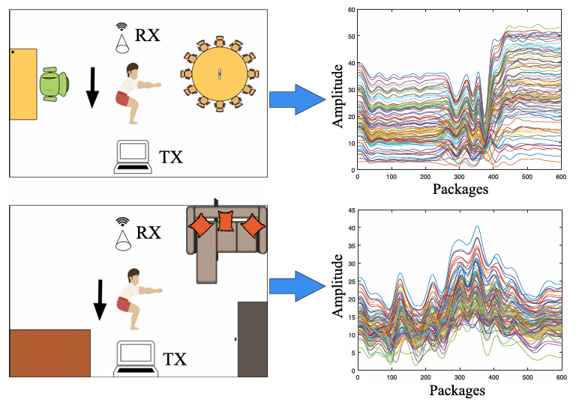
What is Wi-Fi sensing?

Slide 4
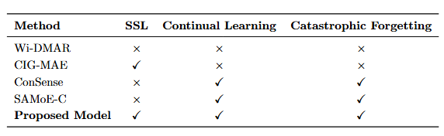
Literature Summary & Problem Formulation
[2]
[3]
[1]
[4]
Key Observations:
Catastrophic Forgetting is Universal
Labels are the Bottleneck
Exemplar Storage has Privacy Risk
Continual learning in Domain adaptation in Wifi HAR unexplored
[1] R. Li, T. Deng, S. Feng, M. Sun, and J. Jia, "ConSense: Continually sensing human activity with WiFi via growing and picking," in Proc. AAAI Conf. Artif. Intell., vol. 39, no. 22, 2025, pp. 14292–14300.
[2] C. Tang, P. Tang, H. Zhang, J. Jin and S. Mao, "Wi-DMAR: Cross-Domain Human Activity Recognition via an Enhanced Conditional Diffusion Model," in IEEE Internet of Things Journal, vol. 13, no. 11, pp. 25343-25353, 1 June1, 2026, doi: 10.1109/JIOT.2026.3676817.
[3] G. Liu, Y. Hao and Y. Zou, "CIG-MAE: Cross-Modal Information-Guided Masked Autoencoder for Self-Supervised WiFi Sensing," in IEEE Internet of Things Journal, doi: 10.1109/JIOT.2026.3696504.
[4] W. Zheng, Y. Mao, and I. W. H. Ho, "Scene-adaptive continual learning for CSI-based human activity recognition with mixture of experts," arXiv preprint arXiv:2605.06447, 2026.
| 4

Slide 5
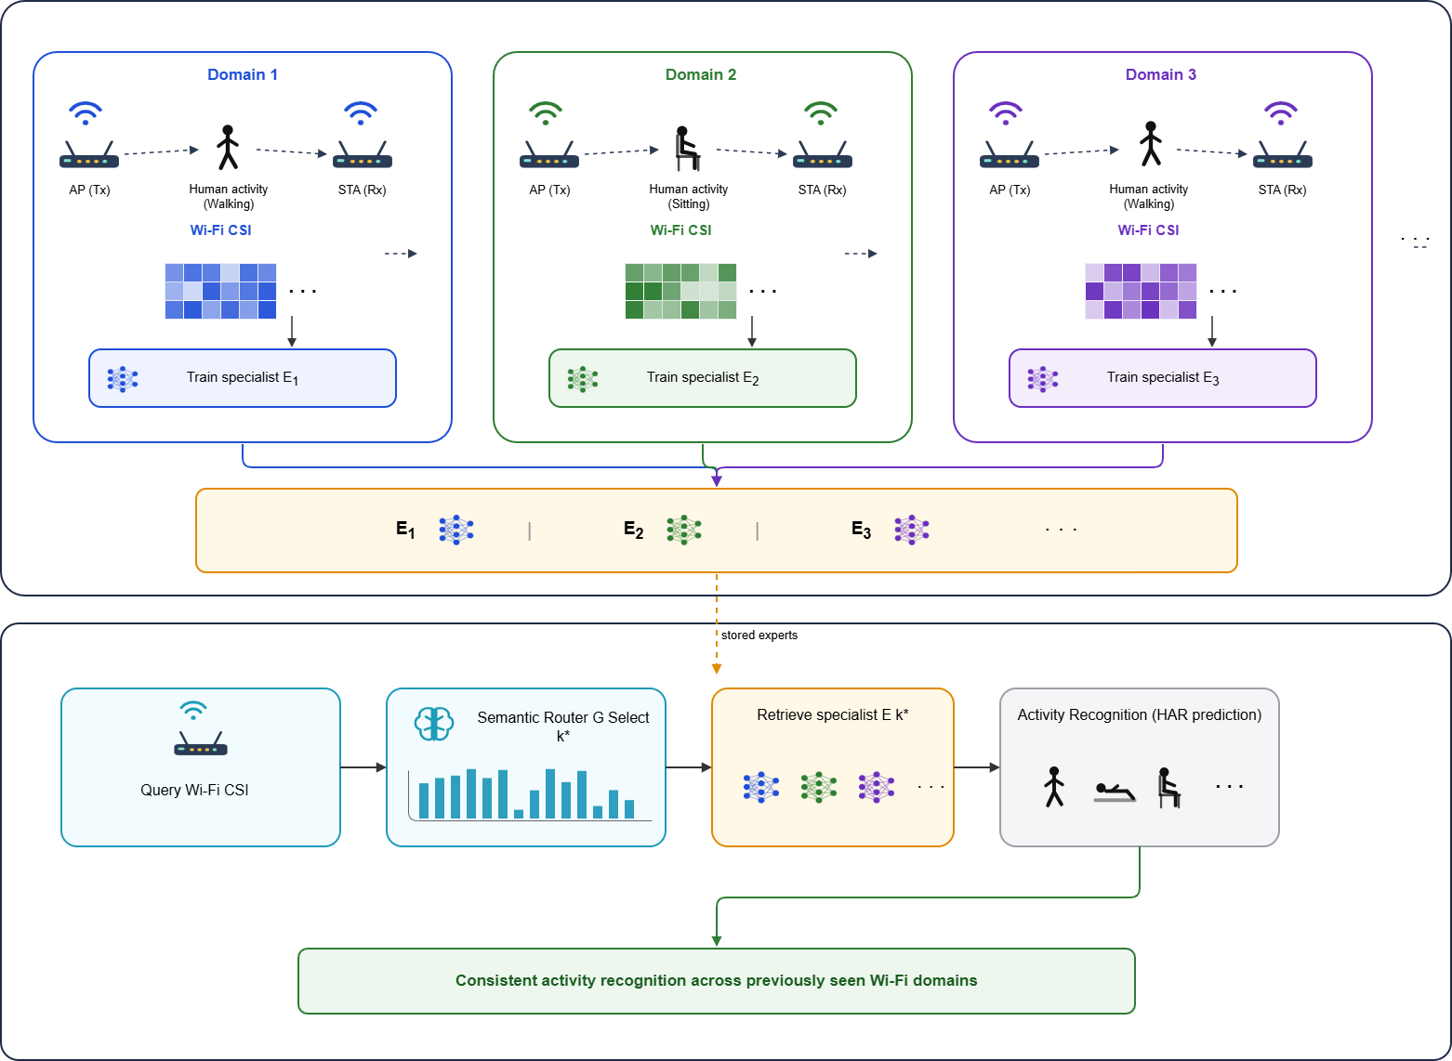
Understanding MoE

Slide 6
Publication Roadmap and Next Milestones
Tentative Paper Title:
  ASCEND: Adaptive Self-supervised Continual Expert Network for Domain-Incremental Wifi Sensing
Timeline:
  Phase 1 (Week 1-3):
    Understanding Domain
    Finding Problem Formulation
    Critically understand related recent literature regarding that problem
  Phase 2 (Week 4-6):
    Reproducing Baselines
    Understanding possible KPIs
    Starting Coding for ASCEND
  Phase 3 (Week 7-9):
    Running Experiments and Generating Relevant KPIs
    Hyperparameter Sweeping
  Phase 4 (Week 10):
    Submitting final paper with final presentation

Slide 7
References
[1] R. Li, T. Deng, S. Feng, M. Sun, and J. Jia, "ConSense: Continually sensing human activity with WiFi via growing and picking," in Proc. AAAI Conf. Artif. Intell., vol. 39, no. 22, 2025, pp. 14292–14300.
[2] C. Tang, P. Tang, H. Zhang, J. Jin and S. Mao, "Wi-DMAR: Cross-Domain Human Activity Recognition via an Enhanced Conditional Diffusion Model," in IEEE Internet of Things Journal, vol. 13, no. 11, pp. 25343-25353, 1 June1, 2026, doi: 10.1109/JIOT.2026.3676817.
[3] G. Liu, Y. Hao and Y. Zou, "CIG-MAE: Cross-Modal Information-Guided Masked Autoencoder for Self-Supervised WiFi Sensing," in IEEE Internet of Things Journal, doi: 10.1109/JIOT.2026.3696504.
[4] W. Zheng, Y. Mao, and I. W. H. Ho, "Scene-adaptive continual learning for CSI-based human activity recognition with mixture of experts," arXiv preprint arXiv:2605.06447, 2026.
[5] “MMFi Dataset,” Google Drive. [Online]. Available: https://drive.google.com/drive/folders/1zDbhfH3BV-xCZVUHmK65EgVV1HMDEYcz.
[6] A. Nigam, “IIT Mandi Deep Learning Course,” YouTube playlist. [Online]. Available: https://youtube.com/playlist?list=PLKvX2d3IUq586Ic9gIhZj6ubpWV-OJfl4. [Accessed: Jul. 12, 2026].
[7] K. Thakral, S. Mittal, U. Uppal, B. Giddwani, M. Vatsa, and R. Singh, “Self-Supervised Continual Learning,” submitted to Tiny Papers @ ICLR 2023, Mar. 2023, revised Jun. 2023. [Online]. Available: https://openreview.net/forum?id=udl9OobOxZu. [Accessed: Jul. 12, 2026].
| 7

Slide 8
Thank you

