Slide 1

Student: Dhvanit Mahesuriya
(AU2440039)
Programme: B.Tech CSE
Domain: Bayesian LLM reasoning
Date: 15th October 2026
CSE516 Probabilistic Graphical Models
Bayesian Reasoning for LLM Agents
under Uncertain and Conflicting Evidence
B.Tech Computer Science Engineering, School of Engineering and Applied Sciences

Slide 2
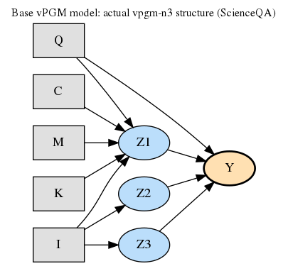
Base model: vPGM-N3 on ScienceQA
INPUTS
Q, C, M, I, K
HIDDEN
Z1 knowledge needed
Z2 caption reliable
Z3 text reliable
OUTPUT
Y from Q and Z1, Z2, Z3
Same structure for all 50 questions

Slide 3
Our extension: reliability per evidence item
Evidence Ei
observed
Reliability Ri
hidden, 0 to 1
Hidden Z
reasoning facts
Answer Y
with confidence
›
›
›
The question X also feeds Ri and Z. Ri = 0 means: ignore this evidence.
NEW 1
Any number of evidence items
NEW 2
Reliability depends on the question
NEW 3
Sequential update and ΔC
The base model already judges the caption (Z2) and detected text (Z3) for fixed sources.

Slide 4
Belief update rule
α' = α + r·κ·s̄ π' = (1 − w)·π + w·s̄ w = rκ / (A + rκ)
IRRELEVANT
r = 0: no change
Worked example
 | Class 1 | Class 2 | Class 3
Before | 0.625 | 0.313 | 0.063
After | 0.588 | 0.353 | 0.059
Change | −0.037 | +0.040 | −0.004
DIRECTION
Support raises belief, contradiction lowers it
BOUNDED
One item moves belief by at most w
Evidence supports class 2, r = 0.5. Direct and closed-form results agree.

Slide 5
Pipeline and setup
ScienceQA
50 questions
Llama-3-8B
transformers, GPU+CPU
Methods
vPGM-N3, CoT, Chameleon
Metrics
Accuracy, ECE
›
›
›
Same 50
questions, model, metric script
19 h 56 min
vPGM-N3 on 50 questions
≈ 24 min
per question
vLLM replaced by transformers (old GPU driver). Prompts and logic unchanged.

Slide 6
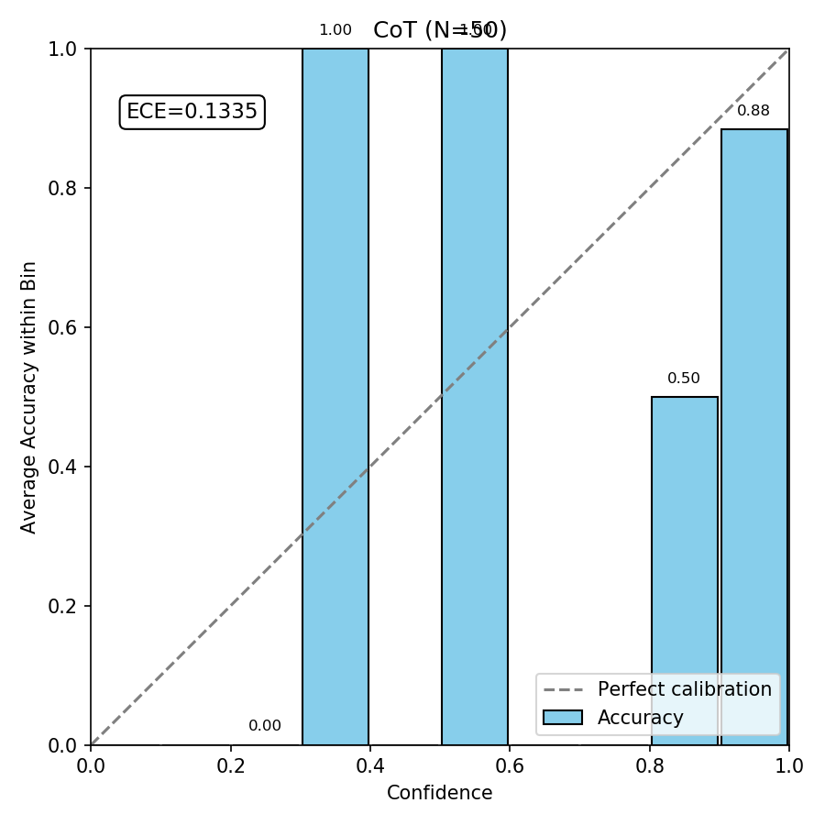
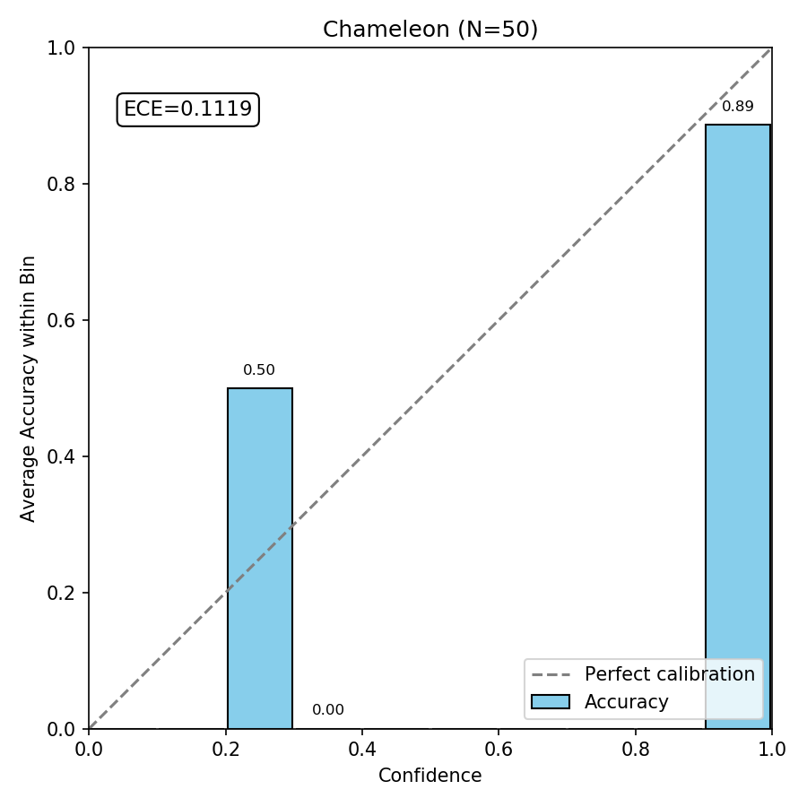
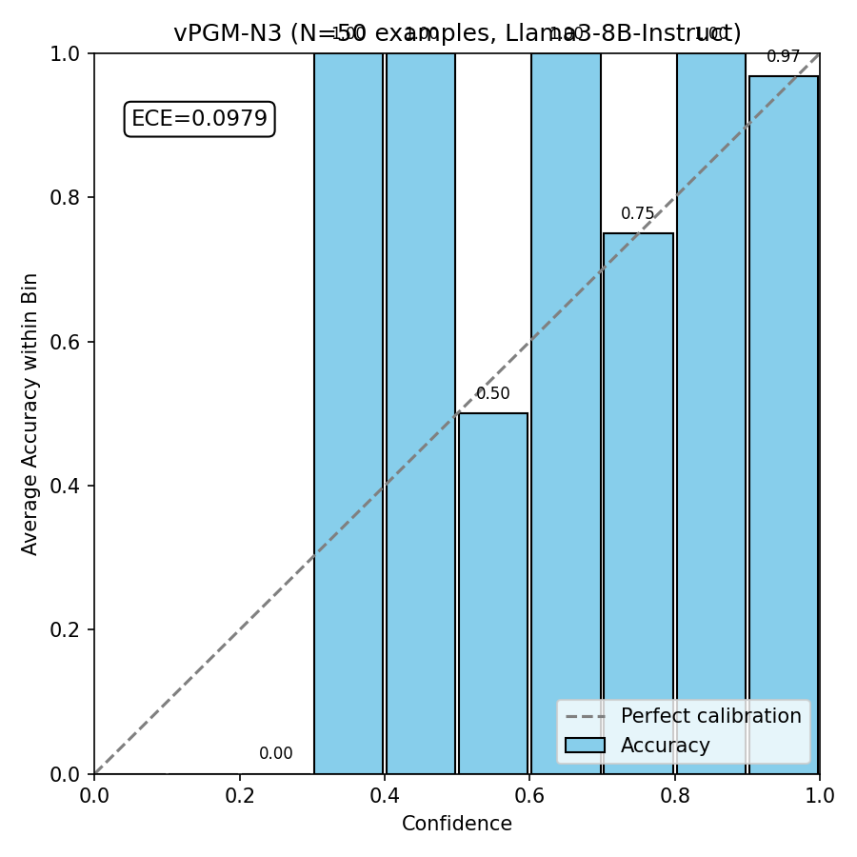
Results on 50 ScienceQA questions
Method | Accuracy | ECE (×10²)
CoT | 86% | 13.35
Chameleon | 82% | 11.19
vPGM-N3 | 90% | 9.79
90%
accuracy
9.79
ECE ×10²
N = 50: intervals overlap, so differences are not significant.

Slide 7
Limitations and next steps
Limitations
Next (M3)
Only 50 questions
3 samples vs 1 for baselines
One model, one run
Extension not yet run on the LLM
Fit λ offline (BayesVPGM)
Code the update rule
Evidence experiments: measure ΔC
Ablations and A-OKVQA
Foundation in place: pipeline runs, baselines measured, extension formalised

Slide 8
References
[1] H. Huang et al., "BayesAgent: Bayesian Agentic Reasoning Under Uncertainty via Verbalized Probabilistic Graphical Modeling," AAAI, 2026.
[2] J. Wei et al., "Chain-of-Thought Prompting Elicits Reasoning in Large Language Models," NeurIPS, 2022.
[3] C. Guo et al., "On Calibration of Modern Neural Networks," ICML, 2017.
[4] P. Lu et al., "Learn to Explain: Multimodal Reasoning via Thought Chains for Science Question Answering," NeurIPS, 2022.
[5] A. Xiong et al., "Can LLMs Express Their Uncertainty? An Empirical Evaluation of Confidence Elicitation," 2023.
[6] Qiu et al., "Bayesian Teaching Enables Probabilistic Reasoning in LLMs," Nature Communications, 2026.
[7] Microsoft Research, "Is In-Context Learning in Large Language Models Bayesian? A Martingale Perspective."
8

