Slide 1

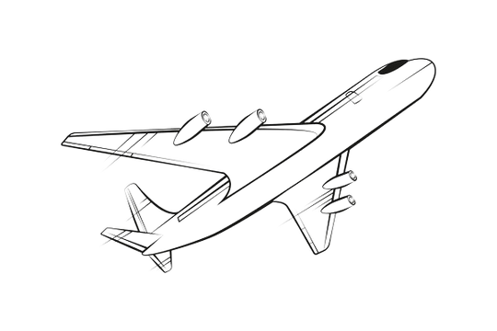
Forecasting International Passenger Volumes
Analysis and Insights Using ARIMA and ETS Models
DHWAJESH BHANDARI
BUSINESS FORECASTING

Slide 2
Forecasting Question and Importance
WHAT WILL INTERNATIONAL PASSENGER VOLUMES BE OVER THE NEXT 12 MONTHS?
Optimizing operations (staffing, scheduling, resource allocation)
Improving financial planning and marketing
Supporting strategic decision-making

Slide 3
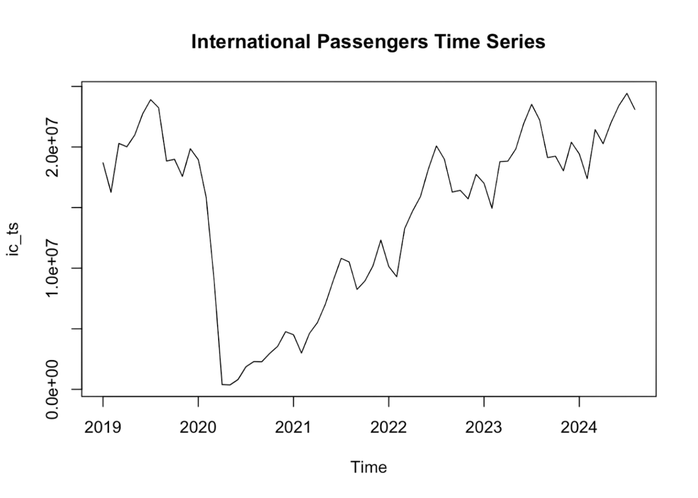
Data Overview
DATASET DESCRIPTION:
KEY STATISTICS:
Monthly passenger volumes (2019–latest)
Focus: International passenger volumes
Columns: Year, Month, Domestic, International, TOTAL
Min: 372,915
Median: 17,194,230
Max: 24,427,292
Mean: 14,577,337

Slide 4
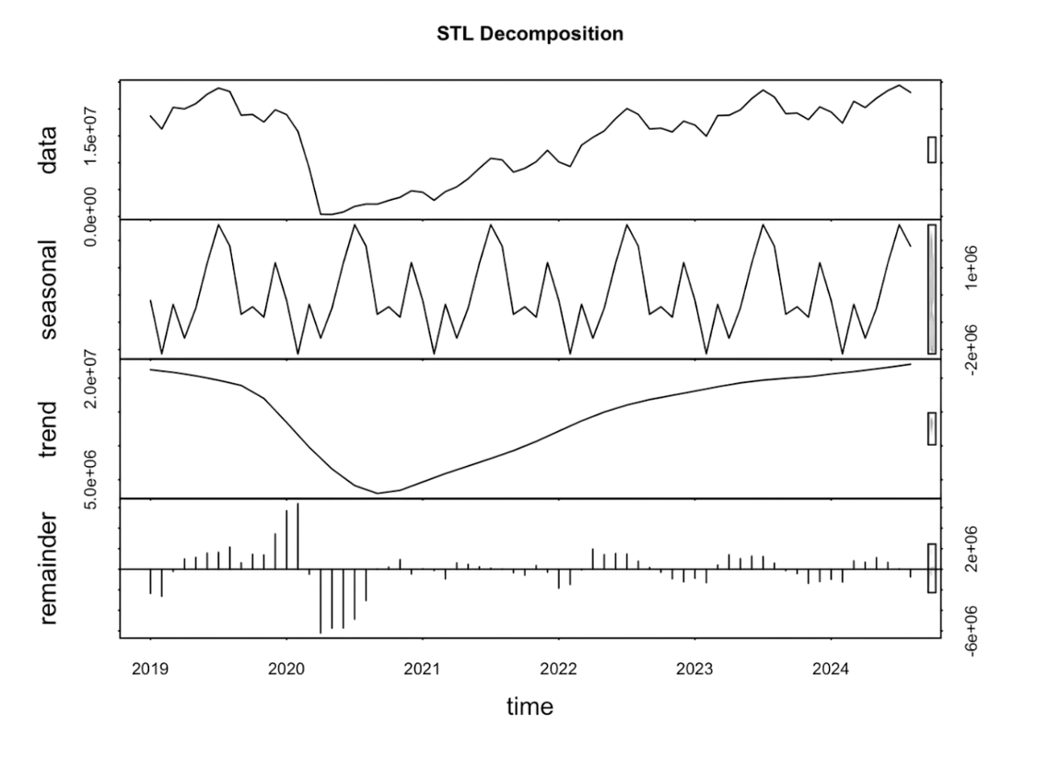


Data Analysis
TREND
Consistent growth in passenger volumes over time.
SEASONALITY
Regular peaks during holidays and travel seasons.
STATIONARITY
Differencing required for stationarity in ARIMA modeling.

Slide 5
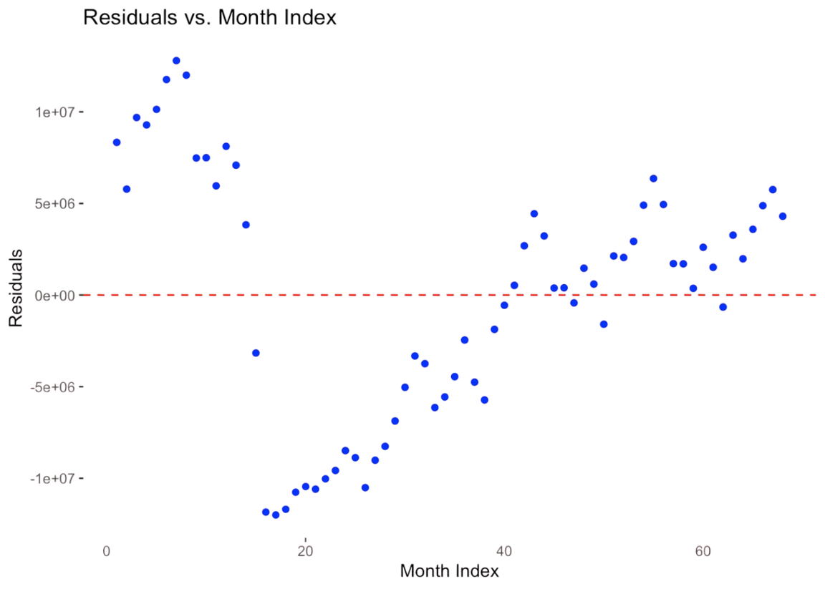
Forecasting Methods
ARIMA
(1,1,0)(1,0,0)[12]
Captures trend, differencing, and seasonal effects.
Residuals: White noise, no significant autocorrelations.
ETS
Handles trend and seasonal patterns multiplicatively.
Residuals: Some autocorrelation.

Slide 6
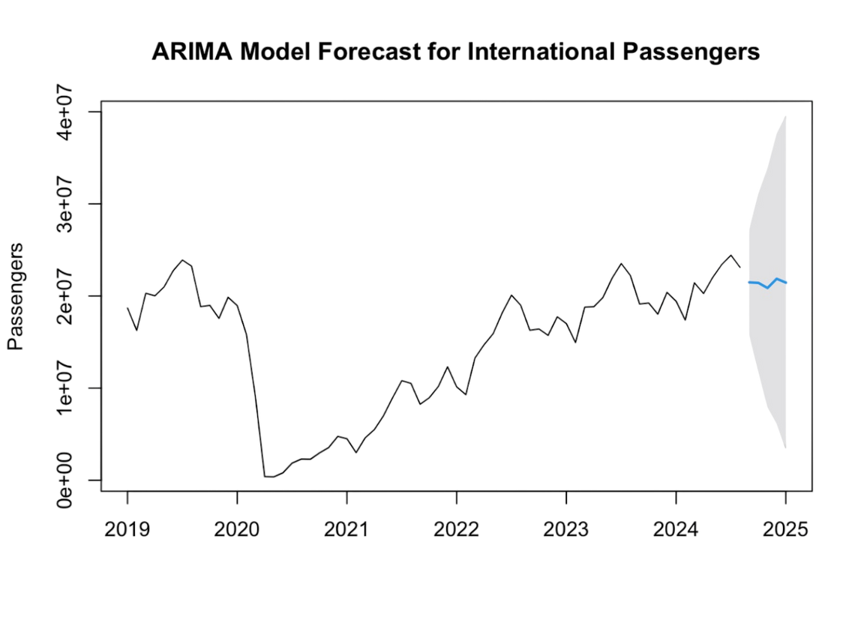
Forecast Results
12-Month Forecasted Volumes
Month 1: 22,009,199
Month 2: 22,009,455
Month 3: 21,975,841
Month 4: 22,071,701
Month 5: 22,036,500
Month 6: 21,938,439
Month 7: 22,121,244 Month 8: 22,123,265 Month 9: 22,171,085
Month 10: 22,270,736 Month 11: 22,345,831 Month 12: 22,284,472
Accuracy Metrics:
ARIMA
MAPE = 10.76%, RMSE = 2,451,180
ETS
MAPE = 17.57%, RMSE = 4,126,521

Slide 7
Model Comparison
ARIMA
ETS
MAPE (%) 10.76
RMSE. 2,451,180
MAPE (%) 17.57
RMSE. 4,126,521
Insight
ARIMA outperforms ETS, with lower errors and better residual diagnostics.

Slide 8
Recommendation: ARIMA
WHY ARIMA?
HIGHER ACCURACY:
BETTER RESIDUAL DIAGNOSTICS:
SEASONALITY HANDLING:
MAPE: 10.76% (ETS: 17.57%)
RMSE: 2,451,180 (ETS: 4,126,521)
Residuals are white noise (independent and uncorrelated).
ETS showed residual autocorrelation, indicating less reliability.
Effectively captures yearly seasonality with seasonal order
(1,0,0)[12].
Provides narrower and more reliable confidence intervals.

Slide 9

Thank You!

