Slide 1
Electricity Consumption Forecasting
Time Series Analysis Using SARIMA
By Dhwani Zala

Slide 2

Problem Statement
Energy demand fluctuates, leading to inefficiencies.
Forecasting demand helps in resource planning and cost reduction.
Objective: Build a model to predict electricity consumption.

Slide 3
Dataset Overview
Timeframe: 5-minute intervals of electricity usage 2021-2024 year data.
Features: Temperature, humidity, wind speed, pressure.
Source: Kaggle dataset.
20XX | 20XX | 20XX | 20XX

Slide 4

Data Preprocessing
Handling Missing Values – Used interpolation and forward-filling.
Renaming Columns – Standardized names for clarity.
Resampling Data – Converted 5-minute data into daily summaries.
Datetime Indexing – Set timestamp as index for time series analysis

Slide 5
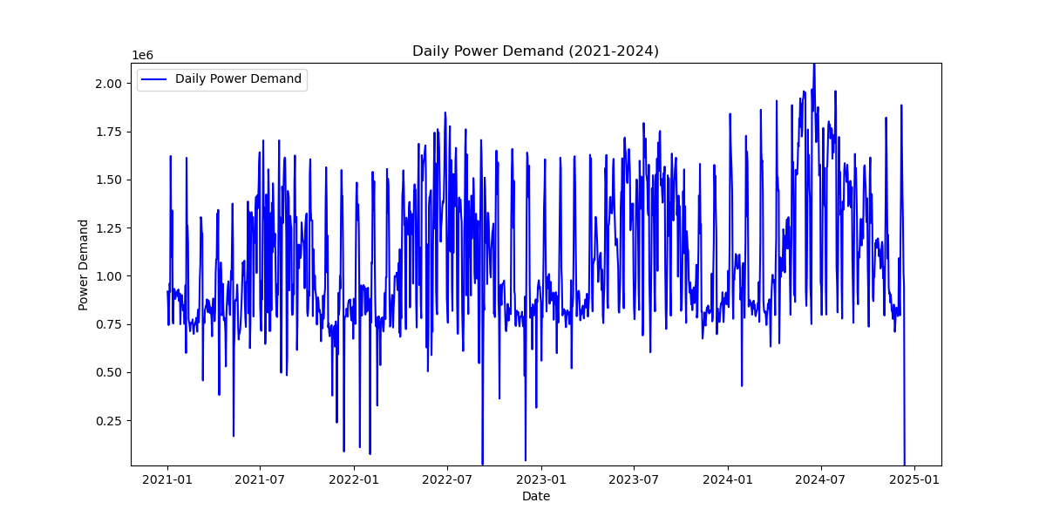
Power Demand Over Time
The daily power demand (2021-2024) shows significant fluctuations with noticeable seasonal patterns. There are recurring peaks and troughs, indicating periodic demand changes. The data exhibits high volatility, with sudden drops that might suggest missing values or reporting inconsistencies. Despite fluctuations, the overall demand trend appears to be increasing, especially in mid-2022 and early 2024.

Slide 6
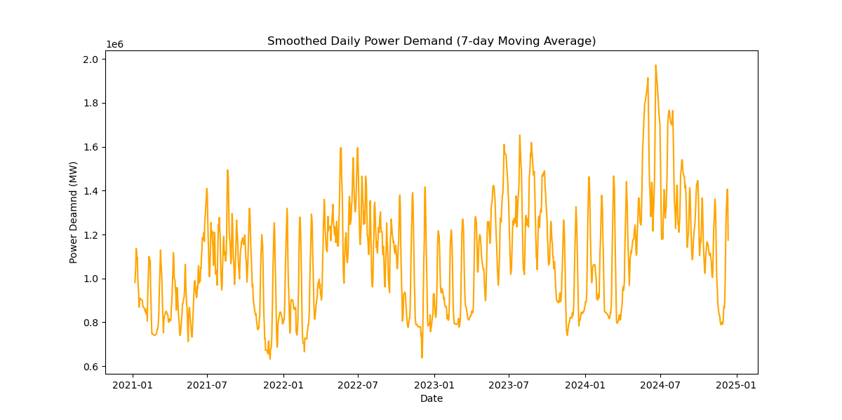
Smoothed Daily Power Demand
The smoothed power demand shows recurring patterns of increase and decrease, indicating seasonal trends. High demand periods are observed in mid-2022 and mid-2024, likely due to seasonal factors affecting electricity usage. The overall trend follows a cyclical pattern

Slide 7
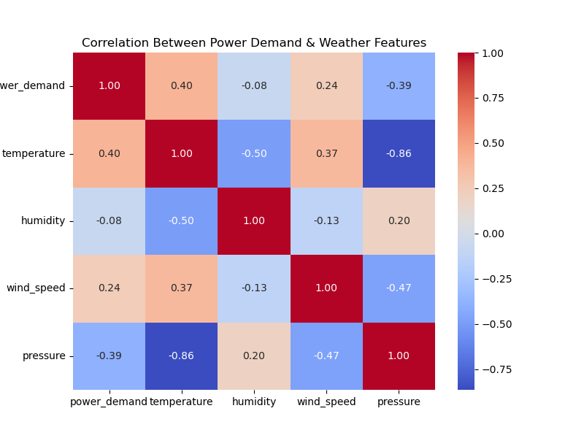
Correlation Between Power Demand and Weather Factors
The correlation heatmap shows that power demand increases with higher temperatures (0.40) and wind speed (0.24). It decreases with higher pressure (-0.39), suggesting that cooler, high-pressure conditions reduce consumption. Humidity has minimal impact on electricity usage
Correlation Insights:
Positive correlation with temperature.
Negative correlation with pressure.

Slide 8

Model Selection - Why SARIMA?
Tried multiple models but SARIMA performed best.
Captures seasonality, trend, and dependencies.
Hyperparameter tuning using ACF/PACF plots.

Slide 9
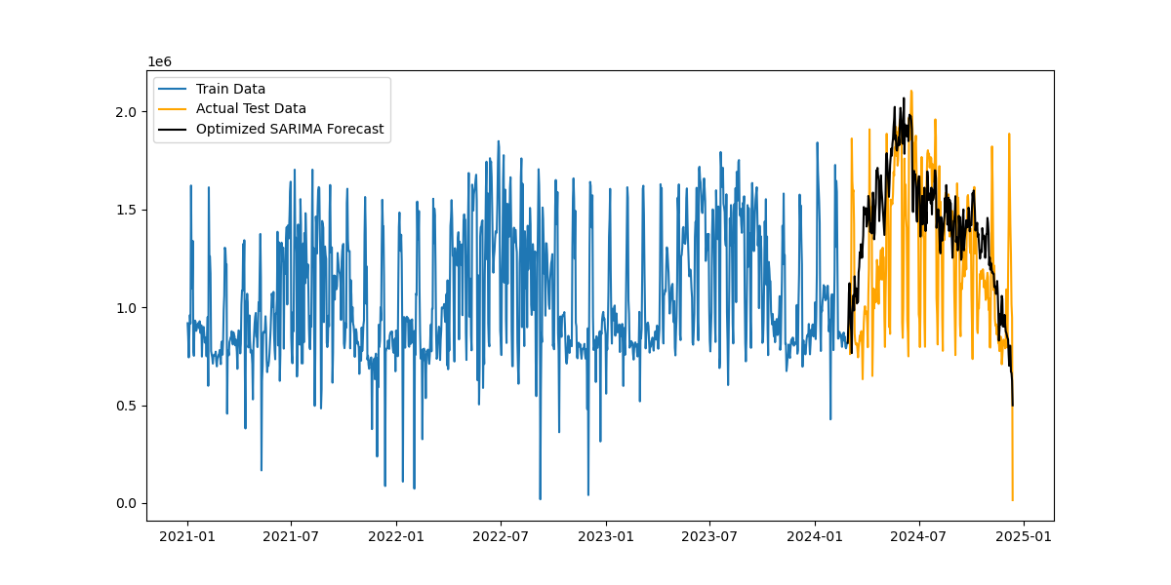
The SARIMA model captures overall trends in power demand but struggles with extreme fluctuations. While it follows the test data pattern, it shows some deviations, especially in high-variance periods. Further tuning or adding external factors may improve accuracy.

Slide 10

Model Performance & Metrics
MAE: 287,249
MSE: 139,283,540,200
RMSE: 373,207
MAPE: 38.12%
The SARIMAX model resulted in a MAPE of 38.12%, indicating a moderate prediction error. The RMSE of 373,207.10 suggests a significant deviation in power demand forecasting. While this model outperformed other approaches, Despite some error, the model provides valuable insights into electricity demand trends.

Slide 11
Key Challenges & Recommendations
Challenges Identified:
Frequent Power Demand Spikes: The data shows abrupt spikes, possibly due to inconsistent energy usage or external factors.
Zero Power Demand Issues: Repeated instances of zero values suggest potential power outages, data collection issues, or system failures.
Data Insufficiency: More granular details like consumer category (residential vs. industrial) or time-based energy policies could improve forecasting accuracy.

Slide 12
Recommendations:
Investigate the cause of power spikes and implement anomaly detection for better insights.
Analyze regions with zero demand to determine whether power outages or sensor failures are causing data gaps.
Collect additional variables, such as grid load data or economic activity, to refine forecasting accuracy.
Consider real-time data processing to improve demand prediction and grid stability.

Slide 13
Thank You
Contact Details:
dhwanizala25@gmail.com

