Slide 1

Heart Disease Prediction Using Logistic Regression
Predicting the likelihood of heart disease using clinical parameters and machine learning techniques
Created By
Dhwani Chauhan
Techno India University

Slide 2
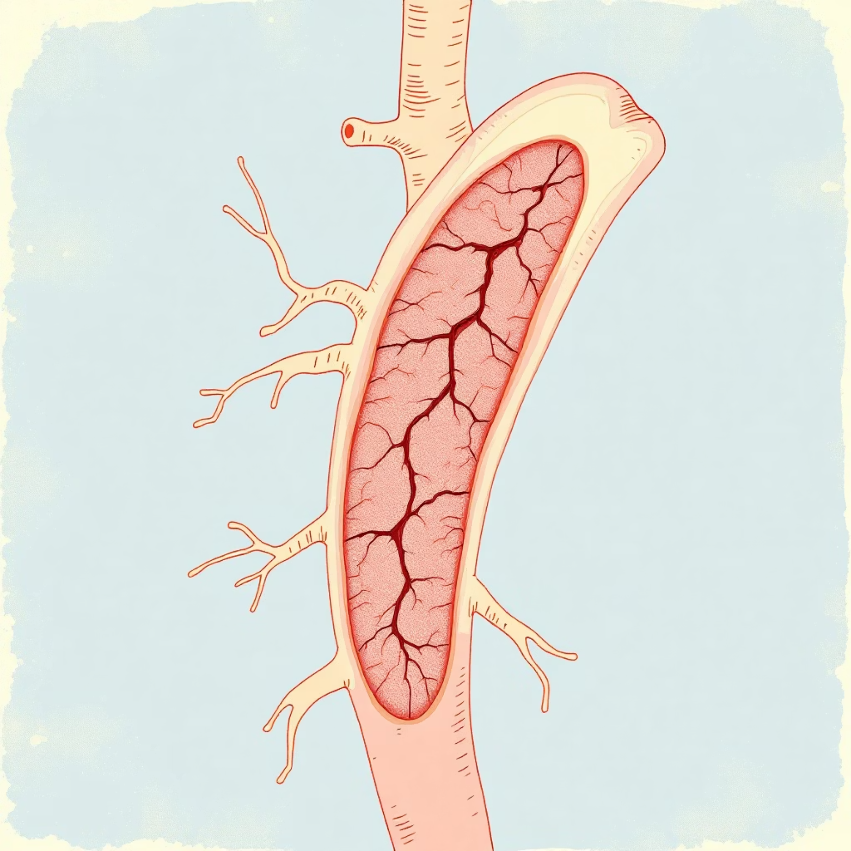
Understanding Heart Disease
Heart disease encompasses a range of conditions affecting the heart muscles, valves, or blood supply. The most prevalent form is coronary artery disease (CAD), which develops when plaque accumulates in the coronary arteries, restricting blood flow to the heart muscle and potentially leading to severe cardiovascular events.
Common Symptoms
Persistent fatigue and weakness
Shortness of breath during activity
Heart palpitations or irregular heartbeat
Chest pain or discomfort (angina)

Slide 3
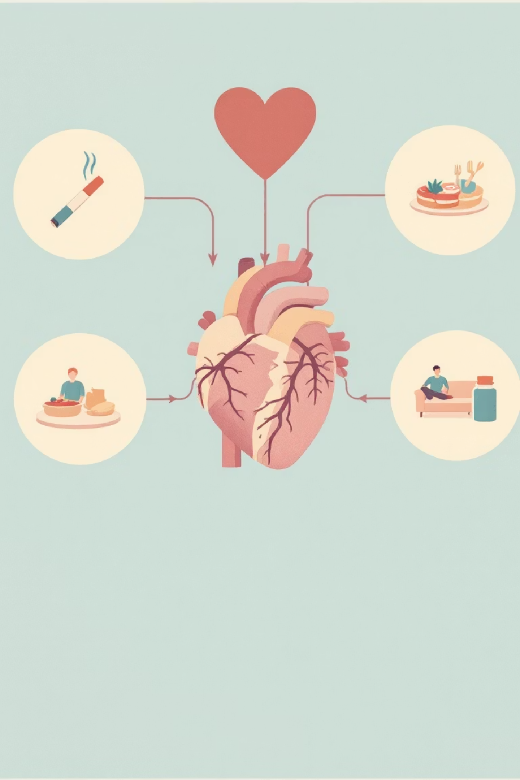


Factors That Influence Heart Disease
Clinical Risk Factors
Advanced age
Male sex
Chest pain type (angina patterns)
Elevated cholesterol levels
Hypertension (high blood pressure)
Elevated fasting blood glucose
Reduced physical activity
Lifestyle Risk Factors
Tobacco smoking
Obesity and excess weight
Chronic stress
Poor dietary habits
Excessive alcohol consumption
Predictive models harness the power of data analytics to identify high-risk individuals by detecting complex patterns across multiple clinical and lifestyle parameters. This enables healthcare providers to stratify patient populations and allocate resources more effectively.

Slide 4

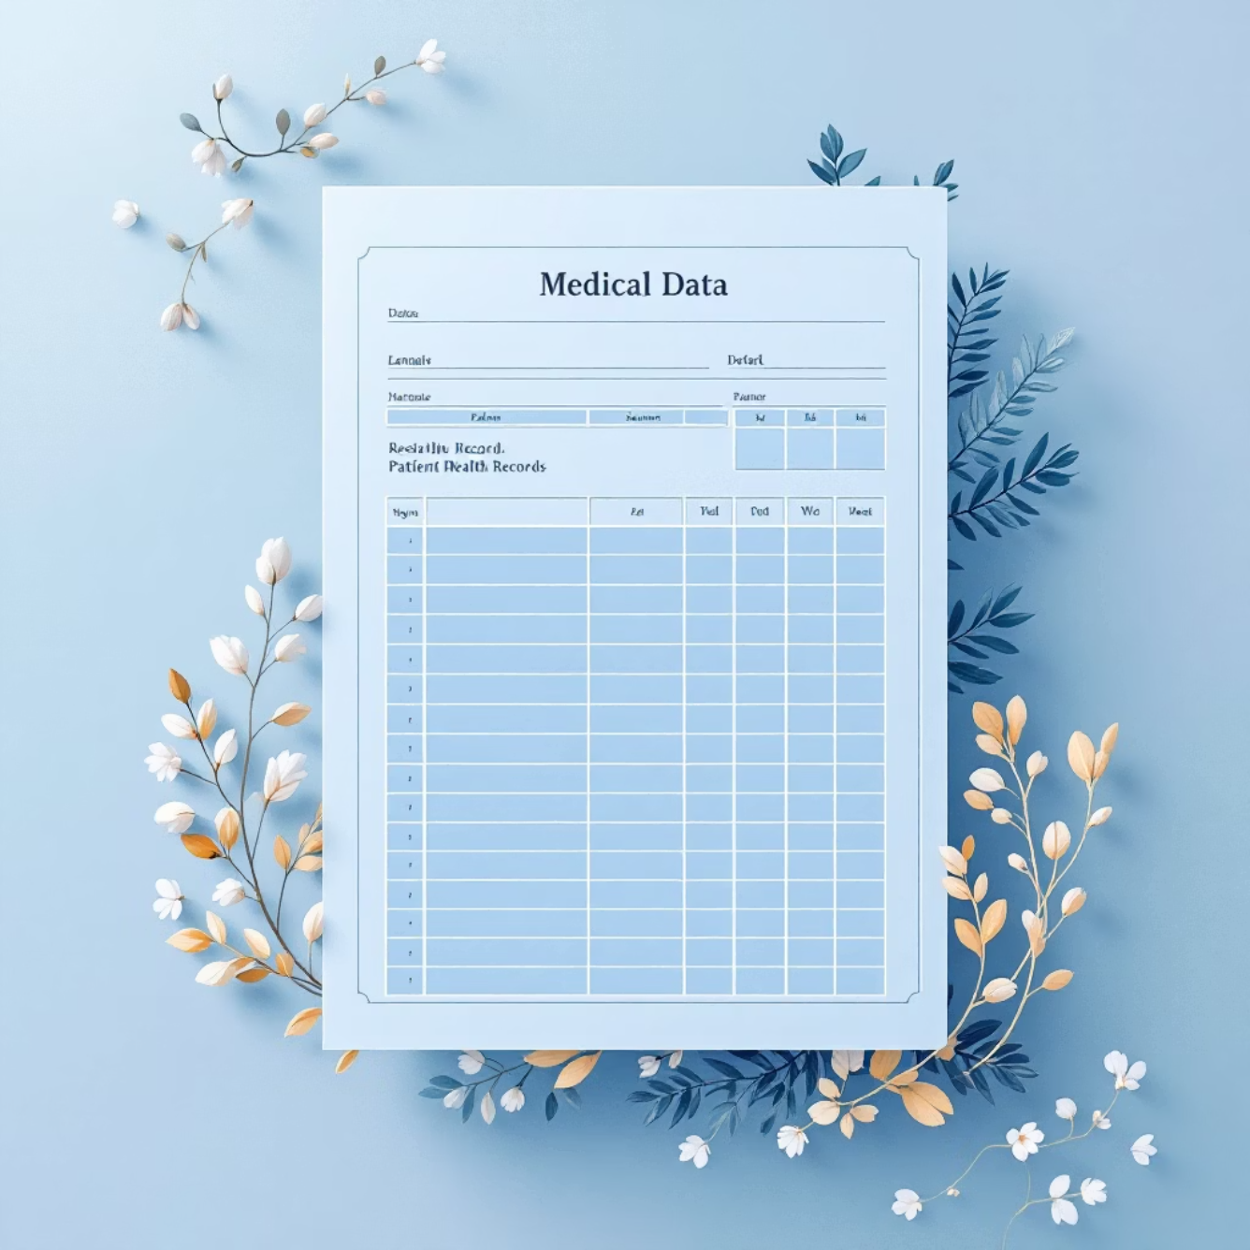
Dataset Used for Prediction
The predictive model utilises the Heart Disease UCI Dataset, a comprehensive collection of patient health measurements routinely recorded in clinical settings. This dataset provides a robust foundation for training machine learning algorithms to identify cardiovascular disease patterns.
Target Variable
1: Heart Disease Present
Key Clinical Features
0: No Heart Disease
Age – patient's age in years
Sex – biological sex (male/female)
Chest Pain Type – categorised angina patterns
Resting BP – blood pressure at rest
Serum Cholesterol – total cholesterol level
Fasting Blood Sugar – glucose measurement
Resting ECG – electrocardiogram results
Max Heart Rate – peak heart rate achieved
Exercise-Induced Angina – chest pain during exertion
ST Depression (Oldpeak) – ECG abnormality measure
Slope of ST Segment – ECG slope pattern
Number of Major Vessels (CA) – vessels with blockage
Thalassemia (Thal) – blood disorder status

Slide 5
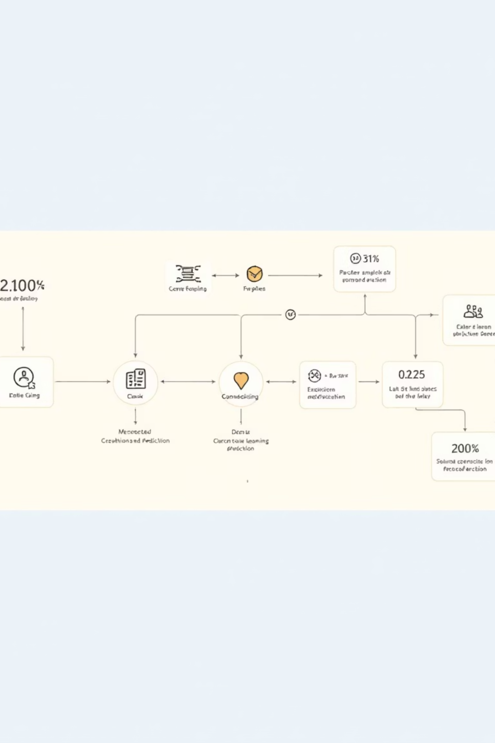
Machine Learning Approach
Model Selection
Preprocessing Steps
Model Training
A Logistic Regression model was selected for its exceptional balance of simplicity, interpretability, and clinical applicability. Unlike complex black-box algorithms, logistic regression provides transparent probability outputs that clinicians can readily understand and incorporate into diagnostic workflows.
The dataset was strategically partitioned:
Missing value imputation using median (numeric) and mode (categorical)
70% Training set
15% Validation set
15% Testing set
Feature scaling for numeric variables
The optimal classification threshold was determined using Youden's J statistic, prioritising recall to minimise false negatives—a critical consideration in medical screening.
One-hot encoding for categorical features
Data validation and quality checks

Slide 6
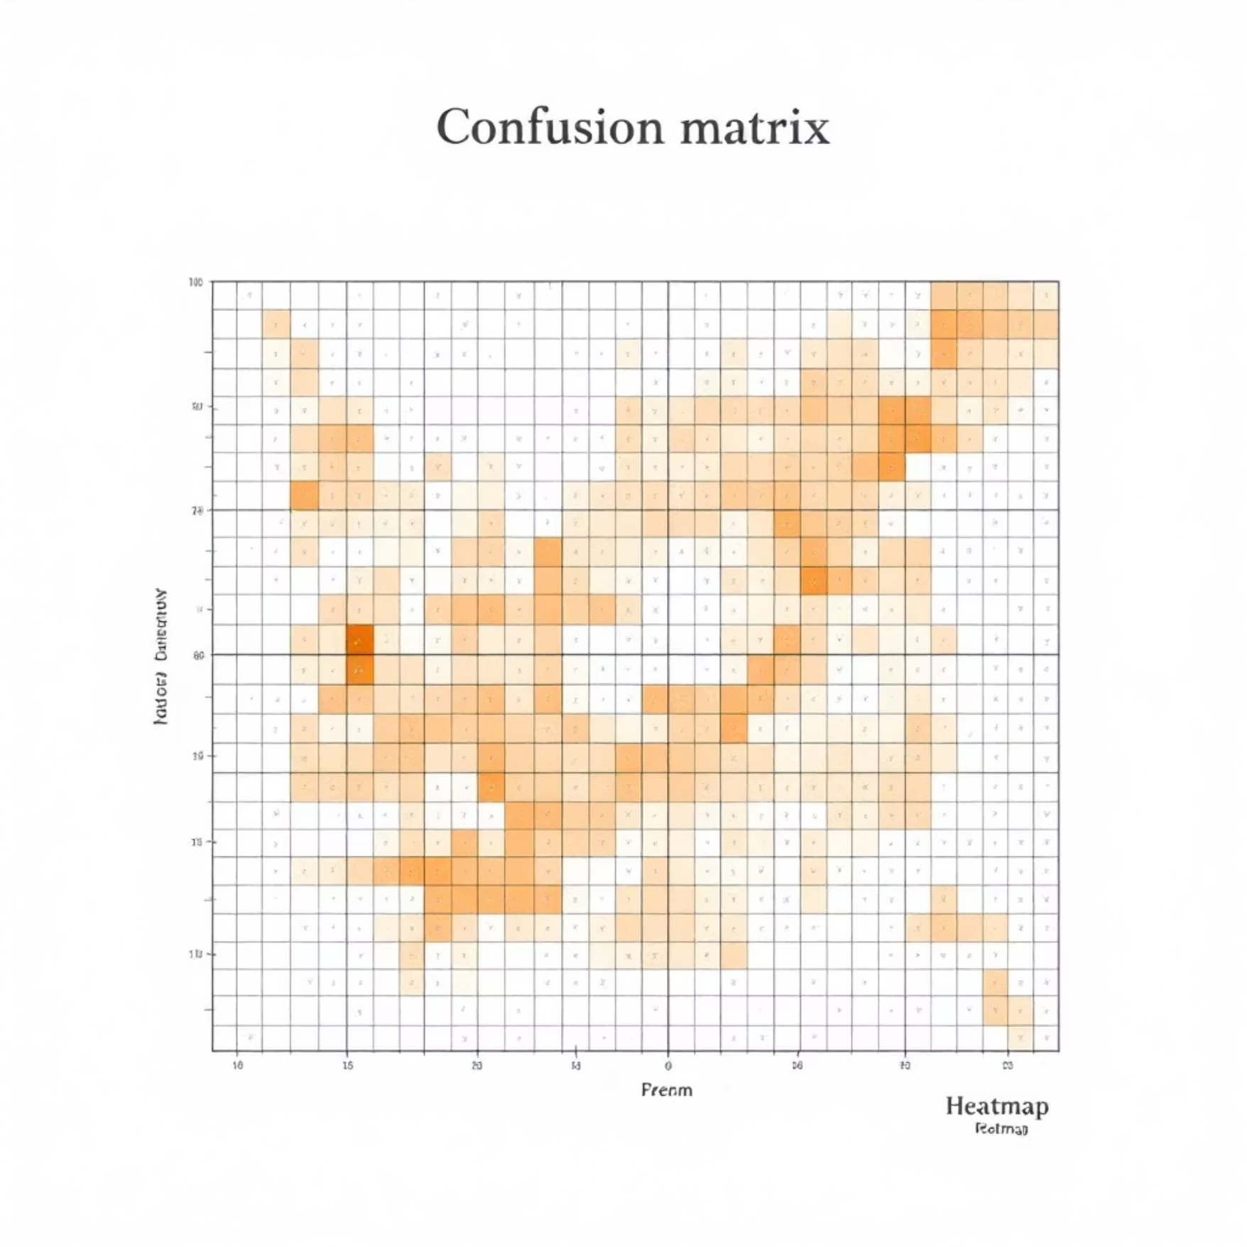
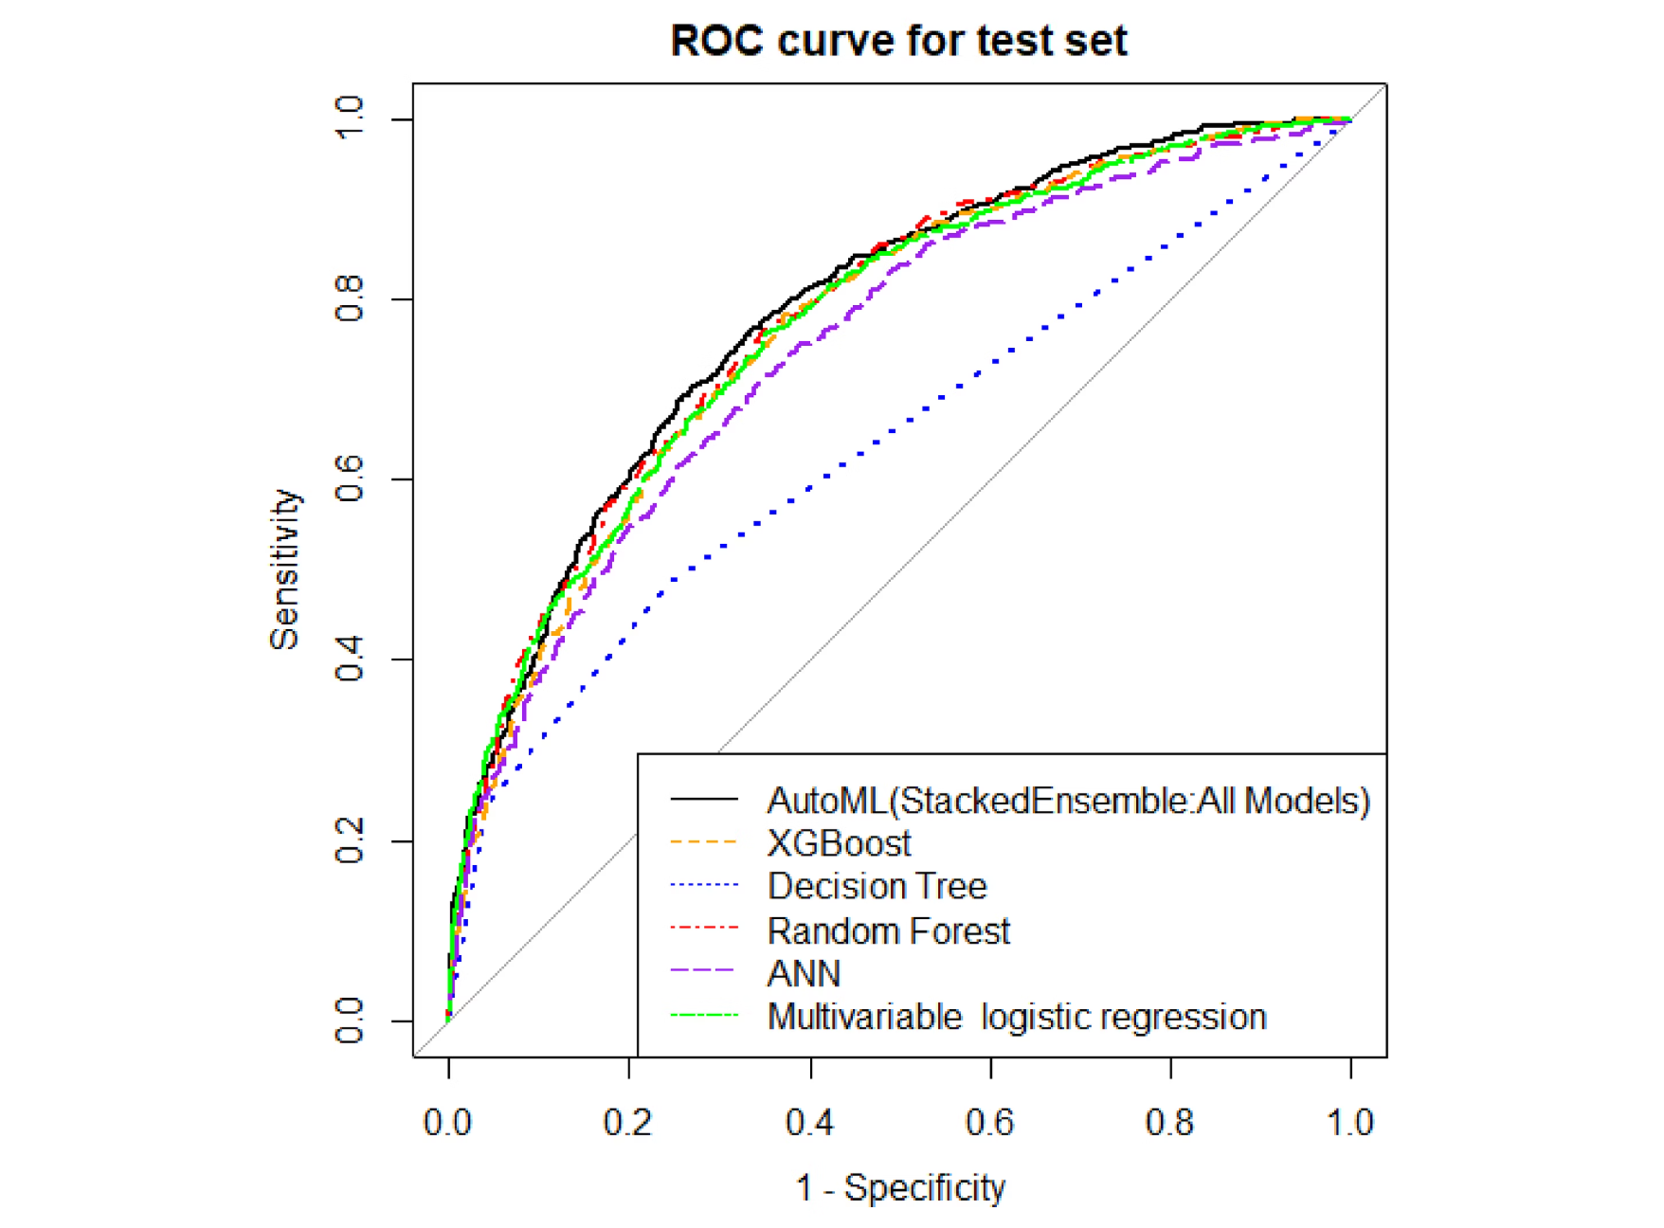
Model Evaluation & Performance
The model's performance was rigorously assessed using multiple evaluation metrics to ensure clinical reliability and robustness. In medical prediction tasks, recall (sensitivity) is particularly crucial as it measures the model's ability to correctly identify patients with heart disease, thereby minimising potentially dangerous false negatives.
87%
85%
91%
0.88
Accuracy
Precision
Recall
ROC-AUC
Overall prediction correctness
Positive prediction reliability
Disease detection rate
Discrimination ability

Slide 7

Understanding the Prediction Process
01
Patient Data Input
Clinical measurements and patient history are collected and entered into the system
02
Feature Processing
Data is cleaned, scaled, and transformed to match the model's requirements
03
Probability Calculation
The model calculates the likelihood of heart disease based on learned patterns
04
Risk Classification
If probability exceeds the threshold, the patient is classified as high-risk for heart disease

Slide 8


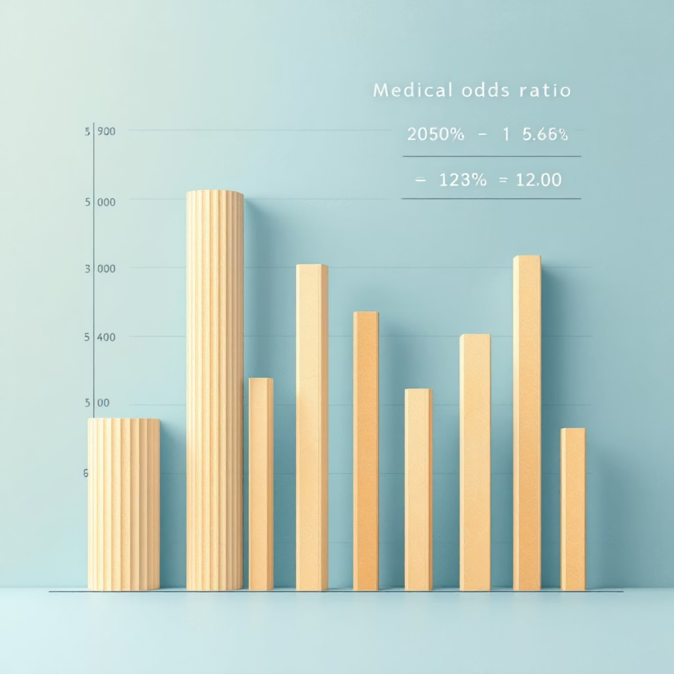
Feature Influence & Clinical Significance
The model identifies key predictive features through odds ratios, revealing which clinical parameters most strongly influence heart disease risk. Understanding these relationships enables clinicians to focus on the most relevant indicators during patient assessment.
Clinical Applications
Identify high-risk patients requiring immediate intervention
Strongest Predictive Features
Support evidence-based clinical decision-making
Chest Pain Type (CP)
Prioritise diagnostic testing for at-risk individuals
Specific angina patterns strongly indicate coronary issues
Reduce unnecessary procedures for low-risk patients
Enable personalised treatment planning
Maximum Heart Rate (Thalach)
Lower peak heart rates correlate with disease presence
ST Depression (Oldpeak)
ECG abnormalities signal myocardial ischaemia
Major Vessels (CA)
Number of blocked vessels directly predicts severity

Slide 9
Real-World Impact & Implementation
Emergency Triage
Primary Care Screening
Preventive Medicine
Rapidly assess incoming patients to prioritise those at highest cardiovascular risk for immediate attention
Enable general practitioners to identify at-risk patients during routine check-ups for specialist referral
Support population health initiatives by identifying individuals who would benefit from lifestyle interventions
"Machine learning models like this don't replace clinical judgement—they augment it, providing data-driven insights that help healthcare professionals make more informed decisions and ultimately save lives."

Slide 10





Conclusion & Future Enhancements
This logistic regression model demonstrates that interpretable machine learning can provide clinically valuable predictions for heart disease risk assessment. The model successfully identifies patterns in routinely collected clinical data, offering a practical tool for early diagnosis and preventive care without requiring expensive or invasive procedures.
Future Development Roadmap
Advanced Algorithms
Implement ensemble methods like Random Forest and XGBoost for improved accuracy
Clinical Dashboard
Develop real-time hospital integration system for seamless workflow
Wearable Integration
Incorporate continuous monitoring data from wearable devices
Digital Deployment
Launch mobile and web applications for widespread accessibility

Slide 11

Thank You
Questions are welcome

