Slide 1

Note: The data and information in this document is reflective of a hypothetical situation and client. This document is to be used for KPMG Virtual Internship purposes only.
Sprocket Central Pty Ltd
Data analytics approach
Dhwani Gupta

Slide 2
Note: The data and information in this document is reflective of a hypothetical situation and client. This document is to be used for KPMG Virtual Internship purposes only.
Agenda
Introduction
Data Exploration
Model Development
Interpretation

Slide 3
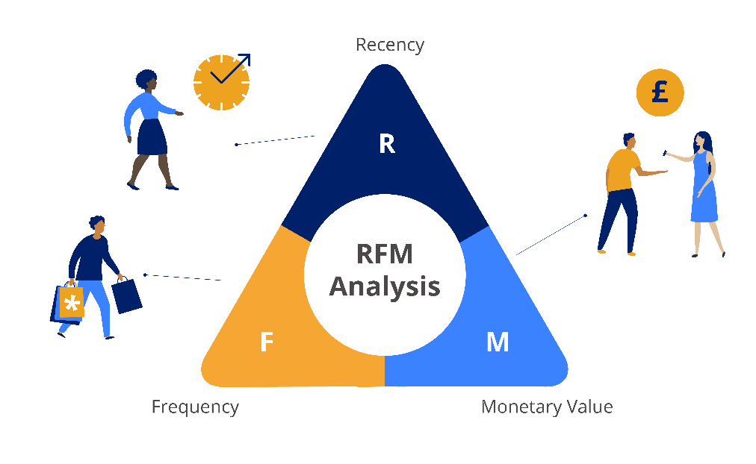
Note: The data and information in this document is reflective of a hypothetical situation and client. This document is to be used for KPMG Virtual Internship purposes only.
Introduction
Key Problems and the recommendation on the bases of Analysis
Key Problem
Increase in Sales
Expend the Target Market
Approach for DA
We have used RFM Approach because it uses ranking system to identify the better customer. And with there are some graphical representation for easy understanding.

Slide 4
Note: The data and information in this document is reflective of a hypothetical situation and client. This document is to be used for KPMG Virtual Internship purposes only.
Data Exploration
Data Quality Assessment
As we have discussed under Task 1, These are some of the issues related with the dataset.

Slide 5
Note: The data and information in this document is reflective of a hypothetical situation and client. This document is to be used for KPMG Virtual Internship purposes only.
Data Exploration
Customer Profile – RFM Value
Most of the customer fall under “Platinum category” which is a good thing.
The grouping for the RFM Value is done as following:

Slide 6
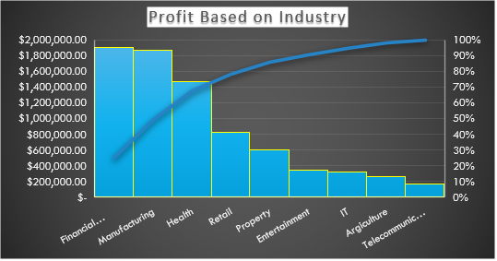
Note: The data and information in this document is reflective of a hypothetical situation and client. This document is to be used for KPMG Virtual Internship purposes only.
Data Exploration
Profit based on the Industry Sector
From the graph, its very clear that the top 3 industry from witch the most of the revenue is generated are Financial, Manufacturing and Health.

Slide 7
Note: The data and information in this document is reflective of a hypothetical situation and client. This document is to be used for KPMG Virtual Internship purposes only.
Data Exploration
Age Clusters Profit
The “MASS CUSTOMER” are bringing more profit in comparison with other two.
The age group 38-47 have highest buying capacity.
The buying capacity increase up to 47 and after that decaling is seen.

Slide 8
Note: The data and information in this document is reflective of a hypothetical situation and client. This document is to be used for KPMG Virtual Internship purposes only.
Data Exploration
State Wise Number of Cars
From the graph, it is very much clear that NSW is at 1st position and then VIC in on 2nd position and then QLD is at 3rd i.e. last position in terms of buying car.

Slide 9
Note: The data and information in this document is reflective of a hypothetical situation and client. This document is to be used for KPMG Virtual Internship purposes only.
Data Exploration
Bike Related Purchase Based on Gender
Data Shows, female has made more bike related purchases then male in last 3 years.
On average female have 1% more bike purchase then male.

Slide 10
Note: The data and information in this document is reflective of a hypothetical situation and client. This document is to be used for KPMG Virtual Internship purposes only.
Model Development
Customer Classification
Customer classification has been carried out on the bases of the observations.
Industry on which there should be more focus are Financial, Manufacturing and Health.
New target Market should be ranged between 38-47.
NWS is generating more revenue.
In comparison of gender the females are contributing more then male.

Slide 11
Note: The data and information in this document is reflective of a hypothetical situation and client. This document is to be used for KPMG Virtual Internship purposes only.
Interpretation
Top prospects from the new customer list
These are Top 5 prospects for the new customer target.
These customer are picked from new customer list on bases of there age, industry and wealth segment.

