Slide 1
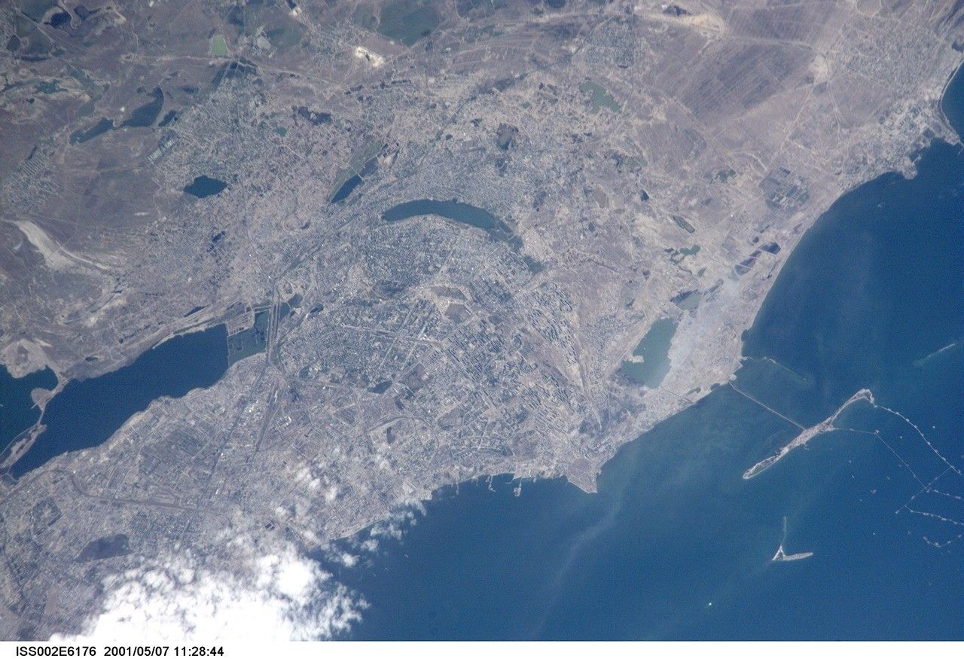
TERRATRACE
AI + Satellite Methane Intelligence for Oil and Gas Operators
Final Pitch Deck - July 2026

Slide 2
The Problem
Oil and gas methane leaks are the fastest available lever to slow near-term warming - and abatement is frequently free
124 Mt/yr
$34B
80x
30%
Fossil methane emissions (IEA Global Methane Tracker 2026)
Lost product value from leaked gas every year (UNEP)
Methane's heat-trapping power vs CO2 over 20 years (IPCC AR6)
Of O&G methane emissions abatable at zero net cost (IEA)
The barrier is not the economics of the fix. It is finding the leak fast enough, cheaply enough, and reliably enough to act on it.

Slide 3
Why Now - Regulatory Pressure Is Real
EU Methane Regulation
Non-compliant gas imports face market access restriction by 2030
2024
US EPA OOOOb/c
Mandates leak detection and repair, incl. satellite-triggered super-emitter response
2024
OGMP 2.0
140+ operators committed to measurement-based, not estimated, reporting
Ongoing
Global Methane Pledge
159 countries, 30% cut by 2030 - emissions have plateaued, not dropped
2021

Slide 4
Detection Exists. Reliability Does Not.
58%
12%
Accuracy across 9 satellite systems on 82 identical controlled methane releases (Stanford single-blind study)
Of confirmed leak alerts through the UN's own MARS system get any response at all
This is not a sensing problem anymore. It is an AI-reliability problem and an accountability problem - and that is what TerraTrace is built to close.

Slide 5
Competitive Landscape
Company | Model | Key Fact
AIRMO | Aircraft + satellite campaigns | Zero satellites in orbit today, launching 2027
Kayrros | TROPOMI + AI | Now owned by Energy Aspects, a trading-data firm
Arolytics | Workflow / aggregation layer | Not a detection company - integrates 125+ sources
GHGSat | Tasked nanosatellites | ~100-240 kg/hr detection limit, premium pricing
TerraTrace | Free continuous satellite AI | Unrationed coverage, zero launch risk, ships today

Slide 6
Our Differentiation
01
02
03
Unrationed coverage
Deliverable now
Serves the underserved tier
Runs on already-orbiting free imagery. Every facility monitored on every pass - no booking, no waitlist, no minimum contract.
No hardware or launch risk. Ships today as a software problem, not a bet on a 2027 satellite that has not flown yet.
Small-to-mid operators and emerging-market regulators that AIRMO, Kayrros and GHGSat structurally price out.

Slide 7
Our Solution - The Four-Step Pipeline
01
02
03
04
Satellite Ingestion
AI Spectral Analysis
Plume Attribution
Alert and Reporting
>
>
>
Sentinel-2 (10m, 5-day revisit) + Landsat 8/9 (30m, 16-day revisit), SWIR bands 11/12
CNN/ViT model, cloud and aerosol filtering, multitemporal baseline comparison
Facility database cross-reference, ERA5 wind back-tracing, kg/hr emission estimate
24-48h alert with GPS, confidence score, OGMP 2.0 / EU Methane Regulation format

Slide 8
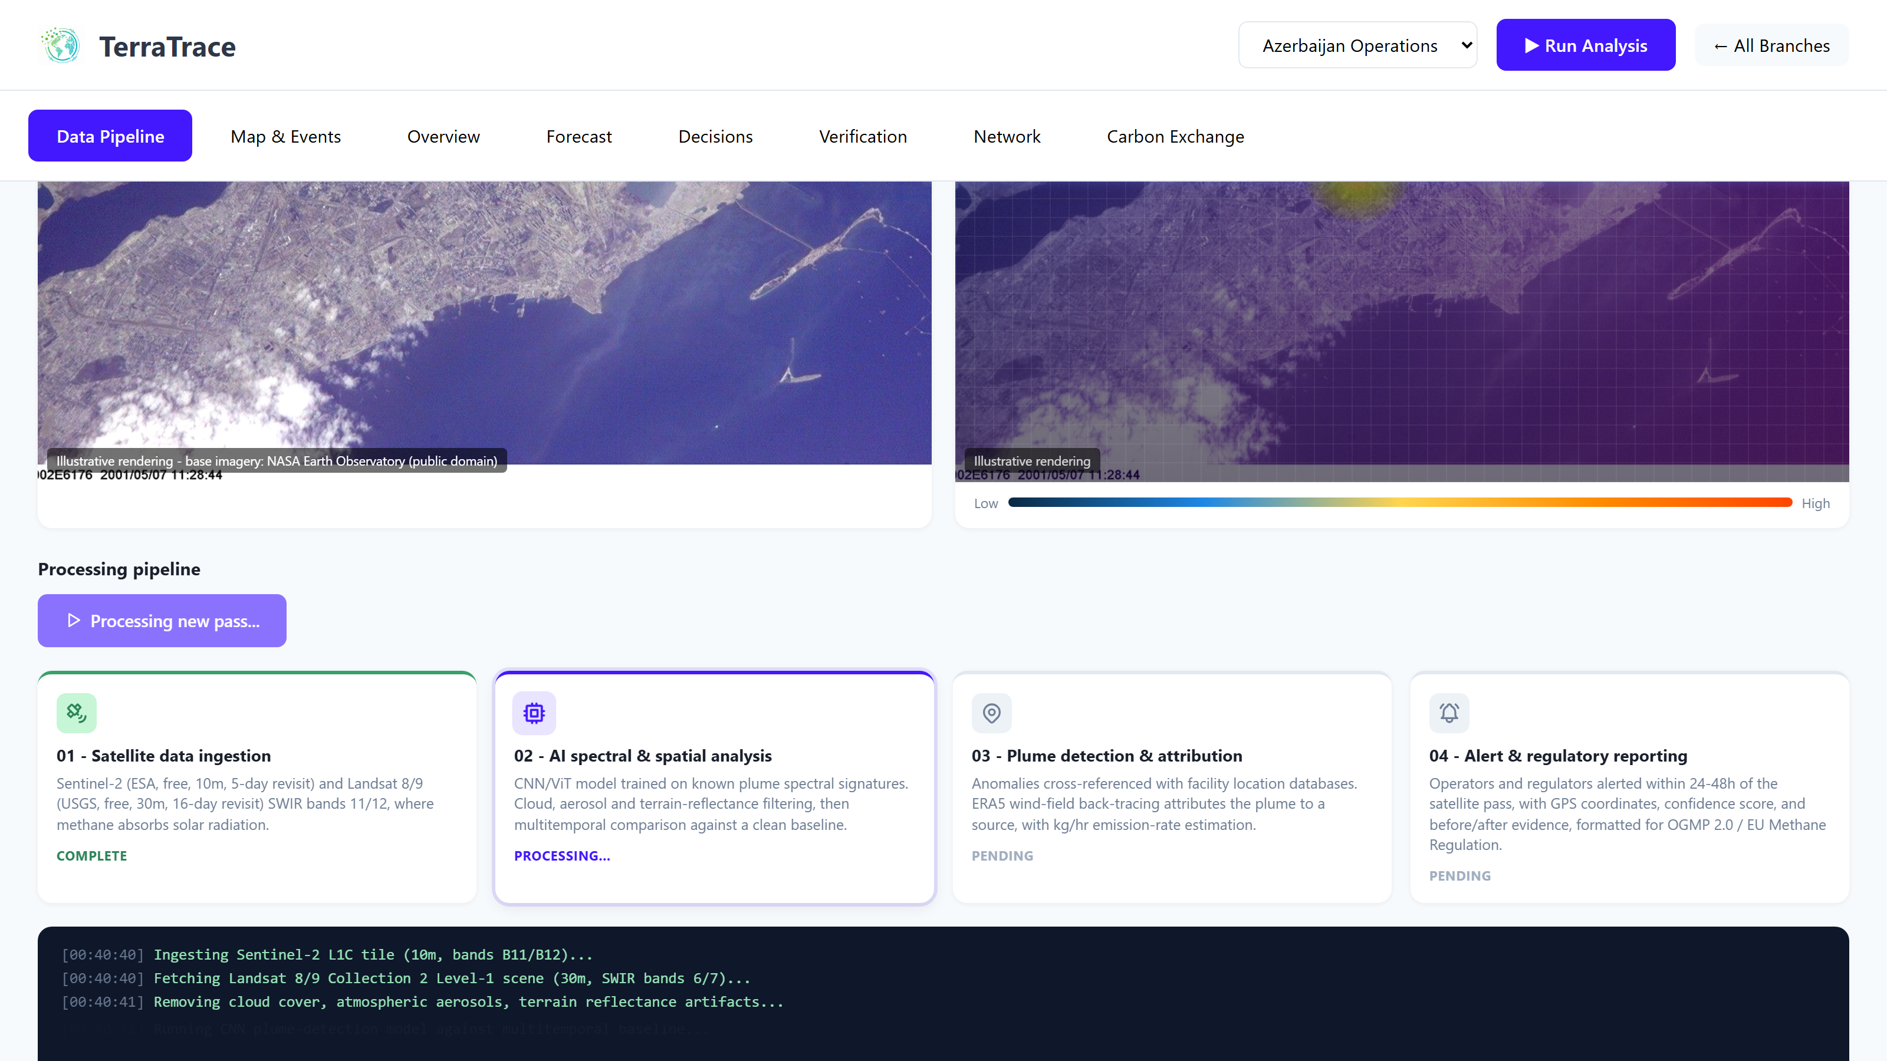
Product - Data Pipeline
The default view: satellite pass cadence, real imagery, and the live 4-step AI pipeline

Slide 9
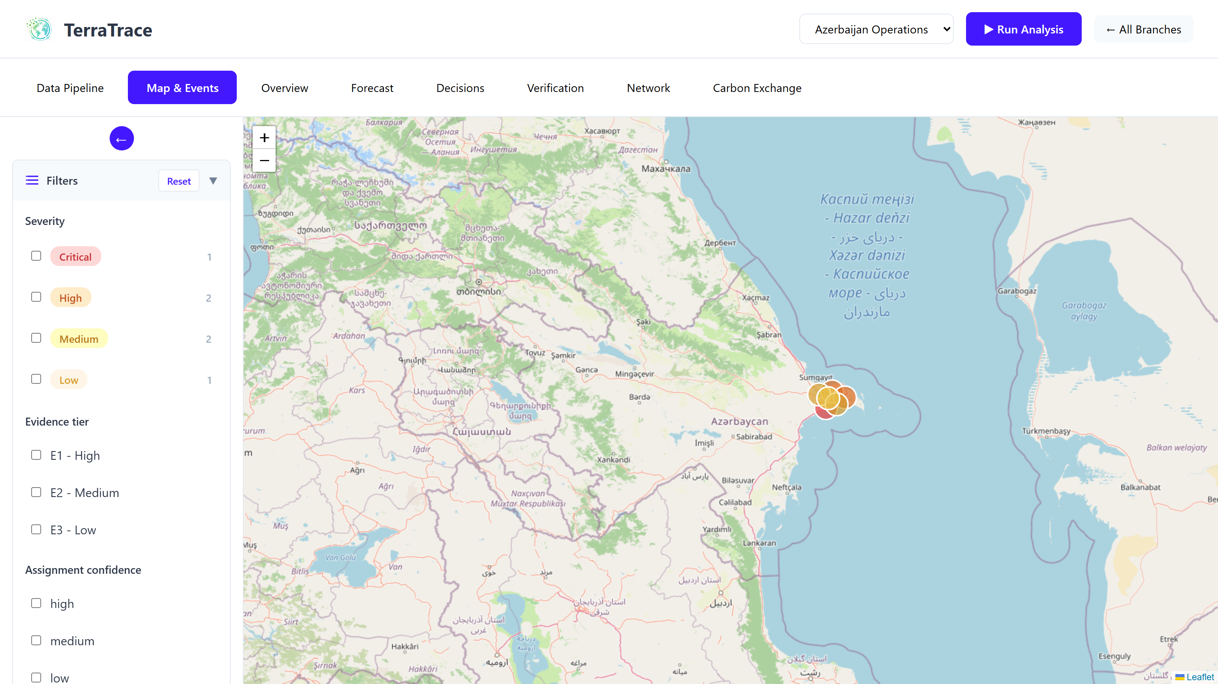
Product - Map and Events
Facility-level incident map with severity filters and a dedicated super-emitter panel

Slide 10
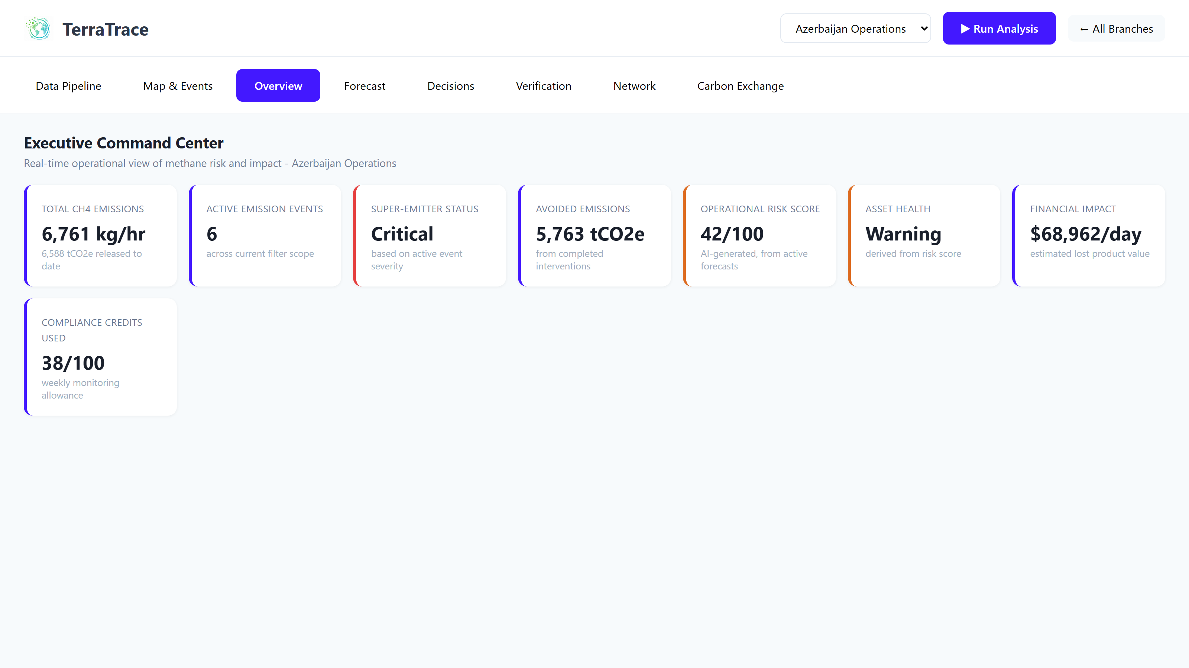
Product - Executive Overview
Total CH4 emissions, risk score, asset health, and financial impact at a glance

Slide 11
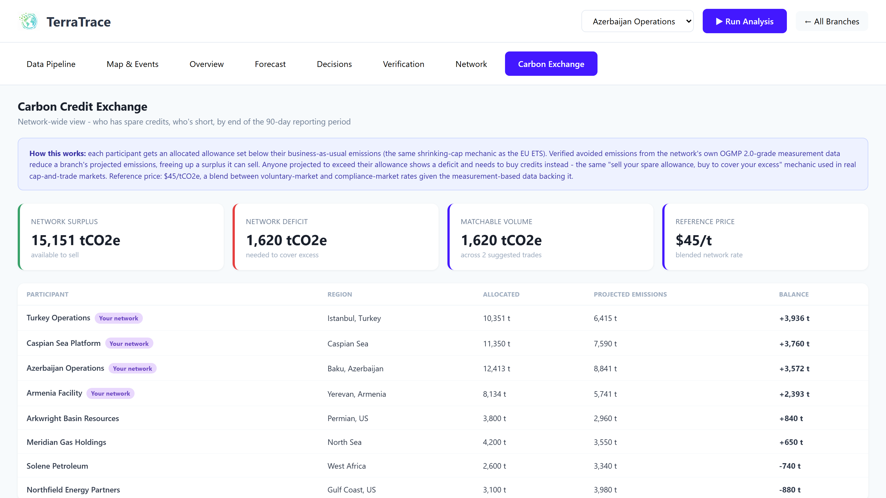
Product - Carbon Credit Exchange
Network-wide surplus and deficit, auto-matched trades, live status tracking

Slide 12
Carbon Credit Exchange - How It Works
Modeled on real cap-and-trade mechanics, not invented rules
-
Each branch gets an allowance set at 85% of business-as-usual emissions - a shrinking cap, same mechanic as the EU ETS
-
Reference price: USD 45/tCO2e - blended between voluntary (USD 8-30) and compliance (USD 72-85) market rates
-
Verified avoided emissions reduce projected emissions, freeing up a sellable surplus
-
Trades move through Suggested to Proposed to Accepted to Retired - once retired, a credit is gone for good
-
External network-partner operators included, so trading is genuinely cross-company
-
Prevents double-counting, exactly like Verra and Gold Standard registries

Slide 13
Business Model and Go-to-Market
MRV technology market for methane projected at USD 2-5B+ by 2030
-
Primary customers: small-to-mid oil and gas operators and emerging-market regulators priced out of enterprise-only competitors
-
Secondary channel: integration with workflow platforms like Arolytics, feeding detections into existing LDAR tooling
-
Positioning: continuous low-cost screening layer that feeds high-confidence candidates to premium verification providers
-
Pricing: multi-year base contract plus usage-based scaling - not cancel-anytime, matching OGMP 2.0's need for a consistent trend record

Slide 14
Roadmap
Phase 1 - Now
Validated product narrative, full-featured mock-data prototype across all 7 modules plus Carbon Exchange
Phase 2
Real Sentinel-2/Landsat ingestion; train and validate a super-emitter model against controlled-release data
Phase 3
Pilot with 1-2 small-to-mid operators or a national regulator; real OGMP 2.0-formatted reporting output
Phase 4
Registry integration for real, auditable carbon credits rather than modeled ones

Slide 15
30% of oil and gas methane leaks could be fixed at zero net cost.
The technology gap is not the fix - it is finding the leak fast enough, cheaply enough, and reliably enough to act on it.
TerraTrace closes that gap.
Thank you

