Slide 1
Effects of new treatment on gene expression
Data as of 22/03/2024

Slide 2
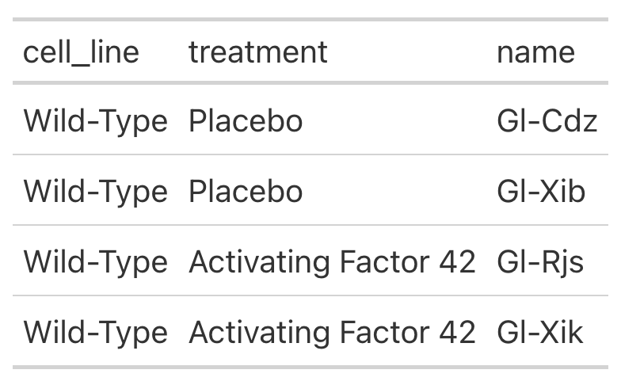
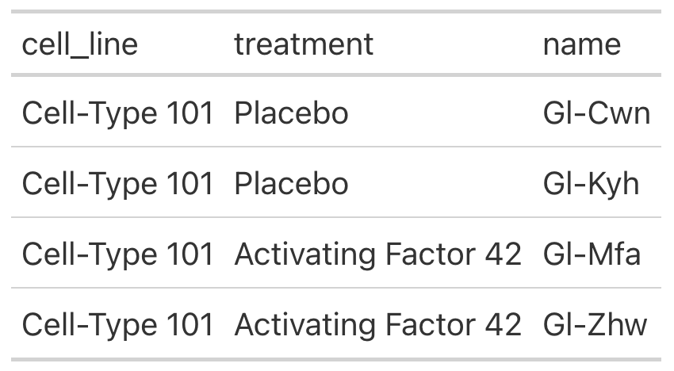
Cell lines

Slide 3
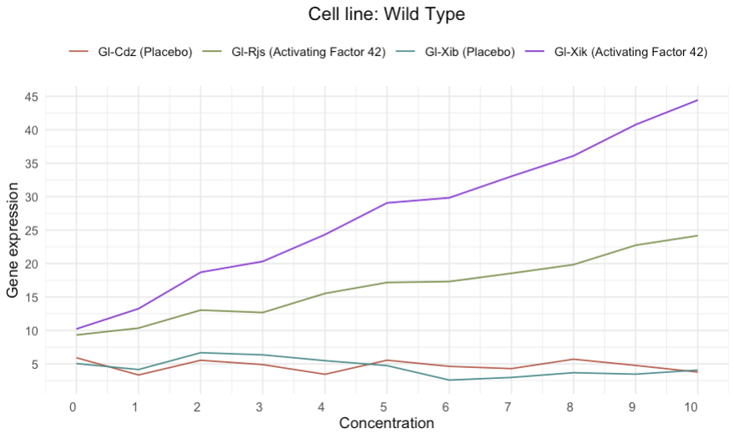
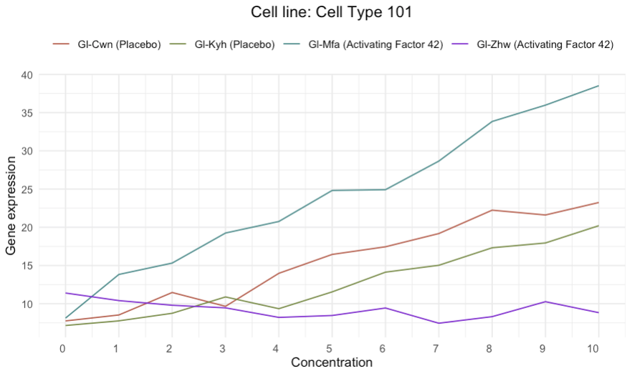
Gene expressions
Generally, the gene expression of the wild type cells is increased more by the treatment (activating factor 42) than cell type 101

Slide 4
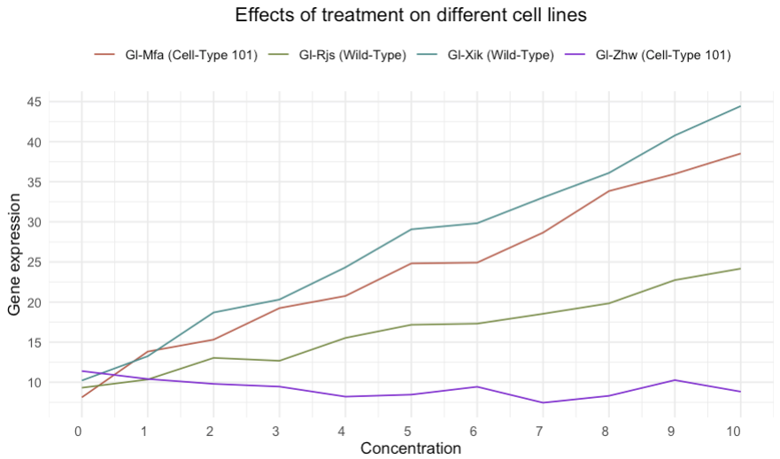
Activating factor 42
The wild type cells, Gl-Xik have the highest gene expression and cell type 101 cell, Gl-Zhw have the lowest gene expression when the concentration is 10
Cell Type 101:
Gene expression of Gl-Mfa increases by 0.136 on average as the concentration increases
Gene expression of Gl-Zhw decreases by 0.035 as the concentration increases
Wild Type:
Gene expression increases by 0.088 for Gl-Rjs and 0.133 for Gl-Xik

Slide 5
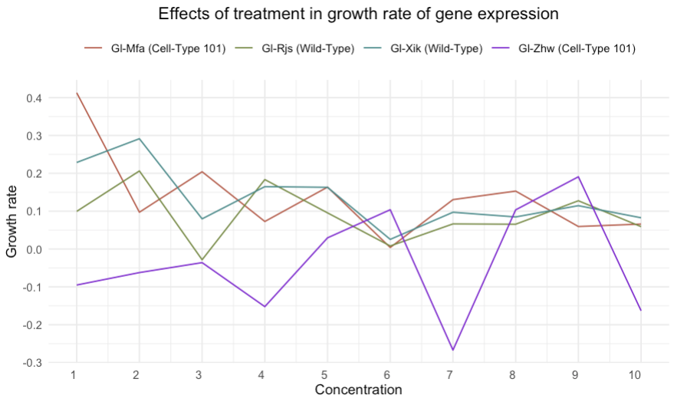
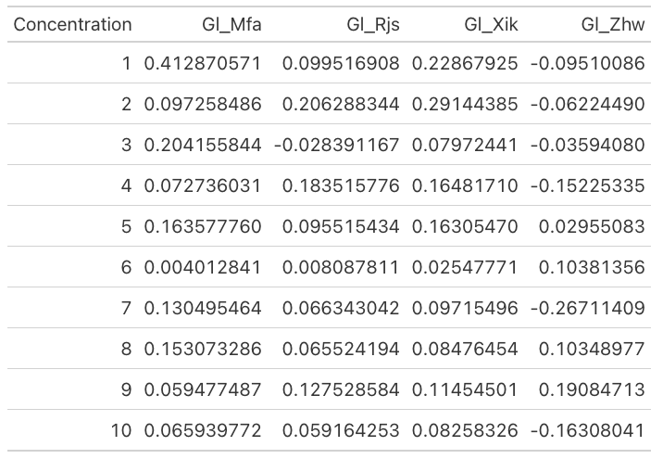
Growth rate
The growth rate of gene expressions at all concentrations from 1 to 10 are calculated below:
Highest growth is by Gl-Xik (wild type) and Gl-Mfa (cell type 101)
Lowest growth is by Gl-Zhw (cell type 101)

