Slide 1
Project #19
Standalone Root Cause Analysis
Progress Since July 2026
Progress through 22 September 2026
Notes:
/Users/dhwanilchauhan/Downloads/S&T_PTC_July2026Presentation.pptx slides 7–13. Progress cutoff 22 September 2026, not a confirmed meeting date.

Slide 2
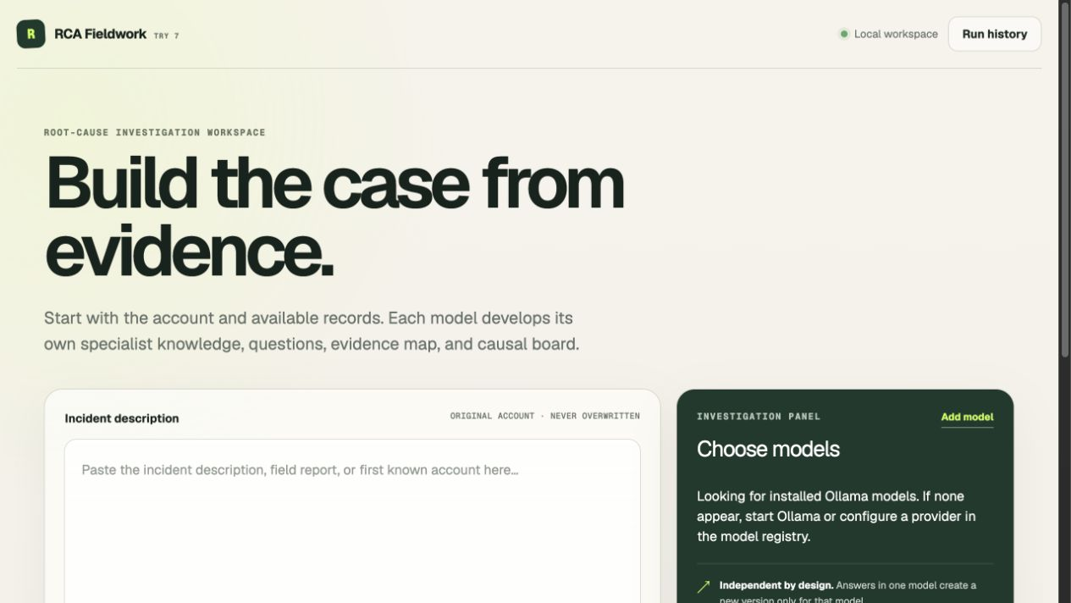
Progress Since July
JULY
Current investigation workspace
Stepwise RCA concept
Initial causal mapping
Qwen testing planned
SINCE JULY
Preserved investigations
Evidence-driven revisions
Recorded Qwen experiments
Prototype implemented. Causal quality remains under evaluation.
Notes:
/Users/dhwanilchauhan/Downloads/S&T_PTC_July2026Presentation.pptx slides 7–13. /Users/dhwanilchauhan/Desktop/RCA Try 1/Try 7/TRY7_EXECUTIVE_PLAN.md, section 10 implementation receipt and observed smoke outcome. Screenshot: current Try 7 local interface captured 22 September 2026. Workflow availability is not evidence of RCA accuracy.

Slide 3
How the Investigation Now Works
One incident develops through evidence and successive saved versions
Incident + records
Initial understanding
Targeted expertise
Original sources retained
Entities and hypotheses
Focused questions
NEW
EVIDENCE
Saved versions
Review + revision
Questions + answers
Later records
Board and open questions
Facts, roles and links
Requests and sourced answers
Answers or corrections
New information can strengthen, challenge or withdraw an explanation.
Notes:
/Users/dhwanilchauhan/Desktop/RCA Try 1/RCA_RESEARCH_OVERVIEW_AND_PLAN.md sections 5, 8; /Users/dhwanilchauhan/Desktop/RCA Try 1/Try 7/TRY7_EXECUTIVE_PLAN.md sections 4, 10. Simplified conceptual workflow. The diagram summarizes responsibilities, not separate fixed sequential API agents. Review outcomes and questions can reopen investigation work.

Slide 4
What Changed Between V1 and V2
Instrument-air case: saved partial investigations
A concrete issue found
Pressure loss
Recovery
V1 retained both directions
for the “preceded” relationship.
The board grew.
Key causal errors remained.
5 to 9 nodes. Verified connections stayed at 0.
Notes:
/Users/dhwanilchauhan/Desktop/RCA Try 1/Try 6/evals/v1-v2-presentation-review/output/Try6_V1_V2_Evidence_Review.md sections 1–3; /Users/dhwanilchauhan/Desktop/RCA Try 1/Try 6/public/history/featured-causal-boards.json. One Try 6 development case, IA-16036, Qwen3.5. Counts include focal event. V1 5 nodes/4 active links/0 verified links; V2 9/6/0. No claim that greater size means greater accuracy. Diagram at right is an abbreviated excerpt of the two opposing preceded links present in saved V1, not a correct process model.

Slide 5
Improvements to Evidence Review
Corrections now have an explicit route back to the investigation
Source evidence
Proposed correction
Re-review
Saved revision
Preserved originals
Source-bound change
Check the revised claim
History + current view
Three separate judgments
Factual support
Causal role
Connection validity
Does the source establish it?
Is it an event, condition or barrier?
Is the proposed relationship justified?
97 recorded software checks passed. Model RCA improvement still needs testing.
Notes:
/Users/dhwanilchauhan/Desktop/RCA Try 1/Try 7/TRY7_EXECUTIVE_PLAN.md, section 10 implementation receipt and observed smoke outcome. These functions are described in the implementation receipt; full-plan acceptance is incomplete. The 97 checks are recorded deterministic software checks, not model accuracy scores.

Slide 6
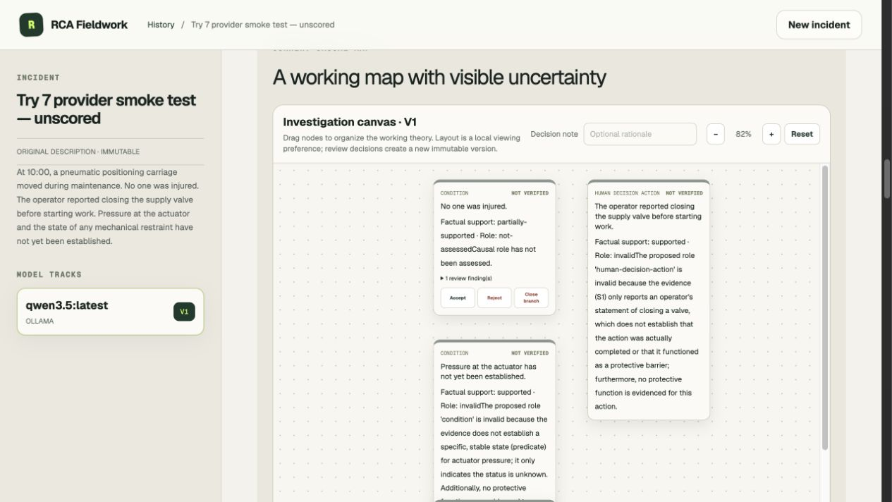
Latest Qwen Investigation
21
tasks completed
Partial V1
5 observations
+ focal event
0 causal links
Real run, preserved output. Execution remains inconclusive.
Notes:
/Users/dhwanilchauhan/Desktop/RCA Try 1/Try 7/TRY7_EXECUTIVE_PLAN.md, section 10 implementation receipt and observed smoke outcome. Screenshot of the saved unscored Try 7 pneumatic-carriage smoke run. The screenshot shows the current app displaying the historical V1 snapshot. 21 tasks completed; partial version; 5 observations plus focal event, zero causal links; execution-inconclusive. Post-run fixes are not validated by a fresh frozen-config experiment.

Slide 7
Staged Evidence for Validation
Two development cases
R3 beam fall
Instrument-air loss
Technical review required
Prepared for pilot
B0: starter evidence
B1: new evidence
B2: further evidence
Initial account and available records
Records that distinguish explanations
Deeper context or a correction
V1
V2
V3
Synthetic reconstructions. Independent technical validation remains pending.
Notes:
/Users/dhwanilchauhan/Desktop/RCA Try 1/Synthetic Evidence Packages 2026-09-22/README_OPERATOR_ONLY.md. Two historically anchored synthetic reconstructions, not recovered company records. Both are derivatives of previously used development cases, not independent held-out cases. B0/B1/B2 are cumulative releases corresponding to V1/V2/V3. No new RCA run is claimed.

Slide 8
Next Steps
Next milestone: one reproducible investigation across three evidence releases
Freeze the pilot
Run V1–V3
Baseline comparison
Assess quality
Model, prompts and release schedule
Save every input, board and revision
Same model and same evidence
Evidence, mechanisms and revisions
Technical review
Success criterion
Review case realism and
causal interpretation.
Evidence produces justified
changes in the explanation.
Notes:
/Users/dhwanilchauhan/Desktop/RCA Try 1/RCA_IMPLEMENTATION_AND_PAPER_CHECKLIST.md sections C–E. /Users/dhwanilchauhan/Desktop/RCA Try 1/Try 7/TRY7_EXECUTIVE_PLAN.md, section 10 implementation receipt and observed smoke outcome. Proposed milestones, not completed outcomes or dated commitments. Review R3 mechanics before scored use. Use equivalent evidence for baseline comparisons.

