Slide 1
Finance Tracker
Student 1 Name: Raj Dudhat Roll no:97
Enrollment No: 24002170110038 Batch: A3 Branch: CE
Student 2 Name: Yash Mungalpara Roll no: 98
Enrollment No: 24002170110095 Batch: A3 Branch: CE
Student 3 Name: Dhyan Patel Roll no:115
Enrollment No: 24002170110120 Batch: A3 Branch: CE

Slide 2
Introduction
Smart Finance Tracker is a Python and Streamlit based personal finance web application that helps users manage their money in an organized and efficient way.
The application allows users to track income and expenses, giving a clear view of their spending patterns.
It supports budget planning and savings goal management, helping users control expenses and save regularly.
The system also provides risk-free investment learning, enabling users to
understand basic investment concepts safely.
Overall, this project helps users analyze their financial activities and improve their financial health.

Slide 3
Technology
Python
SQLite
Tools & IDE
Core logic & backend development
Handles financial calculations
Implements Data
Structures (Stack)
Database storage
Streamlit (UI development)
VS Code (Coding environment)
Plotly (Charts & analytics)
Stores user, admin & transaction records
Fast and lightweight DBMS

Slide 4
Advantage & Disadvantages
Advantages
Easy tracking of income and expenses
Helps control budget and reduce overspending
User-friendly and simple to use
Secure handling of financial data
Disadvantages
Manual data entry may cause errors
No real-time bank integration
Limited scalability for large systems

Slide 5
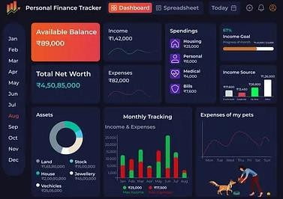
Future Scope
Mobile application version
Cloud-based database integration
Advanced analytics and reports
Multi-user collaboration features

Slide 6
THANK YOU!

