Slide 1



JAVA + DBMS + DS
Book Rental System
Student 1 : Name: Dhyan Patel Roll no:148 Enrollment No: 24002170110120 Batch: D6 Branch: CE
Student 2 : Name: Sahil Patel Roll no:151 Enrollment No: 24002170110136 Batch: D6 Branch: CE
Student 3 : Name: Ved Patel Roll no:155 Enrollment No: 24002170110143 Batch: D6 Branch: CE

Slide 2
Introduction
Book Rental System is a software application developed using Java, DBMS and Data Structures. It provides an efficient way to manage the process of renting and returning books.
Helps users to rent books easily without manual paperwork. Stores all records in a centralized database (MySQL). Provides secure and accurate tracking of transactions.
Uses Data Structures (like queues & searching algorithms) for fast and efficient book management. Reduces manual errors and saves time.

Slide 3
Technology
Java
MySQL
Tools & IDE
Core Java for logic JDBC for DB connection DS (Searching, Sorting, Queue/Stack)
Database storage User & book records Easy GUI management
IntelliJ IDEA (Java + DS) phpMyAdmin (MySQL)

Slide 4
System Architecture
Presentation Layer
Application Layer
Database Layer
(Java UI) User interacts with system (Login, Rent, Return, Search).
(Java + DS + JDBC) Handles logic, applies searching/sorting, connects DB.
(MySQL + phpMyAdmin) Stores users, books, transactions.

Slide 5
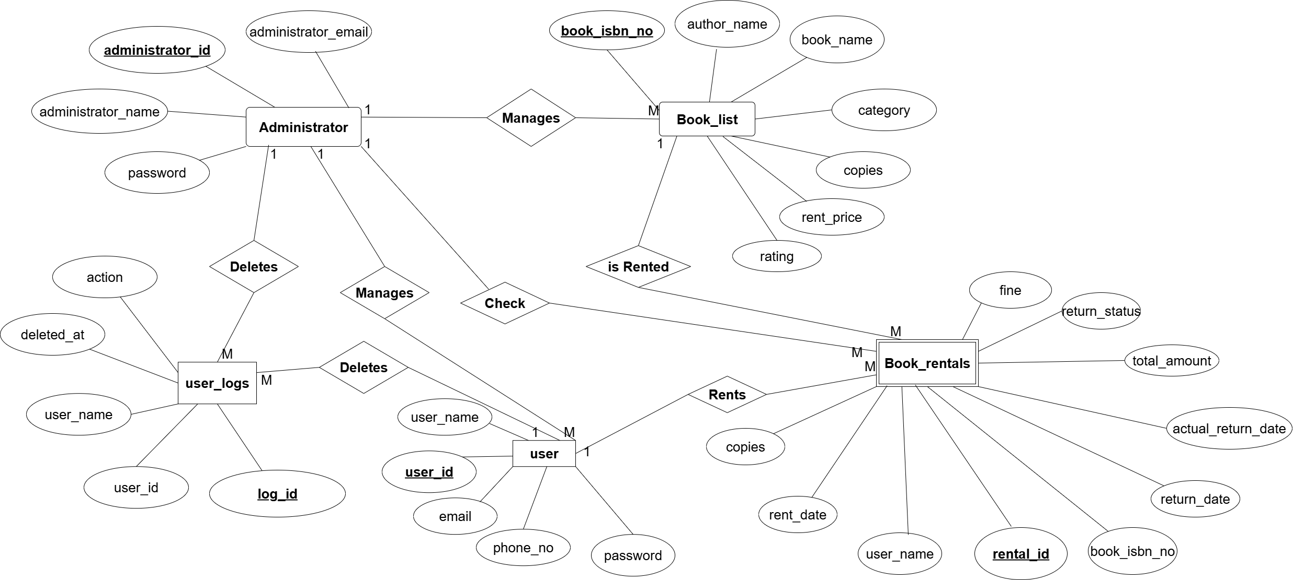
ER Diagram

Slide 6
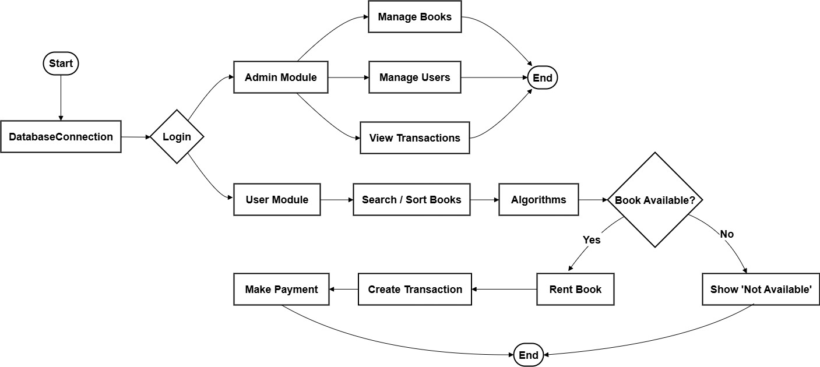
Design Flow

Slide 7
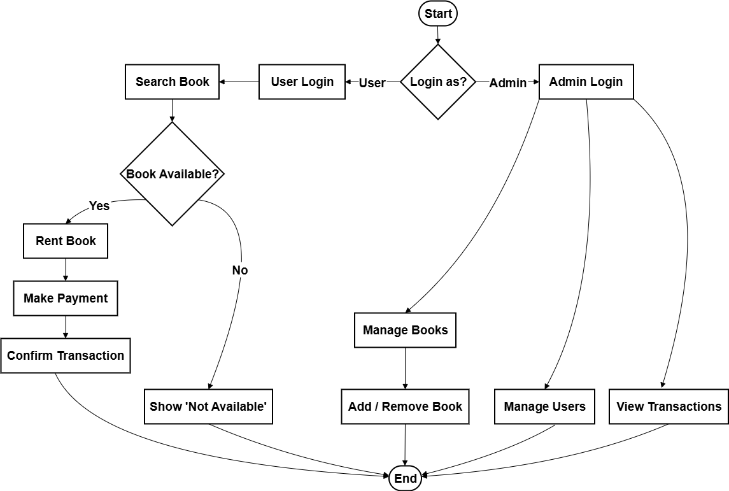
Activity Diagram

Slide 8
Database Schema
users (user_id, user_name, password, email, MobileNo) administrator (administrator_id, administrator_name, password, mobileNo, administrator_email,) book_list (book_isbn_no, book_name, rent_price, rating, category, author_name, copies) Book_rentals (rental_id, user_name, book_isbn_no, rent_date, return_date, total_amount, return_status, actual_return_date, fine, rented_copies) user_logs(log_id, user_id, user_name, action, deleted_at)

Slide 9
Code Snippets
DatabaseConnection.java – connectDB() User.java – login() User.java – register() User.java – searchBook() Admin.java – addBook()
6. Admin.java – removeBook() 7. Admin.java – manageUsers() 8. Book.java – getDetails() 9. Transaction.java – rentBook() 10. Transaction.java – returnBook()

Slide 10
Advantages & Limitations
Advantages Faster searching with DS Secure data storage in MySQL Reduces manual work Easy to use interface Online payment integration
Limitations Requires internet & system setup Limited to desktop (no mobile app yet) Basic user interface Database scalability challenges Needs training for new users

Slide 11
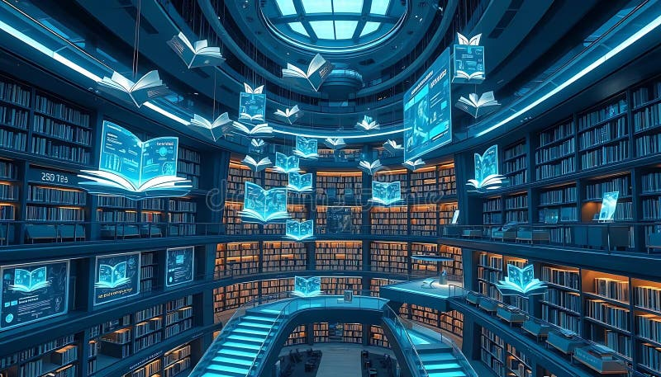
Future Scope
Mobile App Support AI-based Recommendations Multi-branch Library Support Cloud Database Scalability

Slide 12
Conclusion
Successfully developed Book Rental System using Java, DBMS and DS. System is efficient, secure and user-friendly. Ensures automation of book renting and returning process. Maintains a centralized database for easy management. Can be further extended with online payment and mobile app.

Slide 13
THANK YOU!

