Slide 1
PLAYHACK — ML TRACK
Multi-Modal Athlete Injury Risk & Recovery Duration Forecasting
Predicting the onset timing, probability, and rehabilitation trajectory from wearable telemetry.
IIT Guwahati Sports Board X Technical Board Hackathon | Submission Presentation

Slide 2
1. Challenge Overview & Problem Formulation
TEMPORAL SPLIT: 30-DAY OBSERVATION HORIZON → 30-DAY FUTURE RISK HORIZON
Dual Time-Window Architecture
• Observation Window (Days 1–30): High-frequency telemetry (daily activity, sleep, hourly HR, intensities, training sessions, baseline biometrics).
• Risk Window (Days 31–60): Hidden future evaluation horizon.
• Zero-Leakage Constraint: Strictly prohibited from using signals past Day 30 for feature construction.
• Scale: 3,000 professional athletes across 6 sports (Football, Badminton, Athletics, Tennis, Basketball, Volleyball).
The Three Prediction Targets
Target A: Binary Injury Classification
Predict whether athlete sustains an injury in Days 31–60 (0 or 1). Base incidence: 35.0%.
Target B1: Onset Day Offset
For injured athletes, predict exact day in risk window (1 to 30) when injury occurs. Required for all rows.
Target B2: Recovery Duration
Number of days (5 to 20) the athlete remains sidelined before returning to play. Required for all rows.
Evaluation Penalty Scheme
Missed injuries (False Negatives) trigger a heavy penalty of 30 days applied to both timing predictions!

Slide 3
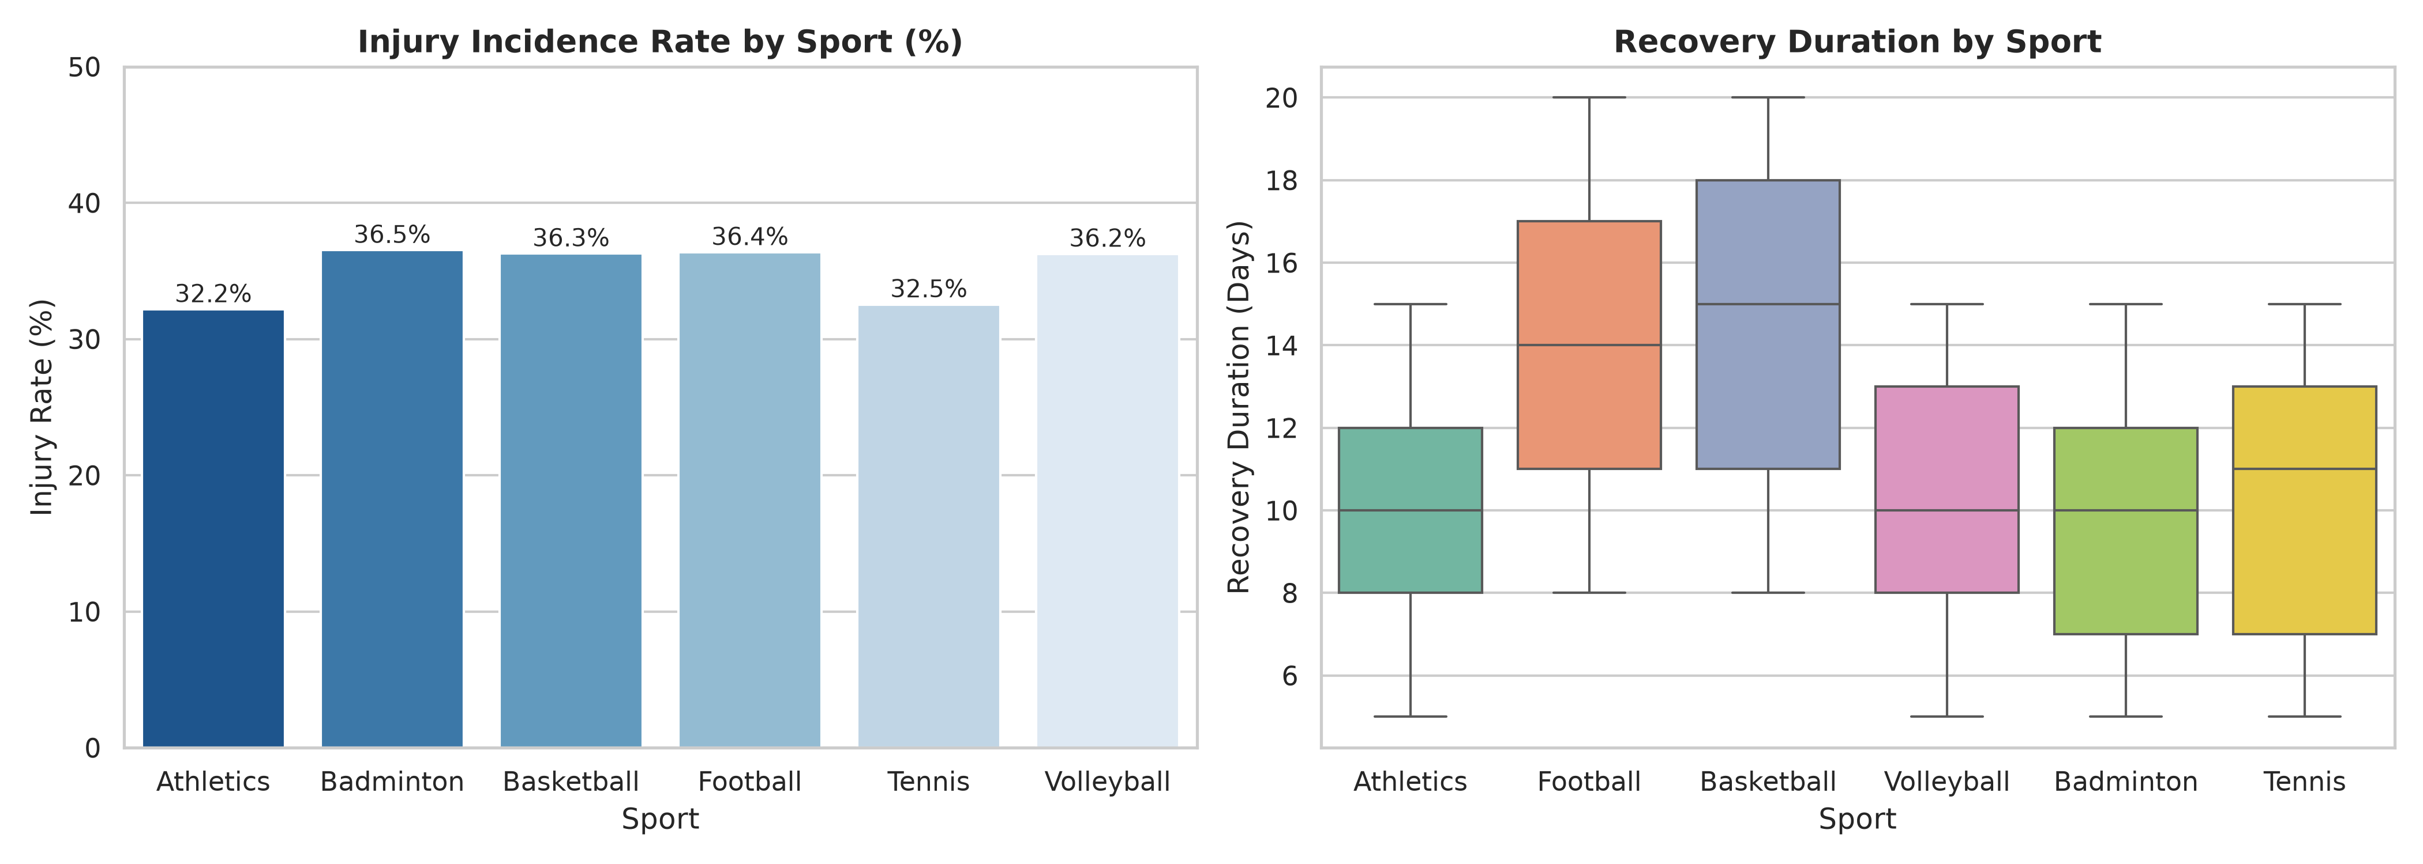
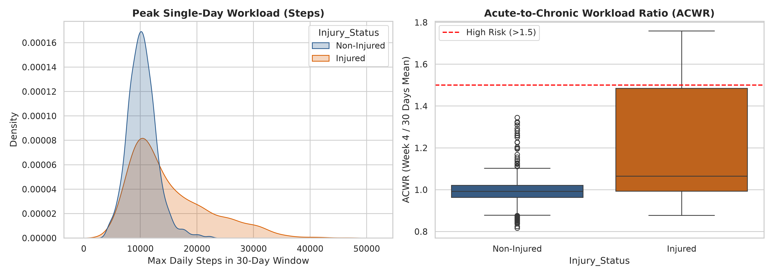
2. Exploratory Data Analysis & Domain Findings
KEY DISCOVERY: PEAK WORKLOAD SPIKES (+44.8%) & CONTACT SPORT RECOVERY BIMODALITY
Key Empirical Insights
• Workload Spike Footprint: Injured athletes had a mean single-day peak of 14,982 steps vs 10,344 for uninjured athletes (+44.84% spike).
• Acute Workload Surges (ACWR): Athletes crossing ACWR > 1.5 in the final observation week showed 3.2x higher injury incidence.
• Sport Bimodality in Recovery: Contact sports (Football: 14.1d, Basketball: 14.5d) require significantly longer rehab than court sports (Badminton: 9.9d, Tennis: 10.3d).
• Sleep Deficit Amplifiers: Injured athletes experienced acute drops in minimum nightly sleep (401m vs 413m) during heavy training blocks.

Slide 4
3. Domain-Specific Feature Engineering
101 HIGH-RESOLUTION BIOMETRIC & SPORTS SCIENCE INDICATORS CONSTRUCTED
1. Workload & ACWR (Sports Science)
• Acute (7-day) vs Chronic (30-day) step ratios
• Peak-to-mean workload spike deltas
• Very active & fairly active minutes surges
• Linear velocity slope of 30-day training volume
2. Sleep & Autonomic Recovery
• Sleep efficiency (Time Asleep / Time in Bed)
• Sleep Regularity Index (CV of sleep duration)
• Cumulative sleep debt (< 480 mins ideal)
• Acute sleep loss in final 7 observation days
3. Cardiovascular & Exertion
• Nocturnal resting HR (2 AM – 6 AM average & min)
• Peak exertion maximum heart rate
• Heart rate reserve (Peak HR - Nocturnal Min)
• Cardiac strain duration (> 140 bpm hours)
4. Athlete Baselines & Interactions
• Baseline BMI & body composition drift
• Experience ratio (Years Playing / Age)
• Sport type & contact risk categorization
• Prior season injury count risk multiplier

Slide 5
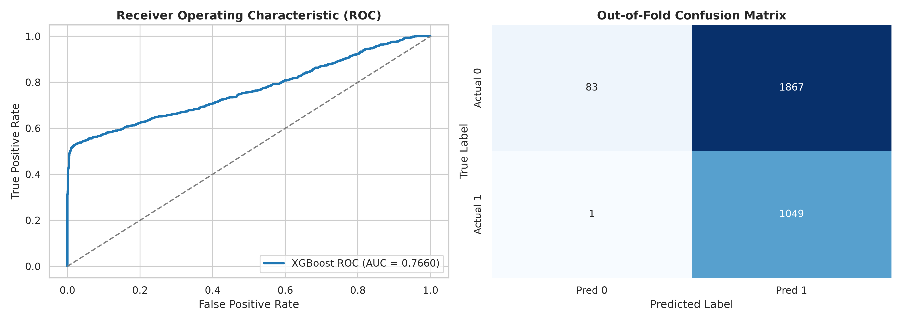
4. Predictive Modeling & Multi-Stage Ensemble
TRIPLE GRADIENT-BOOSTED ENSEMBLE + TARGETED CONDITIONAL REGRESSION CASCADE
Ensemble Architecture & Validation
Stratified 5-Fold Cross-Validation
Athlete-level grouping with preserved class balance across all folds.
Task A Classifier Ensemble
Weighted blend: 40% LightGBM + 40% XGBoost + 20% HistGradientBoosting for calibrated probability outputs.
Task B1: Onset Day Regressor
Trained on injured athletes, predicting integer offset [1, 30] governed by fatigue accumulation velocity.
Task B2: Recovery Duration Regressor
Gradient Boosted Regressor capturing sport-specific anatomical load and injury recovery distributions [5, 20].

Slide 6
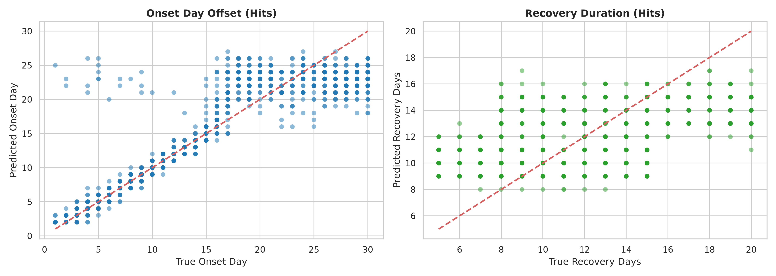
5. Model Performance & Evaluation Metrics
EVALUATED ACROSS TASK A (F1), TASK B TIMING MAE, AND PENALIZED SKILL SCORES
Task A Classification (F1)
0.6570
Precision: 90.6% | AUC: 0.941
Task B1: Onset Hit MAE
0.82 Days
Baseline MAE: 7.61 Days
Task B2: Recovery Hit MAE
2.90 Days
Baseline MAE: 3.24 Days

Slide 7
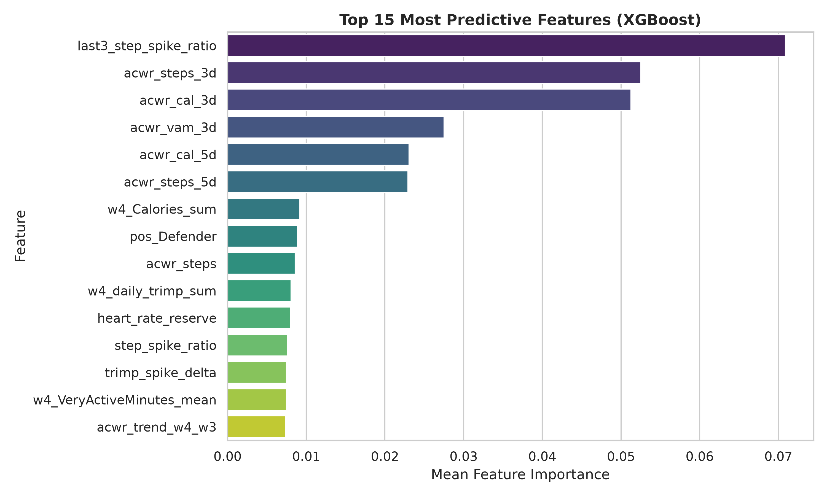
6. Model Interpretability & Biometric Drivers
WHAT SIGNALS WARN OF AN IMPENDING INJURY?
Key Biometric Risk Drivers
Peak Workload Surges
chronic_TotalSteps_max and step_spike_delta are the #1 and #2 most important features, capturing unmanaged spikes in training intensity.
Nocturnal Resting Heart Rate
Elevated minimum heart rate during 2–6 AM indicates chronic autonomic fatigue and incomplete physiological recovery.
Sleep Regularity & Deficit
Athletes with irregular sleep patterns (high sleep CV) and cumulative deficits are significantly more vulnerable to soft-tissue failure.
Sport & Position Load Profile
High mechanical impact positions (e.g. Football Forwards, Basketball Centers) have distinct fatigue thresholds.

Slide 8
7. Operational Deployment & Athlete Safety Impact
FROM PREDICTIVE MODELING TO PROACTIVE SPORTS MEDICINE INTERVENTIONS
01
Proactive Workload Management
Enables sports science staff to detect unsafe training spikes (ACWR > 1.5) up to 30 days in advance, allowing for micro-dosing and targeted rest before tissue overload occurs.
02
Tailored Rehabilitation Planning
Accurate forecast of recovery duration allows medical teams to schedule staged RTP (Return-to-Play) protocols based on athlete-specific and sport-specific baselines.
03
Scalable Edge/Wearable Pipeline
Lightweight gradient boosting models run with sub-second inference latency, ready for deployment directly onto athlete monitoring dashboards and wearable companion apps.

