Slide 1
What Really Drives Loan Default, and What Should Risk Do?
A full analysis: data quality to policy · Credit Risk analytics
24,000 synthetic personal-loan applications, 2022 for development and 2023 for out-of-time testing. Synthetic data created for training. Not actual customer data.

Slide 2
Summary: the three proposed actions treat symptoms; the drivers are affordability and track record
• The dashboard's claims fall apart once borrowers are compared like with like: agent channel odds ratio 1.85 to 1.15, interest rate 1.64 to 1.06, income 0.89 to 0.98.
• The real drivers: debt-to-income, loan size relative to income, utilisation, prior delinquency, credit score and employment type.
• The model ranks well and holds up in a later year: AUC 0.793 out of time (the credit score alone: 0.726), nearly calibrated.
• A model-based approval rule earns ₹334 lakh on 2023 loans, against ₹135 lakh approving all and ₹191 lakh under an agent ban.
Recommendation: decline the three actions, adopt a probability-based approval rule, recalibrate, and monitor quarterly.
Case 27 · Capstone: loan default drivers · synthetic data
2

Slide 3
Step 1: the data needed cleaning
Problem | Rows | Action
exact duplicate rows | 60 | removed
employment labels with inconsistent case or spaces | 2,365 | standardised to salaried / self_employed / gig
impossible ages (<18 or >80) | 3 | set to missing
incomes with two extra zeros | 25 | set to missing, then imputed
monthly income missing | 1,551 | median by employment type + missing indicator
credit score missing (thin file) | 1,231 | indicator + set to the reference value 650
Income is missing more often for the agent channel and self-employed borrowers; a missing credit score signals risk (10.1% default vs 7.3%).
Case 27 · Capstone: loan default drivers · synthetic data
3

Slide 4
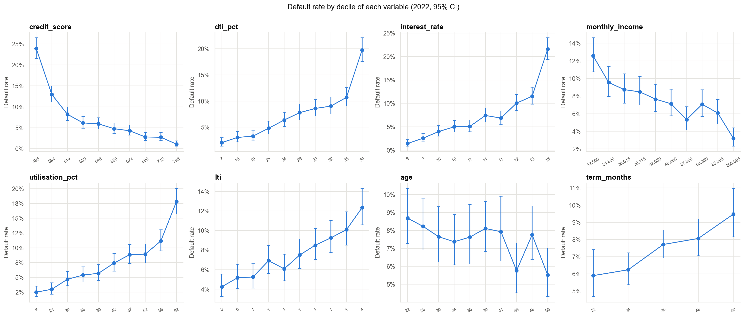
Step 2: default rises with debt-to-income, utilisation, loan size and falls with credit score
Default rate by decile of each variable, 95% intervals. City tier and loan amount carry no signal.
Case 27 · Capstone: loan default drivers · synthetic data
4

Slide 5
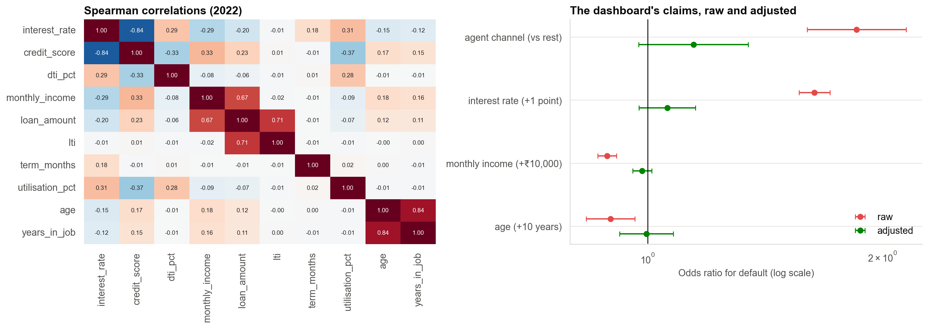
Step 3: the dashboard's claims, raw and adjusted
Agent borrowers have lower credit scores (627 vs 660); the interest rate is correlated −0.84 with the score. Adjusting leaves little behind.
Case 27 · Capstone: loan default drivers · synthetic data
5

Slide 6
Step 4: what moves the probability of default (baseline 7.7%)
Change | Change in default probability (pp)
DTI +10 points | +3.2
credit score +50 | −2.9
prior delinquency 0 to 1 | +2.2
loan-to-annual-income +0.5 | +2.6
term +12 months | +0.8
utilisation +20 points | +2.0
self-employed (vs salaried) | +1.1
gig (vs salaried) | +4.5
agent channel (vs branch) | +0.5
Percentage-point effects from the logistic model. The agent channel adds about half a point once credit quality is in the model.
Case 27 · Capstone: loan default drivers · synthetic data
6

Slide 7
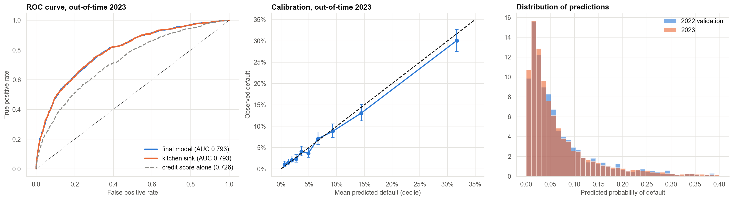
Step 5: validation out of time (2023)
AUC 0.793 (CI 0.777 to 0.808), KS 0.44, calibration slope 0.96. The agent share rose from 22% to 29% with little drift in scores.
Case 27 · Capstone: loan default drivers · synthetic data
7

Slide 8
Step 6: approval policies on 2023 loans (₹6,000 margin, ₹60,000 loss)
Policy | Approved | Default rate | Profit (₹ lakh)
Approve all | 100% | 7.4% | 135
Reject the agent channel (dashboard proposal) | 71% | 5.7% | 191
Credit score at least 650 | 51% | 3.2% | 237
Model: approve if predicted PD below 9.1% | 75% | 3.4% | 334
Model: approve if PD below 6% | 62% | 2.6% | 318
Model: approve if PD below 12% | 82% | 3.9% | 335
The model-based cut-off beats the agent ban and the score rule of thumb; profit is flat between about 9% and 13%.
Case 27 · Capstone: loan default drivers · synthetic data
8

Slide 9
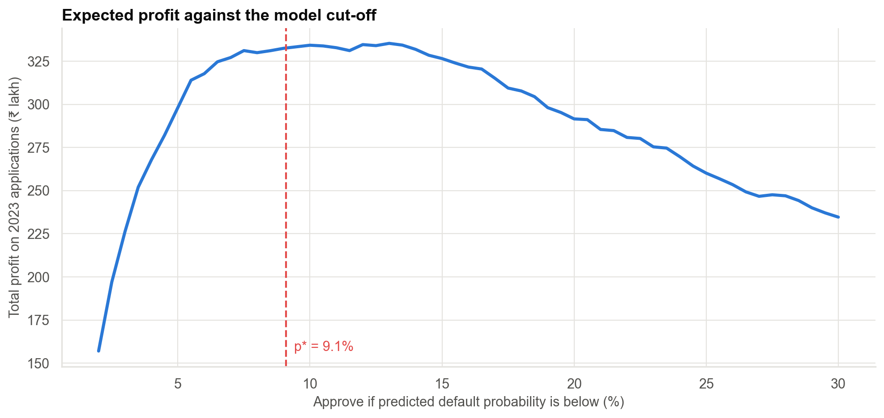
Profit against the model's cut-off
The theoretical cut-off (9.1%) is close to the best on the sample. The result rests on the stated margin and loss.
Case 27 · Capstone: loan default drivers · synthetic data
9

Slide 10
Checking against the truth (training answer key)
• 9 of 10 coefficient intervals contain the true value; the thin-file coefficient is the one miss.
• The three variables with no real effect (interest rate, age, income) have intervals containing zero in the kitchen-sink model.
• The ceiling AUC using the true probabilities is 0.798; the final model is at 0.793.
• The model captures about 95% of the attainable profit.
The drivers are real, the proxies were seen through, and the model is close to the best possible.
Case 27 · Capstone: loan default drivers · synthetic data
10

Slide 11
Recommendations
• Do not stop agent lending: underwrite agent loans with the same model; monitor the agent share.
• Do not raise the minimum income: use DTI and loan-to-income limits.
• Do not price harder on rate segments: price on the model's probability of default.
• Adopt the probability-based approval rule (cut-off about 9% to 13%) and recalibrate before pricing.
• Monitor quarterly: calibration, PSI, agent share, default by channel.
Decision needed: approve the model-based rule for a controlled rollout.
Case 27 · Capstone: loan default drivers · synthetic data
11

Slide 12
Limitations and next steps
Limitations
Next steps
• Observational: 'drivers' means associated after adjustment.
• Costs and margins are assumptions.
• One out-of-time year.
• Synthetic data; no answer key in real life.
• Randomised cut-off test on borderline applications.
• Bureau and behavioural data.
• Challenger model compared out of time.
• Fairness and compliance review.
Case 27 · Capstone: loan default drivers · synthetic data
12

