Slide 1
Personal-Loan Book Health Check
Board Risk Committee pre-read · Retail Risk Analytics
Based on an audited random sample of 2,500 loans from a book of 60,000. Synthetic data created for training. Not actual customer data.

Slide 2
Summary: the book is very likely above risk appetite, and loans are larger than planned
• Delinquency is above appetite. About 5.4% of loans went 90+ days past due within 12 months, against a 4% appetite (likely range 4.5%–6.3%).
• Loans are ~8% larger than the plan assumed. Average ticket ₹3.25 lakh vs ₹3.00 lakh, about ₹147 crore more exposure across the book.
• The 'average' loan is not the typical loan. Half of loans are below ₹2.5 lakh. Large loans (≥ ₹5 lakh) are 16% of loans but 40% of the money.
• DTI policy exceptions are under control at 0.4%, well within the 1% limit.
• Next: a driver analysis before any corrective action. The DSA channel is the first place to look.
Recommendation: report an appetite breach to the Board and commission a driver analysis within 6 weeks.
Case 01 · Personal-loan portfolio health check · synthetic data
2

Slide 3
What the CRO needs to tell the Board
What the Board wants to know
Why this needed care
• What does a typical personal loan look like?
• How concentrated is the money in large loans?
• Is the average ticket in line with the ₹3.0 lakh plan?
• Is 12-month serious delinquency (90+ DPD) within the 4% appetite?
• Are DTI policy exceptions within the 1% limit?
• A system migration left key fields unreconciled.
• Internal Audit re-verified a random sample of 2,500 loan files.
• Every number is therefore an estimate, so we report how precise it is.
We answer every question with a number AND a margin of error, so the Board knows how firm each number is.
Case 01 · Personal-loan portfolio health check · synthetic data
3

Slide 4
The audit sample is a fair, clean miniature of the book
2,500
loans audited
Chosen at random from all 60,000 loans, so every loan had an equal chance.
18 mths
of disbursals
Jan-2024 to Jun-2025; every loan observed for at least 12 months.
±1.5 pp
mix vs book
Channel, region and employment mix of the sample match the book closely.
18
data errors fixed
Duplicates, decimal-keyed rates, annual-as-monthly incomes, invalid ages. Plus 134 'no credit history' codes handled correctly.
Because the sample is random, results apply to the whole book, within the margins of error shown.
Case 01 · Personal-loan portfolio health check · synthetic data
4

Slide 5
Approach: clean, describe, estimate with margins of error, then test against targets
• 1. Clean: remove duplicates and fix provable errors. Large loans were verified as genuine and kept.
• 2. Describe: typical values, spread and concentration, using the median where averages mislead.
• 3. Estimate: for every key number, a range that is right 95% of the time (a '95% confidence interval').
• 4. Test: could the gap between our number and the target be just the luck of the sample?
• 5. Check: we confirmed by simulation that the method's ranges capture the truth ~95% of the time.
Statistics here answers one question: how sure can we be when we only looked at 1 in 24 loans?
Case 01 · Personal-loan portfolio health check · synthetic data
5

Slide 6
A typical personal loan: ₹2.5 lakh at about 16% over three years
₹2.5 lakh
median loan
Half of loans are smaller, half larger. This is the 'typical' customer.
₹3.25 lakh
average loan
Pulled up by a minority of large loans. Use it for exposure totals.
15.7%
average interest rate
Tightly clustered: most loans are within ±1.6 points.
36 months
most common tenure
Larger loans tend to take 48–60 months.
Design products around the median customer. Plan capital using the average.
Case 01 · Personal-loan portfolio health check · synthetic data
6

Slide 7
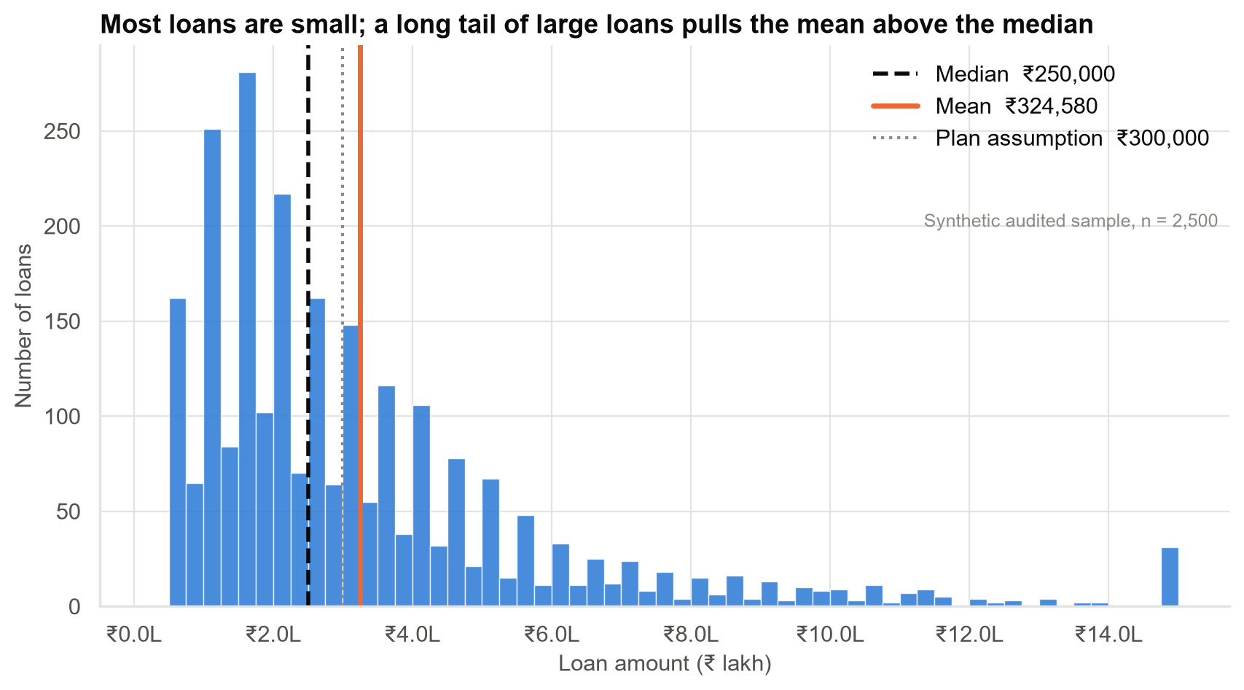
Most loans are small, but a long tail of large loans pulls the average above the typical loan
• Half of all loans are below ₹2.5 lakh.
• The average (₹3.25 lakh) sits above most loans because a few are up to ₹15 lakh.
• Spikes at round amounts: customers ask for ₹1, 2, 3 lakh.
• Large loans are genuine, not data errors, so they stay in.
Case 01 · Personal-loan portfolio health check · synthetic data
7

Slide 8
Loans of ₹5 lakh and above are 16% of loans but 40% of exposure
Loan size | Share of loans | Share of money lent
≤ ₹1L | 15% | 4%
₹1–2L | 28% | 14%
₹2–3L | 19% | 15%
₹3–5L | 22% | 27%
₹5–10L | 12% | 26%
₹10–15L | 4% | 14%
Losses will be driven by large loans. Monitor the ≥ ₹5 lakh segment separately, not just book averages.
Case 01 · Personal-loan portfolio health check · synthetic data
8

Slide 9
Loans are about 8% larger than the business plan assumed
₹3.25 lakh
average ticket (actual)
Likely range ₹3.14 lakh – ₹3.35 lakh.
₹3.00 lakh
plan assumption
Used in the capital and provisioning plan.
+₹25k
per loan
Too large to be the luck of the sample (less than 1-in-1,000 chance).
≈ ₹147 cr
extra exposure
Across 60,000 loans; likely ₹84–211 crore.
Small per loan, material for the book: re-base the plan's ticket size for capital and provisioning.
Case 01 · Personal-loan portfolio health check · synthetic data
9

Slide 10
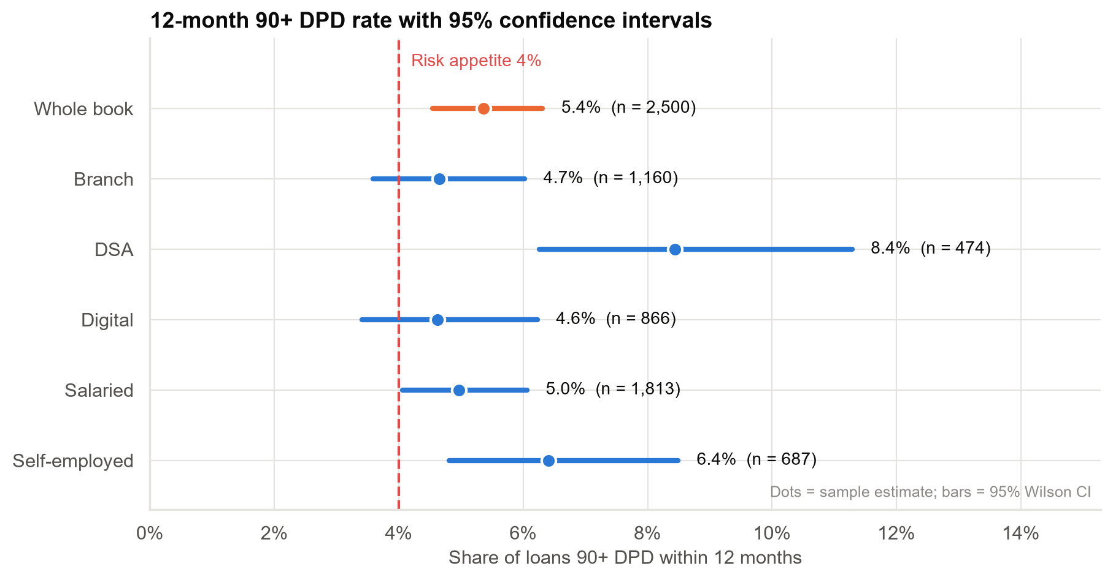
Serious delinquency is about 5.4%, above the 4% risk appetite
• Book estimate 5.4%; likely range 4.5%–6.3%. The whole range is above 4%.
• If the book were truly at 4%, an audit result this high would happen less than 1 time in 1,000.
• DSA-sourced loans: ~8%, roughly double Branch and Digital (4.6%–4.7%).
• Bars show the range of plausible values; smaller segments have wider bars.
Treat this as an appetite breach. The DSA gap is a lead to investigate, not yet a proven cause.
Case 01 · Personal-loan portfolio health check · synthetic data
10

Slide 11
How sure are we? Each conclusion holds across its whole likely range
Metric | Our estimate | Likely range (95%) | Target | Verdict
Average ticket size | ₹3.25 lakh | ₹3.14 lakh – ₹3.35 lakh | ₹3.00 lakh (plan) | Above plan (firm)
Typical (median) ticket | ₹2.5 lakh | ₹2.4 lakh – ₹2.5 lakh | – | –
12-month 90+ DPD rate | 5.4% | 4.5% – 6.3% | ≤ 4% (appetite) | Above appetite (firm)
DTI policy exceptions | 0.44% | 0.25% – 0.79% | ≤ 1% (limit) | Within limit (firm)
'Firm' means the conclusion holds anywhere in the likely range, not only at our single best estimate.
Case 01 · Personal-loan portfolio health check · synthetic data
11

Slide 12
What we can and cannot say yet
We can say
We cannot say yet
• The book is very likely above the 4% appetite.
• Average ticket is above plan by ~8%.
• Exposure is concentrated in large loans.
• DTI exceptions are within limit.
• Why delinquency is high. DSA customers may simply have weaker profiles.
• Whether it is getting worse: we pooled 18 months of loans.
• Anything about loans under 12 months old.
• Whether self-employed borrowers are riskier: the gap is within the noise.
We know where to look, not yet what to change. Acting on the DSA channel now risks fixing the wrong thing.
Case 01 · Personal-loan portfolio health check · synthetic data
12

Slide 13
Recommendations
• Escalate: report the 90+ DPD appetite breach to the Board, with its likely range.
• Diagnose before acting: a 4–6 week driver analysis separating channel, credit score and DTI effects.
• Re-base the plan: use an average ticket of about ₹3.25 lakh for capital and provisioning.
• Report better: show median and percentiles alongside averages; attach a margin of error to every sample-based number.
• Fix the data pipeline: duplicates, unit errors and 'no-history' codes must be fixed before the next system report.
The decision for the Board: acknowledge the breach now; approve the diagnostic work that precedes corrective action.
Case 01 · Personal-loan portfolio health check · synthetic data
13

Slide 14
Limitations: what could change these conclusions
• Sample-based: book-level numbers are precise; segment numbers (e.g., DSA, ~470 loans) much less so.
• One definition of default (ever 90+ DPD in 12 months). Other definitions can differ.
• Income is missing for 4% of loans, mostly self-employed, so income figures are for verified loans only.
• Pooled period: recent months could be better or worse than the 18-month average.
• Approved loans only: results describe the book, not all applicants.
• No cause-and-effect conclusions: differences between segments are associations.
Case 01 · Personal-loan portfolio health check · synthetic data
14

Slide 15
Next steps
• Weeks 1–2: formal comparison of channels and customer types (are the gaps real?).
• Weeks 2–4: vintage view: delinquency by disbursal quarter, to establish the trend.
• Weeks 3–6: driver model of delinquency (score, DTI, channel, employment, age).
• Next quarter: a targeted audit of DSA and ≥ ₹5 lakh loans to sharpen segment estimates.
• Ongoing: monthly delinquency tracking with statistical control limits (react to signal, not noise).
Return to the Committee next quarter with drivers identified and options costed.
Case 01 · Personal-loan portfolio health check · synthetic data
15

