Slide 1
Should We Raise the Minimum Income to ₹30,000?
Evidence review for the Credit Committee · Risk Policy
Based on 5,941 personal loans disbursed in 2024 with 12 months of performance. Synthetic data created for training. Not actual customer data.

Slide 2
Summary: low earners do default more, but a ₹30k floor would cost more than it saves
• The belief is right: default falls steadily with income, from 13.8% (₹20–25k) to 2.0% (≥ ₹100k). This is not chance.
• Customers under ₹30k are 2.6× as likely to default (13% vs 5%).
• But 87% of them repay. A ₹30k floor turns away ~7 good customers for every default it prevents.
• Net effect on the 2024 book: about −₹0.3 crore (likely −₹0.5 crore to −₹0.1 crore), i.e. value lost.
• Part of the income signal is really credit score and debt burden, which we already use.
Recommendation: keep the ₹20k floor; use income in pricing and loan sizing instead of a hard cut-off.
Case 02 · Do higher earners default less? · synthetic data
2

Slide 3
The proposal rests on a belief, a number and a decision; each needs checking
What we were asked
How we checked
• Do higher earners really default less?
• By how much?
• Is raising the floor from ₹20k to ₹30k worth it?
• 5,941 loans approved in 2024, each followed for 12 months.
• Compared default rates across five income bands.
• Tested whether the pattern could be chance.
• Re-ran 2024 as if the ₹30k floor had applied: defaults avoided vs good business lost.
A real risk difference does not automatically make a good policy. The third question needs economics, not just statistics.
Case 02 · Do higher earners default less? · synthetic data
3

Slide 4
The data: one year of approved personal loans
5,941
loans analysed
Disbursed in 2024; 59 with missing income excluded.
6.9%
default rate
90+ days past due within 12 months.
23%
earn under ₹30k
The customers a ₹30k floor would exclude.
Approved only
no declined applicants
We cannot see how applicants below ₹20k would perform.
Case 02 · Do higher earners default less? · synthetic data
4

Slide 5
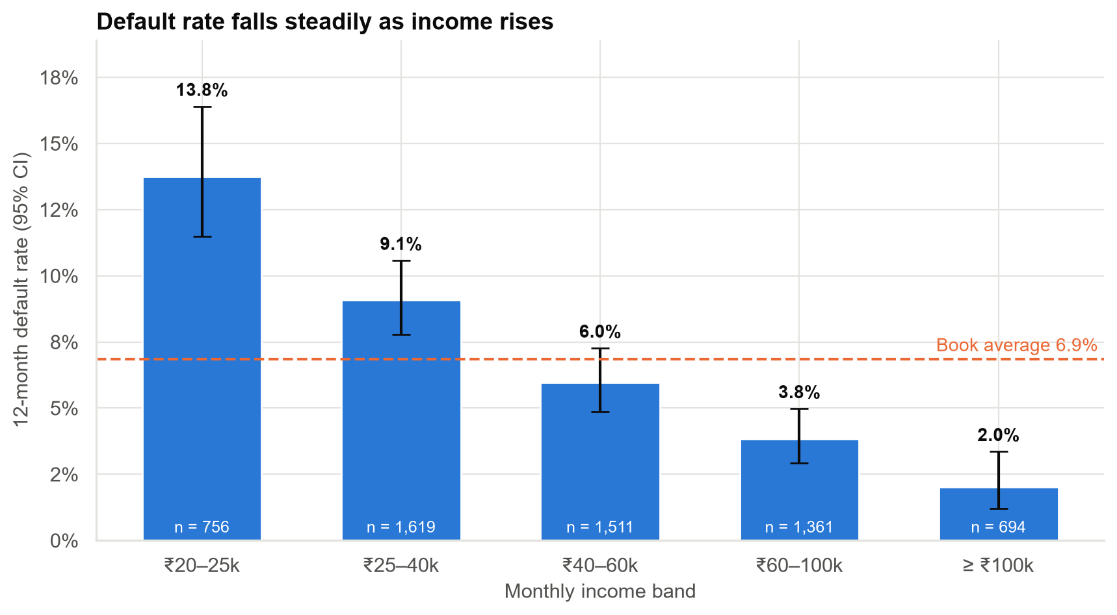
Lower earners do default more, with a steady decline across income bands
• From 13.8% in the lowest band to 2.0% in the highest.
• Every step down in income brings a step up in risk.
• Far too consistent to be the luck of the sample (less than 1-in-a-billion chance).
• Error bars show the likely range for each band.
Income genuinely carries risk information. The question is how best to use it.
Case 02 · Do higher earners default less? · synthetic data
5

Slide 6
How big is the difference? It depends on which way you look at it
2.6×
relative risk under ₹30k
Likely range 2.1–3.1×.
13% vs 5%
default rate below vs above ₹30k
A gap of 8 percentage points.
87%
of under-₹30k customers repay
Most low-income customers are good customers.
43%
of defaulters earn < ₹30k
This is NOT the chance a low earner defaults (that is 13%).
'Most defaulters are low-income' is true, but it does not mean most low-income customers default.
Case 02 · Do higher earners default less? · synthetic data
6

Slide 7
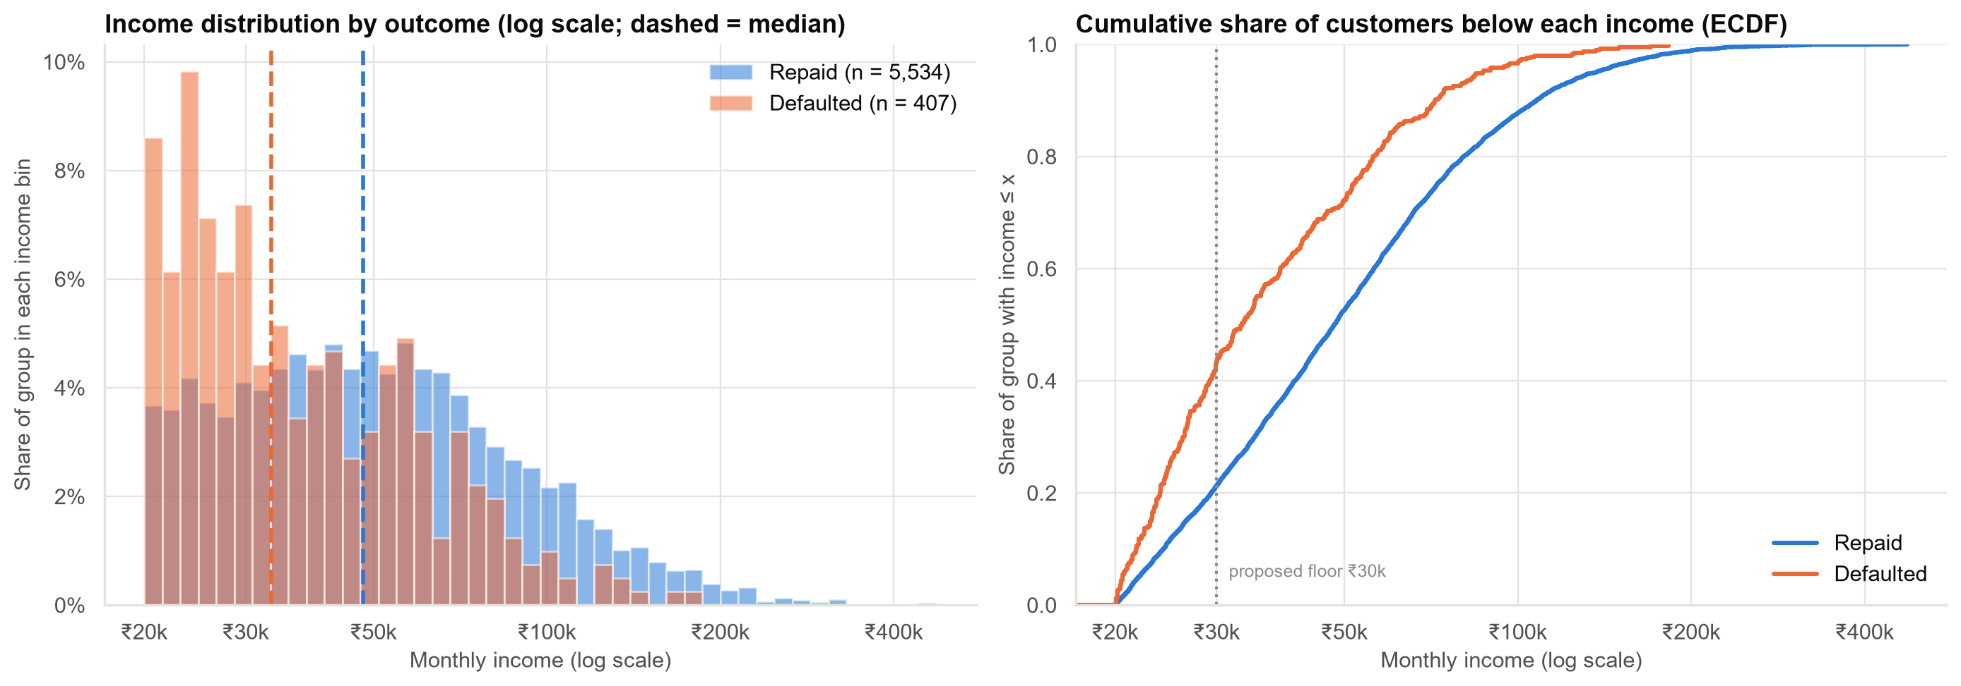
Incomes of defaulters and repayers overlap heavily, so any income cut-off is blunt
• Defaulters' typical income is 26% lower than repayers'.
• But the two groups overlap: many defaulters earn well, and most low earners repay.
• A random defaulter still out-earns a random repayer about 1 time in 3.
Case 02 · Do higher earners default less? · synthetic data
7

Slide 8
Every floor we tested would have lost money on the 2024 book
Income floor | Loans excluded | Defaults avoided | Good customers lost | Good lost per default avoided | Net value (₹ crore)
₹25k | 13% | 104 | 652 | 6.3 | −0.09
₹30k | 23% | 175 | 1,171 | 6.7 | −0.29
₹35k | 32% | 221 | 1,661 | 7.5 | −0.66
₹40k | 40% | 251 | 2,124 | 8.5 | −1.19
The higher the floor, the more good business is lost for each default avoided.
Case 02 · Do higher earners default less? · synthetic data
8

Slide 9
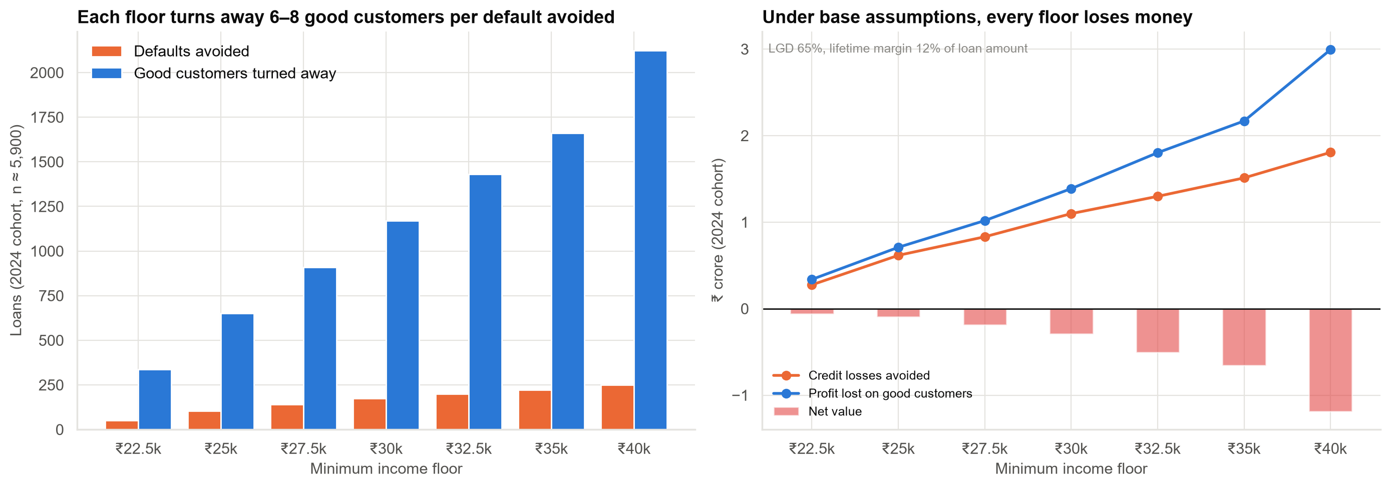
A ₹30k floor saves less in losses than it gives up in profit
₹30k floor: ~175 defaults avoided vs ~1,171 good customers lost. Net ≈ −₹0.3 crore.
Case 02 · Do higher earners default less? · synthetic data
9

Slide 10
The answer hinges on the margin: below ~9.5%, the floor starts to pay
Loss on default (LGD) | Margin 6% | Margin 9% | Margin 12% | Margin 15%
45% | +0.07 | −0.28 | −0.63 | −0.97
55% | +0.24 | −0.11 | −0.46 | −0.80
65% | +0.40 | +0.06 | −0.29 | −0.64
75% | +0.57 | +0.23 | −0.12 | −0.47
85% | +0.74 | +0.40 | +0.05 | −0.30
Net value of the ₹30k floor (₹ crore). Base case: LGD 65%, margin 12%. Ask Finance to confirm the margin before deciding.
Case 02 · Do higher earners default less? · synthetic data
10

Slide 11
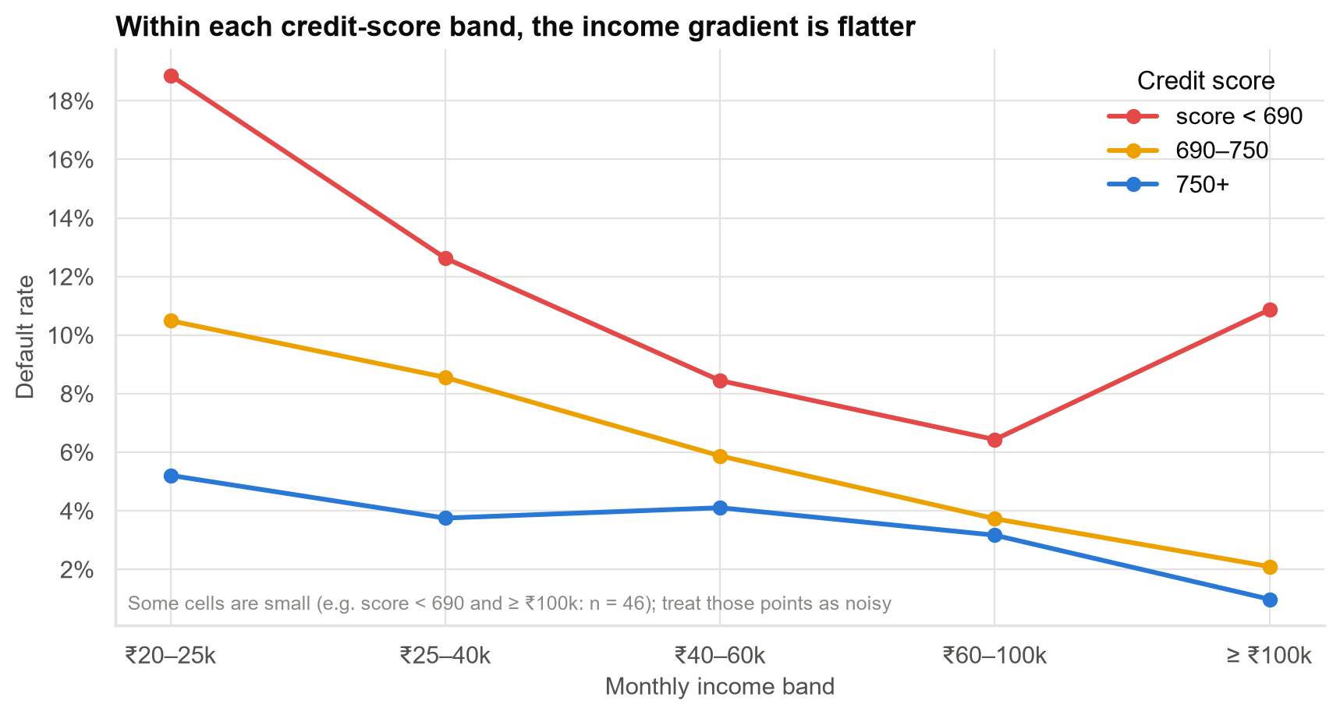
Part of the 'income effect' is really credit score: low earners tend to have weaker scores
• Among customers with similar credit scores, income matters less.
• We already use credit score and debt burden in approvals.
• An income floor would partly double-count risk we already price.
Case 02 · Do higher earners default less? · synthetic data
11

Slide 12
What we can and cannot say
We can say
We cannot say
• Lower-income customers default more, and this is not chance.
• Below ₹30k: 13% default vs 5% above.
• 87% of below-₹30k customers repay.
• A ₹30k floor would very likely reduce value under Finance's assumptions.
• That low income causes default.
• How applicants below ₹20k would perform. We never approved them.
• How much income adds beyond credit score and debt burden.
• That the result holds if the true margin is below ~9.5%.
Case 02 · Do higher earners default less? · synthetic data
12

Slide 13
Recommendations
• Keep the ₹20,000 floor. Do not raise it to ₹30,000 on current evidence.
• Confirm the margin with Finance: if good loans earn under ~9.5% over their life, revisit this.
• Use income more precisely: risk-based pricing, smaller loan sizes or shorter tenures for the ₹20–30k segment.
• Build a combined risk model (income + credit score + debt burden) to measure what income adds.
• Fix the framing: 'most defaulters are low-income' ≠ 'most low-income customers default'.
• If a policy change is still wanted, pilot it in selected regions with a comparison group.
Decision for the Committee: reject the ₹30k floor; approve the combined risk model and a pricing review.
Case 02 · Do higher earners default less? · synthetic data
13

Slide 14
Limitations and next steps
Limitations
Next steps
• Approved loans only: no data below ₹20k.
• Income overlaps with score and debt burden.
• Loss and margin are book-wide Finance assumptions.
• One cohort (2024), one economic environment.
• Weeks 1–4: combined risk model (income, score, debt burden, employment).
• Weeks 2–4: Finance to provide loss and margin by income band.
• Weeks 4–6: pricing proposal for the ₹20–30k segment.
• Optional: regional pilot of any policy change.
Case 02 · Do higher earners default less? · synthetic data
14

