Slide 1
Personal-Loan Email Campaign: What Did It Really Deliver?
Campaign read-out for Marketing leadership · Marketing Analytics
80,000 eligible customers, 15% randomly held out; plus a 360-customer RM-call pilot. Synthetic data created for training. Not actual customer data.

Slide 2
Summary: the email works and pays, but the effect is about +23%, not 3×
• The email increased conversion: 2.23% vs 1.81% for customers who got no email, a gain of 0.42 points (+23%).
• That is about 1 extra loan per 238 emails, roughly 286 extra loans in total.
• It pays: about ₹24 lakh net (likely ₹7–39 lakh). Emails are cheap, so a small lift is enough.
• The '3× for openers' figure is misleading. People who open emails are engaged customers who borrow more anyway.
• The RM-call pilot is too small to judge: promising, but not proven.
Recommendation: repeat the campaign with a holdout every time; do not double the budget on the '3×' figure.
Case 03 · Did the email campaign increase conversions? · synthetic data
2

Slide 3
Two questions from Marketing
What Marketing asked
Why we could answer properly
• Did the email campaign increase personal-loan take-up?
• Openers converted ~3× more: should we double the email budget?
• Should we scale the relationship-manager (RM) call pilot?
• 15% of eligible customers were randomly held back from the email.
• Random selection makes the two groups alike in every way except the email.
• So the difference between them measures what the email caused.
The holdout group is the most valuable part of the campaign design: without it, we could not measure the effect.
Case 03 · Did the email campaign increase conversions? · synthetic data
3

Slide 4
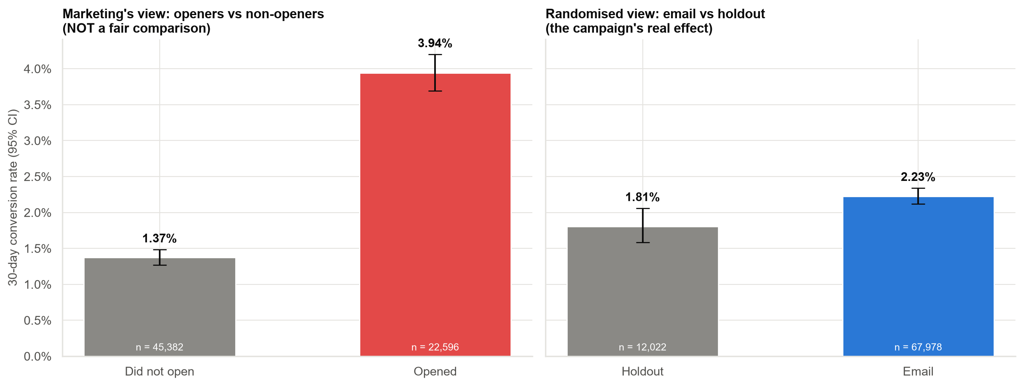
Comparing openers with non-openers exaggerates the effect; the random holdout gives the true picture
• Left: openers vs non-openers, about 3×. But customers chose whether to open.
• Right: email vs random holdout: 2.23% vs 1.81%.
• Only the right-hand comparison is fair.
Case 03 · Did the email campaign increase conversions? · synthetic data
4

Slide 5
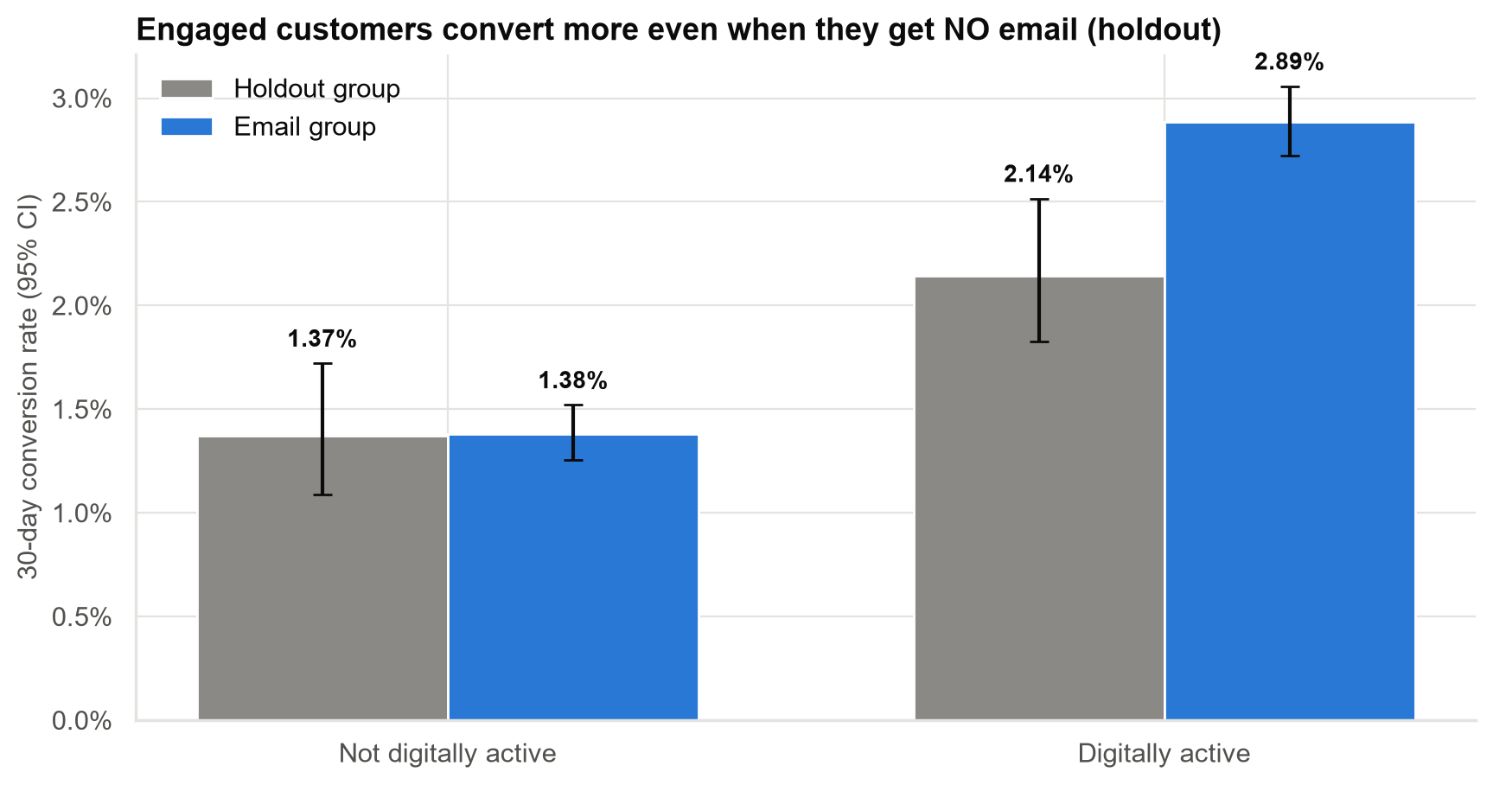
Why openers look so good: engaged customers borrow more even without any email
• In the holdout (no email), digitally active customers converted ~1.5× more than inactive ones.
• Engaged customers both open emails and take loans anyway.
• The email's real effect on openers: about 1.3 points, not the 2.6-point gap the dashboard shows.
Case 03 · Did the email campaign increase conversions? · synthetic data
5

Slide 6
The real effect: modest, clearly positive, and causal
+0.42 pts
conversion lift
Likely range +0.14 to +0.67 points.
+23%
relative lift
Likely range +7% to +42%.
~286
extra loans
Likely 98–456, caused by the email.
< 1 in 250
chance of a fluke
If the email did nothing, a gap this big would almost never appear.
Report this as '+0.4 points (+23%)'. Relative lifts sound bigger than they are when the base rate is ~2%.
Case 03 · Did the email campaign increase conversions? · synthetic data
6

Slide 7
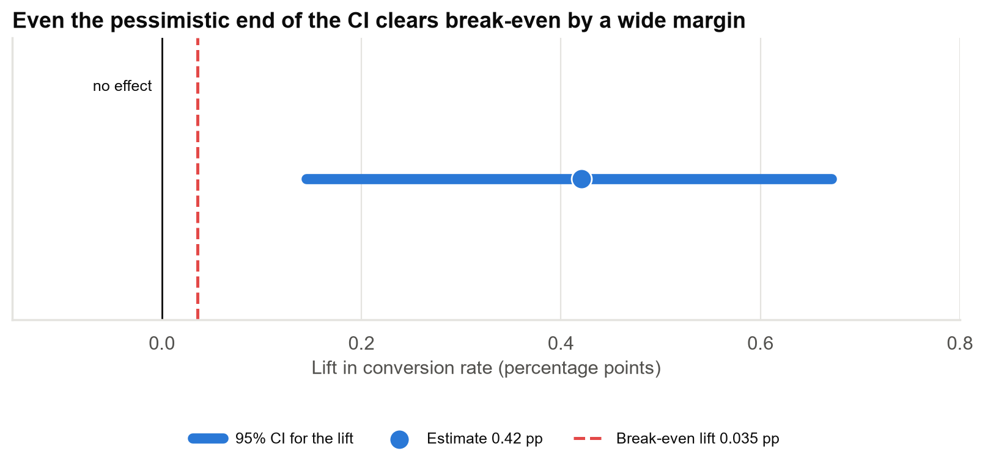
Even the most pessimistic estimate clears break-even many times over
Break-even needs only +0.035 points; the worst plausible lift is about 4× that.
Case 03 · Did the email campaign increase conversions? · synthetic data
7

Slide 8
The campaign returned about 12× its cost
Item | Estimate | Likely range
Emails sent | 67,978 | –
Campaign cost | ₹2.2 lakh | –
Extra loans caused by the email | ~286 | 98 – 456
Value per extra loan | ₹9,000 (Finance) | –
Net value | ₹24 lakh | ₹7 – ₹39 lakh
Cheap channel, positive effect, robust profit. The case for repeating the email is strong.
Case 03 · Did the email campaign increase conversions? · synthetic data
8

Slide 9
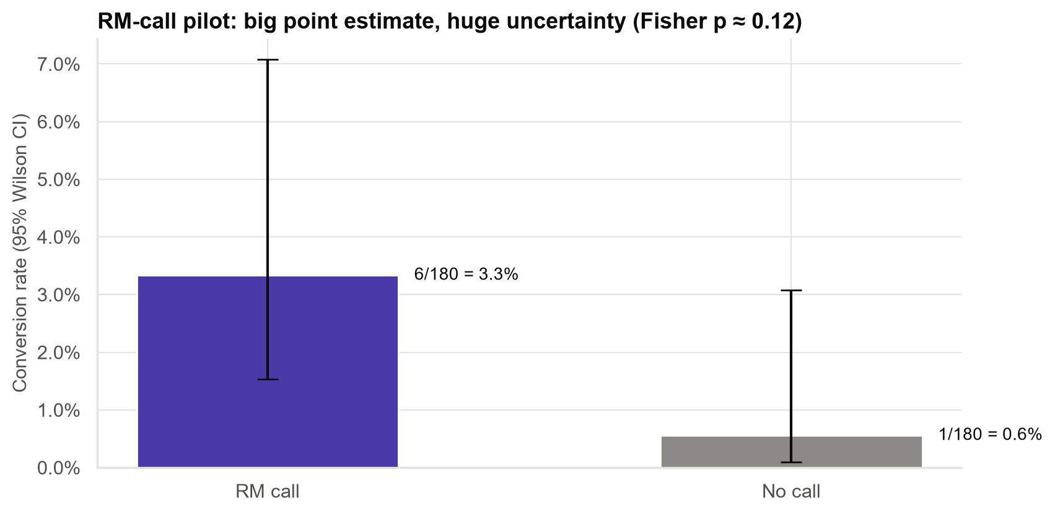
RM-call pilot: an encouraging signal, but far too small to be sure
• Called: 3.3% converted; not called: 0.6%.
• That is 6 vs 1 customers: too few to separate a real effect from luck.
• Plausible effect: anywhere from about −0.3 to +6.6 points.
• 'Not proven' ≠ 'doesn't work'. It means 'test properly'.
Run a larger, properly sized pilot before committing RM time.
Case 03 · Did the email campaign increase conversions? · synthetic data
9

Slide 10
What we can and cannot say
We can say
We cannot say yet
• The email caused a modest rise in loan take-up.
• The campaign was profitable, even in the pessimistic case.
• The 'openers 3×' comparison overstates the effect.
• Whether RM calls work: the pilot is too small.
• Whether the lift holds for repeated campaigns (fatigue).
• How much is truly new business vs loans brought forward a few weeks.
Case 03 · Did the email campaign increase conversions? · synthetic data
10

Slide 11
Recommendations
• Repeat the email campaign, always with a random holdout, so every send is measured.
• Do not double the budget on the basis of the openers comparison. Test frequency and targeting first.
• Fix the dashboard: report email vs holdout with a likely range, not openers vs non-openers.
• RM calls: run a larger pilot (sized in advance) before scaling.
• Measure at 60–90 days to check how much of the lift is pulled forward.
Decision for Marketing: approve the next send with a holdout; approve a properly sized RM pilot.
Case 03 · Did the email campaign increase conversions? · synthetic data
11

Slide 12
Limitations and next steps
Limitations
Next steps
• One campaign, 30-day window.
• Loan value and costs are Finance estimates.
• Engagement finding not planned in advance.
• A repeat could land anywhere from ~+0.15 to ~+0.7 points.
• Next send: same design, with holdout.
• Targeting test: engaged vs non-engaged customers.
• RM pilot sized for a conclusive answer.
• 60/90-day follow-up on conversions.
Case 03 · Did the email campaign increase conversions? · synthetic data
12

