Slide 1
One-Tap Checkout: Test Design and Results
Ship / no-ship read-out for Product leadership · Payments Data Science
14-day randomised test on 10% of app traffic (~66,000 users). Synthetic data created for training. Not actual customer data.

Slide 2
Summary: one-tap works for most users, crashes old Android apps, and may fall short of the 1-point bar
• For v5+ app users (91% of users): checkout completion rose from 70.3% to 71.4%, a gain of +1.0 point (likely +0.3 to +1.8).
• It is real (not a fluke), and payment errors did not increase.
• But we cannot confirm it reaches leadership's 1-point bar: the likely range straddles it.
• Old Android app (pre-v5): one-tap crashes for about a third of users. About 1,270 users silently dropped out of the test.
• Stopping on day 3 would have overstated the gain (+1.8 vs +1.0 points).
Recommendation: ship to v5+ with a 5% holdout; block pre-v5 until the crash is fixed.
Case 04 · Checkout A/B test: design and read-out · synthetic data
2

Slide 3
What we were asked, and when
Before the test
During and after
• How long must we run to detect a 1-point gain?
• Can we do it in a week?
• Day 3: '+1.8 points, p = 0.03. Can we stop and ship?'
• Day 14: the dashboard flags a 'sample ratio mismatch'. Can we trust the test?
• Did one-tap work? Is it at least 1 point? Is it safe for everyone?
Case 04 · Checkout A/B test: design and read-out · synthetic data
3

Slide 4
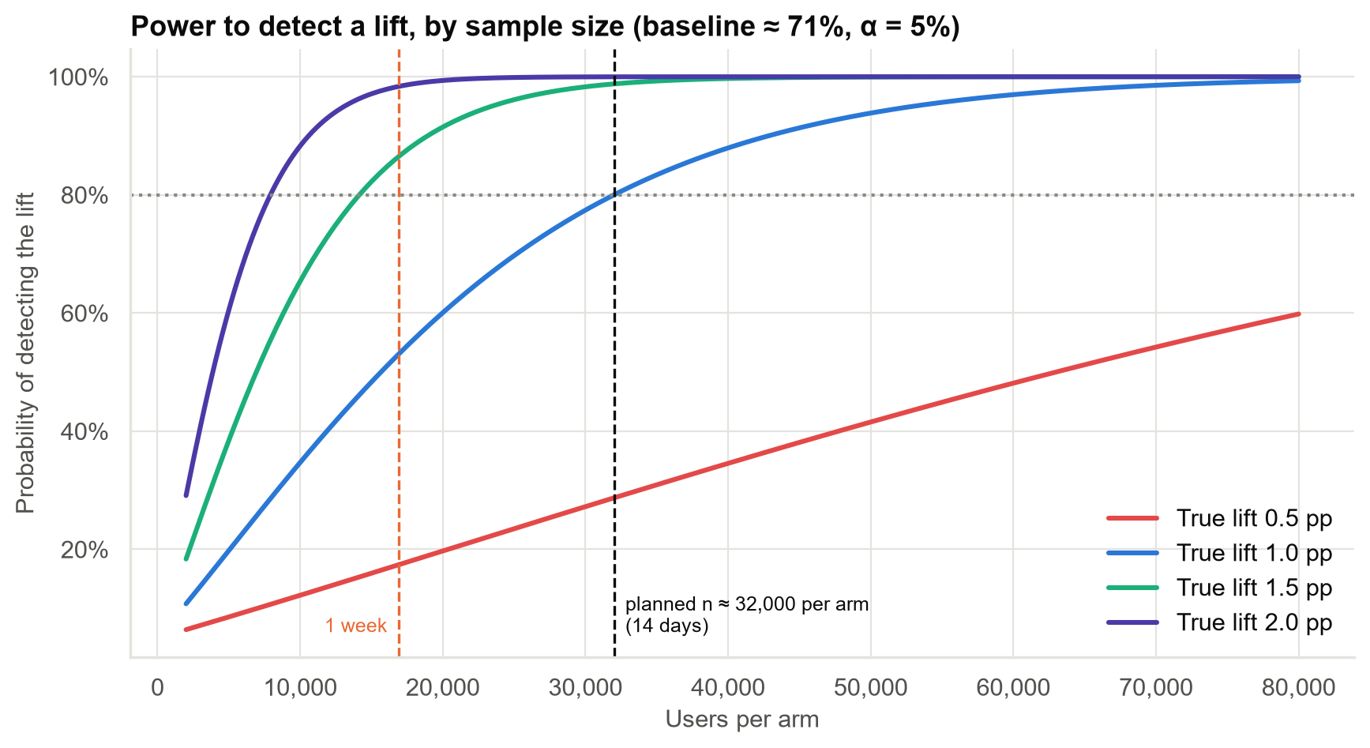
Two full weeks were needed; one week would have missed a real 1-point gain half the time
• Needed: about 32,000 users per group, i.e. 14 days at 10% of traffic.
• After one week: only a 53% chance of detecting a real 1-point gain.
• Always run whole weeks: weekends behave differently.
Case 04 · Checkout A/B test: design and read-out · synthetic data
4

Slide 5
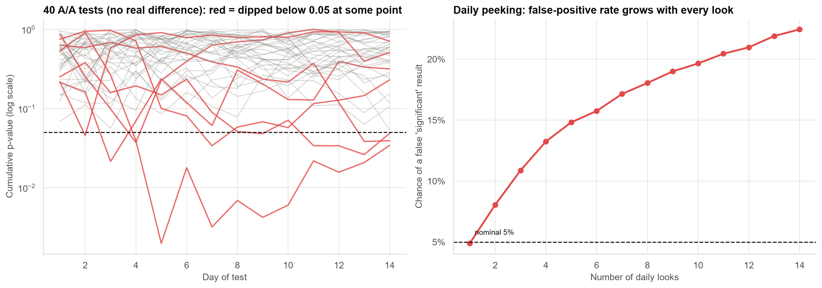
Checking daily and stopping at the first 'significant' result gives false wins 22% of the time
Rule: decide the test length in advance and judge once at the end. Day-3 'significance' is not evidence.
Case 04 · Checkout A/B test: design and read-out · synthetic data
5

Slide 6
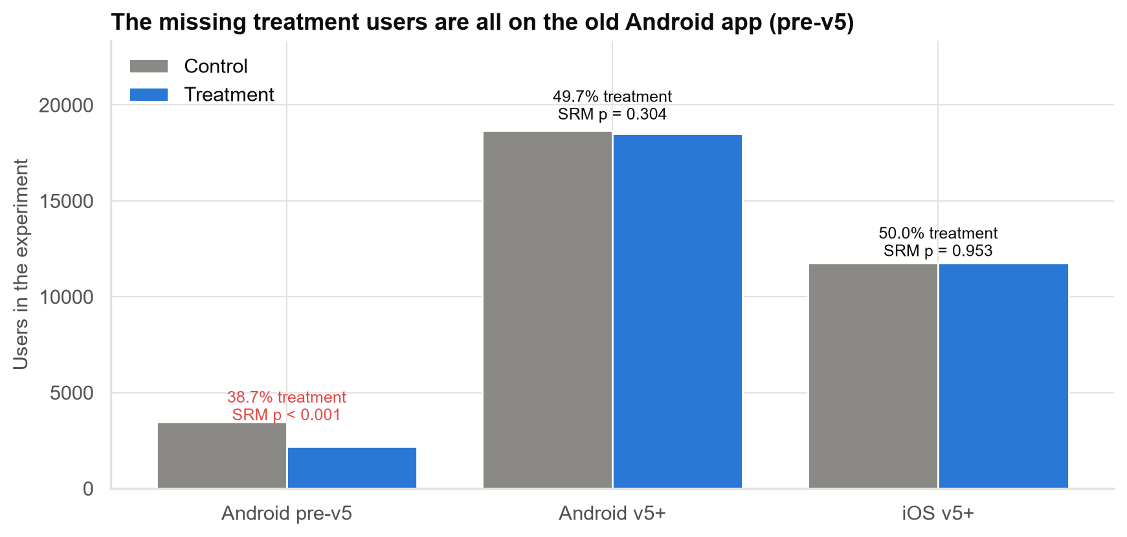
The test was partly broken: the new screen crashes on the old Android app
• Expected a 50/50 split; pre-v5 had only 39% in the new design.
• About 1,270 pre-v5 users crashed before being counted.
• Those who got through saw 3× more payment errors.
• Newer app versions and iOS were unaffected and split evenly.
One-tap must not reach pre-v5 users until the crash is fixed. Add automatic split-ratio alerts.
Case 04 · Checkout A/B test: design and read-out · synthetic data
6

Slide 7
Result for v5+ users: a real gain of about one point, with no harm to payments
+1.04 pts
checkout completion
Likely range +0.3 to +1.8 points.
+1.5%
relative gain
From 70.3% to 71.4%.
~1 in 200
chance it's a fluke
If one-tap did nothing, a gain this big would rarely appear.
−0.10 pts
payment errors
No increase; any rise larger than ~0.13 points is ruled out.
Case 04 · Checkout A/B test: design and read-out · synthetic data
7

Slide 8
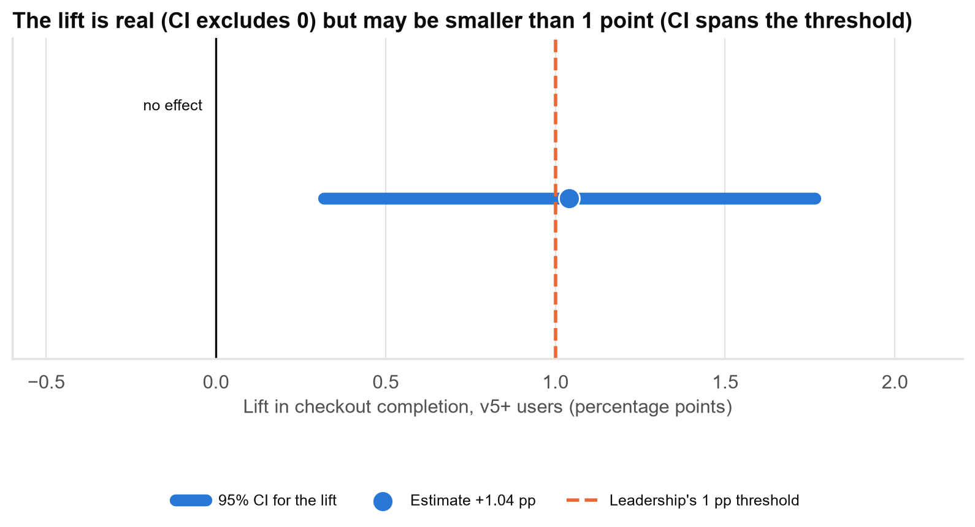
Real, yes. At least one point? We can't tell yet
The likely range clears zero but straddles the 1-point bar, so the bar is neither met nor missed with confidence.
Case 04 · Checkout A/B test: design and read-out · synthetic data
8

Slide 9
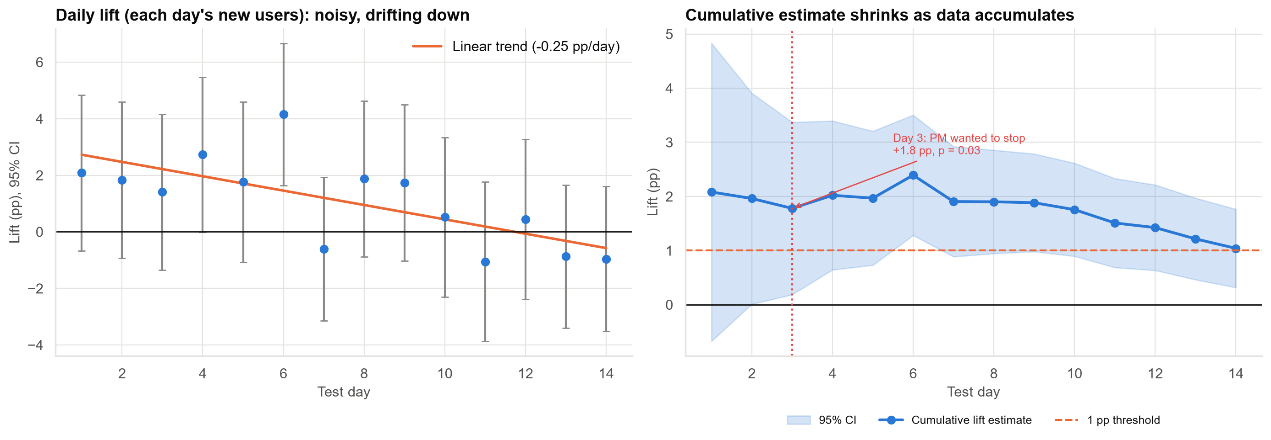
Early results overstated the gain: the effect settled as the novelty wore off
Day 3 showed +1.8 points; the full test shows +1.0. Business cases should use full-test numbers.
Case 04 · Checkout A/B test: design and read-out · synthetic data
9

Slide 10
What a one-point gain is worth
₹17 lakh
per year (estimate)
Net revenue from extra completed payments, v5+ users, full traffic.
₹5–28 lakh
likely range
Reflects the uncertainty in the lift.
No
rise in payment errors
No guardrail harm for v5+ users.
A modest but positive return with little downside, provided pre-v5 users are excluded.
Case 04 · Checkout A/B test: design and read-out · synthetic data
10

Slide 11
Decision options for leadership
Option A (recommended): ship to v5+ now
Option B: extend the test 2 weeks
• Roll out to v5+ users, keeping 5% on the old flow for 4–6 weeks.
• Confirms the settled gain with no further delay.
• Accepts that the gain may be somewhat under 1 point.
• Roughly halves the uncertainty around the 1-point bar.
• Delays any benefit by 2+ weeks.
• Pre-v5 must be fixed and excluded either way.
Either way: block pre-v5, fix the crash, re-test it, and add split-ratio alerts.
Case 04 · Checkout A/B test: design and read-out · synthetic data
11

Slide 12
Process changes we recommend for every future test
• Pre-register the metric, the minimum gain that matters, and the test length.
• Run whole weeks, sized by a power calculation, not by impatience.
• No ship decisions on interim p-values. Use sequential rules if early stopping is needed.
• Check the split ratio first: a mismatch means something is broken.
• Keep a holdout after launch to measure the long-run effect.
Case 04 · Checkout A/B test: design and read-out · synthetic data
12

Slide 13
Limitations and next steps
Limitations
Next steps
• Two weeks may not show the long-run effect.
• Result applies to v5+ users only.
• First checkout only; repeat use not measured.
• Revenue uses Finance's ₹10 per payment.
• Fix pre-v5 crash; re-test that segment.
• Holdout read-outs at 4 and 8 weeks.
• Measure repeat bill payments.
• Use pre-test history (CUPED) to shorten future tests.
Case 04 · Checkout A/B test: design and read-out · synthetic data
13

