Slide 1
Three Growth Proposals, Three Misleading Correlations
Review of the card-spend growth plan for the Head of Cards · Cards Analytics
6,000 cardholders and 36 months of portfolio data. Synthetic data created for training. Not actual customer data.

Slide 2
Summary: none of the three correlations supports the decision built on it
• Raise all limits by 30%? Limits and spend move together mainly because income drives both, and because we raise limits for big spenders. Expected gain: about +1.5% of spend, not +27%.
• App users spend less? Only because Mass customers log in more. Within every customer group, app users spend more.
• Age doesn't matter? It does: spending peaks in the early 40s. A simple correlation cannot see a curve.
• Marketing drives spend (r = 0.91)? Both just grew over time. Month to month, they are unrelated.
Recommendation: no blanket limit increase; keep app investment and age targeting; test changes before rolling them out.
Case 05 · What correlation can and cannot tell you · synthetic data
2

Slide 3
A correlation describes the past; a decision needs to know what changes if we act
What a correlation can tell us
What it cannot tell us
• Two things tend to move together.
• How strongly, in the data we have.
• Why they move together.
• Which one drives the other.
• What happens if we change one of them.
Before acting on any correlation, ask: could a third factor, or the reverse direction, explain it?
Case 05 · What correlation can and cannot tell you · synthetic data
3

Slide 4
Even the strength of the correlation depended on data problems
0.41
with data errors
15 spends keyed in paise made the link look weak.
0.86
with corporate cards
12 special cards made it look stronger.
0.70
robust measure
Rank-based correlation: unaffected either way.
27 unusual rows out of 6,000 swung the dashboard number. Robust measures and a look at the data come first.
Case 05 · What correlation can and cannot tell you · synthetic data
4

Slide 5
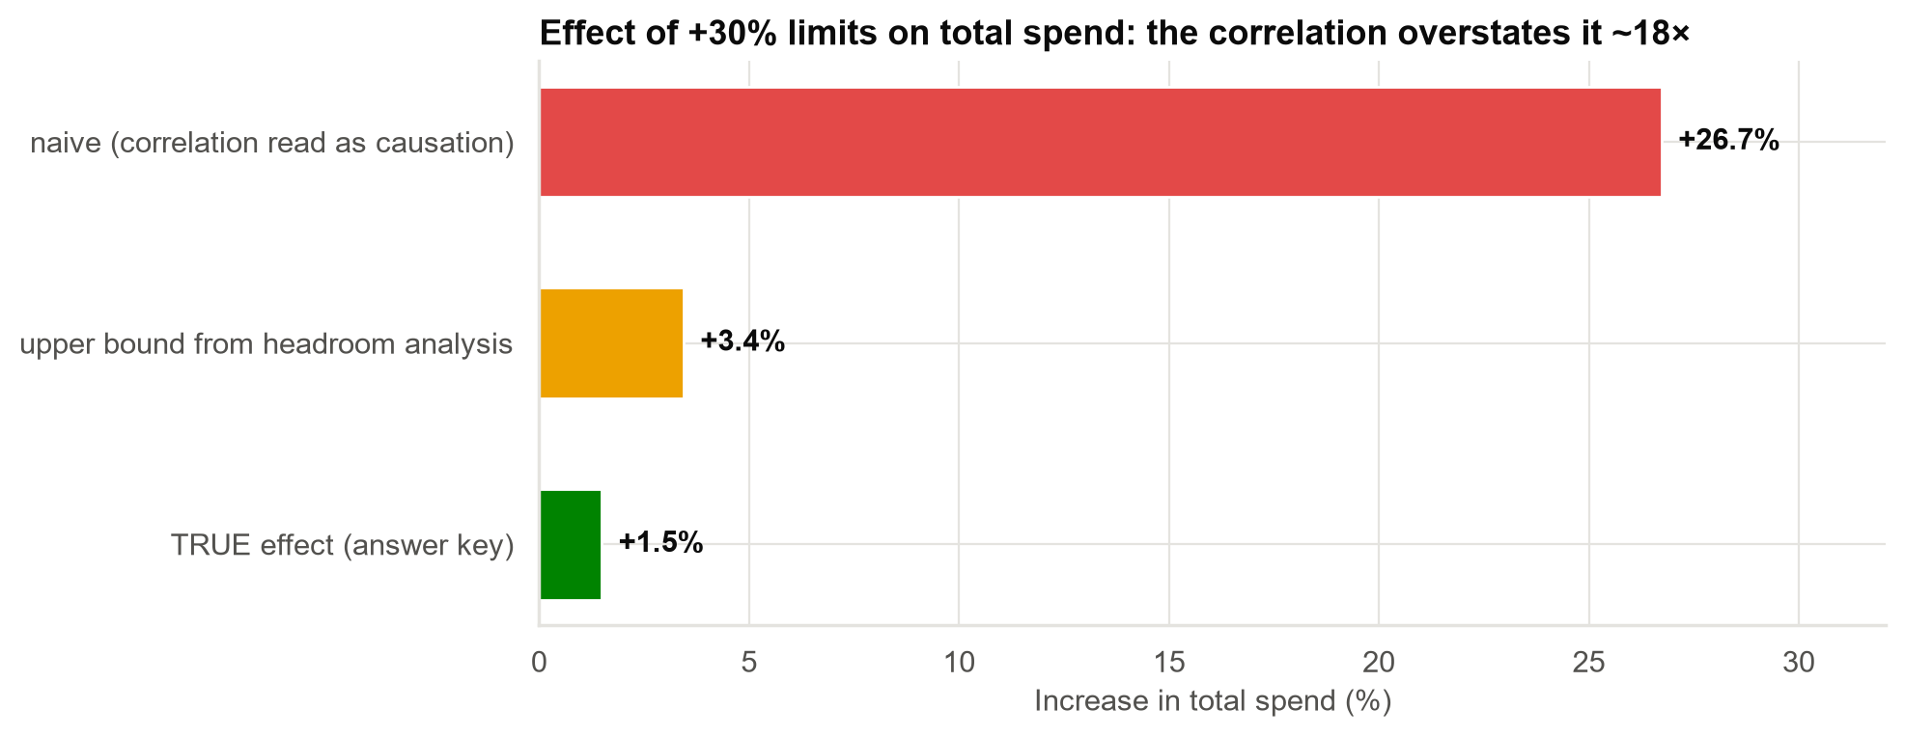
Raising limits for everyone would add about 1.5% to spend, not 27%
• Income drives both the limit we set and what customers spend.
• We already raise limits for heavy users: they spend 2.1× more.
• Most customers use only 15–35% of their limit, so a higher limit changes nothing for them.
A blanket increase adds credit risk on the whole book to gain spend from about 1 customer in 20.
Case 05 · What correlation can and cannot tell you · synthetic data
5

Slide 6
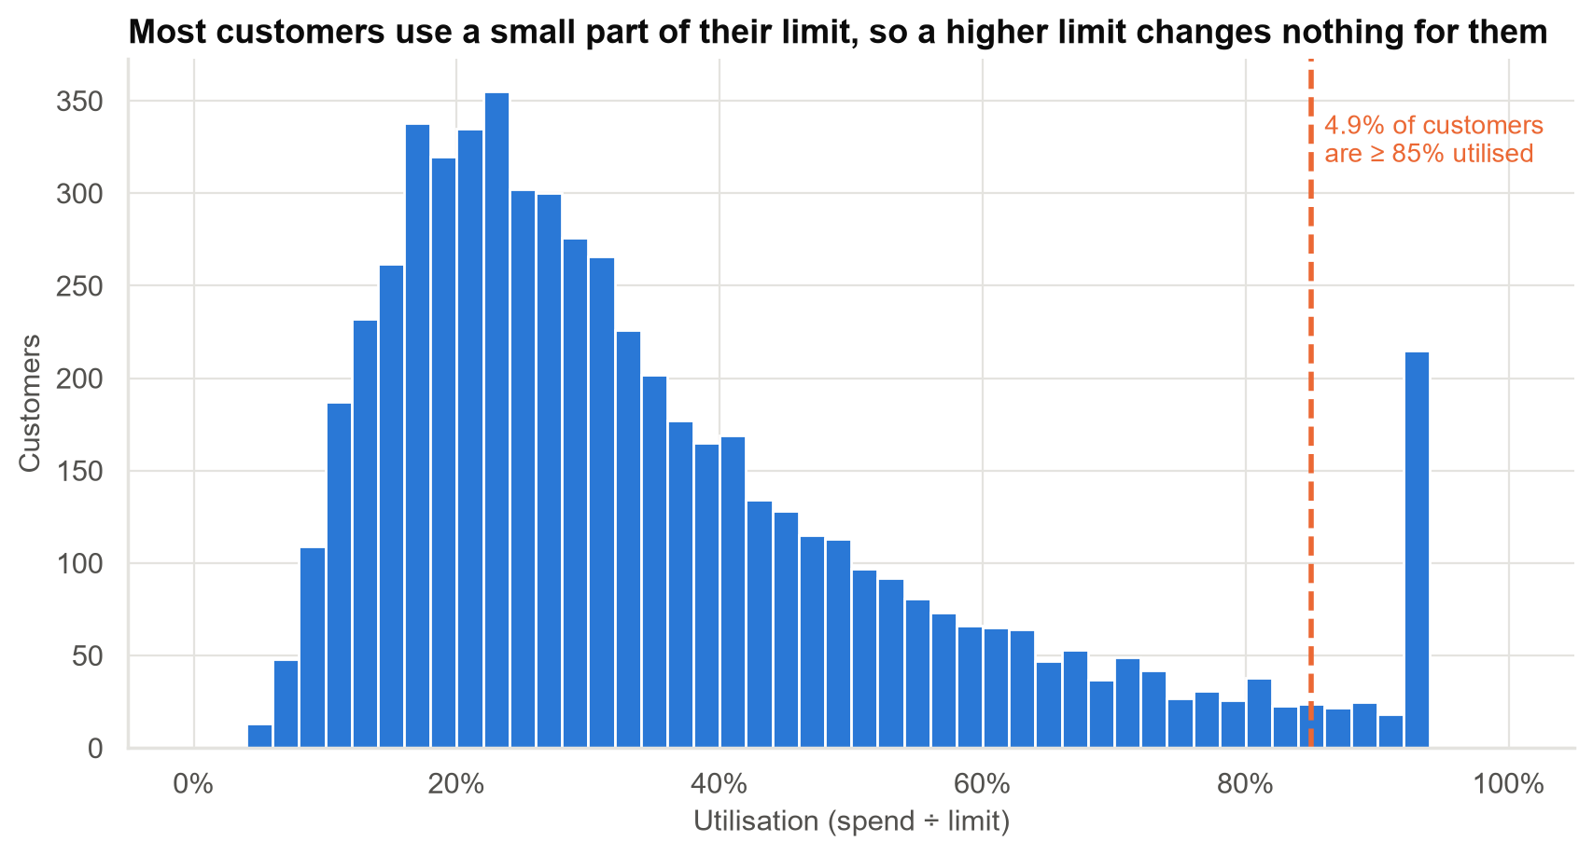
Most customers are nowhere near their limit
Only the small group at the right could spend more with a higher limit. Target and test them instead.
Case 05 · What correlation can and cannot tell you · synthetic data
6

Slide 7
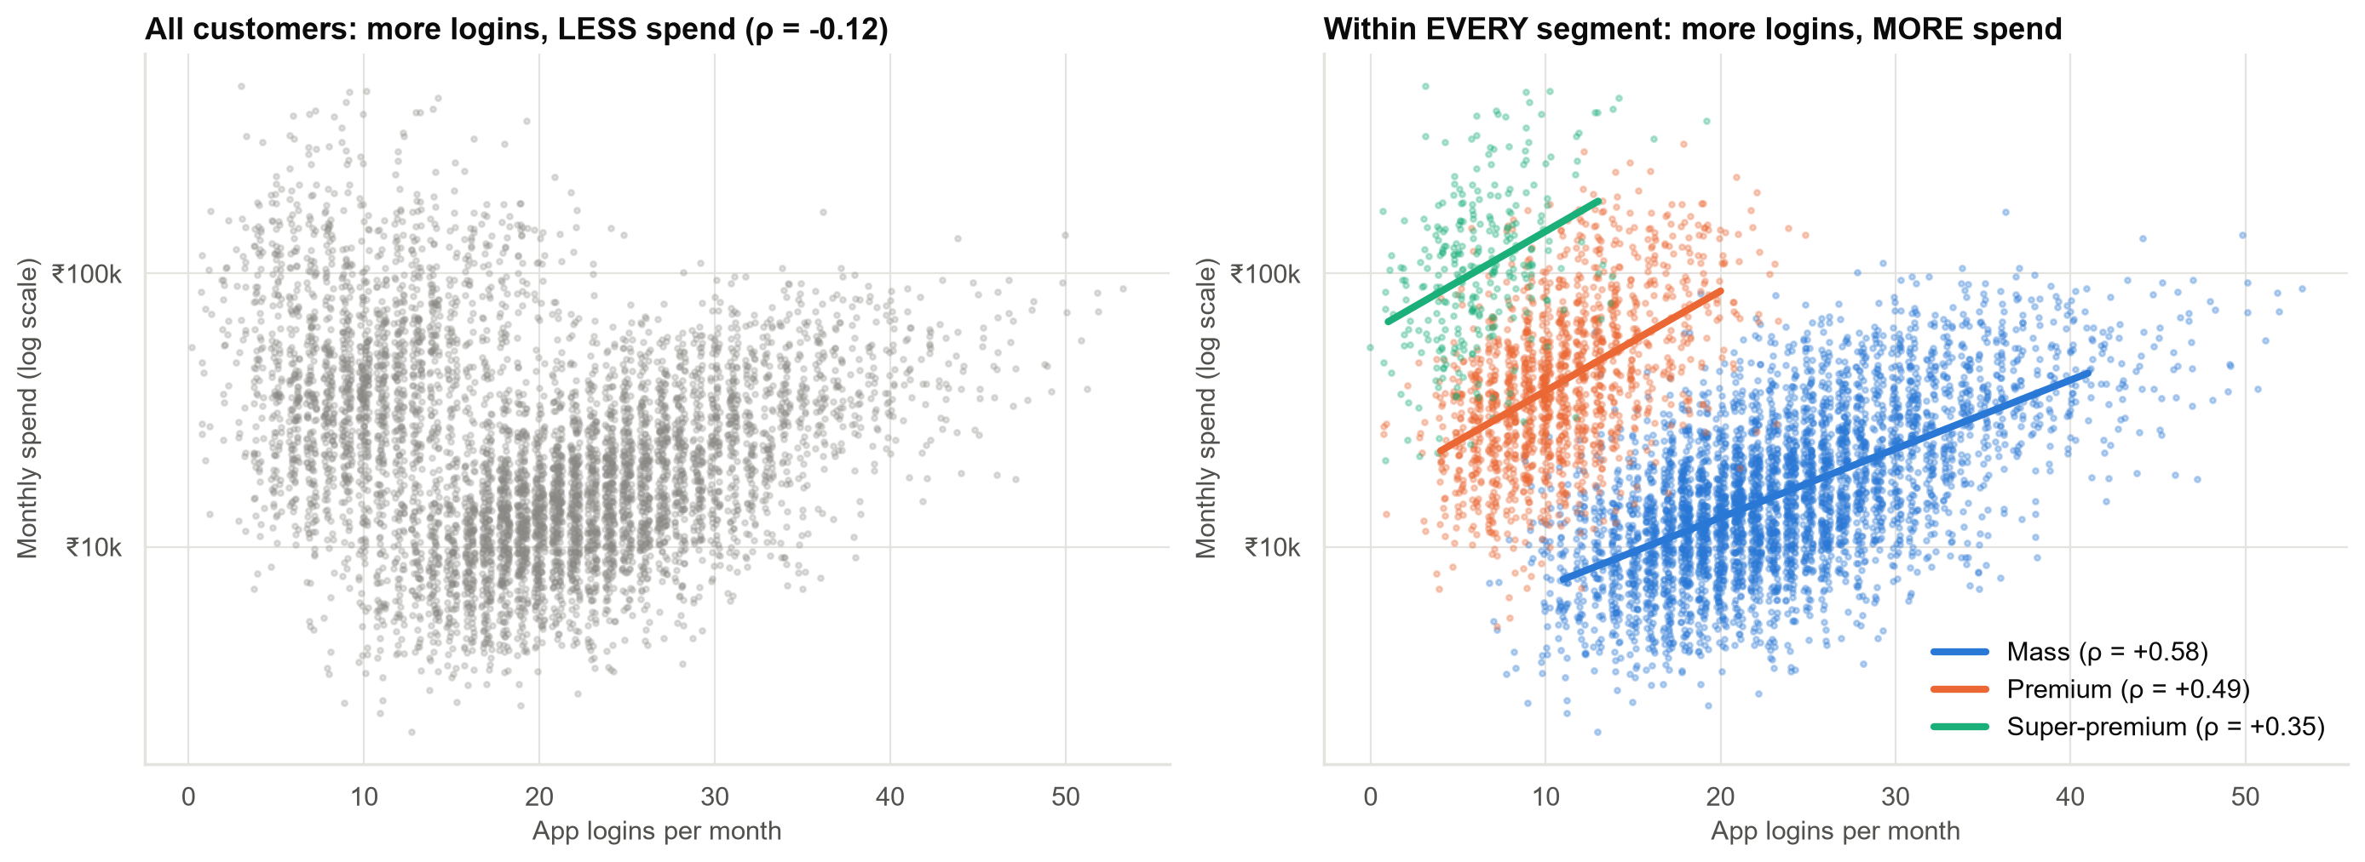
App users spend MORE within every customer group; the opposite pooled pattern is a mix-up of segments
Pooled: −0.12. Within segments: +0.35 to +0.58. Mass customers log in most but spend least.
Case 05 · What correlation can and cannot tell you · synthetic data
7

Slide 8
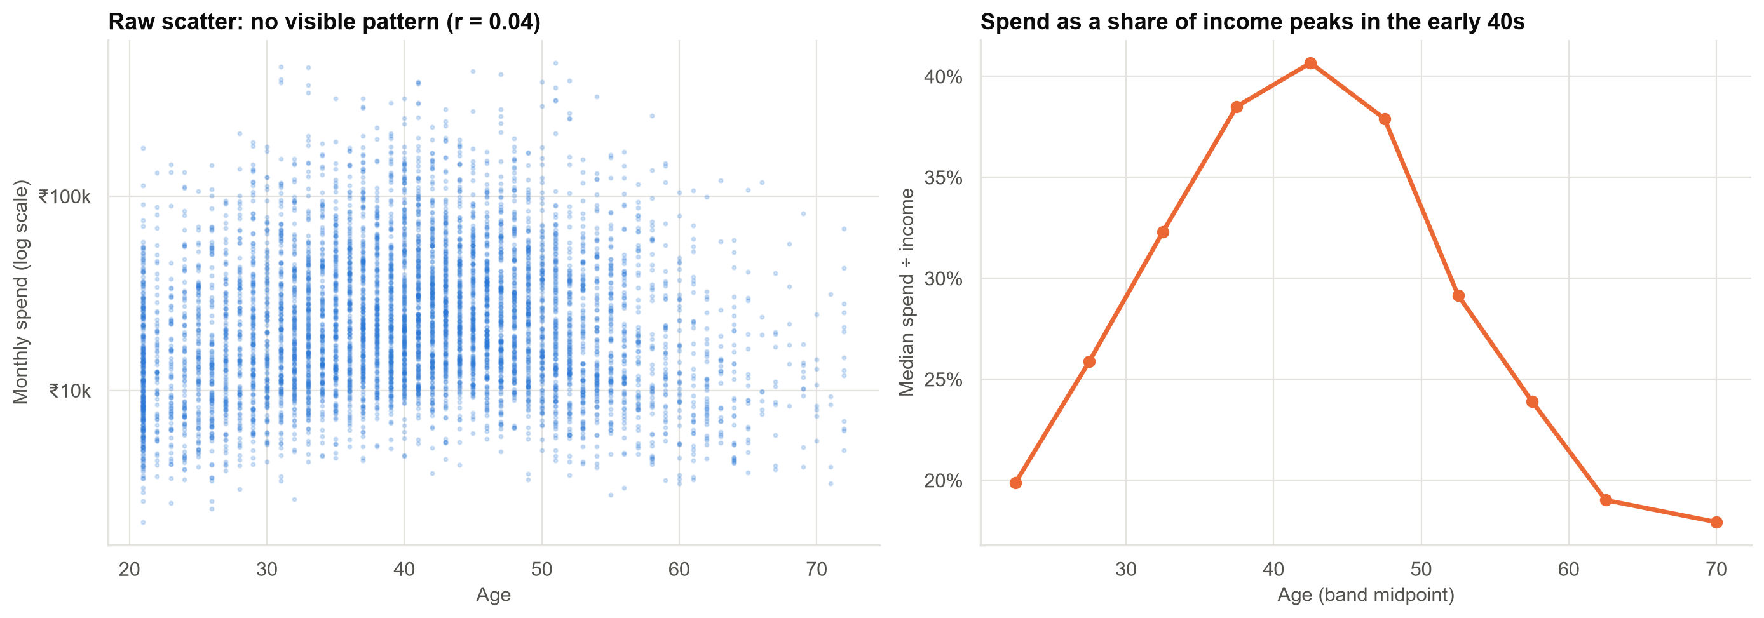
Age matters: spending (relative to income) peaks in the early 40s
Correlation measures straight lines only. A rise-then-fall pattern shows up as 'zero correlation'.
Case 05 · What correlation can and cannot tell you · synthetic data
8

Slide 9
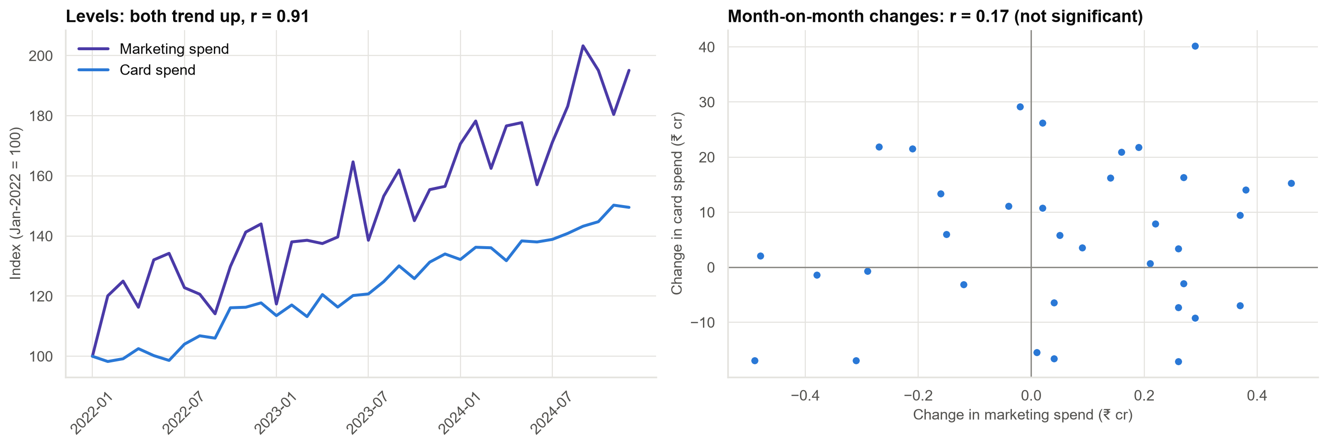
Marketing and card spend both grew, but month-to-month they don't move together
Any two growing numbers correlate. Measuring marketing's effect needs a proper marketing-mix analysis.
Case 05 · What correlation can and cannot tell you · synthetic data
9

Slide 10
Recommendations
• No blanket limit increase. Run a randomised test of limit increases for near-limit, low-risk customers, measuring spend and losses.
• Keep the app budget. Test app campaigns with a holdout group to measure their real effect.
• Keep life-stage (age) targeting: mid-career customers spend the most.
• Fix the dashboard: correct the paise error, report corporate cards separately, show scatter plots and robust correlations.
• Commission a marketing-mix analysis before claiming marketing drives spend.
Decision: reject proposals 1–3 as stated; approve two small experiments that measure real effects.
Case 05 · What correlation can and cannot tell you · synthetic data
10

Slide 11
Limitations and next steps
Limitations
Next steps
• Snapshot data (6-month averages).
• Engagement measured only by logins.
• Only 36 months for the marketing question.
• Design the limit-increase test (sample size, risk guardrails).
• App campaign test with holdout.
• Spend model with income, age and segment.
Case 05 · What correlation can and cannot tell you · synthetic data
11

