Slide 1
A Simple, Honest Loan Pre-Offer Rule for Branches
Recommendation for the Head of Personal Loans · Lending Analytics
Based on 3,000 personal loans disbursed in the last six months. Synthetic data created for training. Not actual customer data.

Slide 2
Summary: customers borrow roughly a fixed number of months of income, give or take 50%
• Each extra ₹10,000 of monthly income goes with about ₹26,000 more borrowing on average (likely ₹25,000–₹28,000).
• Better rule of thumb: 10% more income → about 9% more loan. Loans scale with income.
• Income explains about 59% of loan sizes. A typical customer borrows within ×/÷ 1.5 of the suggested amount.
• Show branches a realistic range, not just one number. On new loans our 80% range held 73%–86% of the time in every income band.
Recommendation: roll out the pre-offer table below for incomes up to ₹4 lakh/month; above that, offer the cap and refer to an RM.
Case 06 · Predicting loan amount from income · synthetic data
2

Slide 3
What the data shows
3,000
recent personal loans
With verified monthly income and the amount taken.
59%
explained by income
The rest depends on debts, purpose, job type, etc.
0.92
elasticity
1% more income → about 0.9% more loan.
×/÷ 1.5
typical spread
How far a real customer is from the suggested amount.
Case 06 · Predicting loan amount from income · synthetic data
3

Slide 4
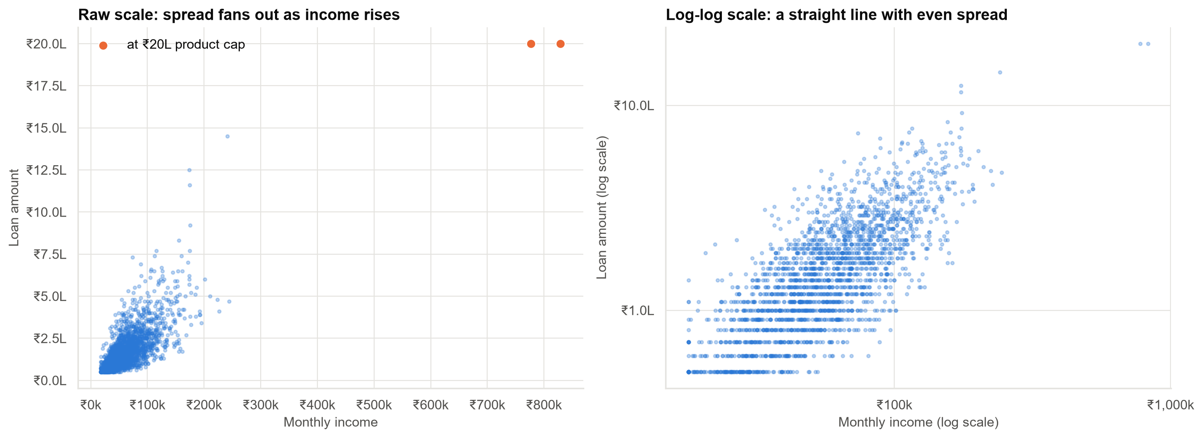
Loan amounts scale with income, and so does the spread between customers
Customers vary by similar PERCENTAGES around the typical amount, so ranges must be in percentages too.
Case 06 · Predicting loan amount from income · synthetic data
4

Slide 5
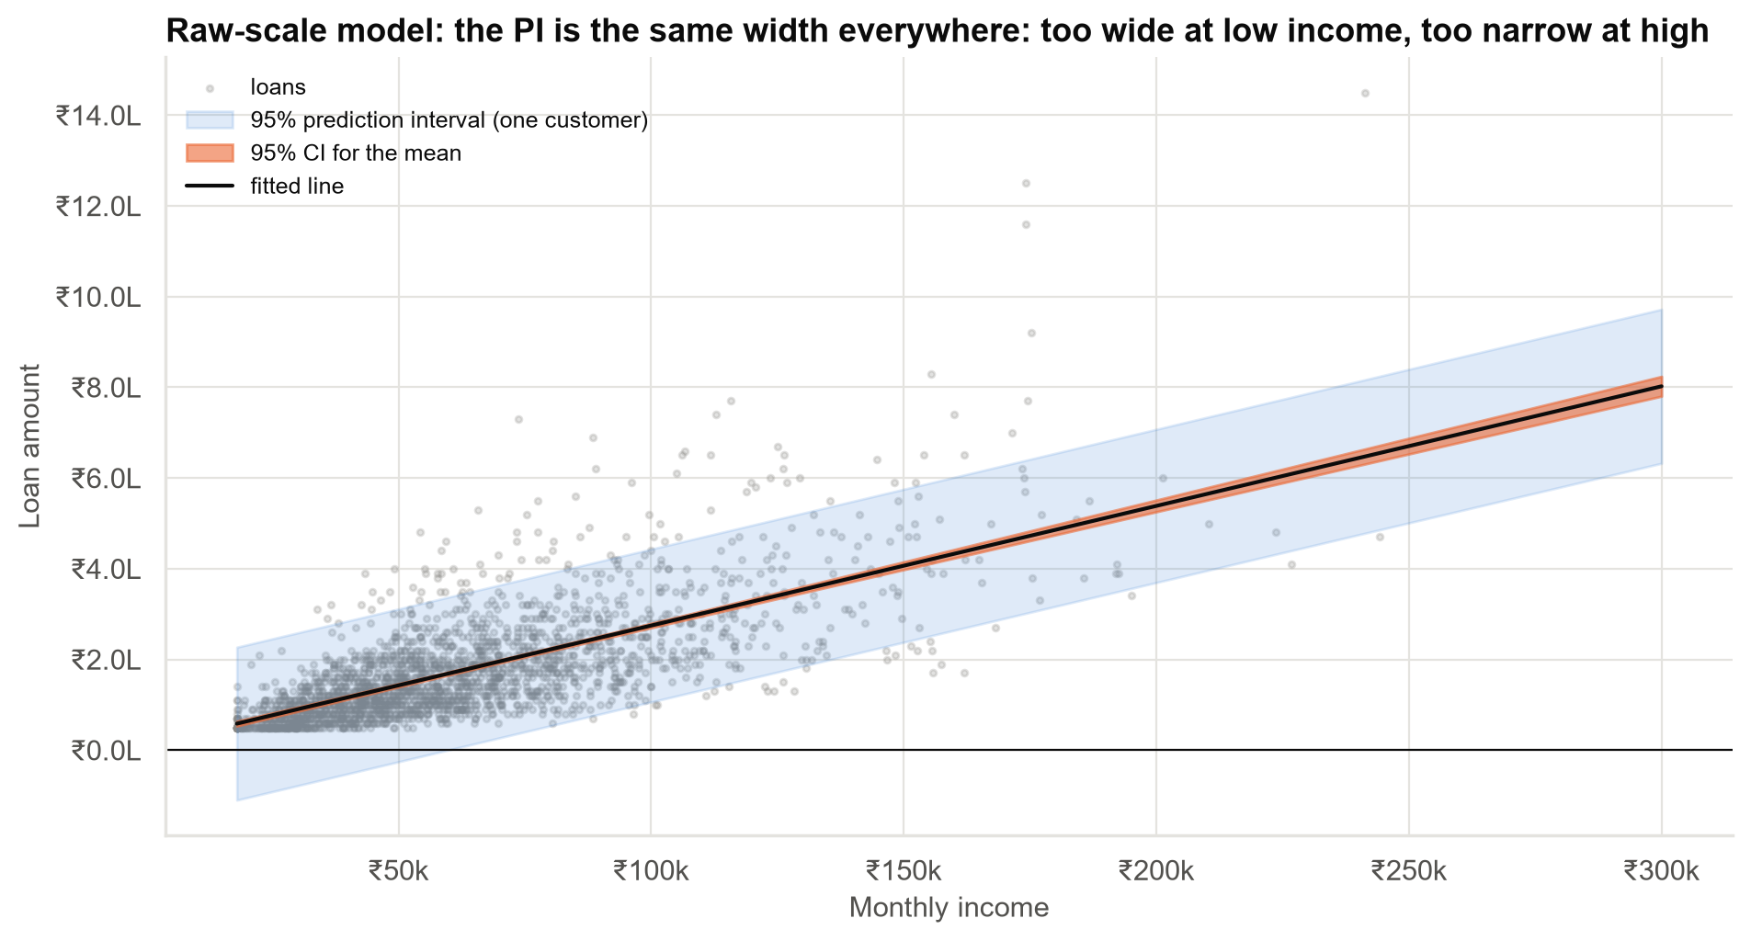
A straight-line rule gives the wrong ranges: too wide for small loans, too narrow for large ones
• The thin orange band is the average customer: precise, but not what branches need.
• The wide blue band is one customer, and it even goes below zero at low incomes.
• The spread in the data clearly widens with income. The straight-line rule ignores that.
Case 06 · Predicting loan amount from income · synthetic data
5

Slide 6
The pre-offer table for branch staff
Monthly income | Suggested offer | Most customers borrow between (80%)
₹25,000 | ₹70,000 | ₹40,000 – ₹120,000
₹40,000 | ₹110,000 | ₹60,000 – ₹180,000
₹60,000 | ₹160,000 | ₹90,000 – ₹260,000
₹100,000 | ₹250,000 | ₹150,000 – ₹420,000
₹150,000 | ₹360,000 | ₹220,000 – ₹610,000
₹250,000 | ₹580,000 | ₹340,000 – ₹980,000
Suggest the middle number; expect most customers to land within the range. Round to the nearest ₹10,000.
Case 06 · Predicting loan amount from income · synthetic data
6

Slide 7
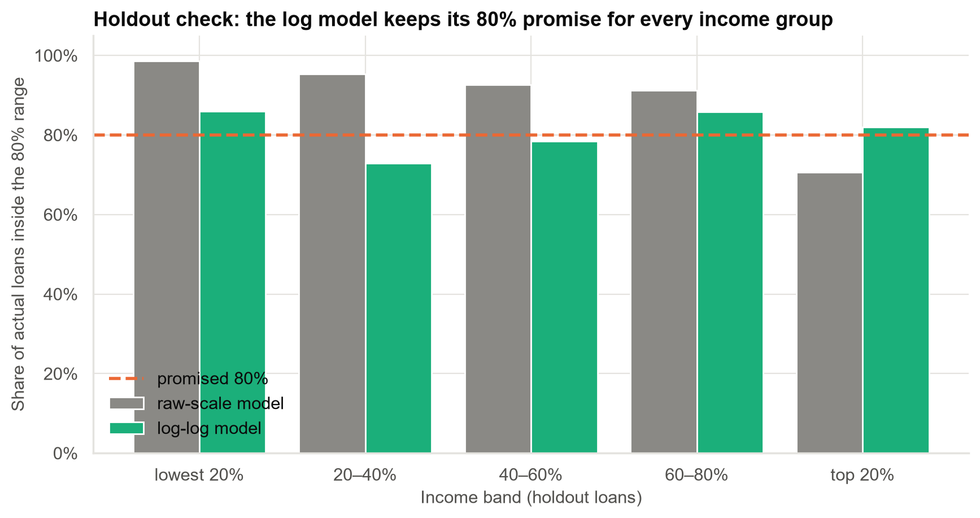
Tested on loans the rule never saw: the range is close to its 80% promise at every income level
Straight-line rule: 99% for low earners vs 71% for top earners. New rule: 86% and 82%.
Case 06 · Predicting loan amount from income · synthetic data
7

Slide 8
What the rule can and cannot do
It can
It cannot
• Give a consistent starting offer across branches.
• Give a realistic range for incomes up to ₹4 lakh/month.
• Be explained in one sentence.
• Say what very high earners would borrow without our ₹20 lakh cap.
• Account for existing debts, purpose or job type (yet).
• Tell us that higher income CAUSES bigger loans. It reflects current customers and policy.
Case 06 · Predicting loan amount from income · synthetic data
8

Slide 9
Recommendations and next steps
• Roll out the pre-offer table (incomes up to ₹4 lakh/month) with its 80% range.
• Above ₹4 lakh/month: offer the cap; route to a relationship manager.
• In planning materials: 'about ₹26,000 more per ₹10,000 of income, on average', with the range.
• Next quarter: add job type and existing debts to narrow the ranges (multiple regression).
• Monitor monthly: check the range still holds ~80% of the time in each income band.
Decision: approve the branch pre-offer rule; fund the next modelling step.
Case 06 · Predicting loan amount from income · synthetic data
9

