Slide 1
What Really Drives How Much Customers Ask For
Input to the offer-tier redesign and disbursement forecast · Lending Analytics
5,000 recent personal-loan applications (requested amounts, before credit decisions). Synthetic data created for training. Not actual customer data.

Slide 2
Summary: income, purpose and existing debt drive requests; city and age do not
• Income is the main driver. 10% more income → about 9% bigger request (salaried); more for self-employed (10%).
• Loan purpose matters a lot: weddings +45%, travel −25% vs debt consolidation, at the same income.
• Customers with more existing EMIs ask for LESS (−1.2% per ₹1,000 of EMI), not more, once income is accounted for.
• Metro and older customers only look different because they earn more. At the same income, no difference.
• Forecasts get much sharper: explained share of requests 47% → 69%; ranges about 20% narrower.
Recommendation: tier offers on income, EMI headroom, purpose and job type; drop city tier and age.
Case 07 · What drives the loan amount customers request? · synthetic data
2

Slide 3
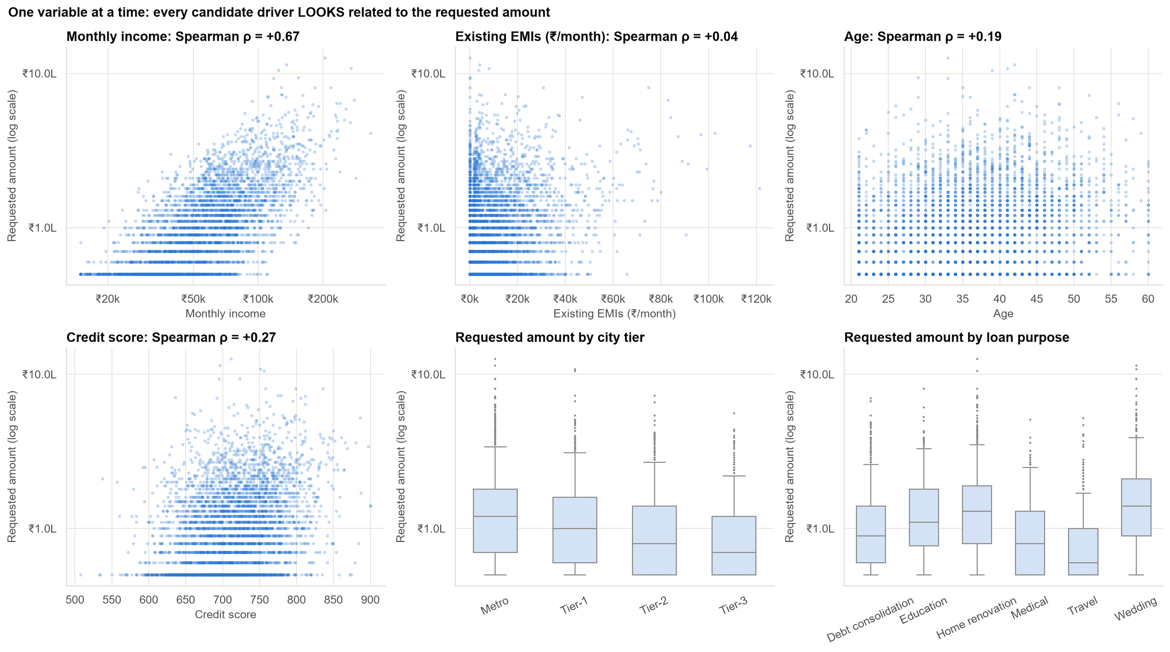
Looked at one by one, everything seems to matter
But most of these variables travel together with income. The question is what matters at the SAME income.
Case 07 · What drives the loan amount customers request? · synthetic data
3

Slide 4
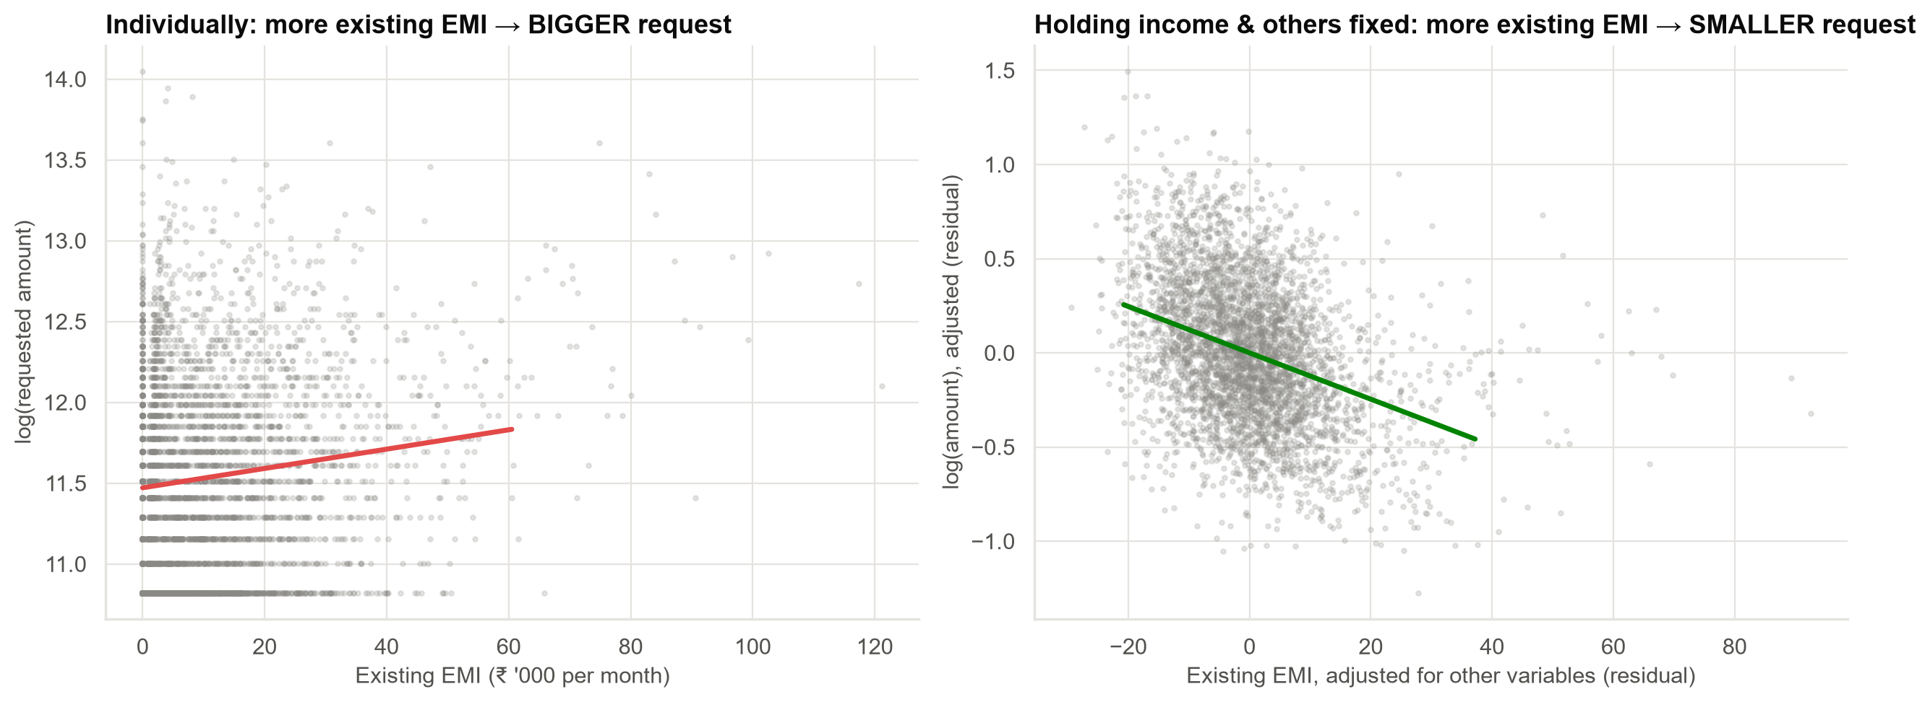
The 'credit-hungry' belief is backwards: at the same income, more debt means a smaller request
On its own, each ₹1,000 of existing EMI goes with +0.6% bigger requests, only because richer people carry bigger EMIs. Comparing like with like: −1.2%.
Case 07 · What drives the loan amount customers request? · synthetic data
4

Slide 5
Three of four dashboard beliefs do not survive a like-for-like comparison
Belief from the dashboard | On its own | At the same income, EMIs, purpose…
Metro customers ask for more | Yes (Tier-3 about 31% lower) | No difference
Older customers ask for more | Yes (+1.3% per year) | No difference
Customers with more EMIs ask for more | Yes (+0.6% per ₹1k) | Opposite (−1.2% per ₹1k)
Better scores, bigger requests | Yes | Small effect (≈ +5% per 50 points)
City tier and age were stand-ins for income. Using them in offer tiers adds nothing.
Case 07 · What drives the loan amount customers request? · synthetic data
5

Slide 6
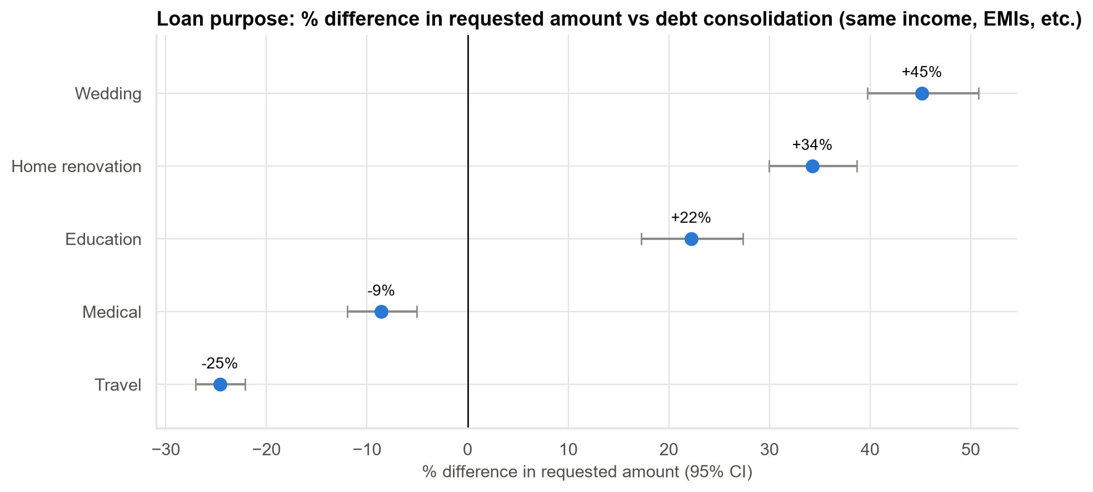
Loan purpose: one of the strongest and cheapest signals we have
Comparisons are with debt consolidation, for customers with the same income, debts and job type.
Case 07 · What drives the loan amount customers request? · synthetic data
6

Slide 7
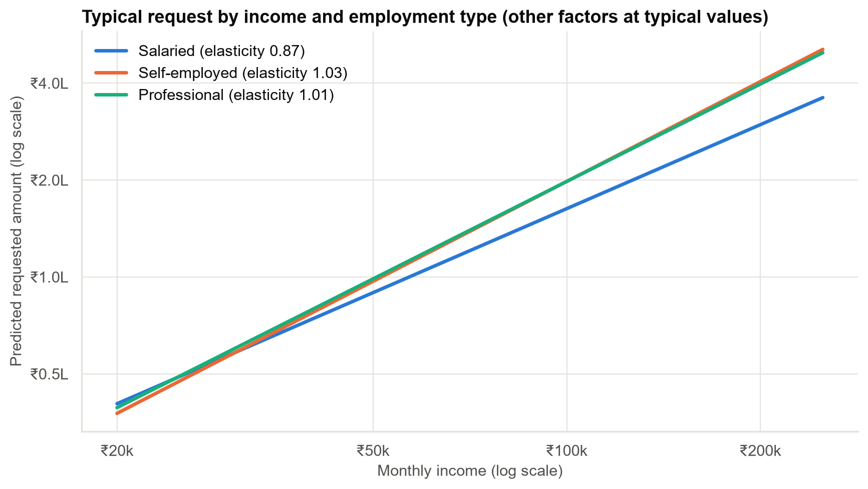
Self-employed customers' requests rise faster with income
One income rule for everyone under-offers high-earning self-employed customers and over-offers low-earning ones.
Case 07 · What drives the loan amount customers request? · synthetic data
7

Slide 8
Same income, very different needs
Customer (all earn ₹60k/month) | Typical request | Most ask between (80%)
Salaried, ₹60k income, ₹5k EMI, debt consolidation | ₹110,000 | ₹70,000 – ₹170,000
Self-employed, ₹60k income, ₹5k EMI, wedding | ₹180,000 | ₹110,000 – ₹280,000
Salaried, ₹60k income, ₹20k EMI, travel | ₹70,000 | ₹40,000 – ₹110,000
An income-only rule would offer these three customers the same amount.
Case 07 · What drives the loan amount customers request? · synthetic data
8

Slide 9
Better forecasts for Finance
47% → 69%
of requests explained
Tested on applications the model never saw.
×3.2 → ×2.5
width of 80% range
High end ÷ low end of the range.
~80%
range reliability
The range still contains ~80% of actual requests.
Case 07 · What drives the loan amount customers request? · synthetic data
9

Slide 10
Recommendations
• Redesign offer tiers on income, existing-EMI headroom, loan purpose and job type.
• Drop city tier and age as tiering variables.
• Retire 'credit-hungry' targeting. At the same income, indebted customers want less.
• Use the multi-driver model for Finance's disbursement forecast.
• Keep loan tenure out of these models. It is chosen together with the amount and would mislead.
Decision: approve the tier redesign using these drivers.
Case 07 · What drives the loan amount customers request? · synthetic data
10

Slide 11
Limitations and next steps
Limitations
Next steps
• Associations, not causes.
• Only variables we observe.
• Requested amounts, not approved ones.
• Model approved amounts and the requested–approved gap.
• Check new bureau variables for overlap (multicollinearity).
• Re-validate on next quarter's applications.
Case 07 · What drives the loan amount customers request? · synthetic data
11

