Slide 1
Why Did "Work Experience" Stop Mattering?
Income-estimation model v2 sign-off · Risk Analytics for Credit Policy
6,000 salaried customers with verified salaries. Synthetic data created for training. Not actual customer data.

Slide 2
Summary: all four proposals rest on one-variable views, and three of them are wrong
• Experience still matters. Its effect now shows up through job grade: about 87% of it runs through promotions (+4.3%/yr → +0.5%/yr at the same grade).
• Metro uplift: reject. The +12% gap is an employer-type effect; at the same employer it is −0.9% (not significant).
• Tenure: keep. No correlation on its own, but −4.0% per year at the same experience (people who never switched jobs).
• Education: keep. Postgraduates look no better paid (−0.7%) only because they are younger; at the same experience they earn 21% more.
Recommendation: approve v2 for customers with verified grade, keep v1 for the rest, keep experience on the form.
Case 08 · Why did work experience stop mattering? · synthetic data
2

Slide 3
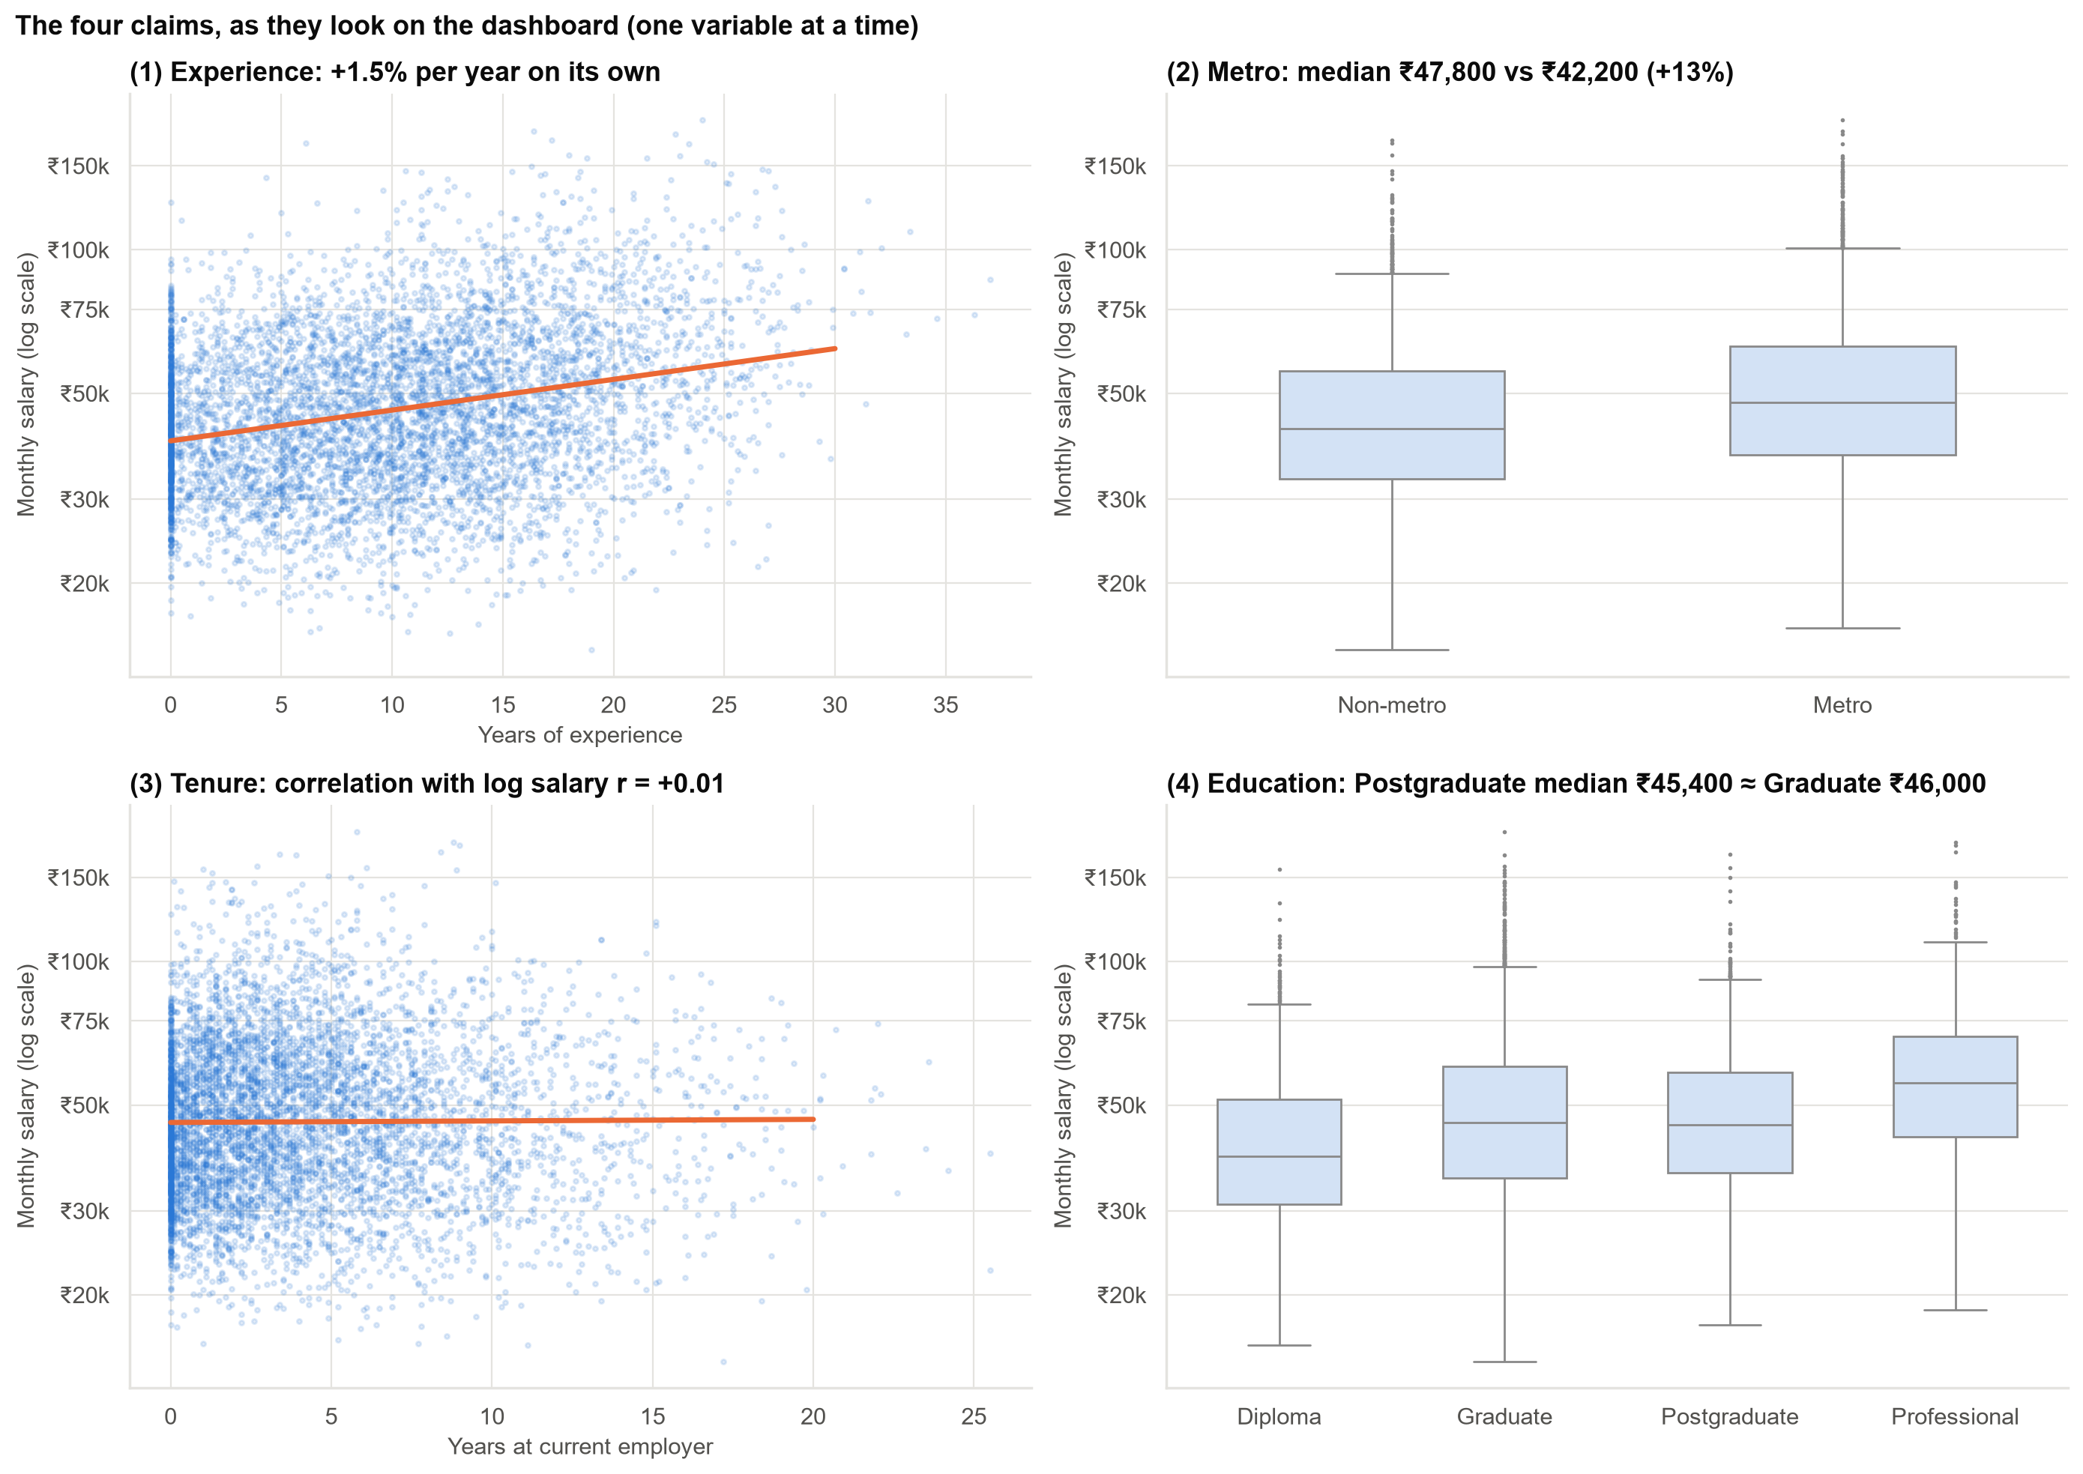
The dashboard view: four claims, each from one variable at a time
Each chart is correct as a description. None of them shows what happens 'with everything else equal'.
Case 08 · Why did work experience stop mattering? · synthetic data
3

Slide 4
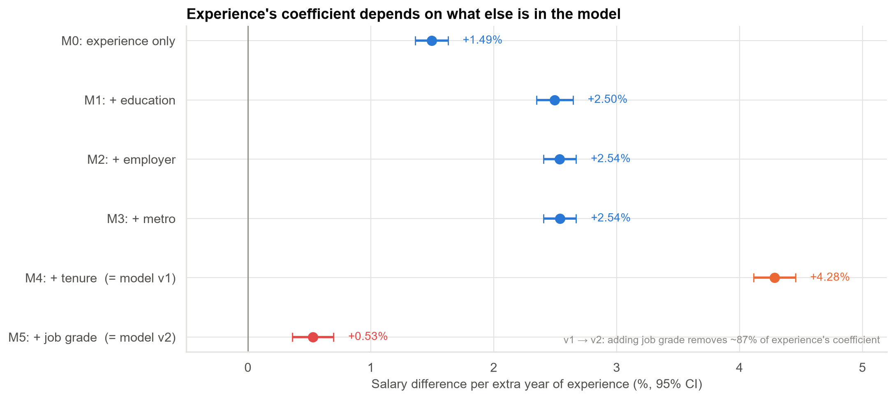
Experience's effect depends on what else is in the model
v1 → v2: adding job grade takes over about 87% of experience's effect. That part did not disappear; it moved.
Case 08 · Why did work experience stop mattering? · synthetic data
4

Slide 5
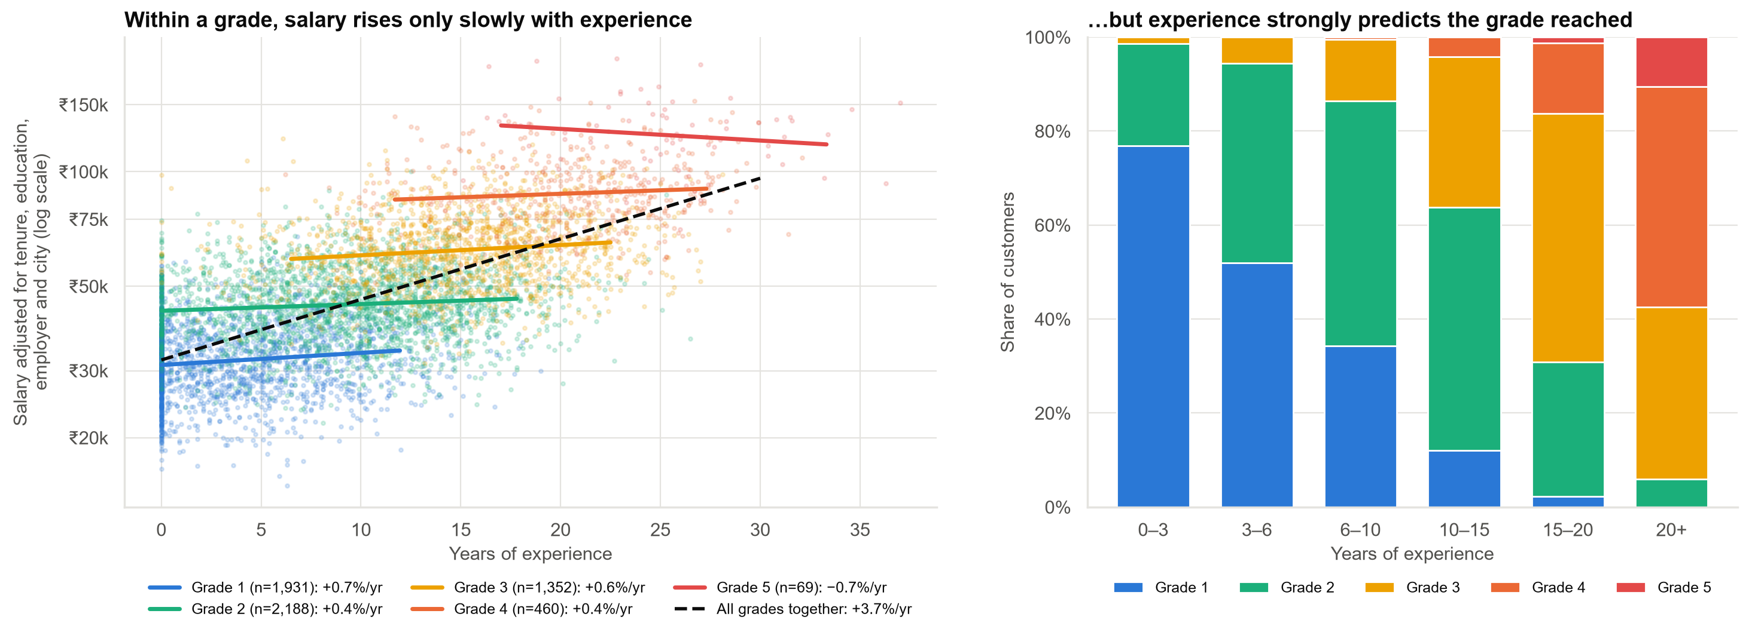
Experience pays off mainly by getting people promoted
Within a grade, extra years add little. But years of experience are what get people to the higher grades.
Case 08 · Why did work experience stop mattering? · synthetic data
5

Slide 6
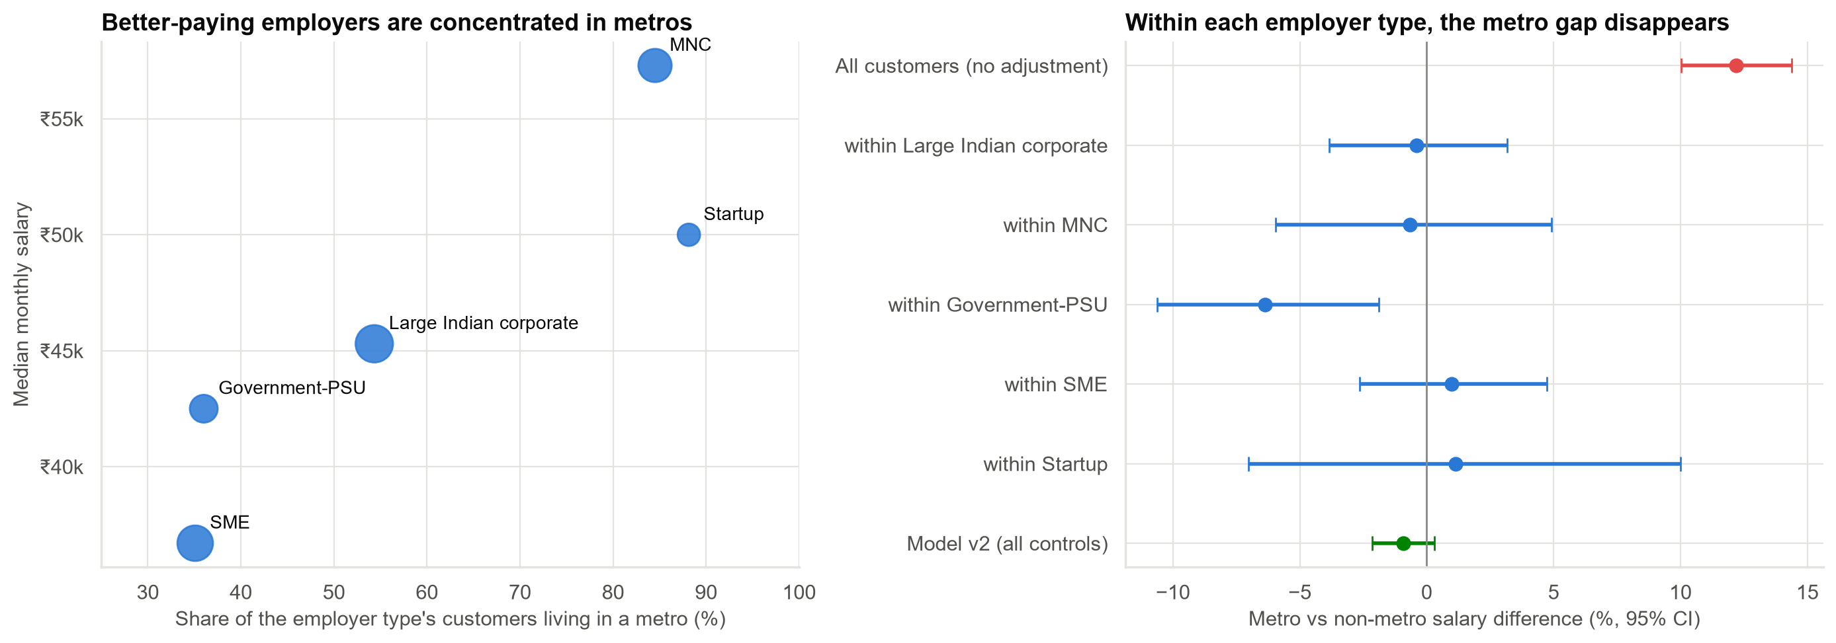
Metro customers earn more only because better-paying employers are in metros
A metro uplift would pay the employer premium twice. Reject.
Case 08 · Why did work experience stop mattering? · synthetic data
6

Slide 7
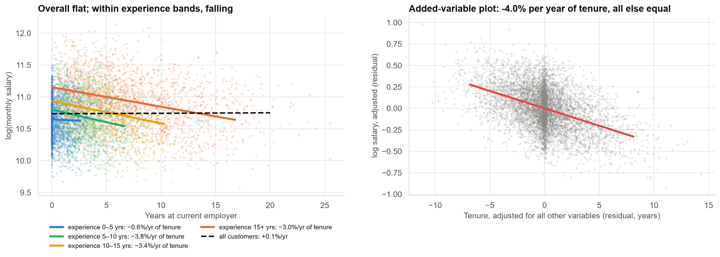
Tenure: zero correlation, yet one of our most useful variables
On its own +0.1%/yr; at the same experience −4.0%/yr. Never drop a variable just because its correlation is near zero.
Case 08 · Why did work experience stop mattering? · synthetic data
7

Slide 8
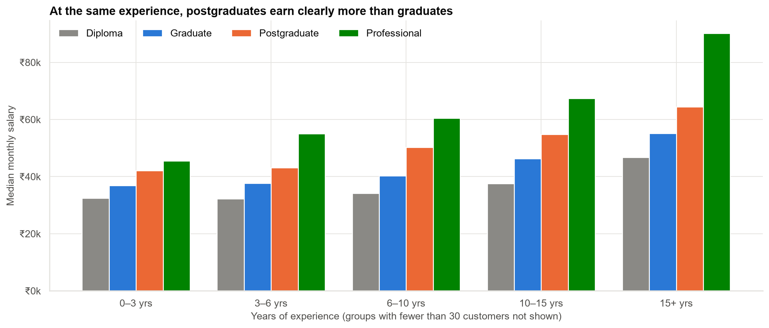
Education: the premium was hidden by who our postgraduate customers are
A campus partnership brought in many young postgraduates. Compared at equal experience, the premium is clear.
Case 08 · Why did work experience stop mattering? · synthetic data
8

Slide 9
Tested on customers the models did not see: what each variable is worth
Model | Typical error (median) | Verdict
v1 (no grade) | 19.0% | Use for the 40% without verified grade
v1 without tenure | 20.3% | Worse
v1 without education | 21.1% | Worse
v2 (with grade) | 14.6% | Use when grade is verified
v2 without experience | 14.5% | No real difference
v2 without tenure | 16.2% | Worse
v2 without metro | 14.5% | No difference
With grade known, experience adds little to accuracy; without grade, it is the most important variable we have.
Case 08 · Why did work experience stop mattering? · synthetic data
9

Slide 10
How confident are we?
• Experience (total), tenure and education: a hidden factor (e.g. ability) would have to explain 21%–47% of the remaining variation to overturn them. Robust.
• Experience at the same grade (+0.5%/yr): a modest hidden factor (≈ 8%) could explain it away. Do not build policy on it.
• These are associations, not proof of cause: we did not run an experiment.
• Training data must not be filtered on salary (e.g. 'premium customers only'): that flattens every effect.
The recommendations rely only on the robust findings.
Case 08 · Why did work experience stop mattering? · synthetic data
10

Slide 11
Recommendations
• Approve model v2 for customers with a payroll-verified grade.
• Keep model v1 for customers without a verified grade (about 40%).
• Keep experience on the application form: v1 depends on it.
• Keep tenure and education in both models.
• Reject the metro uplift. It double-counts employer type.
• Follow up on government/PSU metro customers (about 6% lower pay; may be chance).
Decision needed: sign off v2 with these variable choices.
Case 08 · Why did work experience stop mattering? · synthetic data
11

Slide 12
Limitations and next steps
Limitations
Next steps
• Observational data: associations, not causes.
• Ability and performance are not measured.
• Education masking is specific to our customer mix.
• Validate v1 and v2 on next quarter's customers.
• Track the share of customers with verified grade.
• Add this 'why did the coefficient change?' check to every model review.
Case 08 · Why did work experience stop mattering? · synthetic data
12

