Slide 1
Why Our Spend Model's Coefficients Keep Jumping
Credit-limit model review · Credit Risk for the Head of Cards
4,000 salaried card customers (four quarterly cohorts) and 600 self-employed pilot customers. Synthetic data created for training. Not actual customer data.

Slide 2
Summary: the model's limits are fine; its coefficients are not readable, and it is not ready for the pilot
• Declared income and salary credits are near-copies for salaried customers (correlation 0.996). The model cannot tell them apart, so their separate coefficients swing every quarter.
• Their combined effect is stable: 10% more income → about 8% more spend, every quarter.
• Limits did not jump around. Predictions for salaried customers are stable and accurate.
• Self-employed pilot: not ready. Their salary credits understate income, so the model predicts spend too low: limits would be about 15% too low.
Recommendation: replace the two income columns with one income index; build a separate model for the pilot.
Case 09 · Overlapping signals in the credit-limit model · synthetic data
2

Slide 3
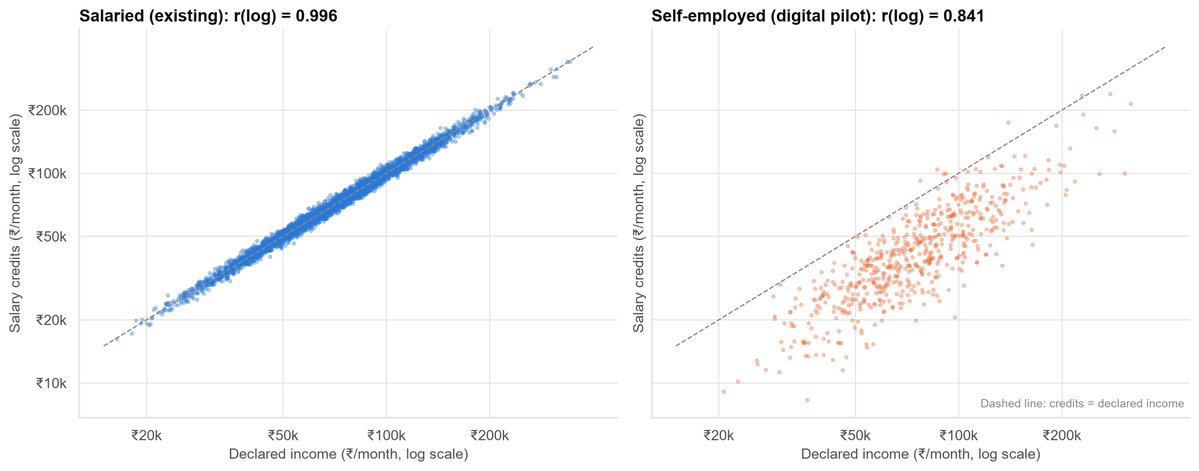
Two columns, one piece of information
For salaried customers, the salary is paid into their account: declared income and credits match. For self-employed customers they do not.
Case 09 · Overlapping signals in the credit-limit model · synthetic data
3

Slide 4
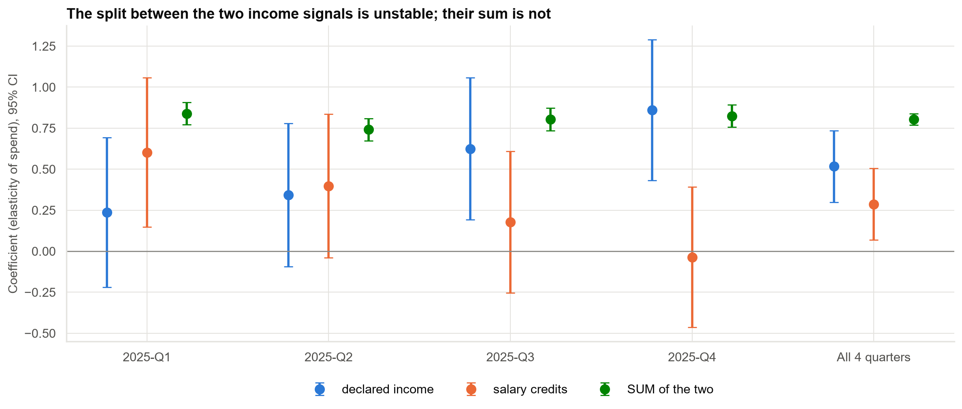
Each quarter splits the income effect differently; the total never changes
Q4's negative salary-credits coefficient (−0.04) is noise: its range runs well into positive values.
Case 09 · Overlapping signals in the credit-limit model · synthetic data
4

Slide 5
'Neither income variable is significant' (Q2) does not mean income doesn't matter
Test (Q2 customers) | Result
Declared income, on its own | p = 0.12: not significant
Salary credits, on its own | p = 0.07: not significant
Both together | p < 0.001: strongest signal in the model
Each test asks 'does this add anything beyond the other one?'. With two near-copies, the answer is no for each, but together they matter most. Always test overlapping variables together.
Case 09 · Overlapping signals in the credit-limit model · synthetic data
5

Slide 6
How severe is the overlap?
116
variance inflation factor (VIF)
Above 10 counts as severe.
99%
of each signal is explained by the others
Almost nothing is left to tell them apart.
×11
uncertainty of each coefficient
Compared with signals that do not overlap.
The other variables in the model are fine (VIF below 5).
Case 09 · Overlapping signals in the credit-limit model · synthetic data
6

Slide 7
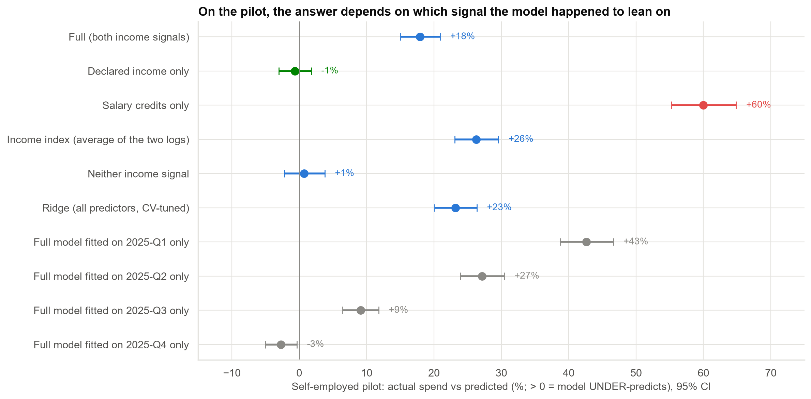
Where overlap hurts: customers whose signals disagree
Actual pilot spend is 18% above the model's prediction, and anywhere from −3% to +43% depending on which quarter the model was fitted on.
Case 09 · Overlapping signals in the credit-limit model · synthetic data
7

Slide 8
Fixing it: an income index keeps accuracy and makes the model readable
Option | Coefficients stable across quarters? | Accuracy (salaried) | Easy to explain?
Keep both (today) | No (SD 0.28) | Same | No
Drop salary credits | Yes (SD 0.04) | Same | Yes
Combine into one income index | Yes (SD 0.04) | Same | Yes
Ridge regression | Partly (SD 0.18) | Same | No
All options predict salaried spend equally well (error 0.297–0.298 on the log scale). The difference is stability and clarity.
Case 09 · Overlapping signals in the credit-limit model · synthetic data
8

Slide 9
Recommendations
• Replace declared income and salary credits with one income index in the salaried model.
• Stop reporting the two income coefficients separately in dashboards and model documentation.
• Remove the duplicate 'total obligations' column (it equals EMI + rent exactly).
• Do not use this model for the self-employed pilot. Build a segment model with income evidence that works for them (tax returns, all-account credits) and check its error before setting limits.
• Add overlap checks (VIF, duplicate columns) to every quarterly refit.
Decision needed: approve the index-based model and a separate pilot model.
Case 09 · Overlapping signals in the credit-limit model · synthetic data
9

Slide 10
Limitations and next steps
Limitations
Next steps
• Spend model only; default risk is assessed separately.
• 600 pilot customers: estimates have a few points of uncertainty.
• Self-declared income may be inflated in digital journeys.
• Monitor how closely income signals agree, by segment and channel.
• Collect independent income evidence for the pilot.
• Re-validate after the next quarterly refit.
Case 09 · Overlapping signals in the credit-limit model · synthetic data
10

