Slide 1
A Claim-Cost Model We Can Defend
Pricing relativities and reserves for open claims · Analytics for the Appointed Actuary
6,000 settled hospitalisation claims; 1,500 held back to test reserving. Synthetic data created for training. Not actual customer data.

Slide 2
Summary: the current model is the wrong shape; a gamma model with the policy cap gets the reserve right
• 6 claims were keyed in paise instead of rupees (×100). They dominated the old model.
• Claim costs are multiplicative and their spread grows with their size. A straight-line model on ₹ cannot capture that: it even predicts negative costs.
• The log model under-reserved by 14% because exp() of a log prediction gives a typical claim, not the average.
• Recommended: a gamma model that respects the sum insured. On 1,500 test claims its total was within 0.1% of what was actually paid.
• Reserve for open claims: ≈ ₹18.7 crore, 90% range ₹18.1–19.3 crore.
Decision needed: adopt the gamma model for pricing and reserving, and add a sum-insured validation rule.
Case 10 · Modelling health claim cost · synthetic data
2

Slide 3
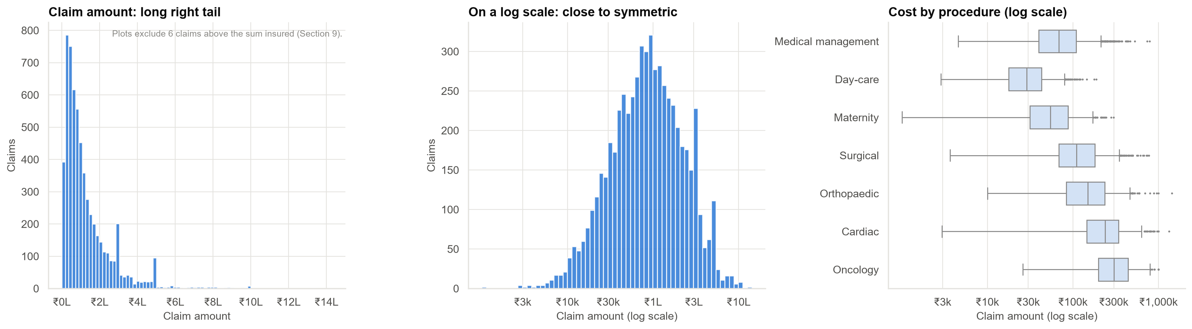
Claim costs: a long tail of expensive claims, very different by procedure
On a log scale the distribution is roughly symmetric, a sign that effects multiply rather than add.
Case 10 · Modelling health claim cost · synthetic data
3

Slide 4
Six impossible claims: above the policy's maximum payout
Claim | Procedure | Sum insured | Recorded claim
HC10104514 | Medical management | ₹5 lakh | ₹224.3 lakh
HC10105310 | Day-care | ₹25 lakh | ₹174.1 lakh
HC10104996 | Surgical | ₹5 lakh | ₹122.9 lakh
HC10103628 | Surgical | ₹5 lakh | ₹41.0 lakh
HC10103950 | Medical management | ₹5 lakh | ₹39.4 lakh
HC10104543 | Medical management | ₹5 lakh | ₹21.1 lakh
Divided by 100 they become normal amounts: keyed in paise. Removed and sent to the claims-data team.
Case 10 · Modelling health claim cost · synthetic data
4

Slide 5
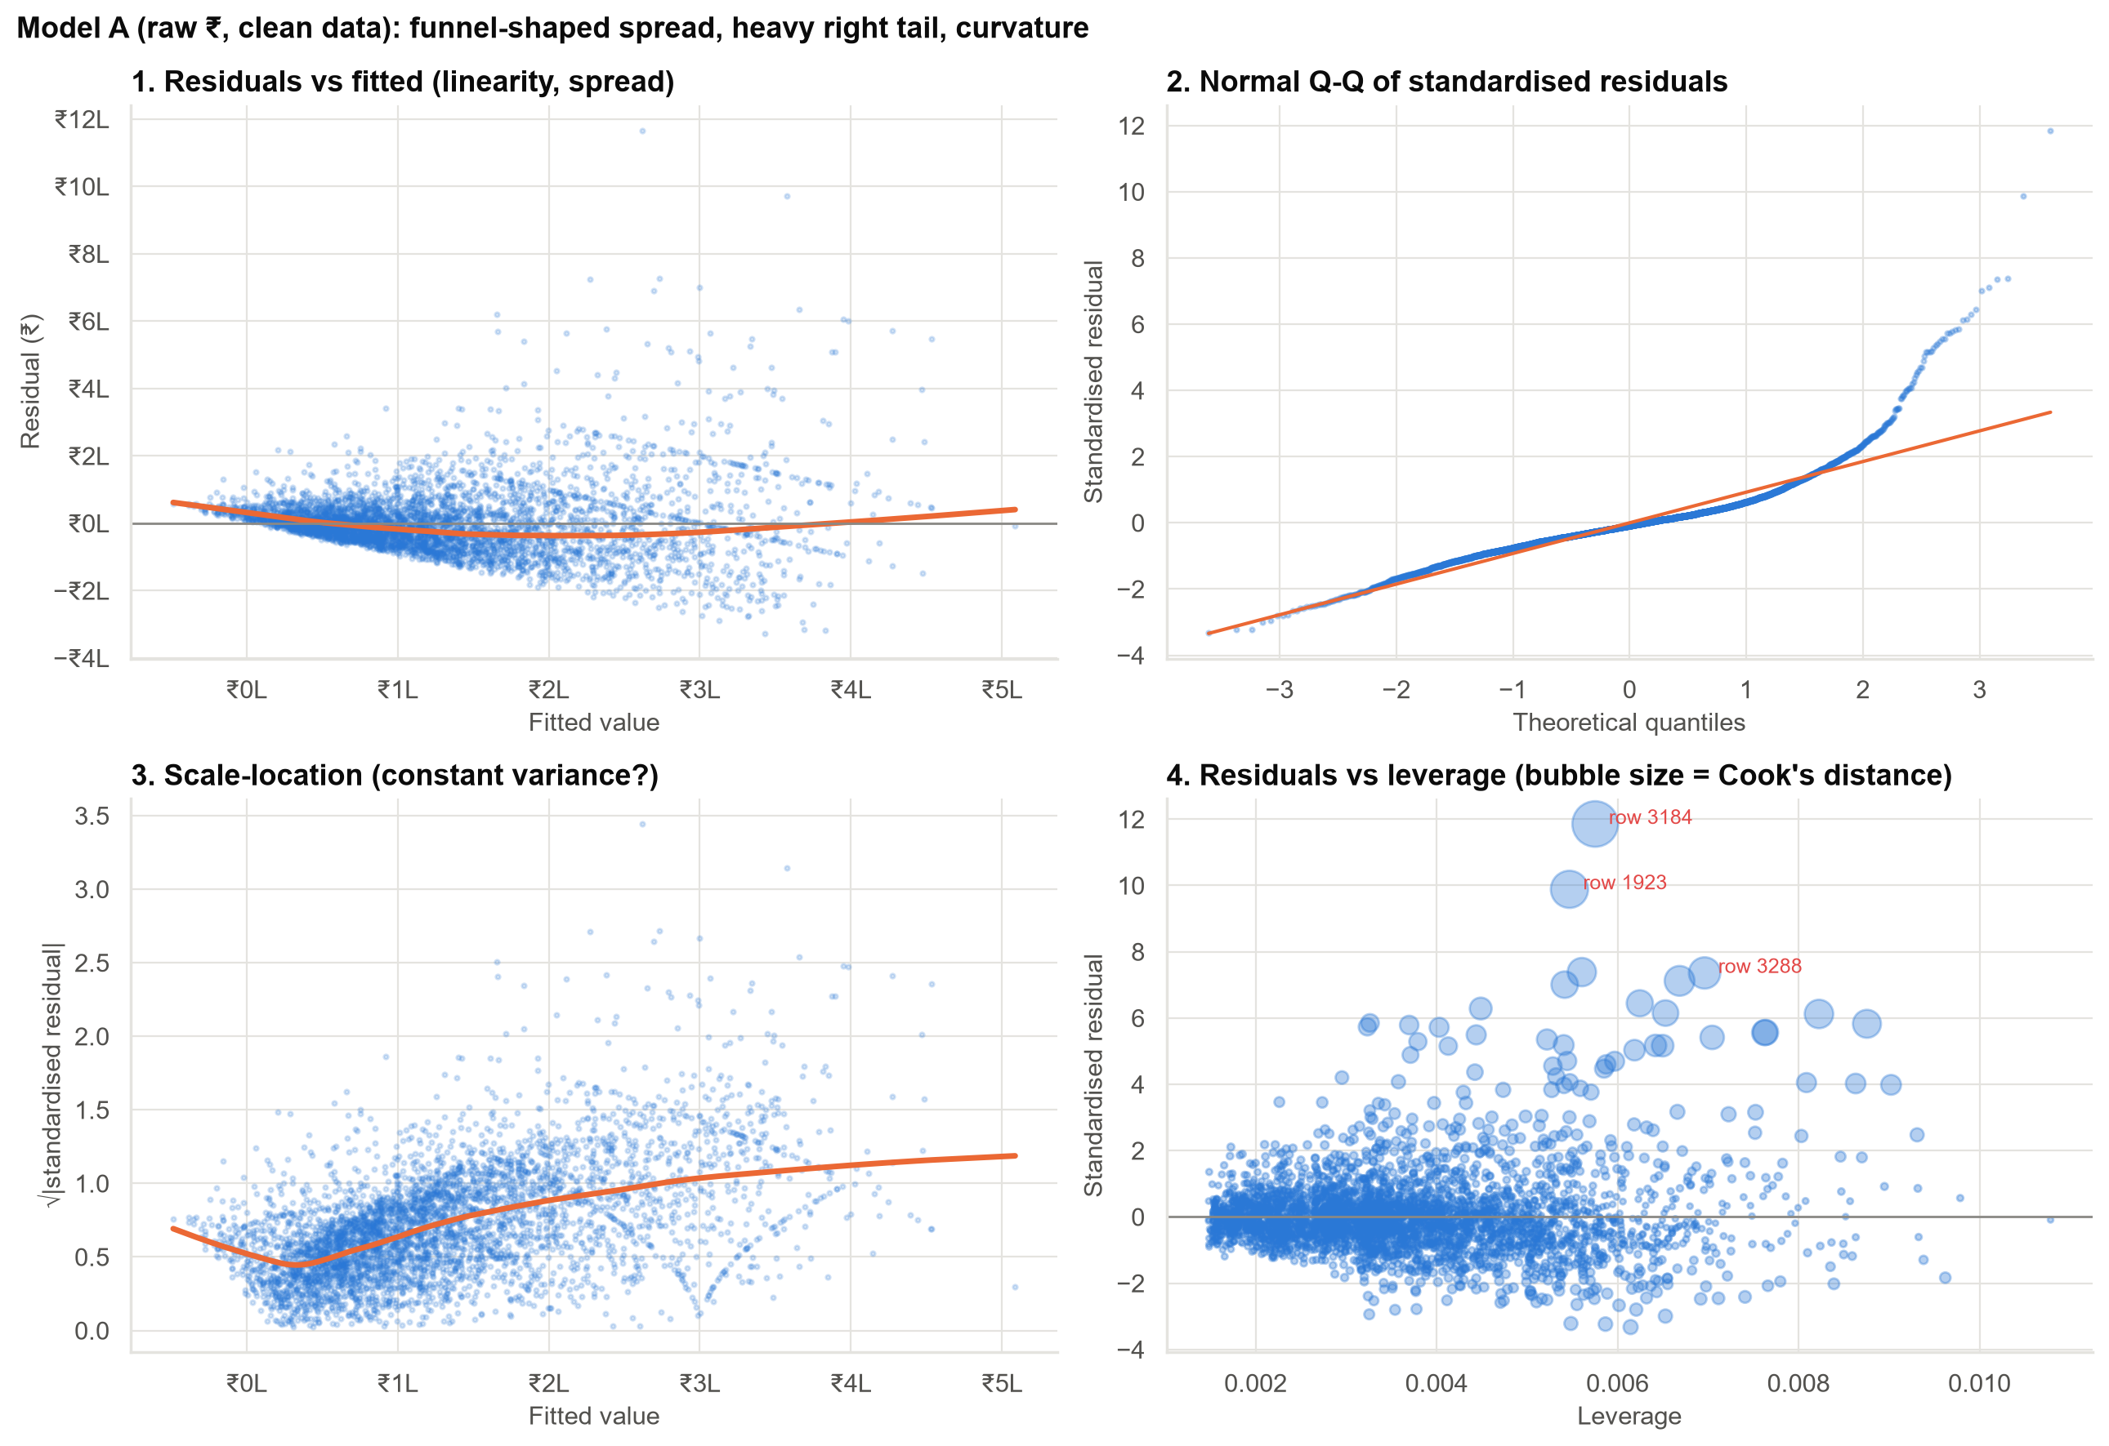
The old model's checks fail: spread grows with claim size, and big claims are far off
Top-left: a funnel. Top-right: far more very large claims than the model expects. Its error bars cannot be trusted.
Case 10 · Modelling health claim cost · synthetic data
5

Slide 6
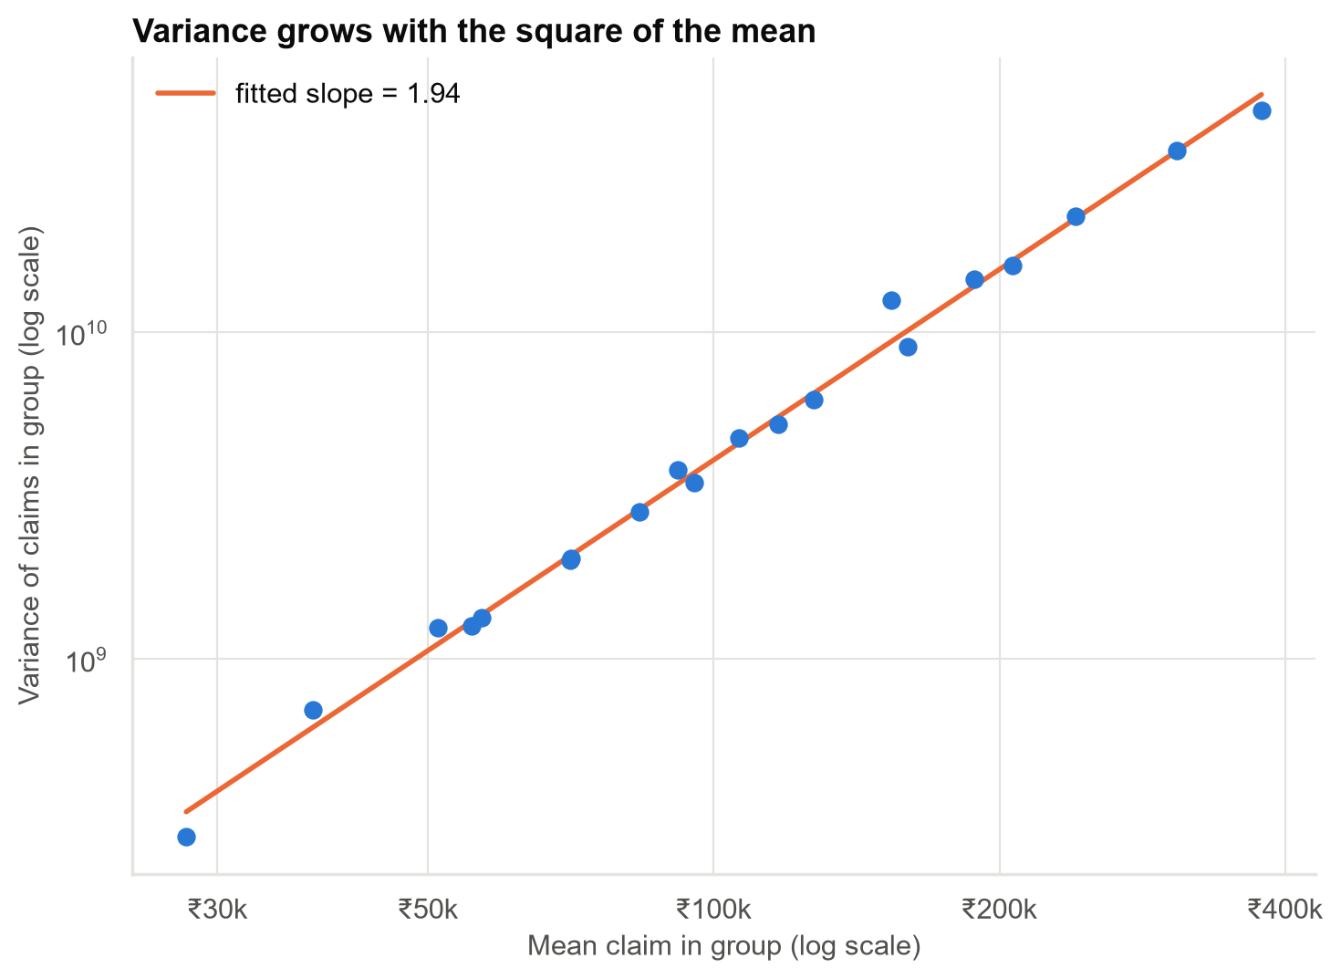
Why a gamma model: the variance of claims grows with the square of their average
Bigger claims are not 'more random' in % terms; they are just bigger. That is exactly what a gamma model assumes.
Case 10 · Modelling health claim cost · synthetic data
6

Slide 7
Why the log model under-reserved
• A log model predicts the typical (median) claim. For skewed costs, the average is higher.
• Reserves need the average. Taking the prediction at face value under-reserved by 14% on the test claims.
• A correction factor (≈ 1.23) fixes the average, but the result still ignores the policy limit.
• Models that ignore the sum-insured cap over-reserve by about 5%: we never pay above the limit.
The gamma model predicts the average directly, and we apply the cap to every claim.
Case 10 · Modelling health claim cost · synthetic data
7

Slide 8
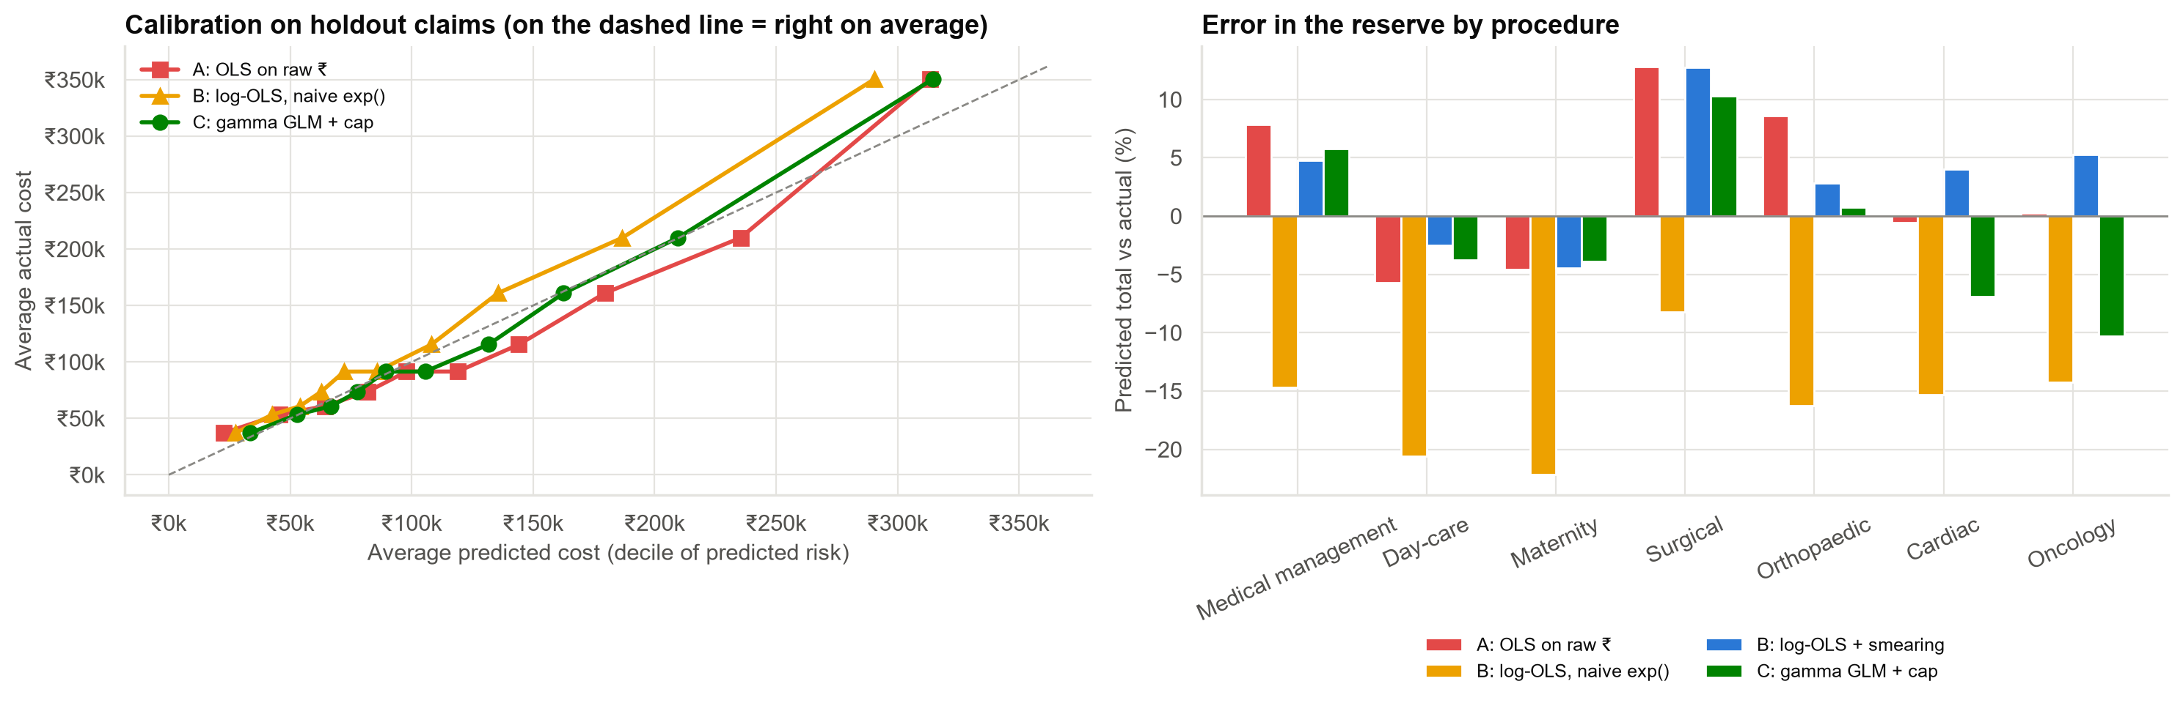
On 1,500 test claims: only the gamma model with the cap gets the total right
Total error: naive log −14%, gamma without cap +5%, gamma with cap −0.1%. Within procedures, errors of up to ~10% remain (small groups).
Case 10 · Modelling health claim cost · synthetic data
8

Slide 9
Pricing relativities from the gamma model (for similar patients and hospitals)
Factor | Cost difference
Cardiac (vs medical management) | +175%
Oncology | +205%
Orthopaedic | +89%
Suite (vs general ward) | +57%
Private room | +30%
Non-network hospital (vs network-metro) | +10%
Diabetic | +7%
Smoker | +6%
Double the length of stay | +26%
Associations, not causes: e.g. non-network patients may also differ in ways we don't observe.
Case 10 · Modelling health claim cost · synthetic data
9

Slide 10
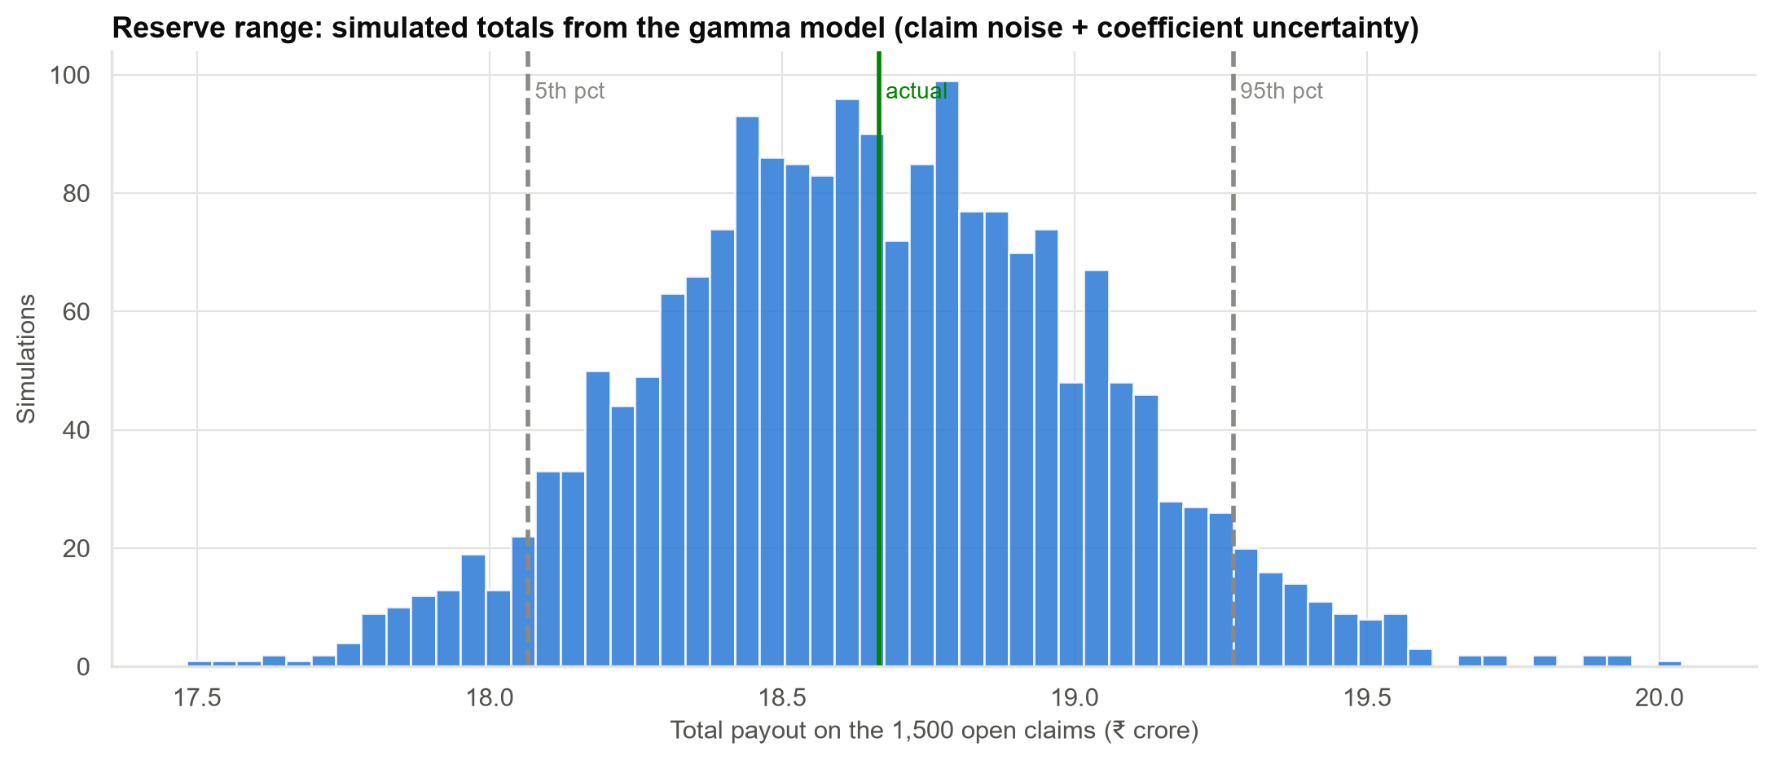
Reserve for the 1,500 open claims: about ₹18.7 crore
90% range ₹18.1–19.3 crore; 99.5th percentile ₹19.7 crore. The total is far more predictable than any single claim.
Case 10 · Modelling health claim cost · synthetic data
10

Slide 11
Recommendations
• Adopt the gamma model (with the sum-insured cap) for pricing relativities and open-claim reserves.
• Reserve ≈ ₹18.7 crore for the open claims; base the risk margin on the simulated range.
• Retire the straight-line ₹ model; do not use the log model without correction.
• Add a load-time rule: reject claim amounts above the sum insured.
• Review calibration by procedure every quarter.
Decision needed: approve the gamma model and the reserve.
Case 10 · Modelling health claim cost · synthetic data
11

Slide 12
Limitations and next steps
Limitations
Next steps
• Real portfolios have rarer, larger claims than a gamma model expects.
• No claim inflation or late-reported claims included.
• Relativities are associations, not causes.
• Test a separate large-claim model above a threshold.
• Add inflation and late-reporting adjustments with the reserving team.
• Track calibration by procedure each quarter.
Case 10 · Modelling health claim cost · synthetic data
12

