Slide 1
Who Is About to Leave, and Whom Should We Call?
Savings-account churn model and retention call list · Retail Liabilities Analytics
12,000 savings customers; churn measured over the following 6 months. Synthetic data created for training. Not actual customer data.

Slide 2
Summary: 28% of next half-year's churners are in the top 8% of customers
• 10.5% of savings customers leave within 6 months.
• Complaints matter most: two or more complaints add about 20 percentage points of churn risk; one adds about 8.
• Salary accounts, more products and a credit card protect: about −8, −3 and −2 points.
• New customers and customers whose balances are falling are the early-warning groups. Region does not matter.
• Calling the top 1,000 reaches 353 churners (28% of all) and is worth about ₹8.8 lakh, if the offer works as assumed.
Recommendation: score monthly, call the top 1,000, and test the offer properly before scaling.
Case 11 · Which customers are about to churn? · synthetic data
2

Slide 3
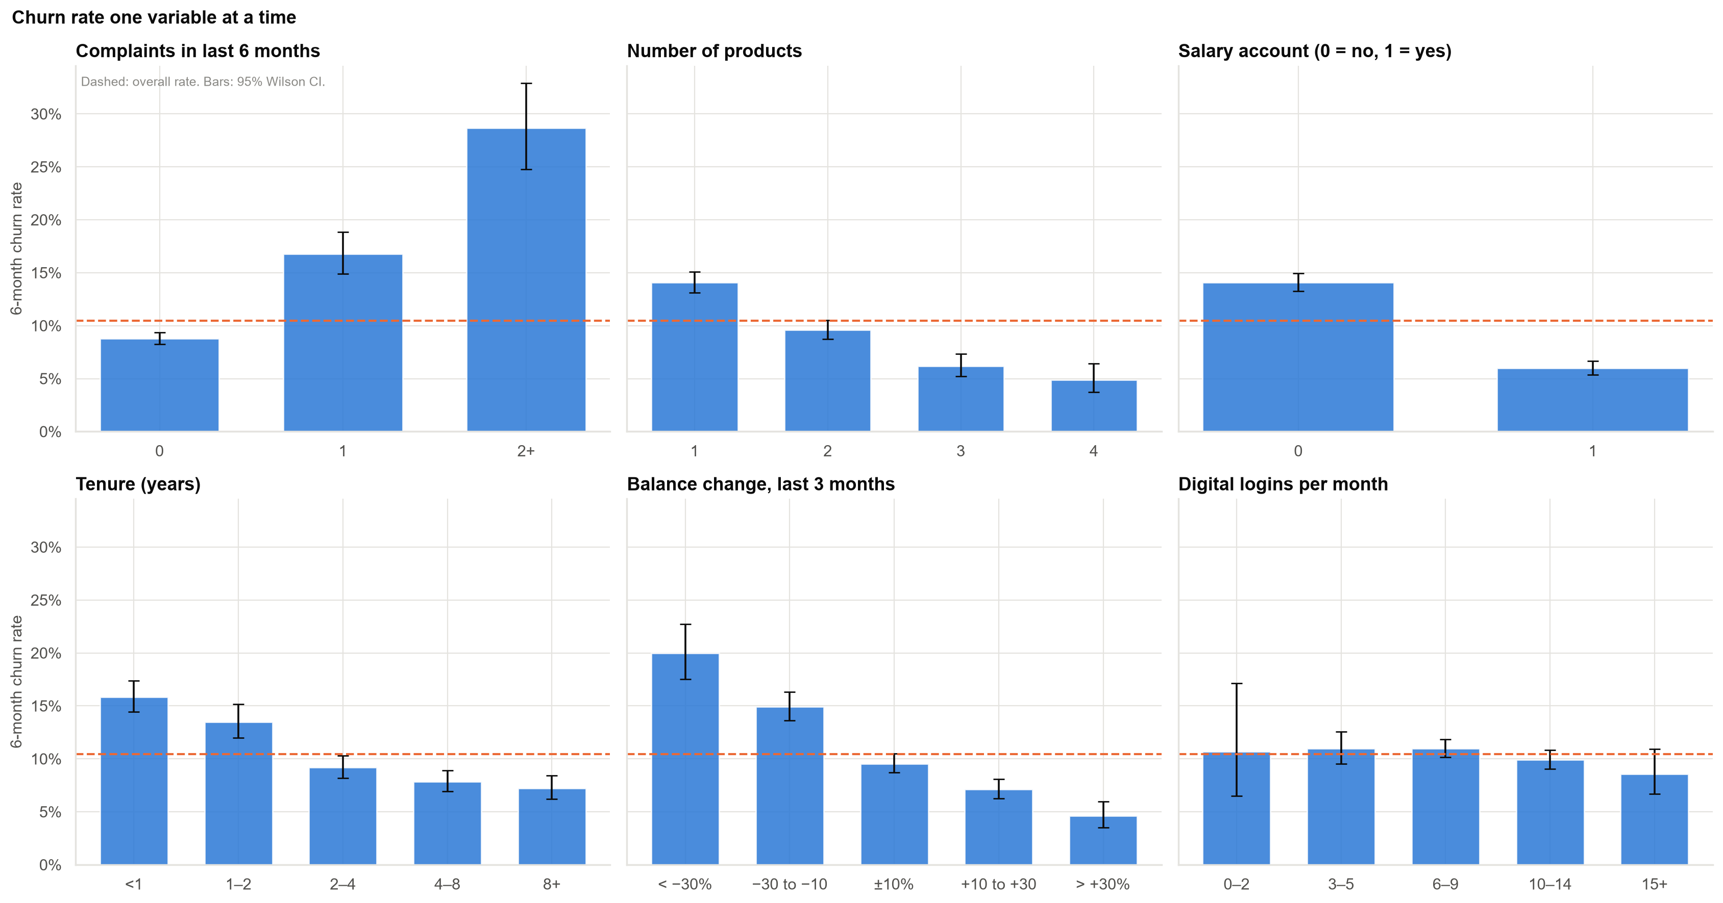
Churn by customer characteristic, one at a time
These raw views mix effects together; the model separates them.
Case 11 · Which customers are about to churn? · synthetic data
3

Slide 4
Is 'complaints make customers three times more likely to leave' right?
Complaints in last 6 months | Churn rate | Compared with none | Extra risk
None | 8.8% | – | –
One | 16.8% | 1.9× as likely | +8 points
Two or more | 28.7% | 3.3× as likely | +20 points
True for repeat complainants, not for one complaint. Beware: model 'odds ratios' are not 'times as likely' (for two or more complaints the odds ratio is 4.9).
Case 11 · Which customers are about to churn? · synthetic data
4

Slide 5
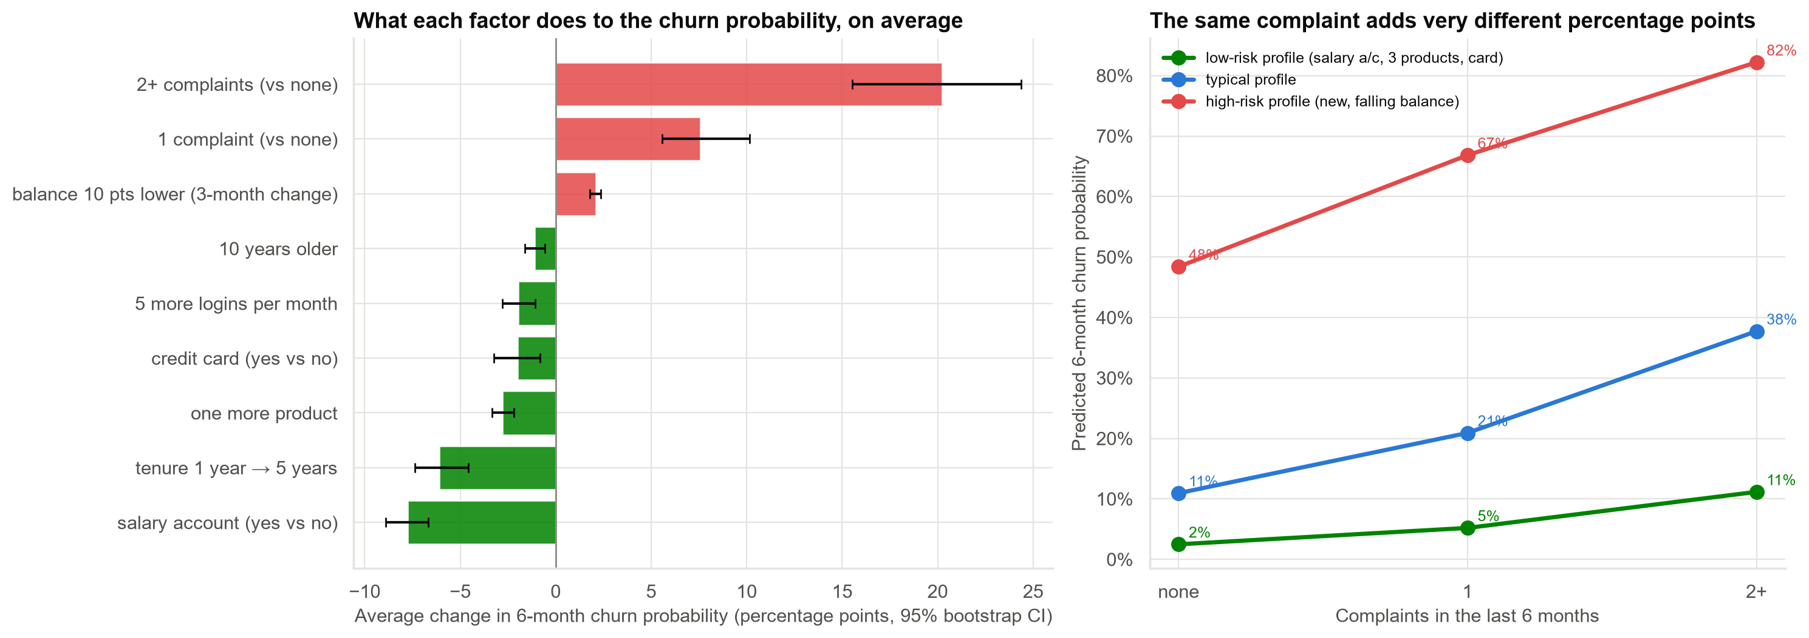
What each factor does to the churn probability
The same complaint adds a few points for a loyal customer and far more for a new customer with a falling balance.
Case 11 · Which customers are about to churn? · synthetic data
5

Slide 6
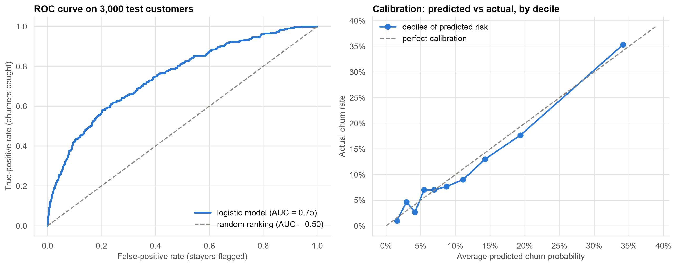
Can we trust the probabilities? Yes: tested on 3,000 customers the model never saw
Ranking quality (AUC) 0.75; predicted and actual churn agree closely across risk deciles (10.9% predicted vs 10.5% actual).
Case 11 · Which customers are about to churn? · synthetic data
6

Slide 7
When is a retention call worth making?
14.3%
break-even churn probability
₹600 offer ÷ (35% success × ₹12,000 value)
2,807
customers above break-even
More than the call centre can handle.
1,000
calls available
So call the highest-risk customers first.
The usual 'above 50%' rule would call only 86 customers and miss most of the value.
Case 11 · Which customers are about to churn? · synthetic data
7

Slide 8
Who to call: the model's top 1,000
Call strategy | Churners reached | Hit rate | Net value
Top 1,000 by predicted risk | 353 (28%) | 35% | +₹8.8 lakh
Everyone above 50% | 52 (4%) | 60% | +₹1.7 lakh
1,000 random customers | 118 (9%) | 12% | −₹1.0 lakh
Based on the assumed 35% offer success rate and ₹12,000 customer value; both should be tested.
Case 11 · Which customers are about to churn? · synthetic data
8

Slide 9
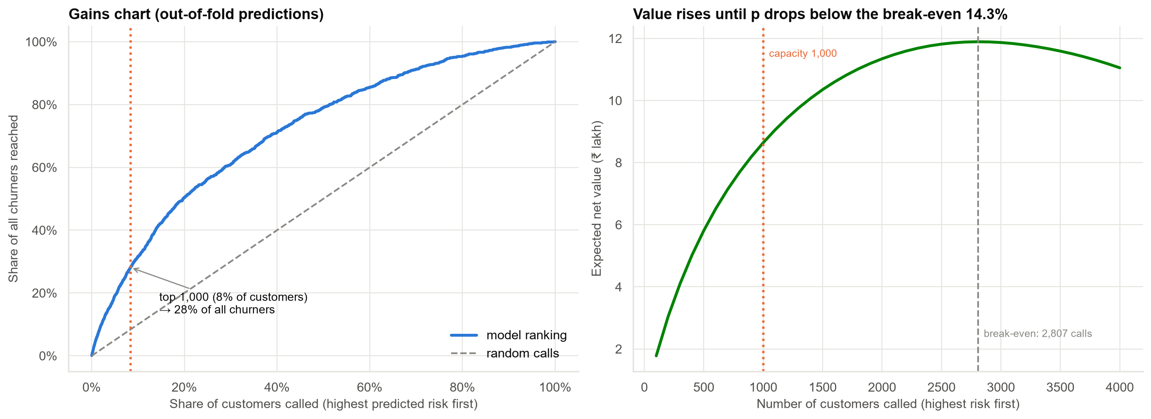
Calling more customers adds value up to the break-even point
The top 1,000 hold 28% of all churners. Extra capacity would pay off up to about 2,807 calls.
Case 11 · Which customers are about to churn? · synthetic data
9

Slide 10
Recommendations
• Score customers monthly and call the top 1,000 (all above the 14.3% break-even).
• Run the offer as a randomised test for two months: call half of the top group, not the other half, and measure the real success rate.
• Escalate repeat complaints: two or more complaints is the strongest single warning sign.
• Watch new customers and falling balances as early-warning triggers.
• Report effects in percentage points, not odds ratios.
Decision needed: approve the call list and the two-month offer test.
Case 11 · Which customers are about to churn? · synthetic data
10

Slide 11
Limitations and next steps
Limitations
Next steps
• Shows who is at risk, not whom a call will keep.
• Offer success (35%) and customer value (₹12,000) are assumptions.
• One cohort; must be re-validated on new data.
• Randomised offer test, then an uplift model.
• Check whether salary-account customers react less to complaints (suggestive, unproven).
• Monitor calibration monthly.
Case 11 · Which customers are about to churn? · synthetic data
11

