Slide 1
Catching More Fraud With Fewer Alerts
Fraud model and alert policy · Fraud Risk analytics for the Head of Fraud Risk
120,000 card transactions over 4 months (fraud ≈ 0.4%); tested on the most recent month. Synthetic data created for training. Not actual customer data.

Slide 2
Summary: a calibrated model, ranked by expected loss, beats our rules within analyst capacity
• '99.6% accuracy' means little: flagging nothing at all is 99.5% accurate.
• Measured properly, the model is much better than our rules: on next month's data, half the fraud can be caught with about 1 in 3 alerts genuine (rules: 3% of alerts genuine).
• Recommended policy: review the 300 transactions (1%) with the highest expected loss. It stops 72% of fraud rupees and saves about ₹2.8 lakh more per month than the rules (in this sample).
• Do not 'rebalance' the data as the vendor suggests: it does not improve ranking and it breaks the probabilities that our money decisions rely on.
• Fraud is shifting: month 4 had about 39% more fraud than the model expected, almost all in online gaming.
Decision needed: replace the two rules with the model and an expected-loss review queue; retrain monthly.
Case 12 · Card transaction fraud detection · synthetic data
2

Slide 3
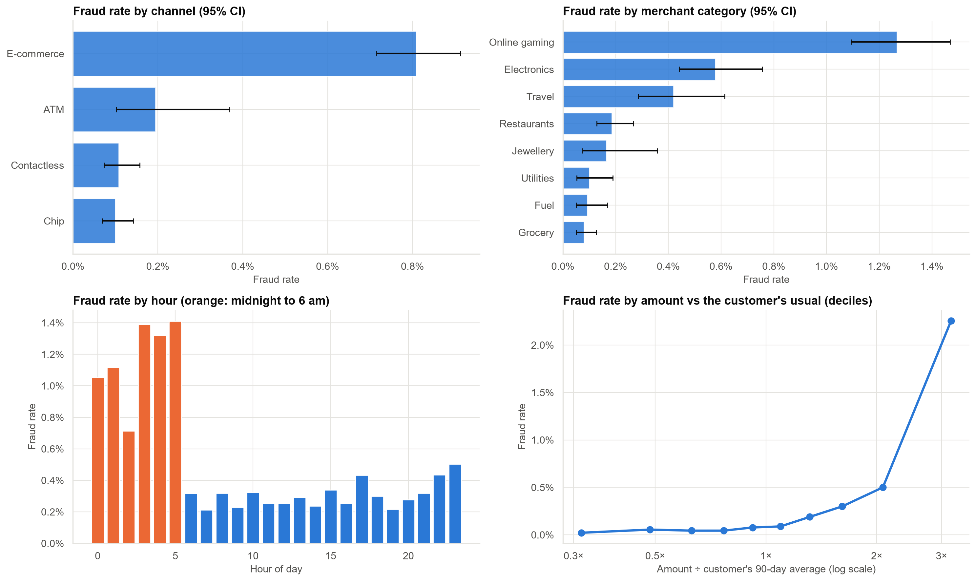
Where fraud happens
E-commerce, online gaming, night-time and unusually large transactions. Even in the riskiest groups, only 1–2% of transactions are fraud.
Case 12 · Card transaction fraud detection · synthetic data
3

Slide 4
'99.6% accurate' can mean 'catches nothing'
Approach (month 4) | Accuracy | Frauds caught | Alerts that are fraud | Fraud ₹ stopped
Flag nothing | 99.5% | 0% | – | 0%
Current rules | 95.5% | 23% | 3% | 62%
Model: top 1% by expected loss | 98.8% | 33% | 17% | 72%
Accuracy hardly moves. What matters is the share of fraud stopped and how clean the alert queue is.
Case 12 · Card transaction fraud detection · synthetic data
4

Slide 5
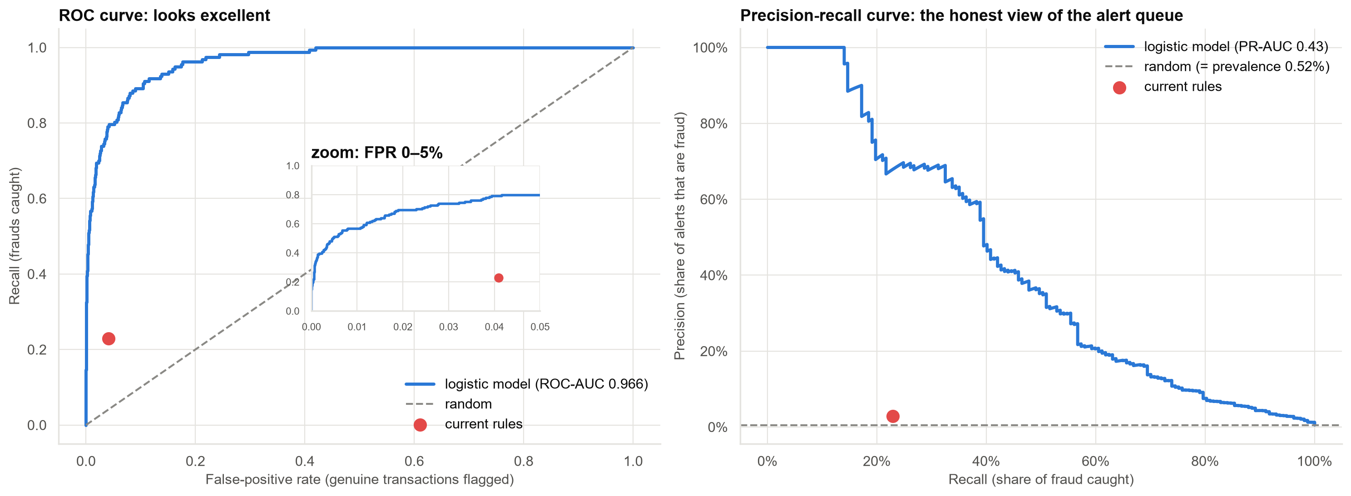
The vendor's 'AUC 0.97' and the view that matters for the alert queue
Same model, two pictures. Left (ROC): looks near-perfect. Right (precision-recall, score 0.43): shows how many alerts are genuine fraud.
Case 12 · Card transaction fraud detection · synthetic data
5

Slide 6
Should we rebalance the data?
0.966 → 0.965
ranking quality
Balancing changes nothing that matters.
0.4% → 17%
average predicted fraud rate
Actual: 0.5%.
−₹5.6 lakh
result of using its probabilities
13,000+ alerts: costs swamp the savings.
Rebalancing only moves the threshold. We can move the threshold directly and keep honest probabilities.
Case 12 · Card transaction fraud detection · synthetic data
6

Slide 7
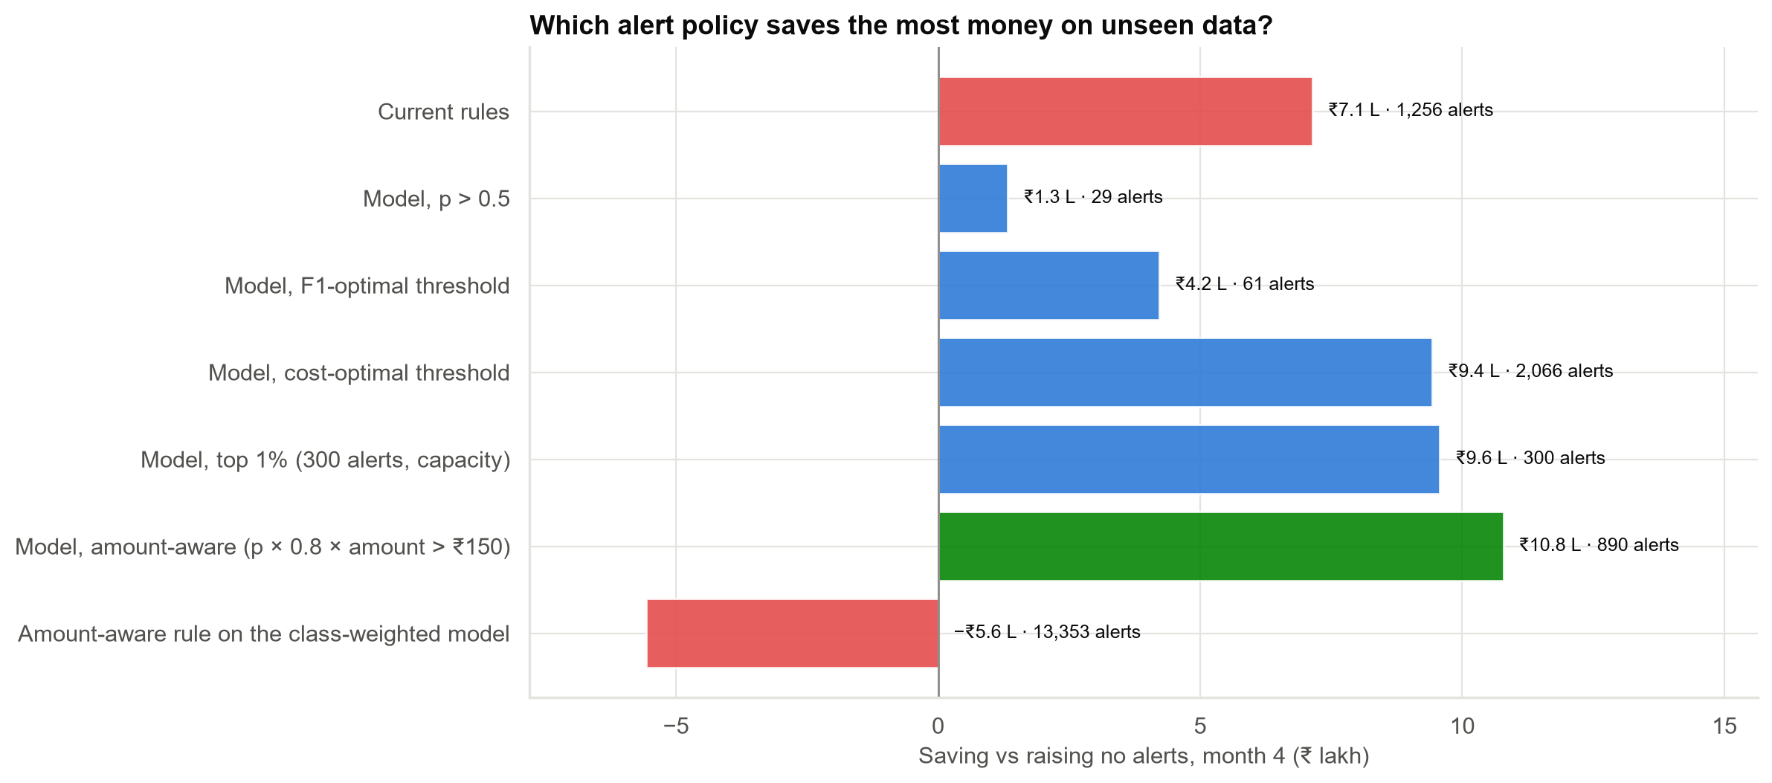
Which alert policy saves the most money? (month 4, unseen)
The best unconstrained policy needs 3× our analysts. Ranking by expected loss within capacity keeps about 92% of its saving.
Case 12 · Card transaction fraud detection · synthetic data
7

Slide 8
How sure are we? Only 157 frauds in the test month
 | Estimate | 95% range
Frauds caught | 33% | 26%–41%
Alerts that are fraud | 17% | 13%–22%
Saving vs no alerts | ₹9.9 lakh | ₹5.0 lakh to ₹16.1 lakh
Extra saving vs current rules | ₹2.8 lakh | ₹0.8 lakh to ₹4.7 lakh
The model is better than the rules in every plausible scenario; how much better is uncertain.
Case 12 · Card transaction fraud detection · synthetic data
8

Slide 9
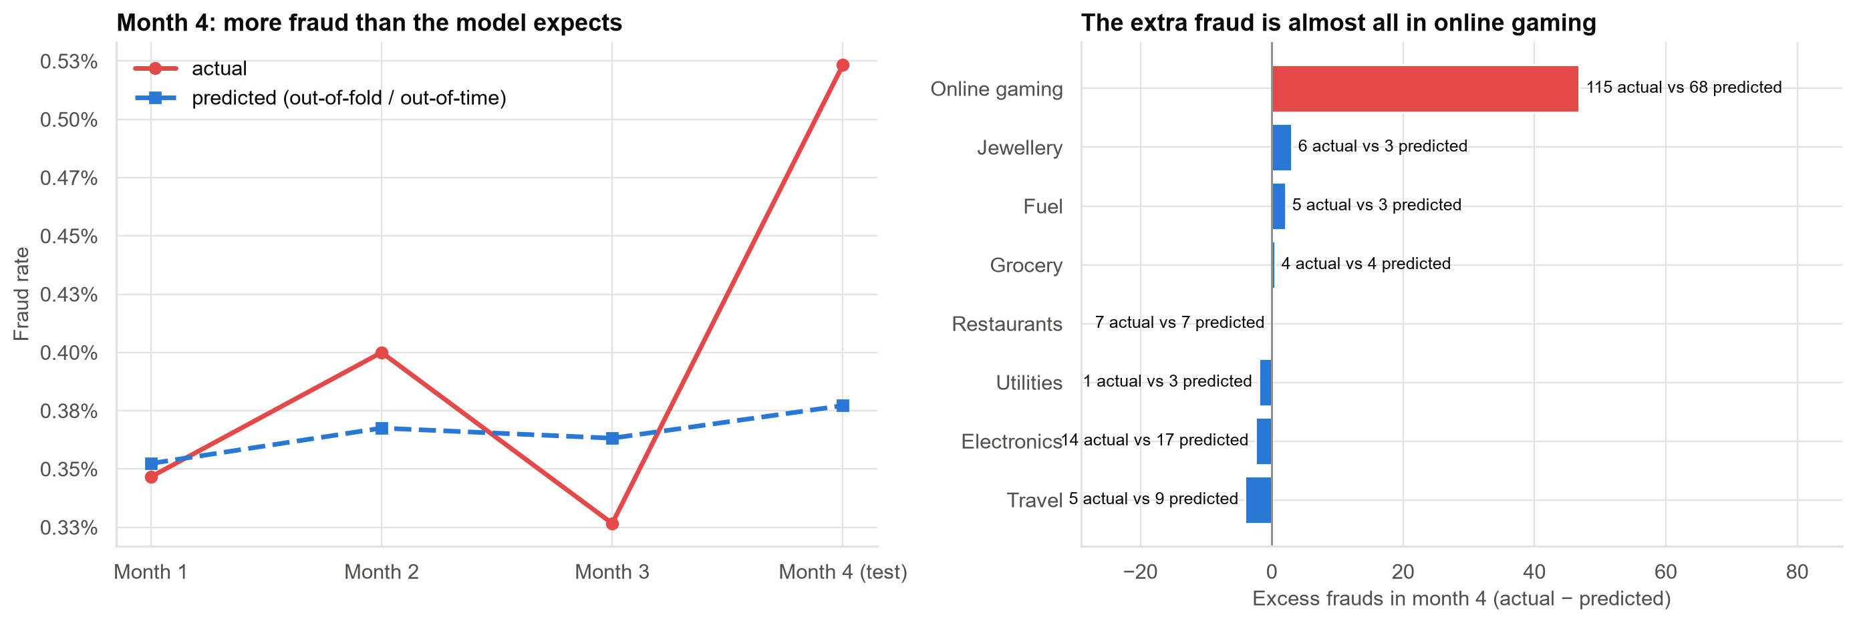
Fraud is shifting: online gaming fraud is rising faster than the model expects
The model must be retrained monthly and its accuracy tracked by merchant type.
Case 12 · Card transaction fraud detection · synthetic data
9

Slide 10
Recommendations
• Replace the two rules with the model. Score every transaction.
• Rank by expected loss (probability × 80% × amount) and send the top 1% to analysts.
• Do not rebalance the training data. If we ever sample for speed, correct the probabilities afterwards.
• Retrain monthly and monitor predicted vs actual fraud by merchant type, starting with online gaming.
• Report precision, recall and rupees stopped with ranges, not accuracy or AUC alone.
Decision needed: approve the switch from rules to the model-based review queue.
Case 12 · Card transaction fraud detection · synthetic data
10

Slide 11
Limitations and next steps
Limitations
Next steps
• One test month with 157 frauds: wide ranges.
• Costs (80% loss, ₹150 per alert) are assumptions.
• Fraud labels arrive late in reality; fraudsters adapt.
• Two-stage policy: auto-decline the very highest risk.
• Retest gradient boosting with 6–12 months of data.
• Monthly drift dashboard by merchant type.
Case 12 · Card transaction fraud detection · synthetic data
11

