Slide 1
Should We Replace Our Scorecard with Machine Learning?
Independent model review for the Chief Risk Officer and Model Risk Committee · Credit Risk Analytics
39,985 card applications (Jan-2023 to Dec-2024) with 12-month outcomes. Synthetic data created for training. Not actual customer data.

Slide 2
Summary: upgrade the scorecard; do not adopt the ML model yet
• The ML team's 'AUC 0.93' is not real. It relies on a field recorded after customers fall into arrears. Without that field, the ML model is no better than today's scorecard (0.77 vs 0.76).
• A better scorecard is available now. Using statistical tests to model curves and one key interaction lifts accuracy on new customers (AUC 0.771 → 0.787), worth about ₹245 lakh a year.
• The ML model does not beat the improved scorecard on new customers (AUC 0.779 vs 0.787). Its extra value is uncertain and roughly equal to its ₹45 lakh running cost.
• ML is not ruled out forever. It is catching up as data grows. We set a clear test it must pass.
Recommendation: deploy the improved scorecard; run the ML model as a silent challenger; review in 12 months.
Case 13 · Is a machine-learning model worth it? · synthetic data
2

Slide 3
The question: is the ML model's gain real, big enough, and lasting?
What the CRO asked
Why the bar for ML is high
• Is the ML team's improvement real?
• Is it big enough to matter in money?
• Will it hold on new customers?
• Could an improved scorecard do just as well?
• Harder to explain decline reasons to customers and the regulator.
• Extended model-risk validation and bias testing.
• New monitoring and retraining infrastructure.
• ≈ ₹45 lakh a year extra running cost.
ML must beat the BEST simple model by more than its cost, on future customers. Beating the old scorecard is not enough.
Case 13 · Is a machine-learning model worth it? · synthetic data
3

Slide 4
How we tested it
39,985
applications
Numerical, ordered and unordered customer attributes.
18 + 6
months: build + test
Models built on older data and tested on the 6 most recent months.
4
models compared
Current scorecard, full scorecard, improved scorecard, ML.
5
independent tests
Cross-validation, out-of-time, DeLong, McNemar, value with uncertainty.
Testing on later months mimics real use: the model always scores customers it has never seen.
Case 13 · Is a machine-learning model worth it? · synthetic data
4

Slide 5
The ML team's headline came from a field we cannot use at application time
0.96
ML with the leaky field
Reproduces (and exceeds) the claimed 0.93.
0.77
ML without it
Same random-split test as the ML team.
0.76
current scorecard
Same test: no meaningful difference.
After
when the field is filled
Collections contact happens once a customer is already in arrears.
'Too good to be true' results usually are. Every model review must check when each field is recorded.
Case 13 · Is a machine-learning model worth it? · synthetic data
5

Slide 6
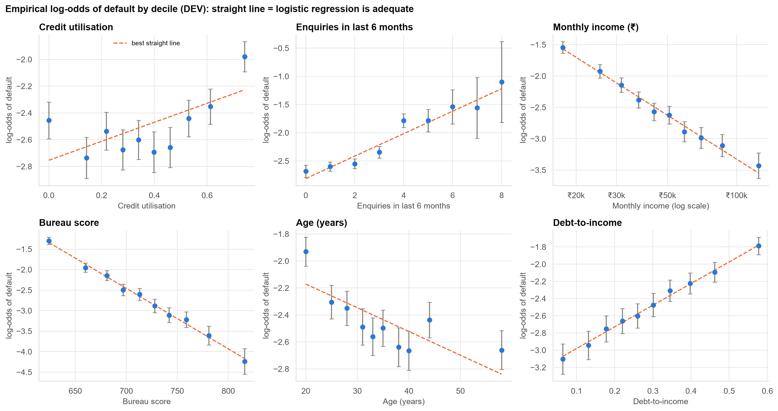
Risk follows curves and thresholds, which a well-built scorecard can capture
• Utilisation: risk is high at 0% and rises steeply at high usage.
• Enquiries: risk jumps after 3 in six months.
• Debt burden hurts the self-employed far more.
• Each pattern was confirmed by a statistical test before entering the model.
Case 13 · Is a machine-learning model worth it? · synthetic data
6

Slide 7
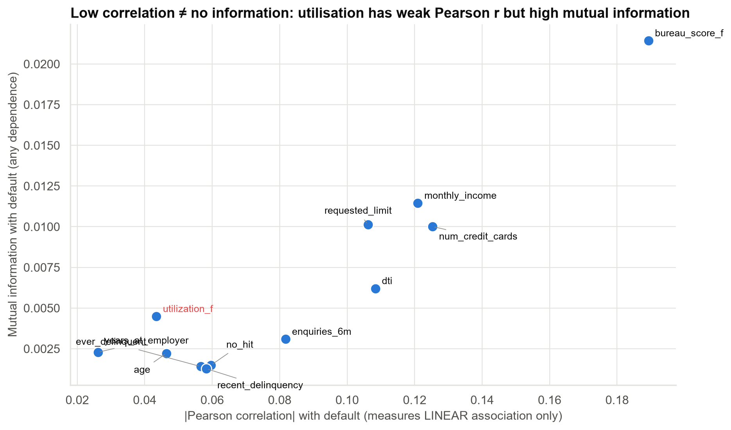
A weak correlation does not mean a weak predictor
• Utilisation barely correlates with default, yet carries real information.
• Its U-shape cancels out in a simple correlation.
• A 'drop low-correlation variables' rule would have thrown it away.
Case 13 · Is a machine-learning model worth it? · synthetic data
7

Slide 8
The improved scorecard is the most accurate model on new customers
Model | Accuracy on new customers (AUC) | Annual value | Explainable?
Current scorecard | 0.771 | ₹2,020 lakh | Yes
Full scorecard (all variables) | 0.781 | ₹2,072 lakh | Yes
Improved scorecard (curves + interaction) | 0.787 | ₹2,266 lakh | Yes
ML model (gradient boosting) | 0.779 | ₹2,304 lakh | Needs extra tooling
Improved vs current scorecard: about ₹245 lakh a year (likely −₹23 lakh to ₹455 lakh).
Case 13 · Is a machine-learning model worth it? · synthetic data
8

Slide 9
Four tests, one consistent answer: the ML model has not earned its place
Question | Answer
Improved vs current scorecard: better? | Yes: AUC +0.017, not chance
ML vs improved scorecard: better? | No: AUC −0.009 (ML slightly worse)
ML vs improved scorecard: different decisions? | No meaningful difference at our approval cut-off
ML vs improved scorecard: worth its cost? | Unclear: +₹39 lakh/yr vs ₹45 lakh cost; 46% chance it pays
The ML model finds the same risk signals as the improved scorecard. It does not find new ones.
Case 13 · Is a machine-learning model worth it? · synthetic data
9

Slide 10
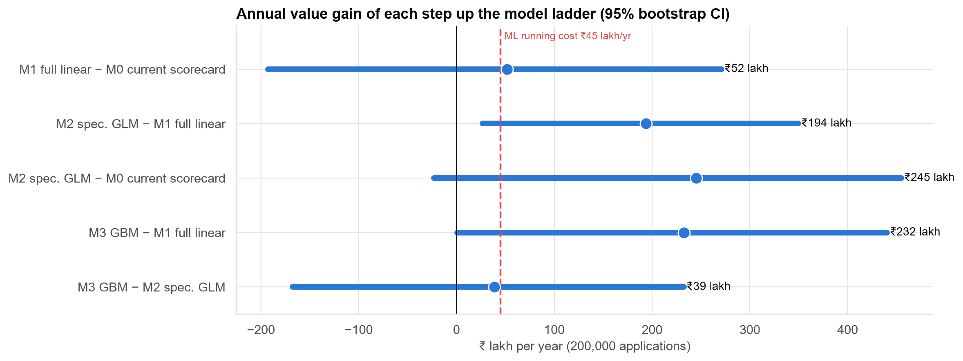
Each step's value, with its uncertainty
The scorecard upgrade very likely pays (about 97% probability). The ML step is as likely to fall short of its cost as to exceed it.
Case 13 · Is a machine-learning model worth it? · synthetic data
10

Slide 11
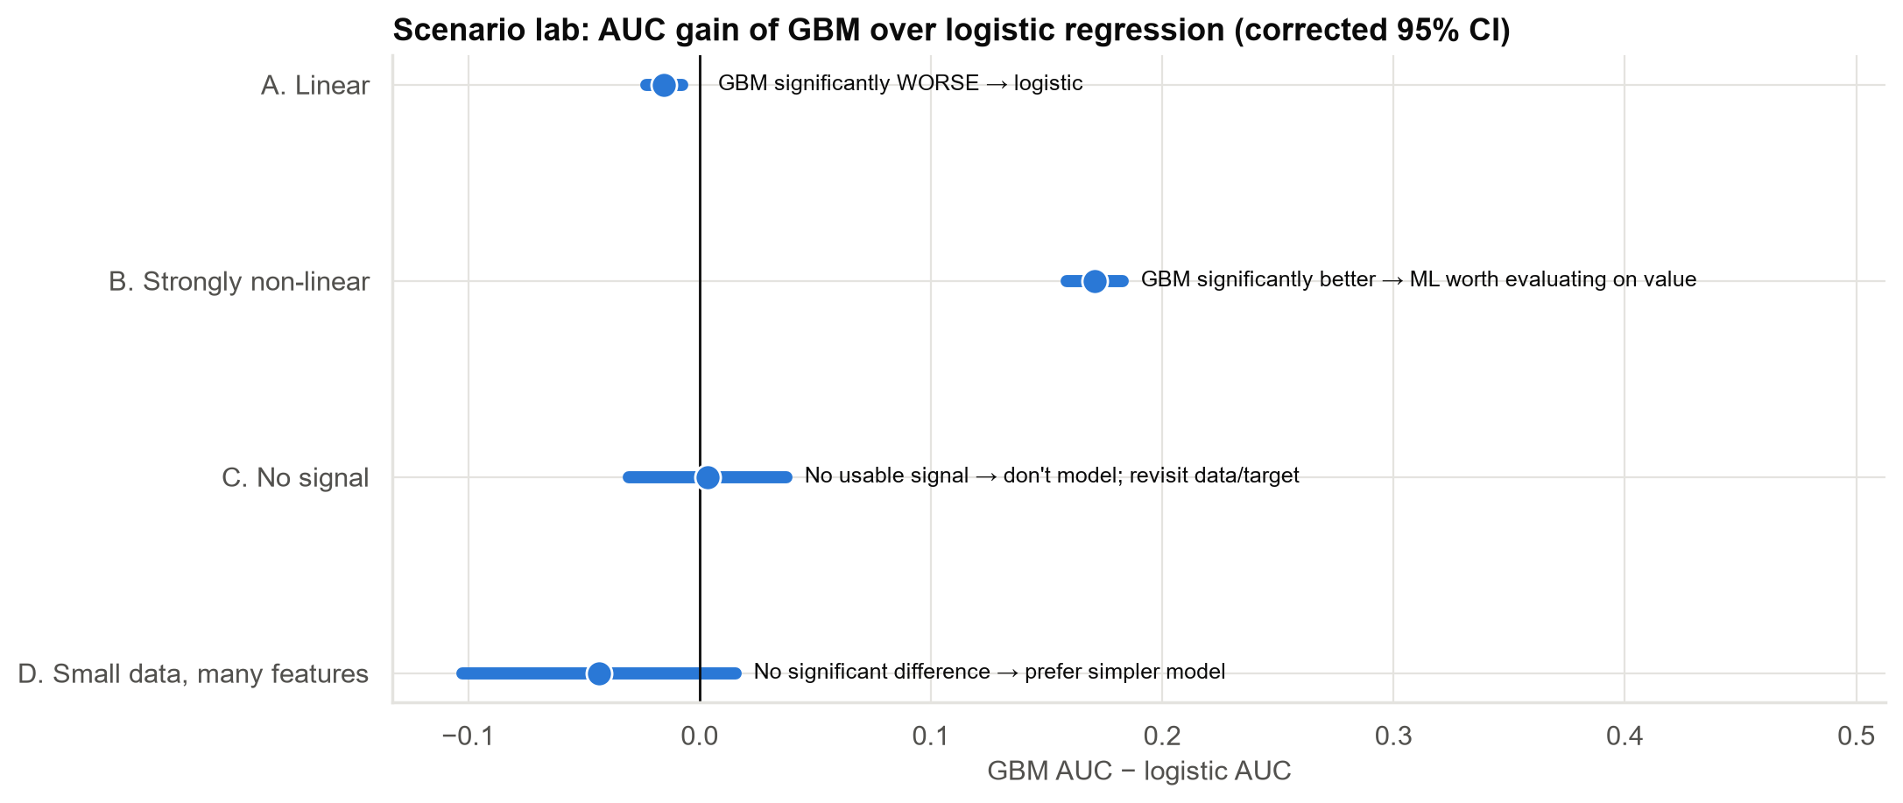
When ML IS worth it: a simulation of four different worlds
• Simple patterns: ML is worse.
• Complex, tangled patterns: ML wins clearly.
• No signal: no model helps.
• Little data: simple models win.
• Our data looks like a mix of the first two, so an improved scorecard is enough today.
Case 13 · Is a machine-learning model worth it? · synthetic data
11

Slide 12
A standing test for any future ML proposal
• No leakage: every field must exist at decision time.
• Tested on later months, not a random sample of the same period.
• Compared with the best scorecard, not the old one.
• Gain confirmed by valid statistical tests (corrected for repeated testing).
• Value gain clearly above running cost, including its uncertainty.
• Explainable enough for decline reasons and Model Risk approval.
Adopt this as model-governance policy, so future ML decisions are made on evidence, not on headlines.
Case 13 · Is a machine-learning model worth it? · synthetic data
12

Slide 13
Recommendations
• Reject the ML proposal as submitted. Its headline result depends on a post-event field.
• Deploy the improved scorecard (≈ ₹6 lakh one-off, within existing systems).
• Run the ML model as a silent challenger, scored in parallel and compared monthly.
• Review in 12 months with more data. The ML model's accuracy is still rising with data size.
• Fix data lineage: flag post-decision fields in the data warehouse so they cannot leak again.
Decision for the Committee: approve the scorecard upgrade and the challenger set-up; decline the ML switch for now.
Case 13 · Is a machine-learning model worth it? · synthetic data
13

Slide 14
Limitations and next steps
Limitations
Next steps
• Outcomes are known only for approved customers.
• Loss and profit per customer are averages.
• One 6-month test window (~10,000 applications).
• Real data may hold richer patterns than this study.
• Validate the improved scorecard's decline reasons with Credit Policy.
• Fairness testing across customer groups.
• Champion–challenger reporting from next month.
• Test new data sources (e.g., bank statements), where ML often helps more.
Case 13 · Is a machine-learning model worth it? · synthetic data
14

