Slide 1
Where Should Next Year's Acquisition Budget Go?
Comparing five card-acquisition channels · Cards Marketing analytics
6,000 customers acquired last year, first-year net revenue and cost per acquisition by channel. Synthetic data created for training. Not actual customer data.

Slide 2
Summary: the aggregator is not our best channel, and social media is not our worst investment
• Channels do differ in first-year revenue per customer, but only social media is reliably lower (₹2,188 vs about ₹3,050–3,300 elsewhere).
• The aggregator's lead is not reliable and comes from richer customers: at the same income, its customers are worth about ₹659 less than branch customers.
• After acquisition cost, the partner co-brand is best (₹2,146 net per customer) and the aggregator worst (₹409).
• Social media is cheap: it returns more value per rupee than branch, search or the aggregator.
Recommendation: do not double the aggregator or cut social media; grow the partner channel and test before big shifts.
Case 14 · Which acquisition channel brings the most valuable customers? · synthetic data
2

Slide 3
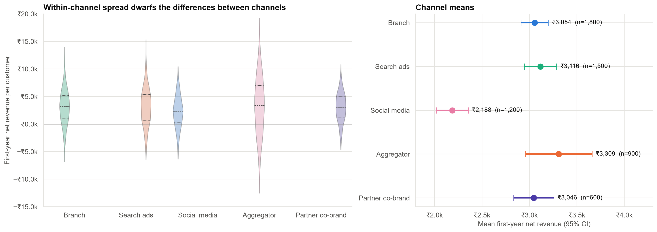
Customers vary far more within a channel than between channels
Channel explains only about 1% of the variation in customer revenue, but ₹ differences × volume still matter.
Case 14 · Which acquisition channel brings the most valuable customers? · synthetic data
3

Slide 4
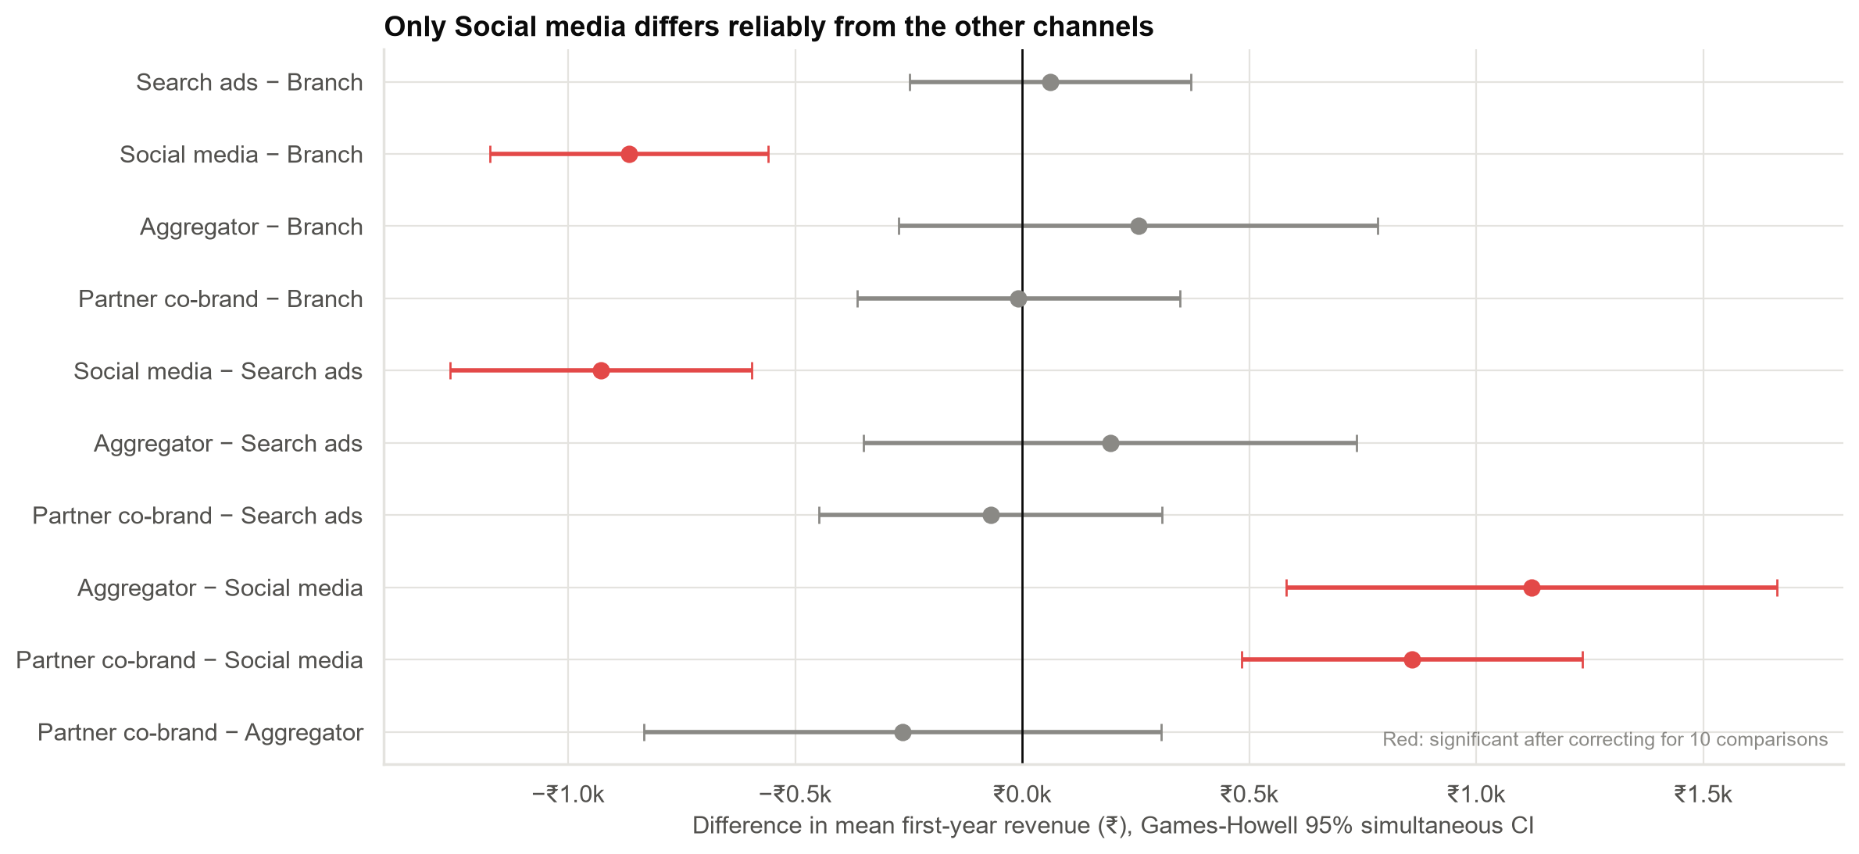
Which channels really differ? Only social media stands out
All 10 pairs compared at once, with a correction so that chance differences are not mistaken for real ones.
Case 14 · Which acquisition channel brings the most valuable customers? · synthetic data
4

Slide 5
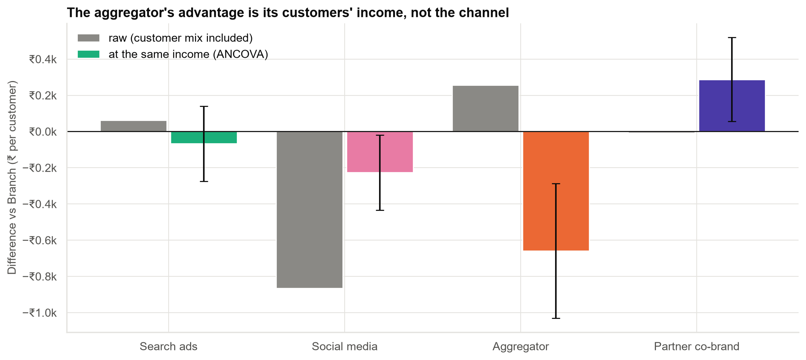
The aggregator's advantage is its customers' income, not the channel
High-income customers from the aggregator are worth less than high-income customers from other channels.
Case 14 · Which acquisition channel brings the most valuable customers? · synthetic data
5

Slide 6
Net of what each customer cost us, the ranking reverses
Channel | Revenue per customer | Cost per acquisition | Net per customer | Value per ₹1 spent
Branch | ₹3,054 | ₹2,200 | ₹854 | ₹1.39
Search ads | ₹3,116 | ₹1,800 | ₹1,316 | ₹1.73
Social media | ₹2,188 | ₹1,100 | ₹1,088 | ₹1.99
Aggregator | ₹3,309 | ₹2,900 | ₹409 | ₹1.14
Partner co-brand | ₹3,046 | ₹900 | ₹2,146 | ₹3.38
The aggregator has the highest revenue per customer and the lowest return on spend.
Case 14 · Which acquisition channel brings the most valuable customers? · synthetic data
6

Slide 7
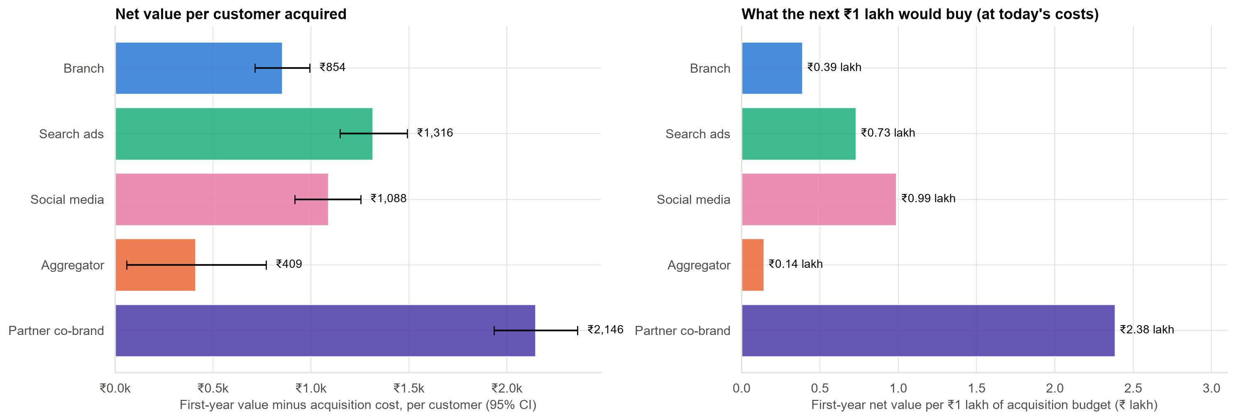
What the next ₹1 lakh would buy, at today's costs
Averages, not marginal returns: doubling a channel's budget may bring worse or costlier customers.
Case 14 · Which acquisition channel brings the most valuable customers? · synthetic data
7

Slide 8
How sure are we?
p < 0.001
channels differ (Welch test)
F = 21.8; robust to unequal spreads.
1%
of customer variation explained by channel
Small per customer, material across thousands.
±₹140–356
95% range on net value per customer
Partner clearly best; aggregator's range nearly reaches zero.
The ranking of partner (best) and aggregator (worst) is robust; the middle three are closer.
Case 14 · Which acquisition channel brings the most valuable customers? · synthetic data
8

Slide 9
Recommendations
• Do not double the aggregator budget. It is the most expensive channel and, at the same income, the weakest.
• Do not cut social media on revenue alone: it is cheap and returns more per rupee than branch or aggregator.
• Grow the partner co-brand as far as its capacity allows.
• Test whether high-income customers can be reached more cheaply through search or partners.
• Run a controlled budget test (some regions or weeks) before any large shift, to measure marginal returns.
Decision needed: approve a partner-led reallocation and a budget-shift test.
Case 14 · Which acquisition channel brings the most valuable customers? · synthetic data
9

Slide 10
Limitations and next steps
Limitations
Next steps
• Observed, not randomised: channels were not assigned at random.
• Average, not marginal, costs and values.
• First-year value only; retention may differ.
• Geo budget-shift experiment.
• Extend to lifetime value.
• Add card type as a second factor.
Case 14 · Which acquisition channel brings the most valuable customers? · synthetic data
10

