Slide 1
Which Branches Are Slow, and Did the New Workflow Help?
Branch comparison and workflow pilot · Lending Operations analytics
190 personal loans from 5 branches; a 20-officer workflow pilot. Synthetic data created for training. Not actual customer data.

Slide 2
Summary: two branches are slower, and the workflow saves about a day; the 'not significant' verdict came from the wrong test
• Panvel and Thane are slower: typical times 10 and 8 days vs about 6 at Andheri, Borivali and Vashi.
• Averages hide it: a few 'stuck' loans of 40–70 days blur the means. A test of averages found nothing (p = 0.10); a test of typical times found a clear difference (p < 0.001).
• The new workflow cut a typical officer's time by about a day (≈ 12%): 18 of 20 officers got faster.
• One officer got 16 days slower because of an unrelated system migration. It dragged the average change to −0.4 days and made the usual test say 'p = 0.65'.
Recommendation: roll out the workflow after fixing the migration issue; review processes at Panvel and Thane.
Case 15 · Branch loan processing times and a new workflow · synthetic data
2

Slide 3
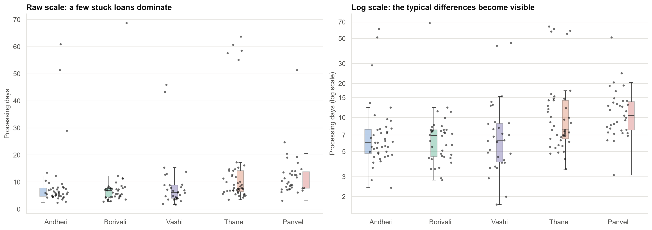
Stuck loans dominate the raw numbers; on a log scale the branch differences show
Every branch has a few loans stuck for 40–70 days; typical loans at Panvel and Thane take longer.
Case 15 · Branch loan processing times and a new workflow · synthetic data
3

Slide 4
Same data, opposite answers: it depends on what the test compares
Test | Result | Verdict
Test of averages (ANOVA) | p = 0.10 | No difference found
Test of averages, unequal spread (Welch) | p = 0.13 | No difference found
Test of log times (ANOVA) | p < 0.001 | Branches differ
Test of typical times (Kruskal-Wallis) | p < 0.001 | Branches differ
Stuck loans inflate the noise in average-based tests. Pick the test from the question and the data's shape, before looking at results.
Case 15 · Branch loan processing times and a new workflow · synthetic data
4

Slide 5
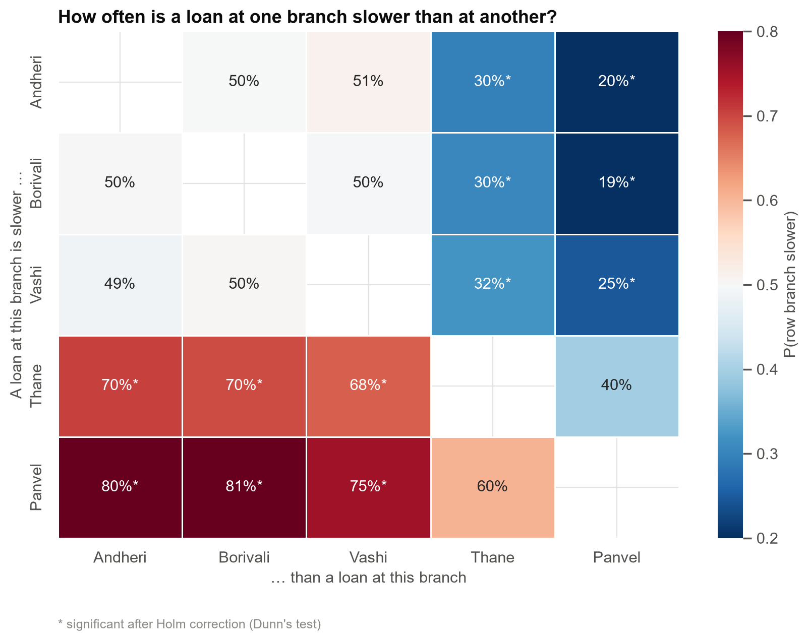
How often is a loan at one branch slower than at another?
6 of 10 pairs differ after correcting for multiple comparisons; Andheri, Borivali and Vashi are indistinguishable.
Case 15 · Branch loan processing times and a new workflow · synthetic data
5

Slide 6
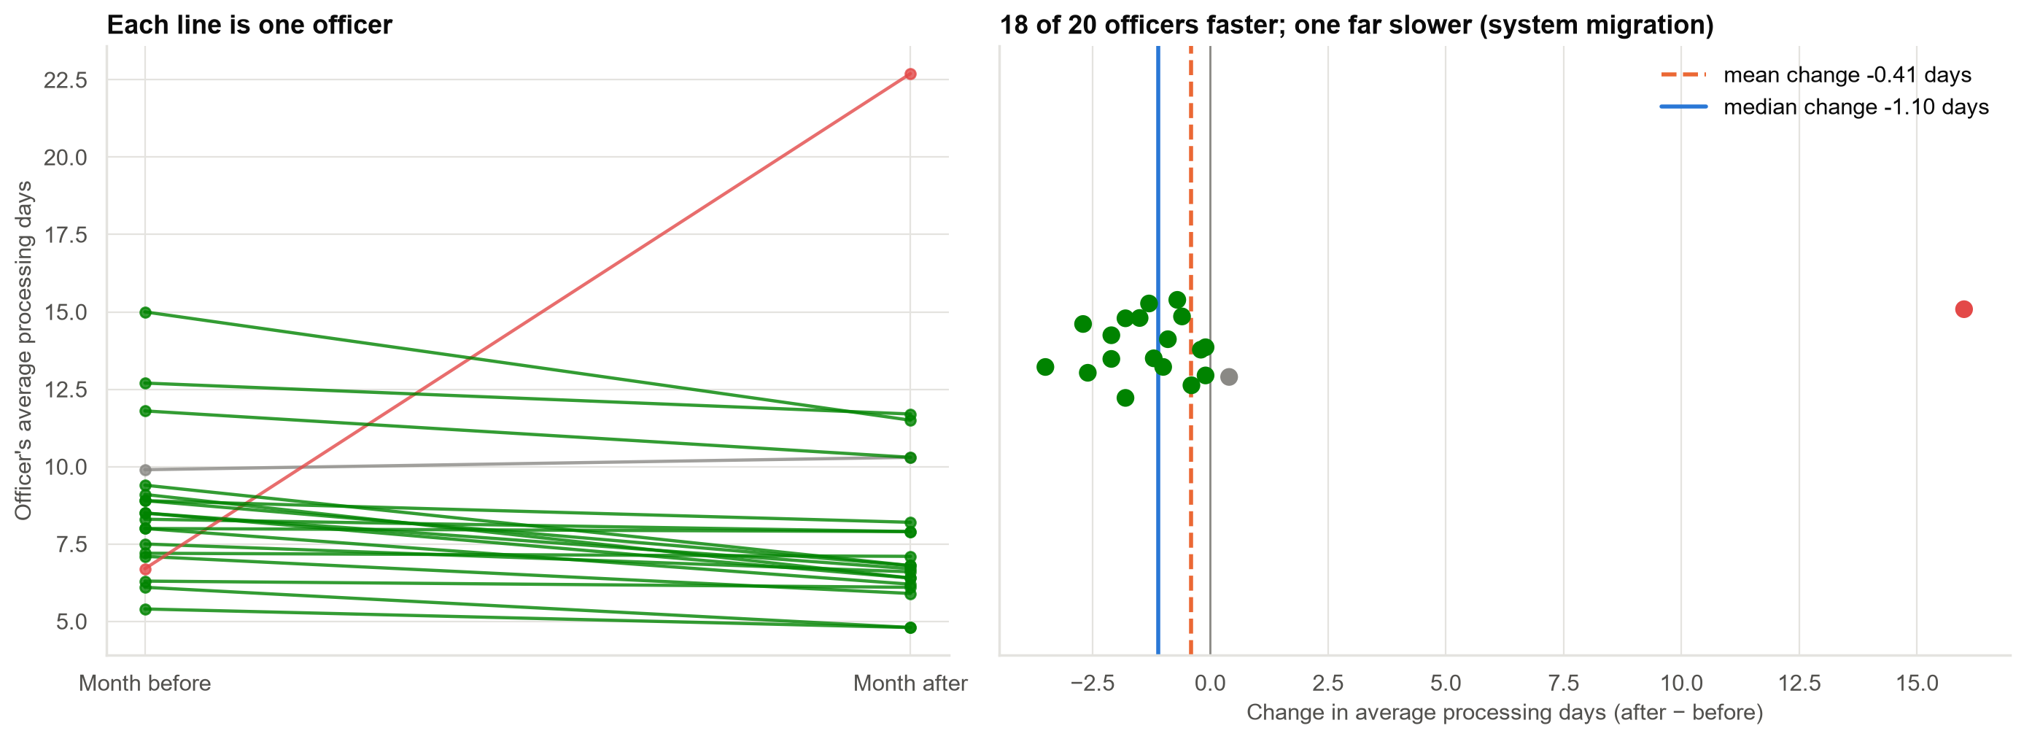
Workflow pilot: most officers got faster; one got much slower
The one slow officer (red) was affected by a system migration, not by the workflow.
Case 15 · Branch loan processing times and a new workflow · synthetic data
6

Slide 7
Workflow: the verdict depends on whether one extreme officer is allowed to dominate
Test | Result | Verdict
Paired t-test (average change) | p = 0.65 | Not significant
Wilcoxon signed-rank (typical change) | p = 0.003 | Significant
Sign test (how many improved) | p < 0.001 | Significant
Permutation test (average change) | p = 0.86 | Not significant
Typical change: −1.1 days (95% range −1.6 to −0.6). Without the migration-affected officer, every test agrees.
Case 15 · Branch loan processing times and a new workflow · synthetic data
7

Slide 8
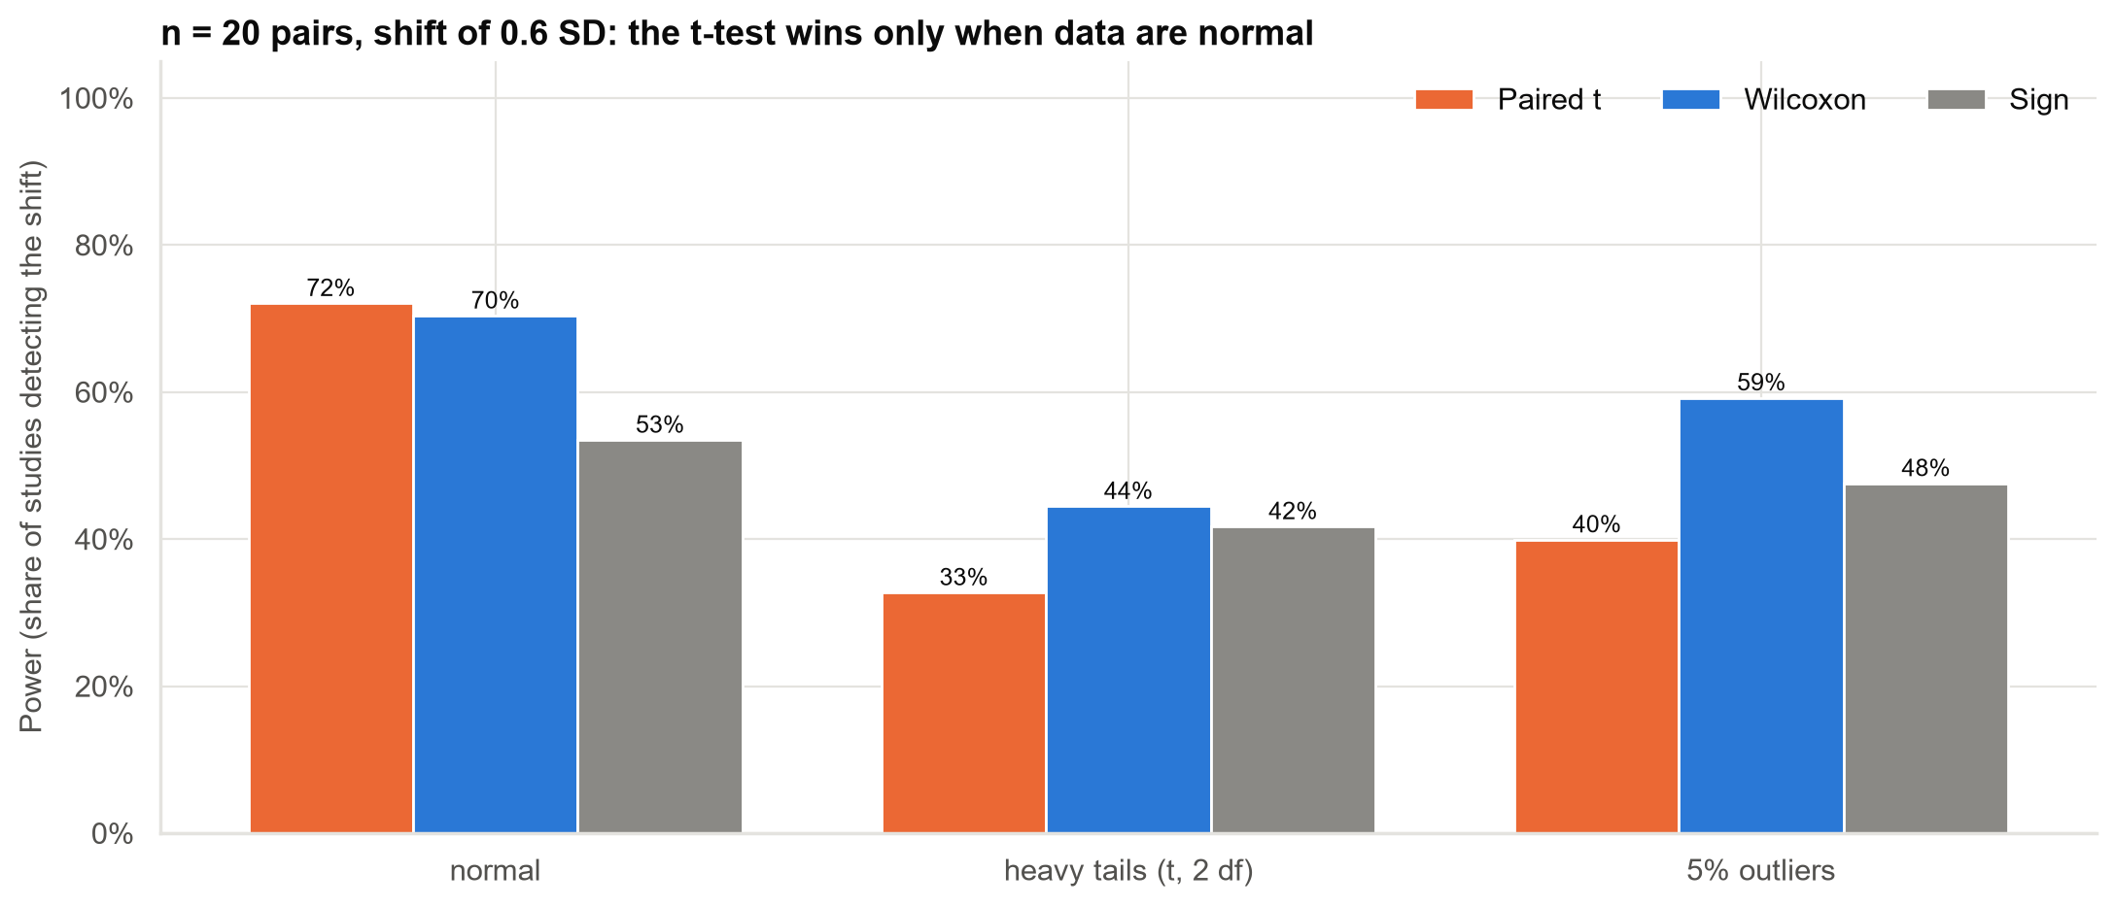
When does each test win? Simulation with 20 pairs
With outliers or heavy tails, rank-based tests detect real effects far more often; with clean normal data, they lose very little.
Case 15 · Branch loan processing times and a new workflow · synthetic data
8

Slide 9
Recommendations
• Roll out the new workflow, after resolving the migration problem that delayed one officer.
• Review processes at Panvel and Thane, separately from the stuck-loan problem, which affects every branch.
• Report median processing time and the share of loans over 20 days as two separate measures.
• Use rank-based tests for small samples of processing times; use averages only when ₹ totals matter.
• Roll out in stages with comparison branches, so improvement can be separated from seasonality.
Decision needed: approve the roll-out and the process reviews.
Case 15 · Branch loan processing times and a new workflow · synthetic data
9

Slide 10
Limitations and next steps
Limitations
Next steps
• Branch case mix (loan size, customer type) may differ.
• The pilot had no control group.
• 20 officers, one month before and after.
• Stepped roll-out across branches.
• Model time-to-disbursement with loan characteristics.
• Early-warning flag for stuck loans.
Case 15 · Branch loan processing times and a new workflow · synthetic data
10

