Slide 1
Which Unusual Payments Are Problems, and Which Are Our Best Customers?
An outlier policy for payment monitoring · Risk Analytics for Payments Operations
20,230 payments over a quarter. Synthetic data created for training. Not actual customer data.

Slide 2
Summary: the '3 standard deviations' rule flags the wrong payments and misses the right ones
• The dashboard flags 58 payments; 35 (60%) are harmless (VIPs, festival purchases, ordinary large payments).
• It catches only 52% of the keying errors and 3% of the fraud.
• A three-lens screen (unusual for the segment, for the customer, and several risk flags) catches all 40 errors and all 60 frauds with 130 flags, and none of the VIP or festival payments.
• Doing nothing about errors overstates the average ticket by 17%; deleting the dashboard's flags understates it by 3.5%.
Recommendation: retire the 3-SD rule; correct errors, investigate fraud, keep and whitelist VIP and festival payments.
Case 16 · Payment outliers: error, fraud, VIP or rare event? · synthetic data
2

Slide 3
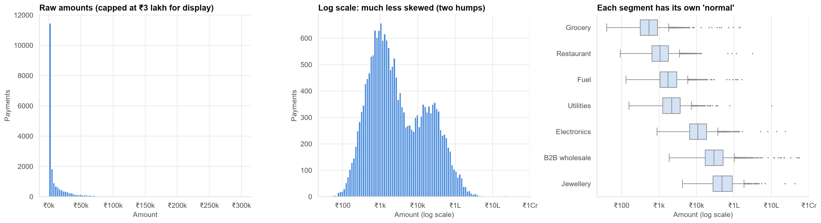
Payments are far from 'normally' distributed: each segment has its own normal
A ₹40,000 payment is routine at a jeweller and extraordinary at a grocer. One mean and one spread cannot describe both.
Case 16 · Payment outliers: error, fraud, VIP or rare event? · synthetic data
3

Slide 4
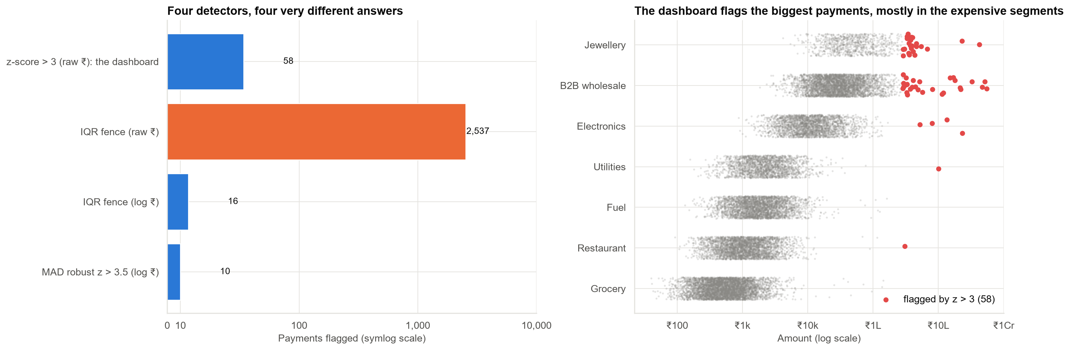
Four ways to define 'unusual' give 10, 16, 58 or 2,537 payments
The dashboard's flags are simply the largest payments in the two most expensive segments.
Case 16 · Payment outliers: error, fraud, VIP or rare event? · synthetic data
4

Slide 5
There are four kinds of unusual payment, and each needs a different action
• Data error: typed 100× too large by an operator → correct it and fix the process.
• Fraud: new device, location mismatch, night time, burst → investigate; never delete.
• VIP: long-standing top-tier customer, amount in line with their own history → keep; do not alert.
• Rare real event: festival-week buying of jewellery or electronics by regular customers → keep; add an event calendar.
The amount alone cannot tell them apart. Context can.
Case 16 · Payment outliers: error, fraud, VIP or rare event? · synthetic data
5

Slide 6
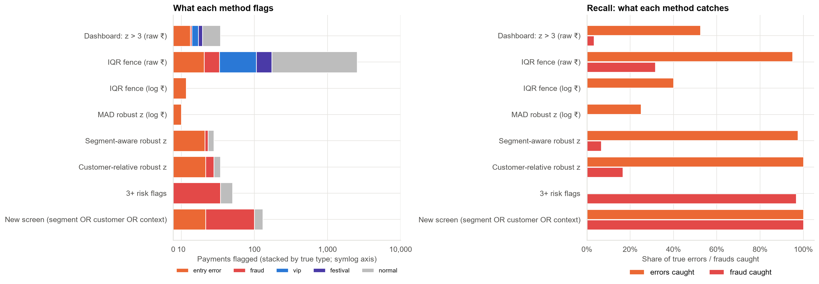
What each method catches: only the combined screen finds both errors and fraud
Left: what is flagged, by true type. Right: the share of real errors and frauds each method catches.
Case 16 · Payment outliers: error, fraud, VIP or rare event? · synthetic data
6

Slide 7
Scorecard of the methods
Method | Flags | Errors caught | Fraud caught
Dashboard: 3 SD on raw ₹ | 58 | 52% | 3%
IQR fence on raw ₹ | 2,537 | 95% | 32%
Robust z on log ₹ (MAD) | 10 | 25% | 0%
Unusual for the customer | 58 | 100% | 17%
Several risk flags | 73 | 0% | 97%
Combined screen | 130 | 100% | 100%
Each lens finds something the others miss. Together they find everything with 130 flags instead of 2,537.
Case 16 · Payment outliers: error, fraud, VIP or rare event? · synthetic data
7

Slide 8
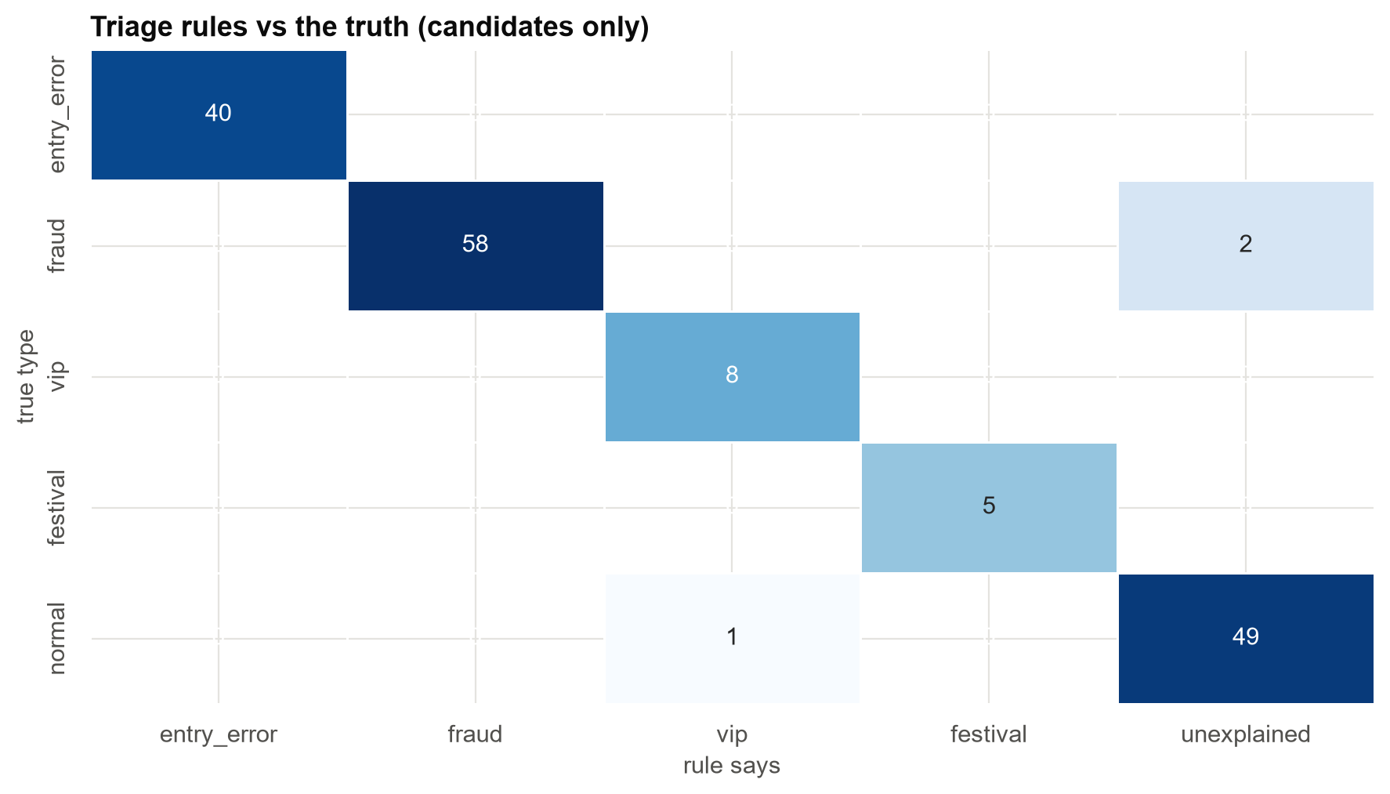
Triage by what the payment is: the rules separate errors, fraud, VIP and festival buying
Errors: 100% precise. Fraud: 100% precise, 97% caught. The remainder is ordinary variation.
Case 16 · Payment outliers: error, fraud, VIP or rare event? · synthetic data
8

Slide 9
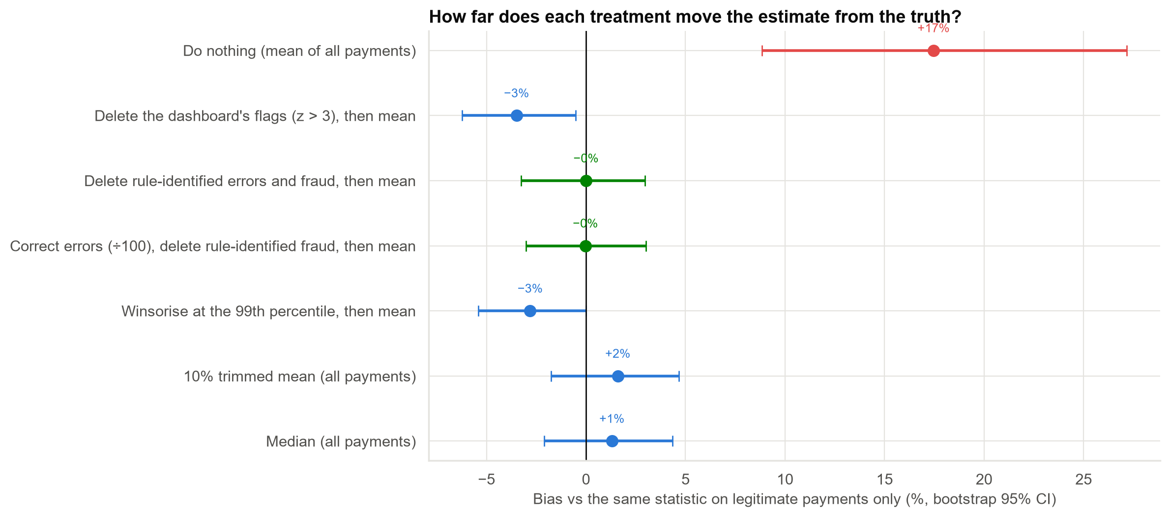
What each treatment does to the average ticket size Finance uses
Ignoring errors: +17%. Deleting all large payments or capping them also distorts. Correcting identified errors gets within 0.1%.
Case 16 · Payment outliers: error, fraud, VIP or rare event? · synthetic data
9

Slide 10
Outliers and the numbers Finance and Risk use
• Average ticket: correct identified errors and keep genuine extremes (−0.04% off the truth).
• Typical ticket: the median or a trimmed mean needs no cleaning.
• Correlations: 40 keying errors cut the correlation between a payment and the customer's usual payment from 0.81 to 0.30; rank and log-scale versions barely move.
• Never delete a payment because it is big. VIP and festival payments are data, and the model needs them.
Delete only what is wrong, and only when you know it is wrong.
Case 16 · Payment outliers: error, fraud, VIP or rare event? · synthetic data
10

Slide 11
Recommendations
• Retire the '3 standard deviations' dashboard rule.
• Screen on the log scale, with three lenses: unusual for the segment, unusual for the customer, several risk flags.
• Route by type: errors to correction, fraud to investigators, VIP and festival payments off the queue.
• Add keying controls: a 'did you mean ₹X?' check when an amount is 10× or more above the customer's usual.
• Audit a random sample of flagged and unflagged payments each quarter to keep the rules honest.
Decision needed: approve the new screen and routing rules.
Case 16 · Payment outliers: error, fraud, VIP or rare event? · synthetic data
11

Slide 12
Limitations and next steps
Limitations
Next steps
• Rules are tuned to this simulated mix; real outliers overlap more.
• Fraud confirmation lags by weeks in reality.
• Thresholds are choices and should be tested on audits.
• Stratified audit sample to measure precision and recall.
• Supervised fraud model with confirmed labels (Case 12).
• Festival calendar feature.
Case 16 · Payment outliers: error, fraud, VIP or rare event? · synthetic data
12

