Slide 1
What to Do When a Quarter of Applications Have No Income
Handling missing income in the personal-loan scorecard · Credit Risk analytics
8,000 personal-loan applications with a known 12-month outcome. Synthetic data created for training. Not actual customer data.

Slide 2
Summary: neither 'delete them' nor 'fill with the average' is safe
• 23% of applications have no income, and it is not random: gig and self-employed applicants, agent and online channels and, crucially, later defaulters leave it out (31% default vs 15% when income is given).
• Over 150 repeated datasets, deleting them weakens the estimated protective effect of income by 14% and its CI contains the truth only 56% of the time; mean-filling weakens it by 43% (coverage 0%).
• Multiple imputation that includes the outcome has the smallest bias (8%) and 91% coverage; leaving the outcome out is as bad as a single fill (32% bias, 0% coverage).
• For scoring new applicants the best approach is different: a simple fill plus a 'income missing' flag, because not providing income is itself a risk signal.
Recommendation: multiple imputation (outcome included) for estimation; mean-fill plus flag for scoring; a sensitivity range for the unknowable part.
Case 17 · The missing income problem · synthetic data
2

Slide 3
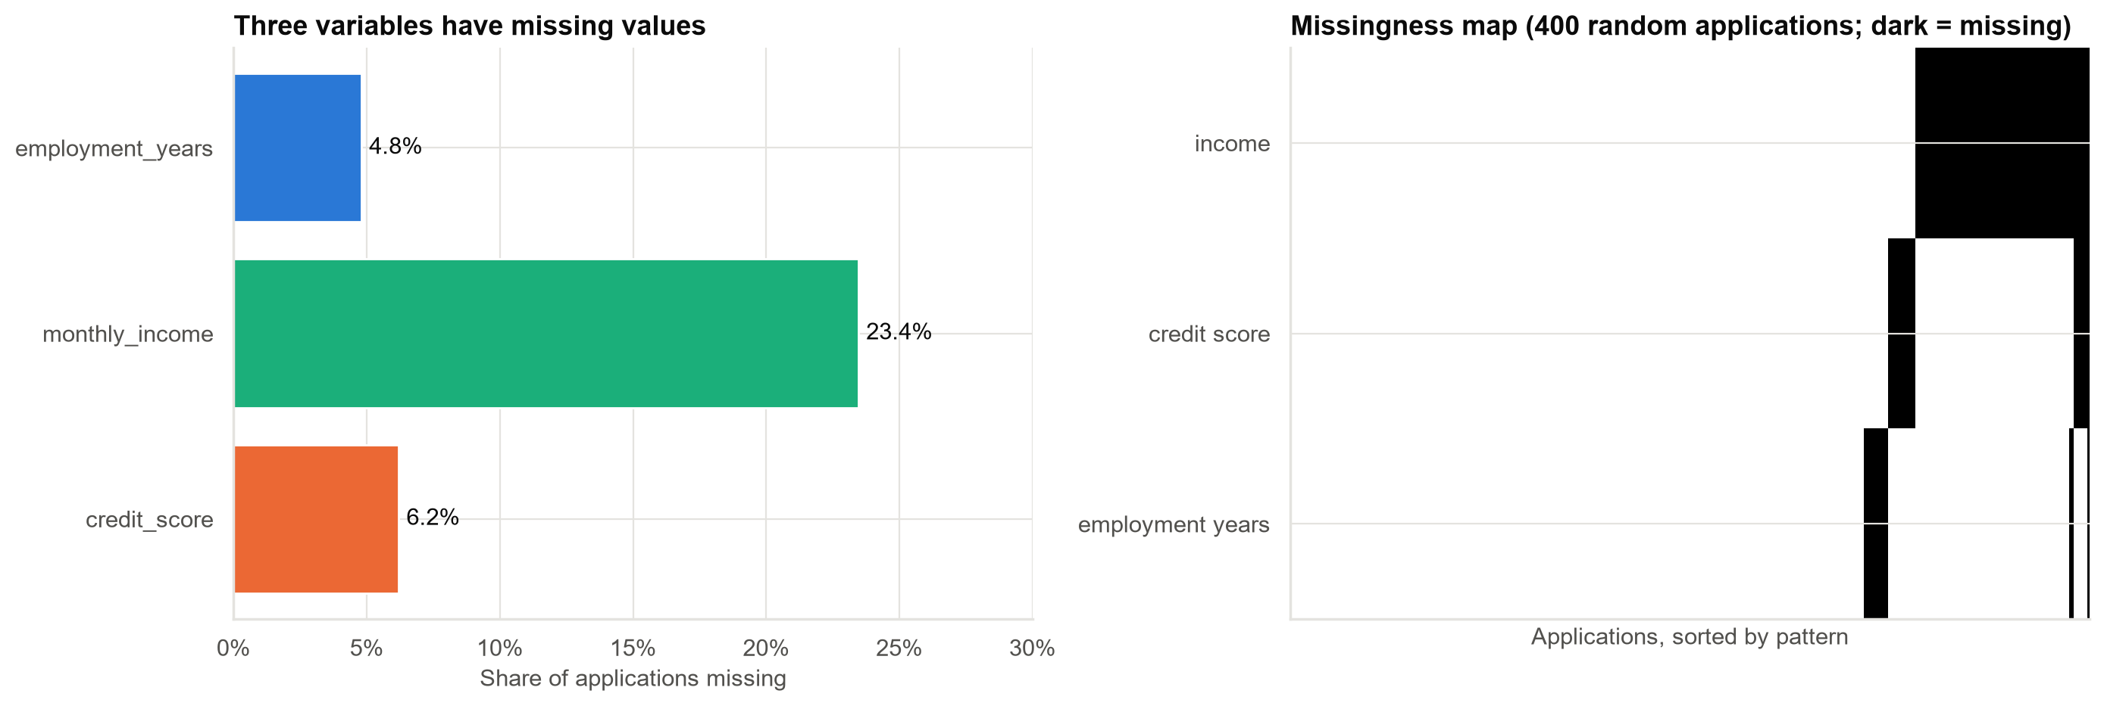
Income is missing for a quarter of applications; score and years for far fewer
Missing credit scores mean 'no credit history' (a thin file), not lost data, so they are modelled differently.
Case 17 · The missing income problem · synthetic data
3

Slide 4
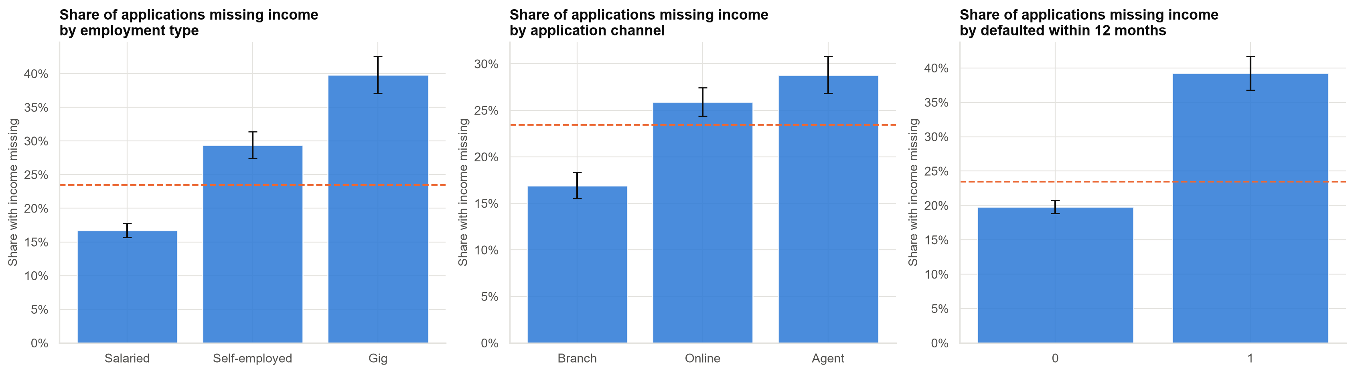
Who leaves income out? Self-employed, gig workers, agent and online applicants, and later defaulters
Because missingness is related to default itself, deleting these applications selects a healthier sample.
Case 17 · The missing income problem · synthetic data
4

Slide 5
Estimating the effect of income on default (truth −1.10; closer to it is better)
Strategy | Income effect | Off by | Spread of income
Complete cases (delete) | −0.96 | 13% | 0.50
Mean imputation | −0.66 | 41% | 0.44
Group-mean imputation | −0.73 | 34% | 0.45
Regression imputation (one value) | −0.89 | 19% | 0.48
Multiple imputation, outcome left out | −0.74 | 33% | 0.51
Multiple imputation, outcome included | −0.98 | 11% | 0.51
In this one dataset, deleting and MI-with-outcome look similar and both CIs cover the truth. One dataset can mislead: see the repeated test next.
Case 17 · The missing income problem · synthetic data
5

Slide 6
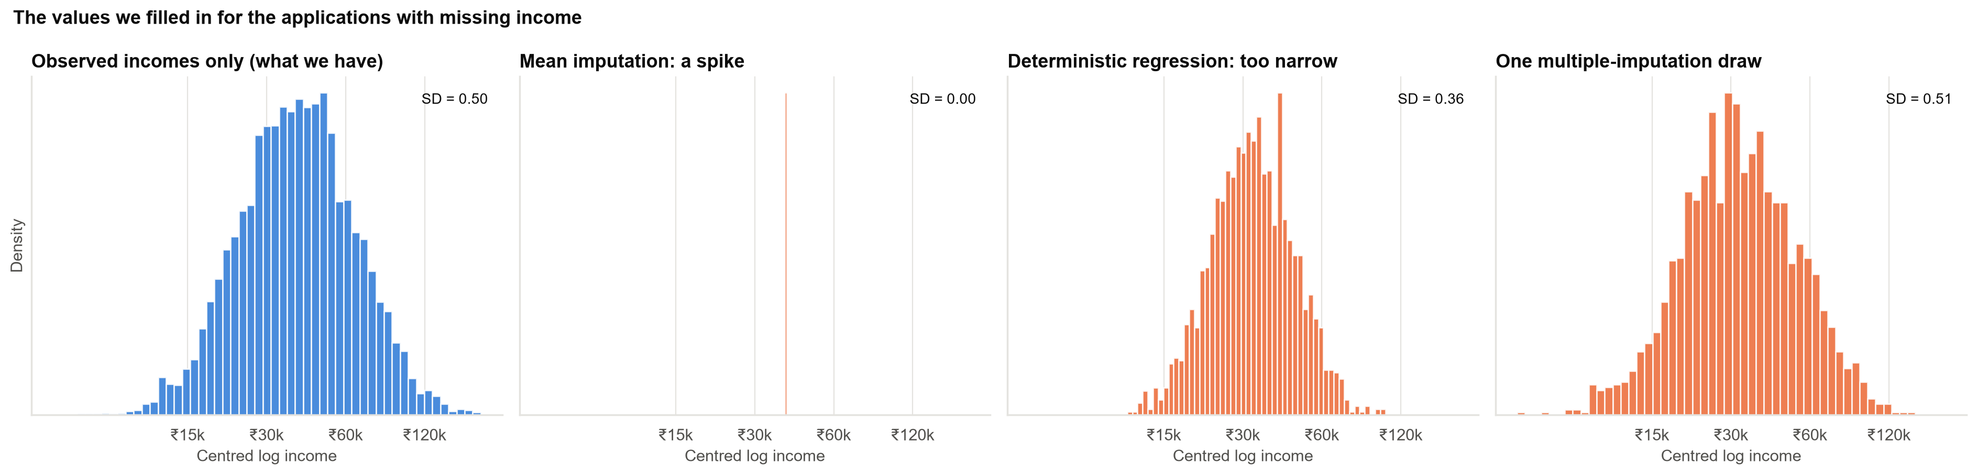
What the filled-in values look like
Mean-filling puts every missing income at one value; good imputation puts the natural variation back.
Case 17 · The missing income problem · synthetic data
6

Slide 7
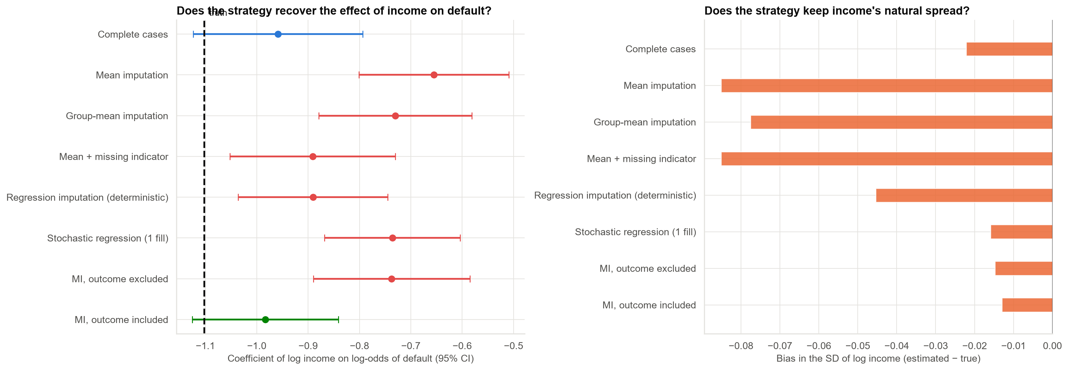
Grading the strategies against the complete data
Left: coefficient and 95% CI for each strategy in the actual dataset. Right: how much each shrinks the spread of income.
Case 17 · The missing income problem · synthetic data
7

Slide 8
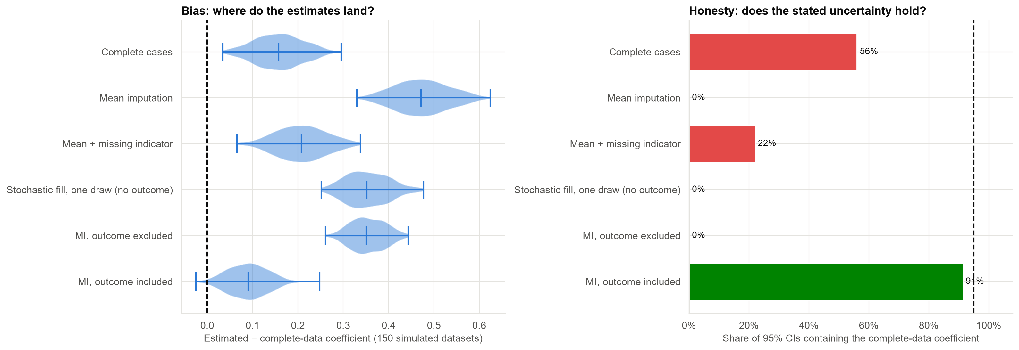
Repeating the exercise on 150 simulated datasets: bias and honesty of each strategy
Deleting: 14% bias, 56% coverage. MI with outcome: 8% bias, 91% coverage. Single fills and MI without the outcome almost never contain the truth.
Case 17 · The missing income problem · synthetic data
8

Slide 9
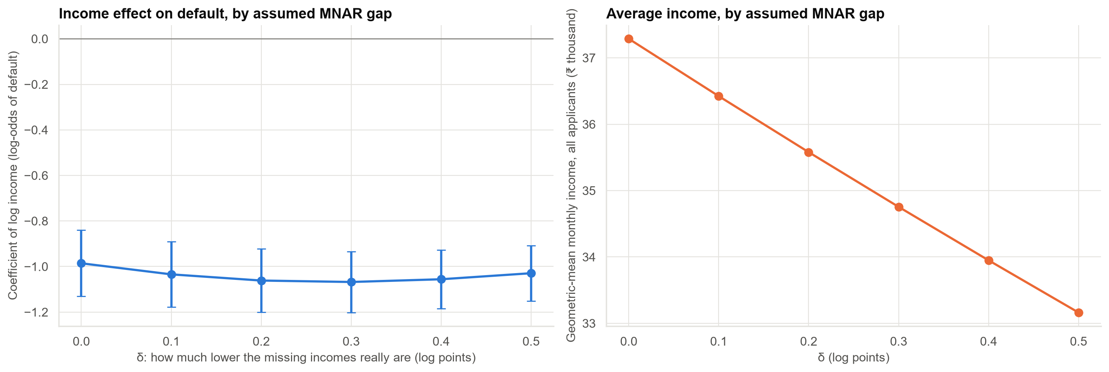
What if low earners are the ones hiding income? Sensitivity range
Even if missing incomes are up to 39% lower than imputed, the income effect stays between −1.07 and −0.99; the average income level moves by about 11%.
Case 17 · The missing income problem · synthetic data
9

Slide 10
Scoring is a different job: keep a 'missing income' flag
Approach for scoring a new applicant | Test AUC | Brier score (lower is better)
No income variable at all | 0.729 | 0.1355
Train on complete cases, mean-fill at scoring | 0.730 | 0.1375
Mean imputation (no indicator) | 0.737 | 0.1344
Mean imputation + missing indicator | 0.767 | 0.1286
Stochastic regression imputation + indicator | 0.767 | 0.1285
A fill plus the missing-income flag gives the best AUC (mean and stochastic fills tie). Not providing income is a risk signal in its own right.
Case 17 · The missing income problem · synthetic data
10

Slide 11
Recommendations
• Do not delete applications without income, and do not fill with the average.
• For coefficients and reporting: multiple imputation (at least 20 draws) with the default outcome in the imputation model.
• For production scoring: fill plus a missing-income flag; review the flag's effect for hidden channel or agent bias.
• Always show a sensitivity range for the part no one can test (are low incomes the ones missing?).
• Fix collection at the source: agent and online channels drive the gaps. Track the missing rate by channel.
Decision needed: approve the imputation approach and the missing-rate KPI.
Case 17 · The missing income problem · synthetic data
11

Slide 12
Limitations and next steps
Limitations
Next steps
• Simple simulated mechanism; real data are messier.
• One variable imputed; real projects impute several jointly.
• Missing-not-at-random cannot be tested, only bounded.
• Chase documents for a random sample to measure the true gap.
• Impute several variables jointly and check diagnostics.
• Monitor the missing-income rate by channel.
Case 17 · The missing income problem · synthetic data
12

