Slide 1
Who Did We Actually Hear From?
Why the 7.9 / 10 satisfaction score should not go in the annual report · Retail Banking customer analytics
40,000 active customers invited; 2,058 answered. Synthetic data created for training. Not actual customer data.

Slide 2
Summary: a precise number that is wrong
• The survey says 7.9 out of 10 and NPS +19, with a margin of error of only ±0.07, but only 5% of customers replied.
• Respondents are not our customers: older, more digital and less likely to have complained. Response ranged from 1.8% to 11.7% across groups.
• Weighting to the customer base lowers the score to 7.63 (NPS +9) but still leaves most of the error, because happier customers answer more even within a group.
• A random phone follow-up of non-respondents gives 7.28, and a combined estimate of 7.31. The true value was 7.07 (NPS −13).
Recommendation: do not publish 7.9. Report a range with the response rate, and use a random sample with follow-up next time.
Case 18 · Customer satisfaction survey · synthetic data
2

Slide 3
The headline versus what we later learned
7.87
Naive survey mean
NPS +19; interval 7.80–7.94
7.63
After weighting
NPS +9; still too high
7.31
With phone follow-up
random sample of non-respondents
7.07
Truth (answer key)
NPS −13; leavers pull all-customer view to 6.83
A confidence interval measures sampling error. It said nothing about the +0.80 bias.
Case 18 · Customer satisfaction survey · synthetic data
3

Slide 4
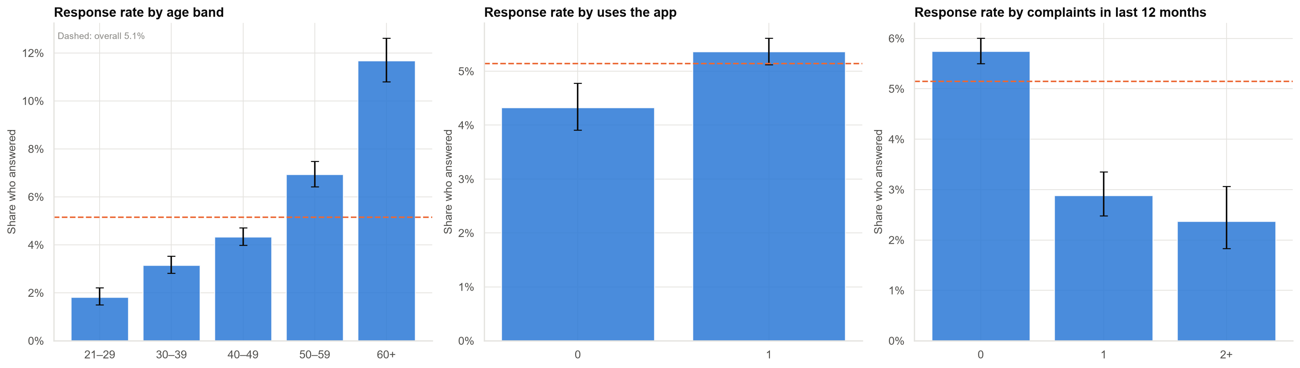
Who answers? Older, app-using, non-complaining customers
Response rate rises from under 2% for the youngest to about 12% for the over-60s. A representative survey needs similar rates in every group.
Case 18 · Customer satisfaction survey · synthetic data
4

Slide 5
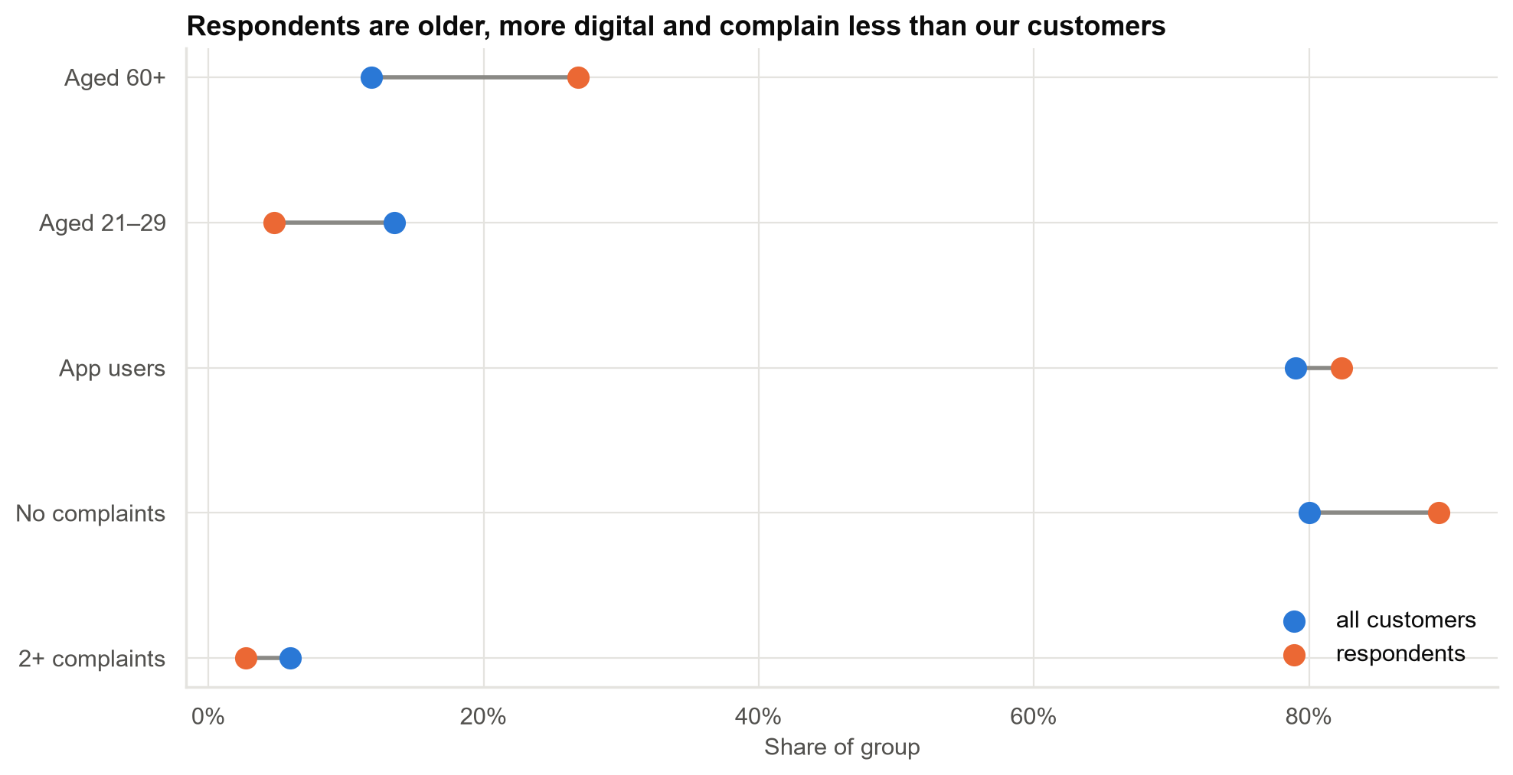
Respondents do not look like our customers
Dots on the right of the grey line are over-represented among respondents; customers with complaints are under-represented.
Case 18 · Customer satisfaction survey · synthetic data
5

Slide 6
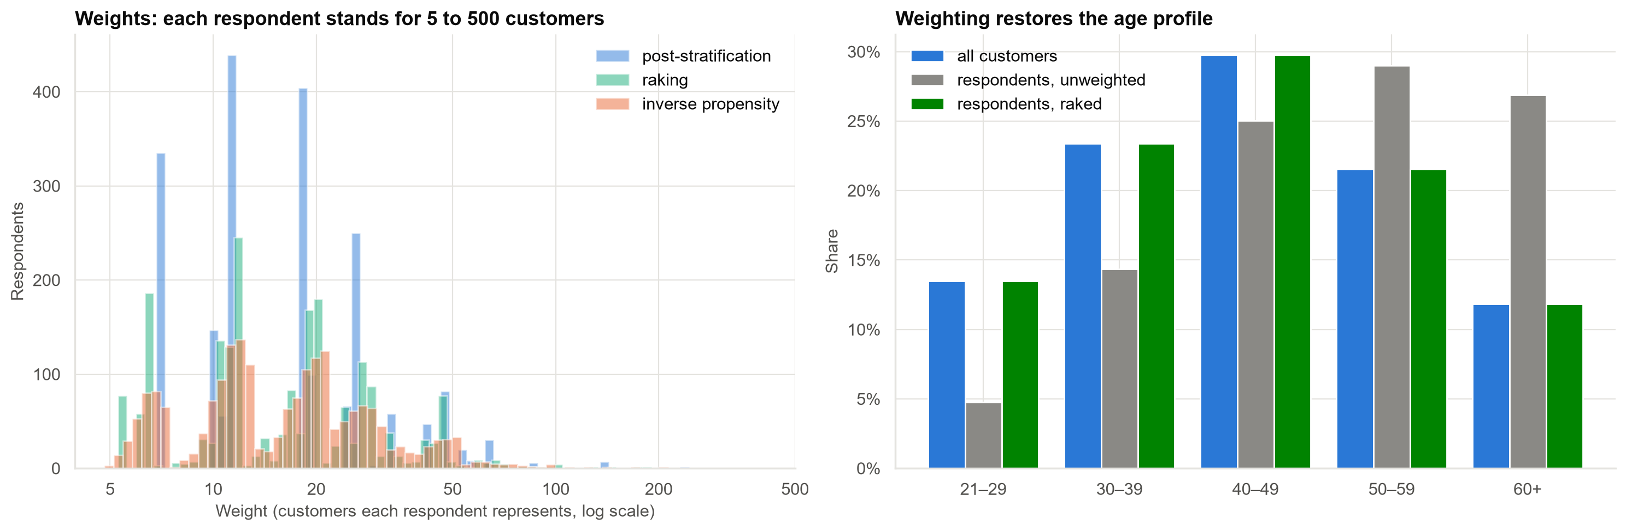
Weighting makes respondents look like the customer base, at a price
Weights run from about 5 to 245. Effective sample size falls from 2,058 to about 1,323.
Case 18 · Customer satisfaction survey · synthetic data
6

Slide 7
Grading the estimates (truth: 7.07)
Estimate | Mean score | Error vs truth | Interval contains truth?
Naive (unweighted) | 7.87 | +0.80 | No
Post-stratified | 7.66 | +0.59 | No
Raked | 7.63 | +0.56 | No
Inverse propensity | 7.62 | +0.55 | No
Phone follow-up combined | 7.31 | +0.24 | No
Weighting removes about 30% of the error. The follow-up gets closest. No interval contains the truth: bias, not noise, is the problem.
Case 18 · Customer satisfaction survey · synthetic data
7

Slide 8
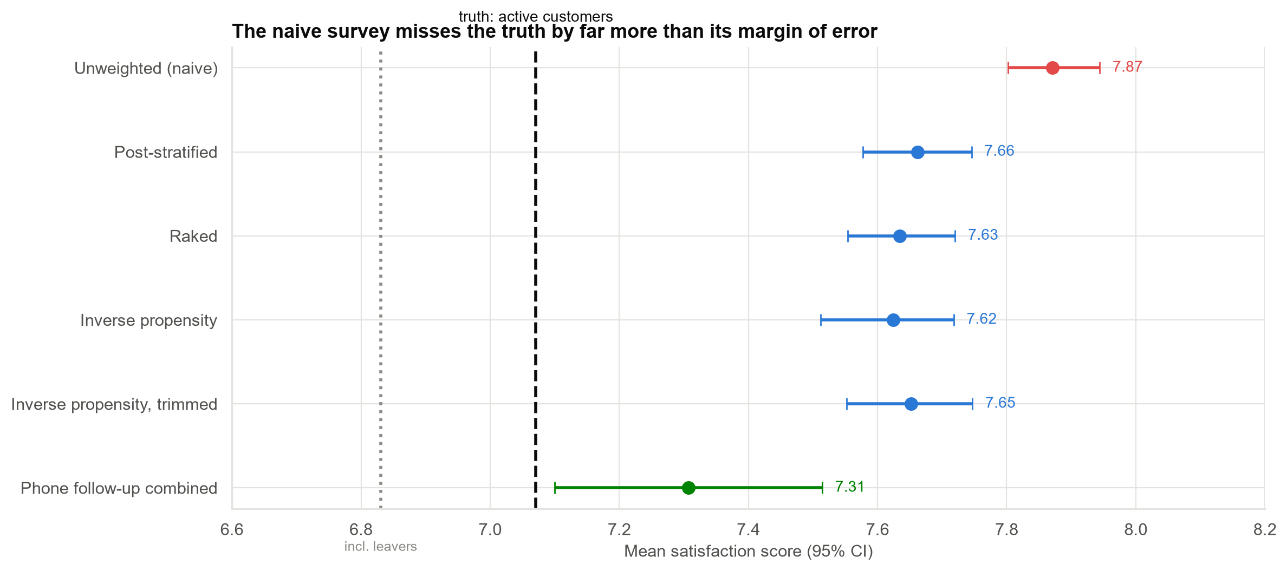
Measured error versus the truth
Customers who left scored 5.2. Including them, the experience of everyone served this year was 6.83.
Case 18 · Customer satisfaction survey · synthetic data
8

Slide 9
How much hidden bias can a conclusion survive?
• If non-respondents score just 0.14 points lower than weighted respondents, the average drops below 7.5.
• At 0.67 points lower it drops below 7.0. The phone follow-up showed a gap of about 0.36.
• With a 95% non-response rate the non-respondents are almost everyone, so even small differences matter.
• At a gap of 0.2 the implied average is 7.44.
Very low response rates need a follow-up study before any number is published.
Case 18 · Customer satisfaction survey · synthetic data
9

Slide 10
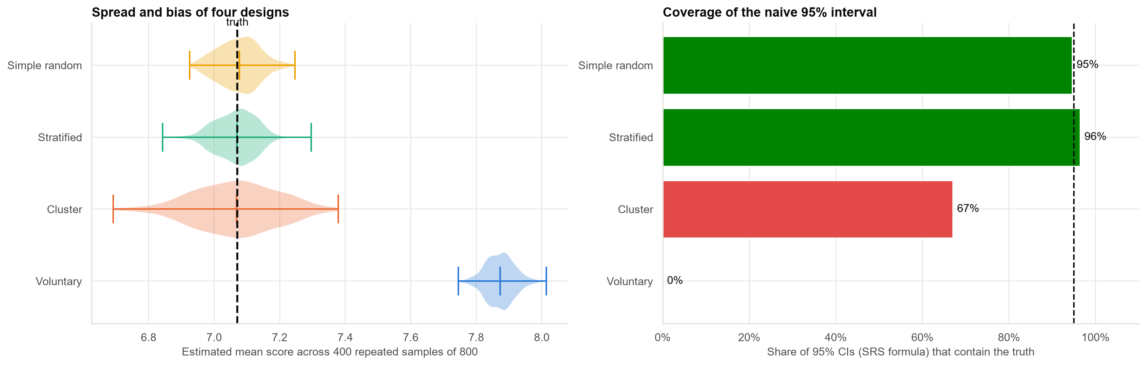
What a better survey design would have done
A random 800 has bias 0.00 and 95% coverage. 800 volunteers have bias +0.80 and 0% coverage.
Case 18 · Customer satisfaction survey · synthetic data
10

Slide 11
Recommendations
• Do not publish 7.9 or NPS +19. If a number is needed, give a range (about 7.3 to 7.6) with the response rate and who it covers.
• Compare years only with the same method. A change in who answers looks like a change in satisfaction.
• Next survey: a stratified random sample, reminder waves and a follow-up of a random sample of non-respondents.
• Add an exit survey so customers who left are not invisible.
• Monitor response rate by group for every survey.
Decision needed: approve a random-sample design for the next survey.
Case 18 · Customer satisfaction survey · synthetic data
11

Slide 12
Limitations and next steps
Limitations
Next steps
• Weights use only variables on the customer list; hidden drivers remain.
• Only 60% of the follow-up sample was reached.
• Synthetic population with a chosen response mechanism.
• Run a stratified random-sample survey in parallel.
• Run an exit survey for leavers.
• Track response rates by age, app use and complaints.
Case 18 · Customer satisfaction survey · synthetic data
12

