Slide 1
Did the New Approval Policy Reduce Approvals?
Why overall approval fell while every risk band improved · Credit Policy analytics
27,000 personal-loan applications, before and after the April policy change. Synthetic data created for training. Not actual customer data.

Slide 2
Summary: overall approval fell, but only because riskier applicants arrived; the policy is more generous at every level
• Overall approval fell 3.9 points (69.6% → 65.7%).
• Within every risk band it rose by 5–6 points. This is Simpson's paradox.
• Why: the share of applicants in the two riskiest bands rose from 24% to 40%. The change splits exactly into +5.6 points from the policy and −9.5 points from who applied.
• The cause is the new agent channel (11% → 45% of applications). The risk mix within each channel did not change.
Recommendation: do not roll back the policy; report approval by risk band and standardised, and monitor defaults.
Case 20 · Did the new approval policy hurt approval rates? · synthetic data
2

Slide 3
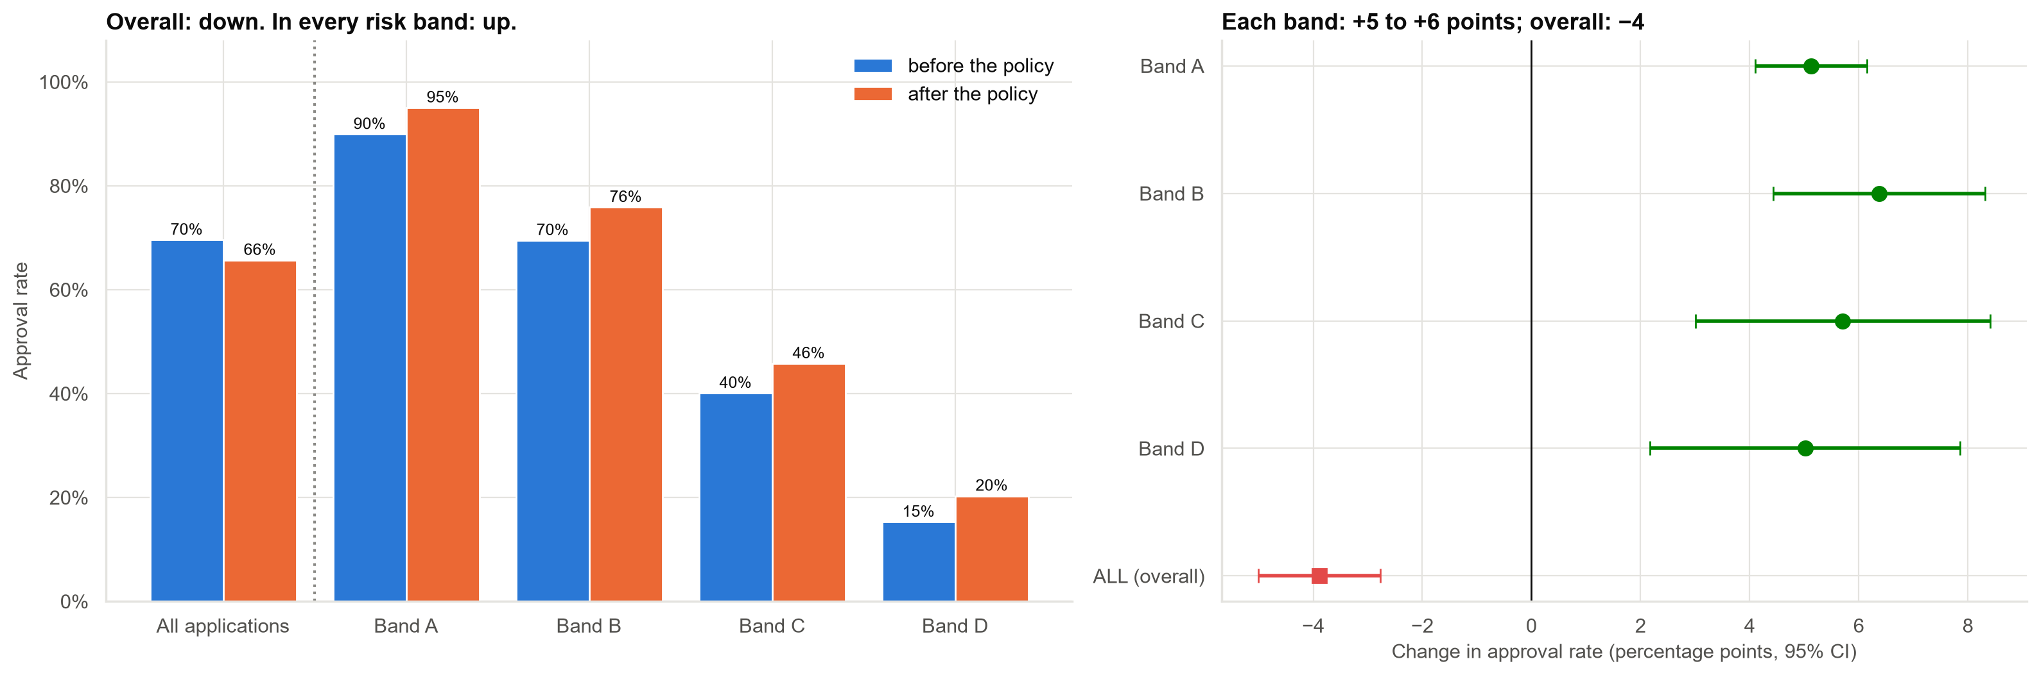
The paradox: down overall, up in every risk band
Left: approval before and after. Right: the change by band (green) and overall (red).
Case 20 · Did the new approval policy hurt approval rates? · synthetic data
3

Slide 4
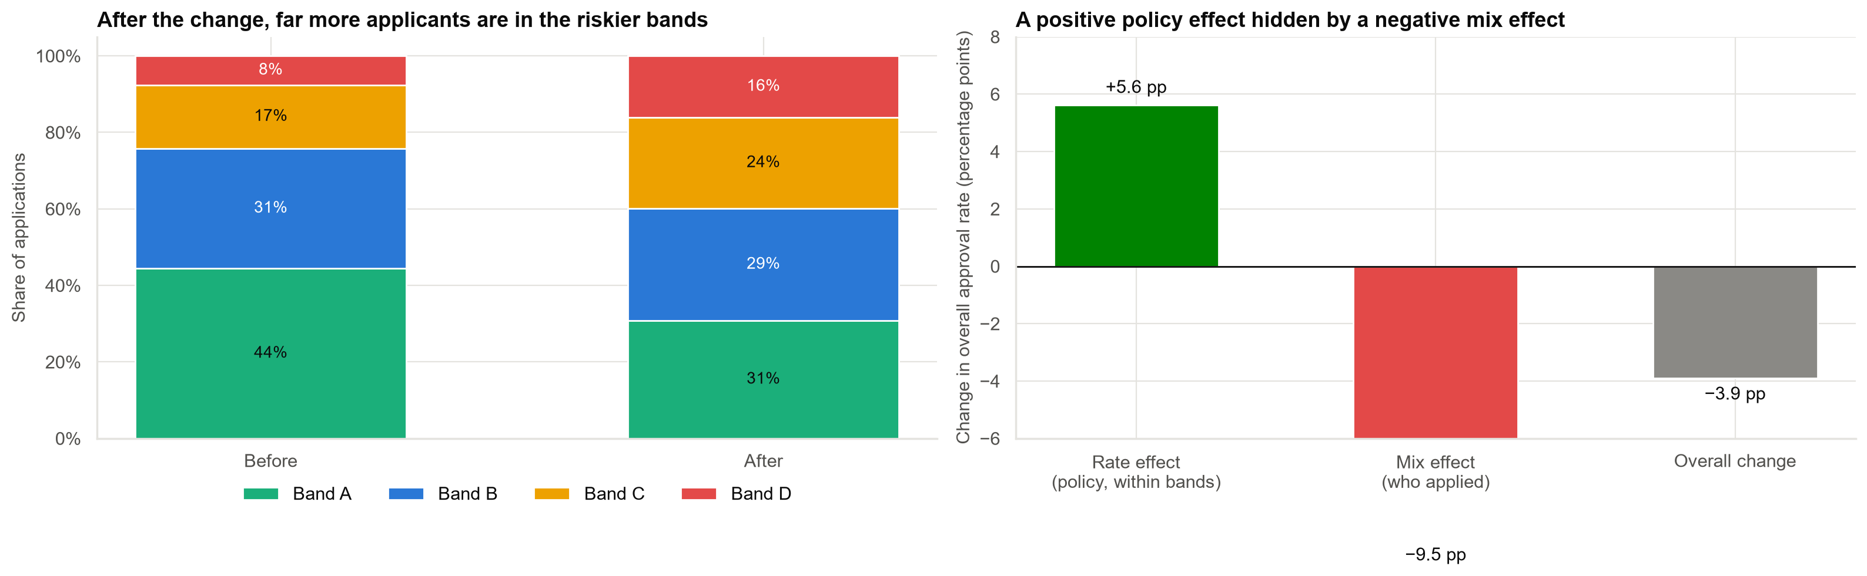
Why: a riskier applicant mix hides the policy's effect
Overall change −3.9 points = policy effect +5.6 + mix effect −9.5.
Case 20 · Did the new approval policy hurt approval rates? · synthetic data
4

Slide 5
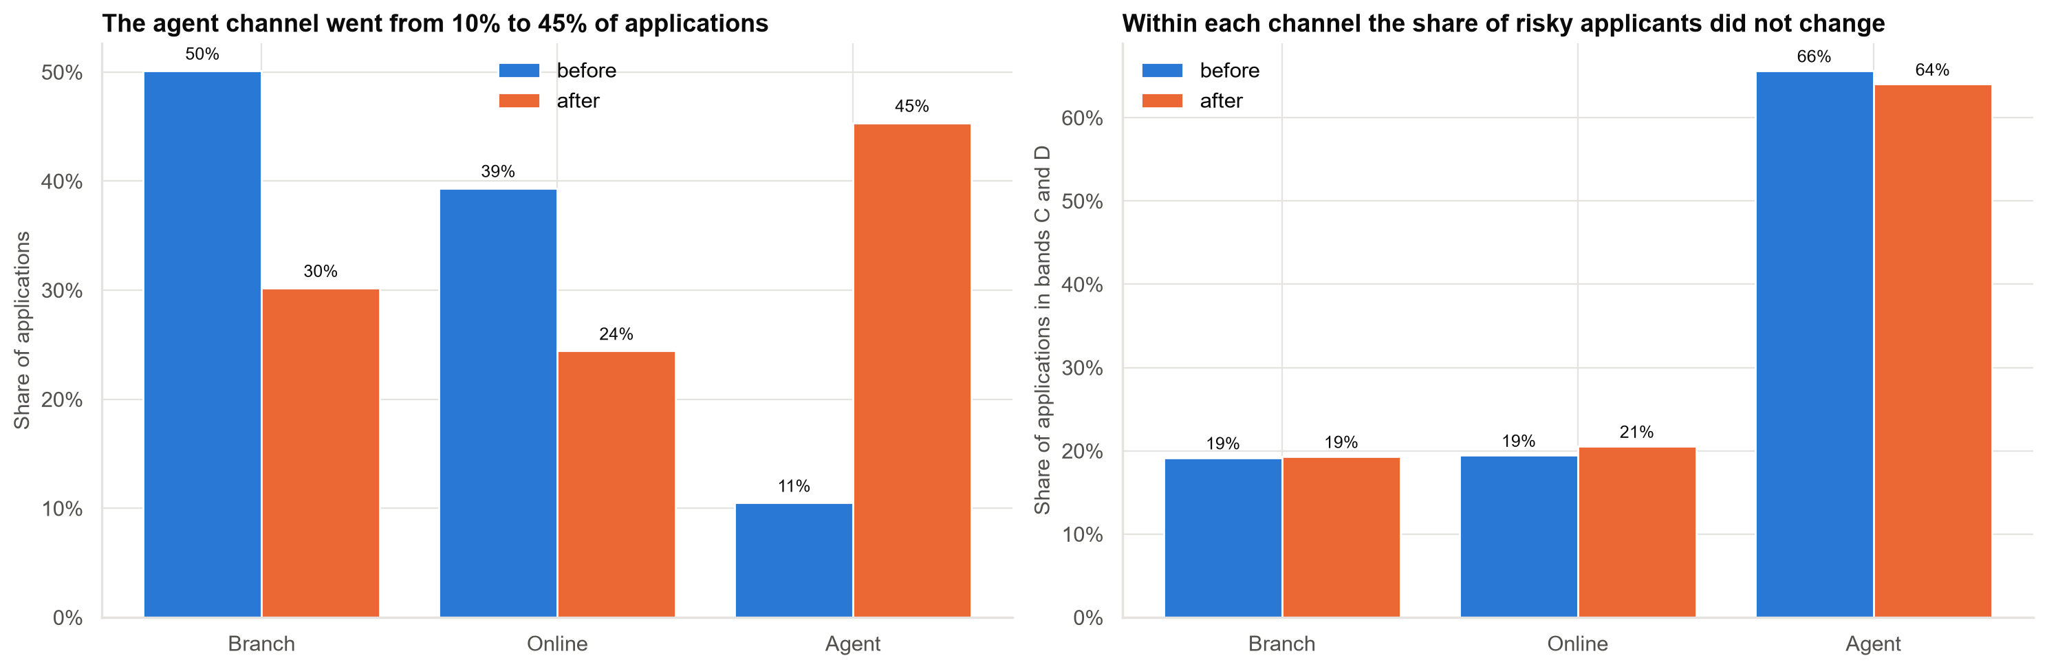
What changed the mix: the agent channel
Agent applicants are mostly in the two riskiest bands. Within each channel, risk did not shift.
Case 20 · Did the new approval policy hurt approval rates? · synthetic data
5

Slide 6
Fair comparisons all agree: the policy raised approvals
Comparison | Result | Answers
Raw overall comparison | −3.9 points | Policy + who applied
At the before-policy mix | +5.6 points | The policy, same applicants
At the after-policy mix | +5.6 points | The policy, same applicants
Mantel-Haenszel odds ratio | 1.45 (95% CI 1.36–1.54) | The policy, band by band
Standardised difference: +5.6 points (95% CI +4.6 to +6.4).
Case 20 · Did the new approval policy hurt approval rates? · synthetic data
6

Slide 7
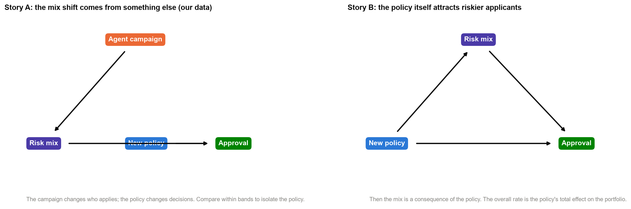
Which comparison is right depends on the causal story
Our data fit story A: the campaign, not the policy, changed who applies. Timing and process knowledge confirm this, not statistics alone.
Case 20 · Did the new approval policy hurt approval rates? · synthetic data
7

Slide 8
What this analysis does not show
• Whether the extra approvals are good. We have not looked at defaults yet.
• Whether anything else changed between the two periods (seasonality, other campaigns). There is no control group.
• Whether finer risk groups would change the picture. Four bands are coarse.
• Effects on the total portfolio. The agent campaign made the book riskier regardless of the policy.
Adjusting for measured bands removes the mix effect, but not unmeasured time effects.
Case 20 · Did the new approval policy hurt approval rates? · synthetic data
8

Slide 9
Recommendations
• Do not roll back the policy. At every risk level it is more generous, as intended.
• Report approval by risk band and standardised to a fixed mix every quarter, next to the overall rate.
• Brief the Chief Risk Officer with the decomposition: about +5.6 points from policy, −9.5 from who applied.
• Monitor default rates by channel and band to judge the extra approvals.
• Run the next policy change as a staged roll-out with a comparison group.
Decision needed: approve the reporting change and the default monitor.
Case 20 · Did the new approval policy hurt approval rates? · synthetic data
9

Slide 10
Limitations and next steps
Limitations
Next steps
• Before/after comparison without a control group.
• Four risk bands only.
• No default outcomes yet.
• Link approvals to 12-month defaults.
• Monthly rate-and-mix dashboard.
• Staged or randomised roll-out for the next change.
Case 20 · Did the new approval policy hurt approval rates? · synthetic data
10

