Slide 1
What Did a 25% Credit-Limit Increase Do to Spend?
Bootstrap confidence intervals for skewed metrics · Credit Cards analytics
Randomised test of 2,500 vs 2,500 customers and a 60 vs 60 regional pilot. Synthetic data created for training. Not actual customer data.

Slide 2
Summary: typical spend is up and utilisation is down; total spend is too noisy to call
• Typical (median) spend rose about 9%, ₹1,382 per month (95% interval ₹254 to ₹2,519).
• Average spend rose ₹2,003, but the interval runs from −1,141 to +5,733 and includes zero: a few very large spenders dominate the mean.
• Spend per rupee of limit fell 3.2 points (interval −5.2 to −1.1): the limit rose 25%, spend far less.
• The 60 vs 60 regional pilot should not guide decisions: its estimates are several times too large and its intervals cover the truth for only 4 of 7 metrics.
Recommendation: quote medians and utilisation as firm results, the mean with its wide interval, and rerun the pilot at scale.
Case 23 · Credit-limit increase and spend · synthetic data
2

Slide 3
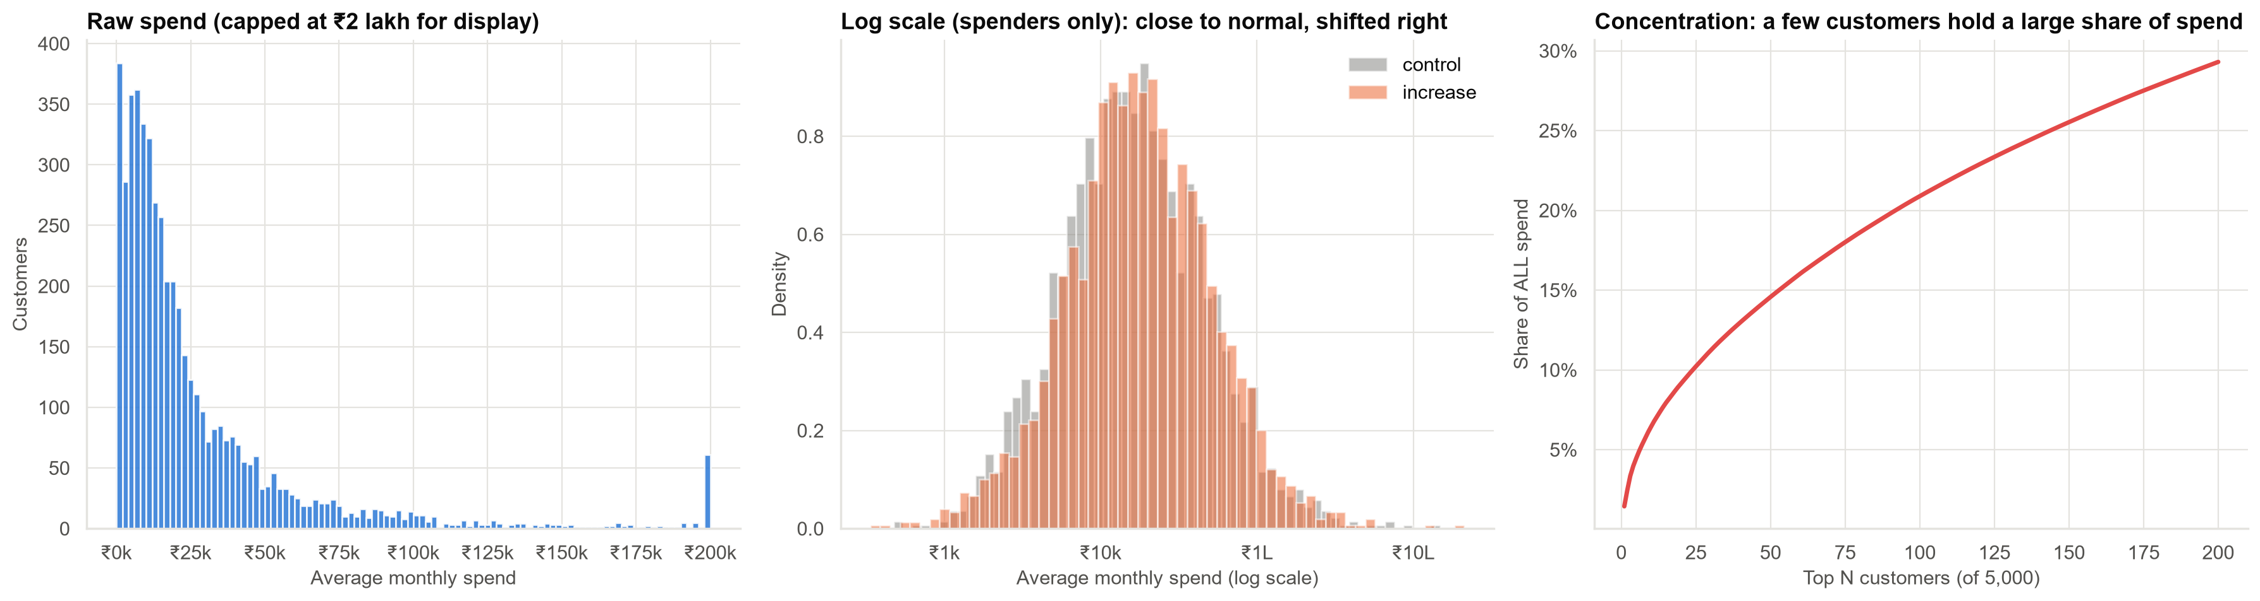
Spend is extremely skewed: a few customers hold a large share
Mean is 1.9 times the median; the top 1% of customers hold 15% of spend.
Case 23 · Credit-limit increase and spend · synthetic data
3

Slide 4
One experiment, five metrics, very different certainty
Metric | Effect | 95% interval | Clear?
Average spend (₹) | +2,003 | −1,141 to +5,733 | No
Typical (median) spend (₹) | +1,382 | +254 to +2,519 | Yes
Ratio of medians | 1.09 | 1.02 to 1.18 | Yes
Share spending over ₹50,000 (pp) | +1.5 | −0.4 to +3.6 | No
Spend per rupee of limit (pp) | −3.2 | −5.2 to −1.1 | Yes
The bootstrap gives an interval for any metric. The width reflects the metric, not the method.
Case 23 · Credit-limit increase and spend · synthetic data
4

Slide 5
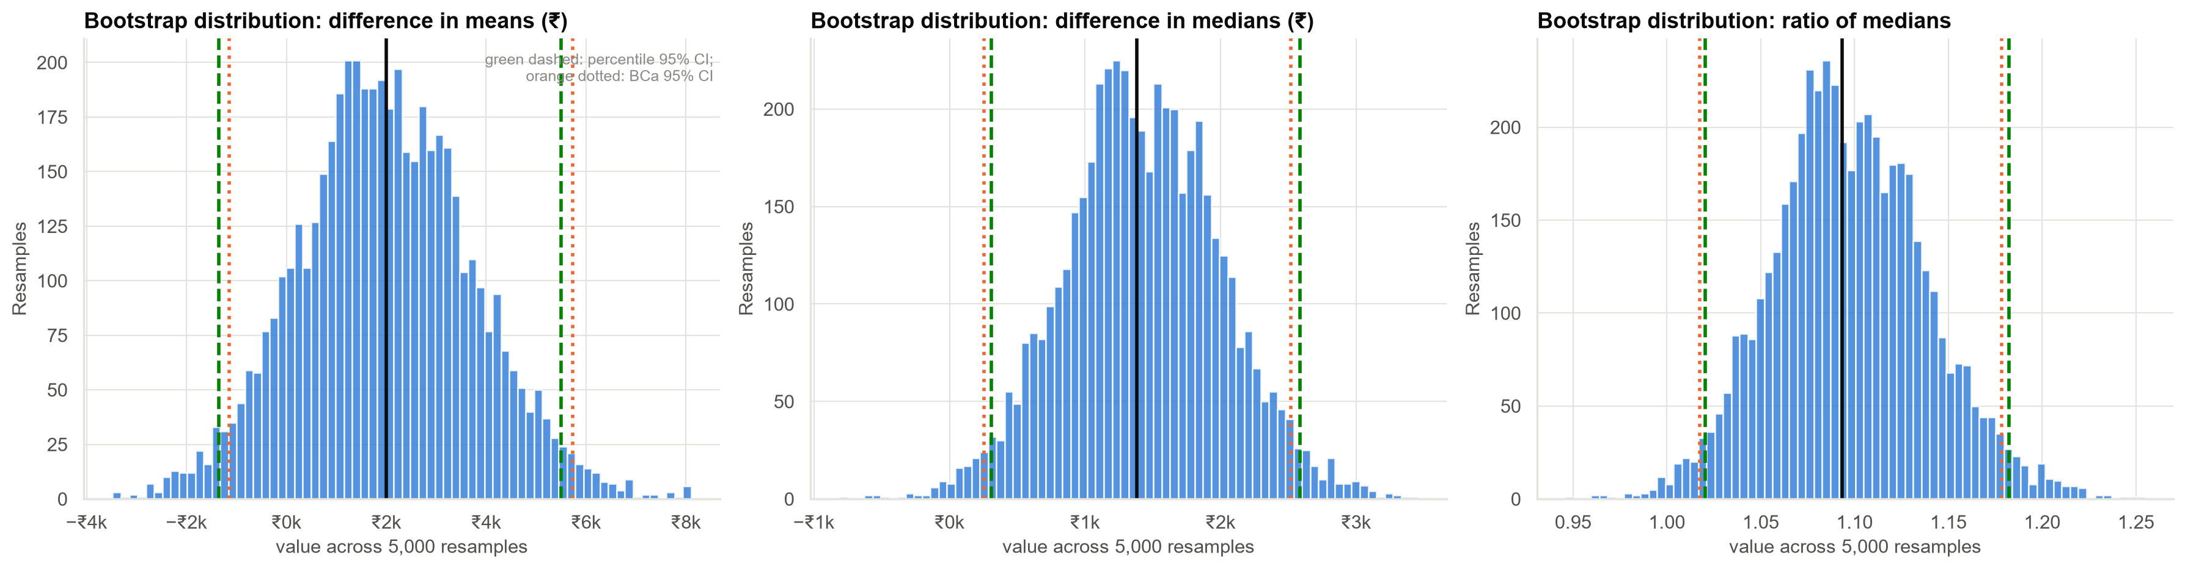
The bootstrap: resample the customers, recompute, read off the interval
With 2,500 per arm, the percentile and BCa intervals nearly coincide.
Case 23 · Credit-limit increase and spend · synthetic data
5

Slide 6
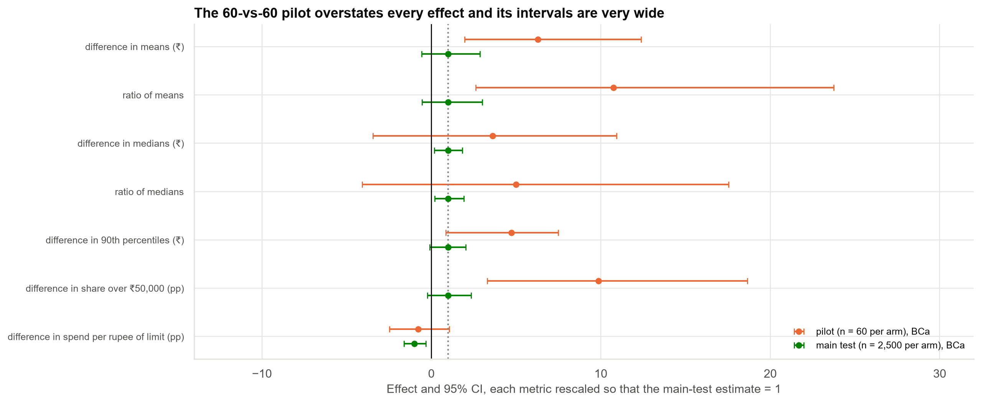
The 60 vs 60 pilot overstates every effect and its intervals are very wide
BCa intervals cover the truth for 7 of 7 metrics in the main test and 4 of 7 in the pilot. The pilot's mean difference (+₹12,600) is about six times the main test's.
Case 23 · Credit-limit increase and spend · synthetic data
6

Slide 7
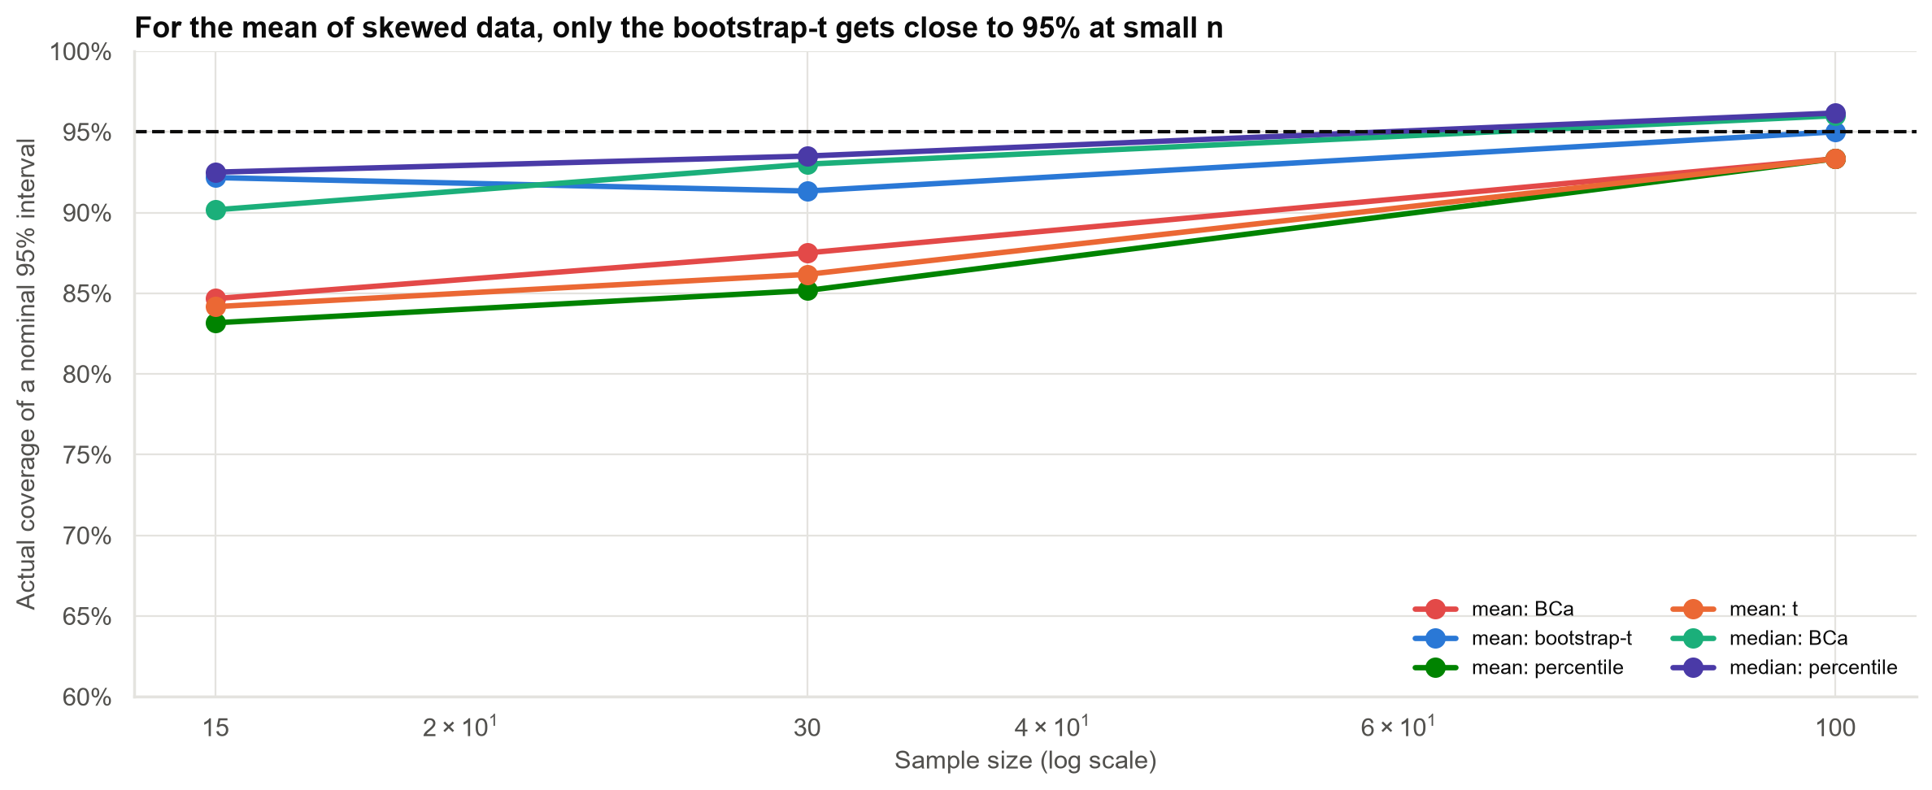
Does the bootstrap deserve trust? A coverage check on skewed data
For the mean at n = 30, a nominal 95% interval contains the truth 86% (t), 85% (percentile), 88% (BCa) and 91% (bootstrap-t) of the time.
Case 23 · Credit-limit increase and spend · synthetic data
7

Slide 8
Where the bootstrap fails
• Extremes: an interval for the maximum never contains the true maximum (0%).
• Tiny samples: with 8 skewed values, coverage is 76%.
• Dependent data: for an autocorrelated series the standard bootstrap covers 58%; resampling blocks restores 88%.
• Resample the unit of randomisation (customer, branch, day), within each experiment arm.
The bootstrap is a large-sample tool that is more flexible than normal theory, not a cure for small samples.
Case 23 · Credit-limit increase and spend · synthetic data
8

Slide 9
Revenue: the number Finance wants is the noisiest one
• At 1.6% interchange, the mean difference is about ₹385 extra annual interchange per customer.
• The interval runs from −219 to +1,101 per customer, so a loss cannot be ruled out.
• This ignores the extra credit-risk cost of larger limits and the fall in utilisation.
A bigger test, or adjusting for prior spend, is needed before quoting revenue.
Case 23 · Credit-limit increase and spend · synthetic data
9

Slide 10
Recommendations
• Report the median effect (about +9%) and the utilisation fall as firm evidence of behaviour change.
• Report the mean with its interval, not as a point estimate.
• Do not use the 60 vs 60 pilot to decide; rerun it at scale or pool regions.
• Add a credit-loss outcome to the next test before rolling out.
• Bootstrap by customer within each arm, and use BCa for medians and ratios.
Decision needed: approve a larger follow-up test with delinquency tracked.
Case 23 · Credit-limit increase and spend · synthetic data
10

Slide 11
Limitations and next steps
Limitations
Next steps
• Three months of outcome only.
• Revenue ignores credit-risk costs.
• Customers assumed independent.
• Adjust for prior spend to shrink the interval.
• Estimate effects by risk segment.
• Bootstrap net revenue including losses.
Case 23 · Credit-limit increase and spend · synthetic data
11

