Slide 1
Are We Meeting the 30-Day Collections SLA?
Censored durations, survival curves and staffing the call desk · Collections analytics
6,000 synthetic overdue accounts and 20 days of call arrivals. Synthetic data created for training. Not actual customer data.

Slide 2
Summary: the report says 61%; the right answer is 42%, and no segment meets the 70% SLA
• The report divided by resolved accounts and got 61% paid within 30 days. A third of accounts are still open or transferred, mostly slow cases.
• Kaplan-Meier, which uses every account for as long as it was observed, gives 42% (95% CI 41% to 43%); median 42 days.
• Call-first speeds resolution (hazard ratio 1.41, CI 1.32 to 1.50); late-bucket and high-balance accounts are slower. Even so, all 12 segments miss 70%.
• Call arrivals peak at 11:00 and 15:00 (about 14 per 15 minutes): 4 to 9 agents needed by hour.
Recommendation: re-base the SLA report on survival curves, expand call-first, and revisit the target.
Case 26 · Collections and SLA · synthetic data
2

Slide 3
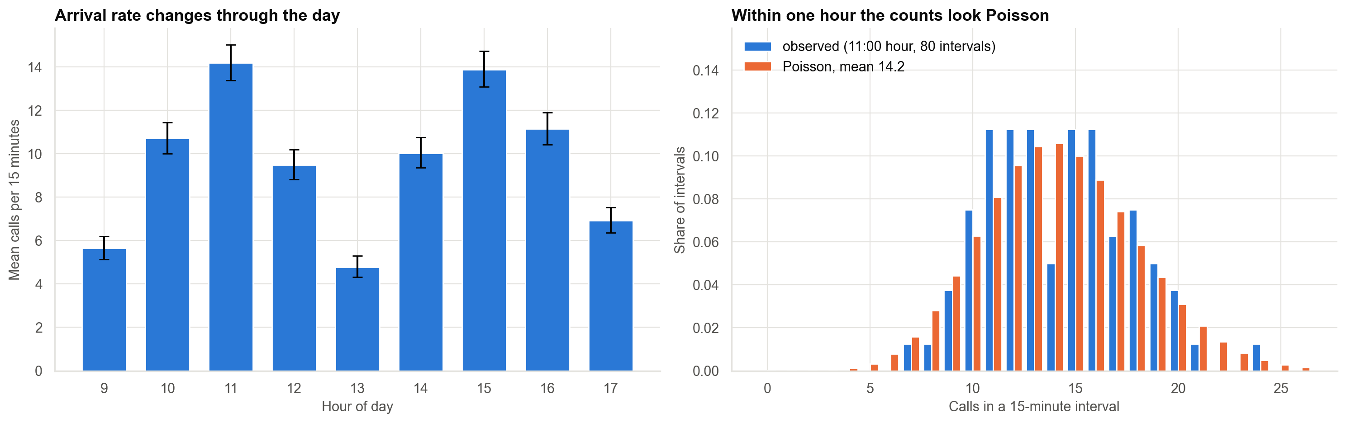
Call arrivals: Poisson within the hour, but the rate changes through the day
Within each hour the variance equals the mean (no hour rejects Poisson). Across the day the variance is twice the mean because the rate moves.
Case 26 · Collections and SLA · synthetic data
3

Slide 4
Staffing by hour for 80% of calls answered in 20 seconds
Hour | Calls per 15 min | Agents needed | Service level
09:00 | 5.7 | 5 | 92%
10:00 | 10.7 | 7 | 85%
11:00 | 14.2 | 9 | 87%
12:00 | 9.5 | 7 | 91%
13:00 | 4.8 | 4 | 86%
14:00 | 10.0 | 7 | 88%
15:00 | 13.9 | 9 | 89%
16:00 | 11.2 | 7 | 82%
17:00 | 6.9 | 5 | 84%
Assumes 6-minute handling time and Poisson arrivals. A flat roster would be overloaded at the peaks and idle at lunch.
Case 26 · Collections and SLA · synthetic data
4

Slide 5
Why the report's number is wrong
• 31.6 days average and 61% within 30 days use only accounts that were paid up.
• That leaves out every account still open or transferred, and slow cases are over-represented among them.
• If open accounts are counted as events at their last day the average becomes 42 days; if counted as unresolved the 30-day share is 39%.
• None of these answers the SLA question: what share of accounts entering collections are paid within 30 days?
A censored account tells us it had not paid by its last day, not when it will.
Case 26 · Collections and SLA · synthetic data
5

Slide 6
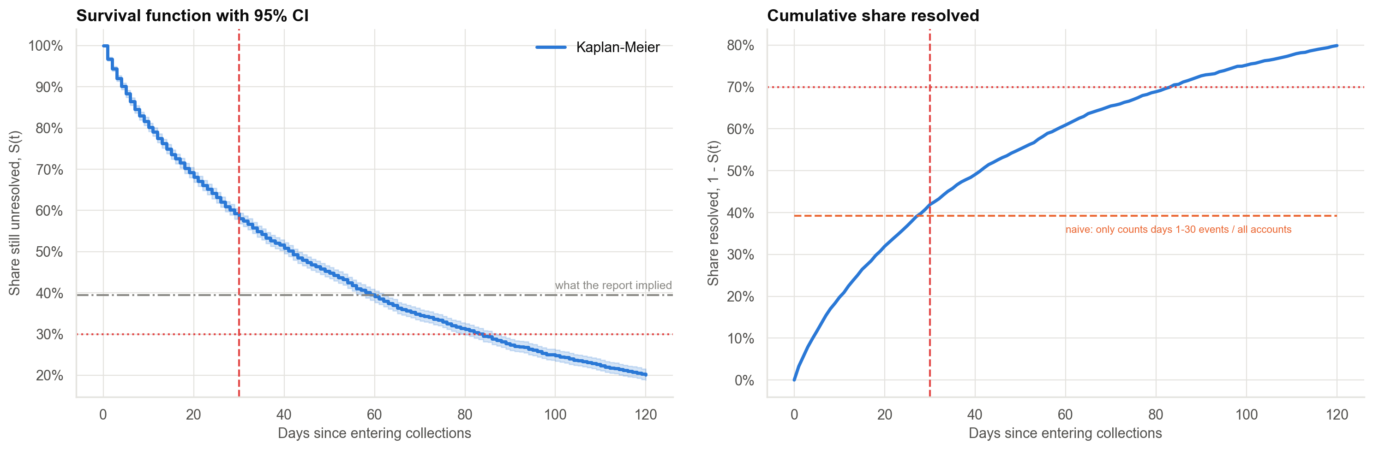
Survival curve: 42% resolved by day 30
Kaplan-Meier with 95% interval. At 60 days 61%; at 90 days 73%.
Case 26 · Collections and SLA · synthetic data
6

Slide 7
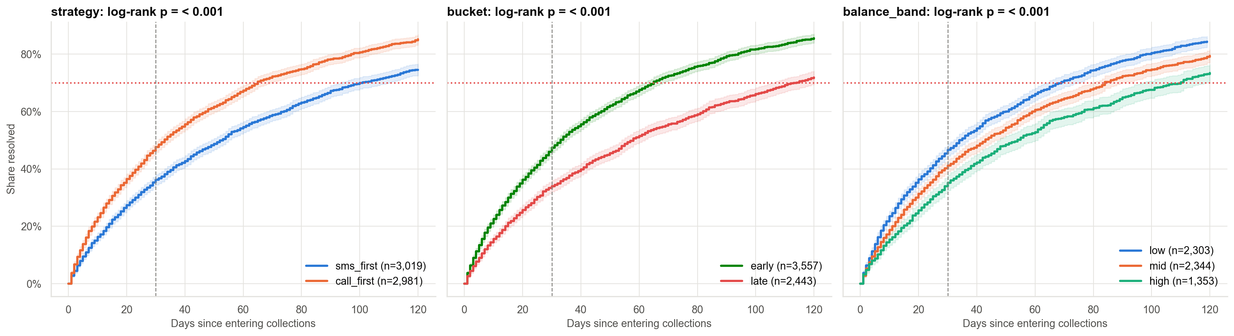
Resolution by strategy, bucket and balance
Resolved by day 30: call-first 48% vs SMS-first 36%; early 47% vs late 34%.
Case 26 · Collections and SLA · synthetic data
7

Slide 8
Effect on the speed of resolution (Cox model)
Factor | Hazard ratio | 95% interval
Call-first (vs SMS-first) | 1.41 | 1.32 to 1.50
Late bucket (vs early) | 0.65 | 0.61 to 0.69
Balance mid (vs low) | 0.85 | 0.79 to 0.91
Balance high (vs low) | 0.71 | 0.65 to 0.77
Above 1 means faster. A ratio of 1.41 is a 41% higher rate of resolution at any time, not 41% more accounts resolved.
Case 26 · Collections and SLA · synthetic data
8

Slide 9
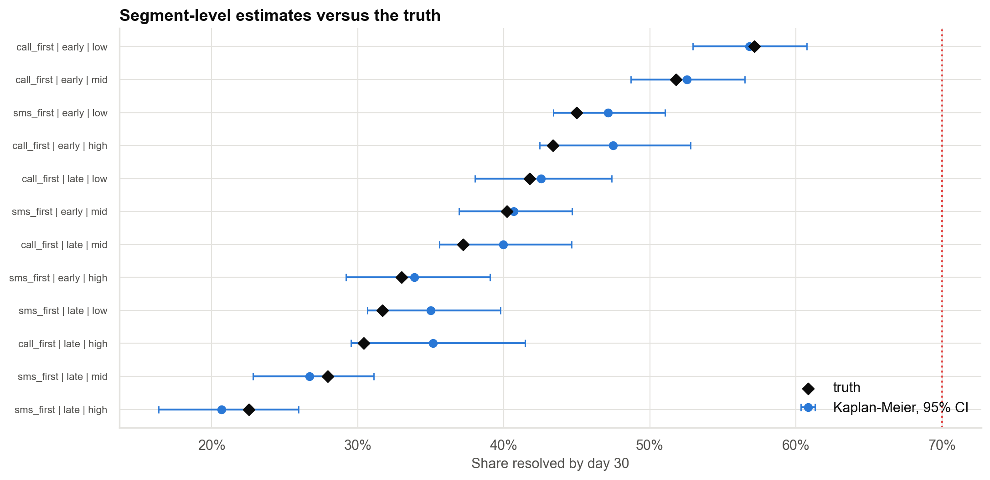
Estimated resolution by day 30, every segment versus the truth
All 12 segments are below the 70% line. The Kaplan-Meier interval covers the truth in 12 of 12 segments.
Case 26 · Collections and SLA · synthetic data
9

Slide 10
Recommendations
• Re-base SLA reporting on Kaplan-Meier probabilities (30, 60, 90 days) with intervals, by segment.
• Expand call-first, especially for late-bucket and high-balance accounts; alone it lifts the 30-day share from about 42% to 48%.
• Revisit the 70%-in-30-days target or set segment targets; 60 days is about 61%.
• Roster by hour with Erlang C: 4 agents at 13:00, 9 at the peaks.
• Randomise strategy in the next cycle to measure the causal effect.
Decision needed: change the SLA metric and approve a randomised strategy test.
Case 26 · Collections and SLA · synthetic data
10

Slide 11
Limitations and next steps
Limitations
Next steps
• Censoring assumed unrelated to the chance of paying.
• Strategy was not randomised.
• Handling time assumed exponential and fixed.
• The Weibull model is right here by construction.
• Randomised call-first test.
• Time-varying covariates in the Cox model.
• Competing risks: paid, written off, transferred.
• Sensitivity analysis for informative censoring.
Case 26 · Collections and SLA · synthetic data
11

