Slide 1
Which Segments Really Respond to the Campaign?
Multiple testing across 40 customer segments · Campaign Analytics for Cards Marketing
Randomised SMS test in 40 segments, two waves, about 258,000 customers. Synthetic data created for training. Not actual customer data.

Slide 2
Summary: the campaign works overall, but the 'seven winning segments' are partly luck
• The SMS lifts conversion by about 0.2 percentage points overall (95% CI 0.04 to 0.40, tested once): real but small.
• Seven of 40 segments are 'significant' at 5%. But even a useless campaign would flag about 2 segments, and at least one in 87% of campaigns.
• After correcting for 40 looks: 2 segments are confirmed (strict, same as the 5% false-discovery screen); four more are promising at a 10% screen.
• Winners' uplifts are inflated: wave-1 winners averaged +2.4 points in wave 1 and only +0.9 in fresh wave-2 data.
Recommendation: keep the broad campaign, budget on shrunken uplifts, and confirm the promising segments in a third wave.
Case 19 · Testing a campaign across 40 segments · synthetic data
2

Slide 3
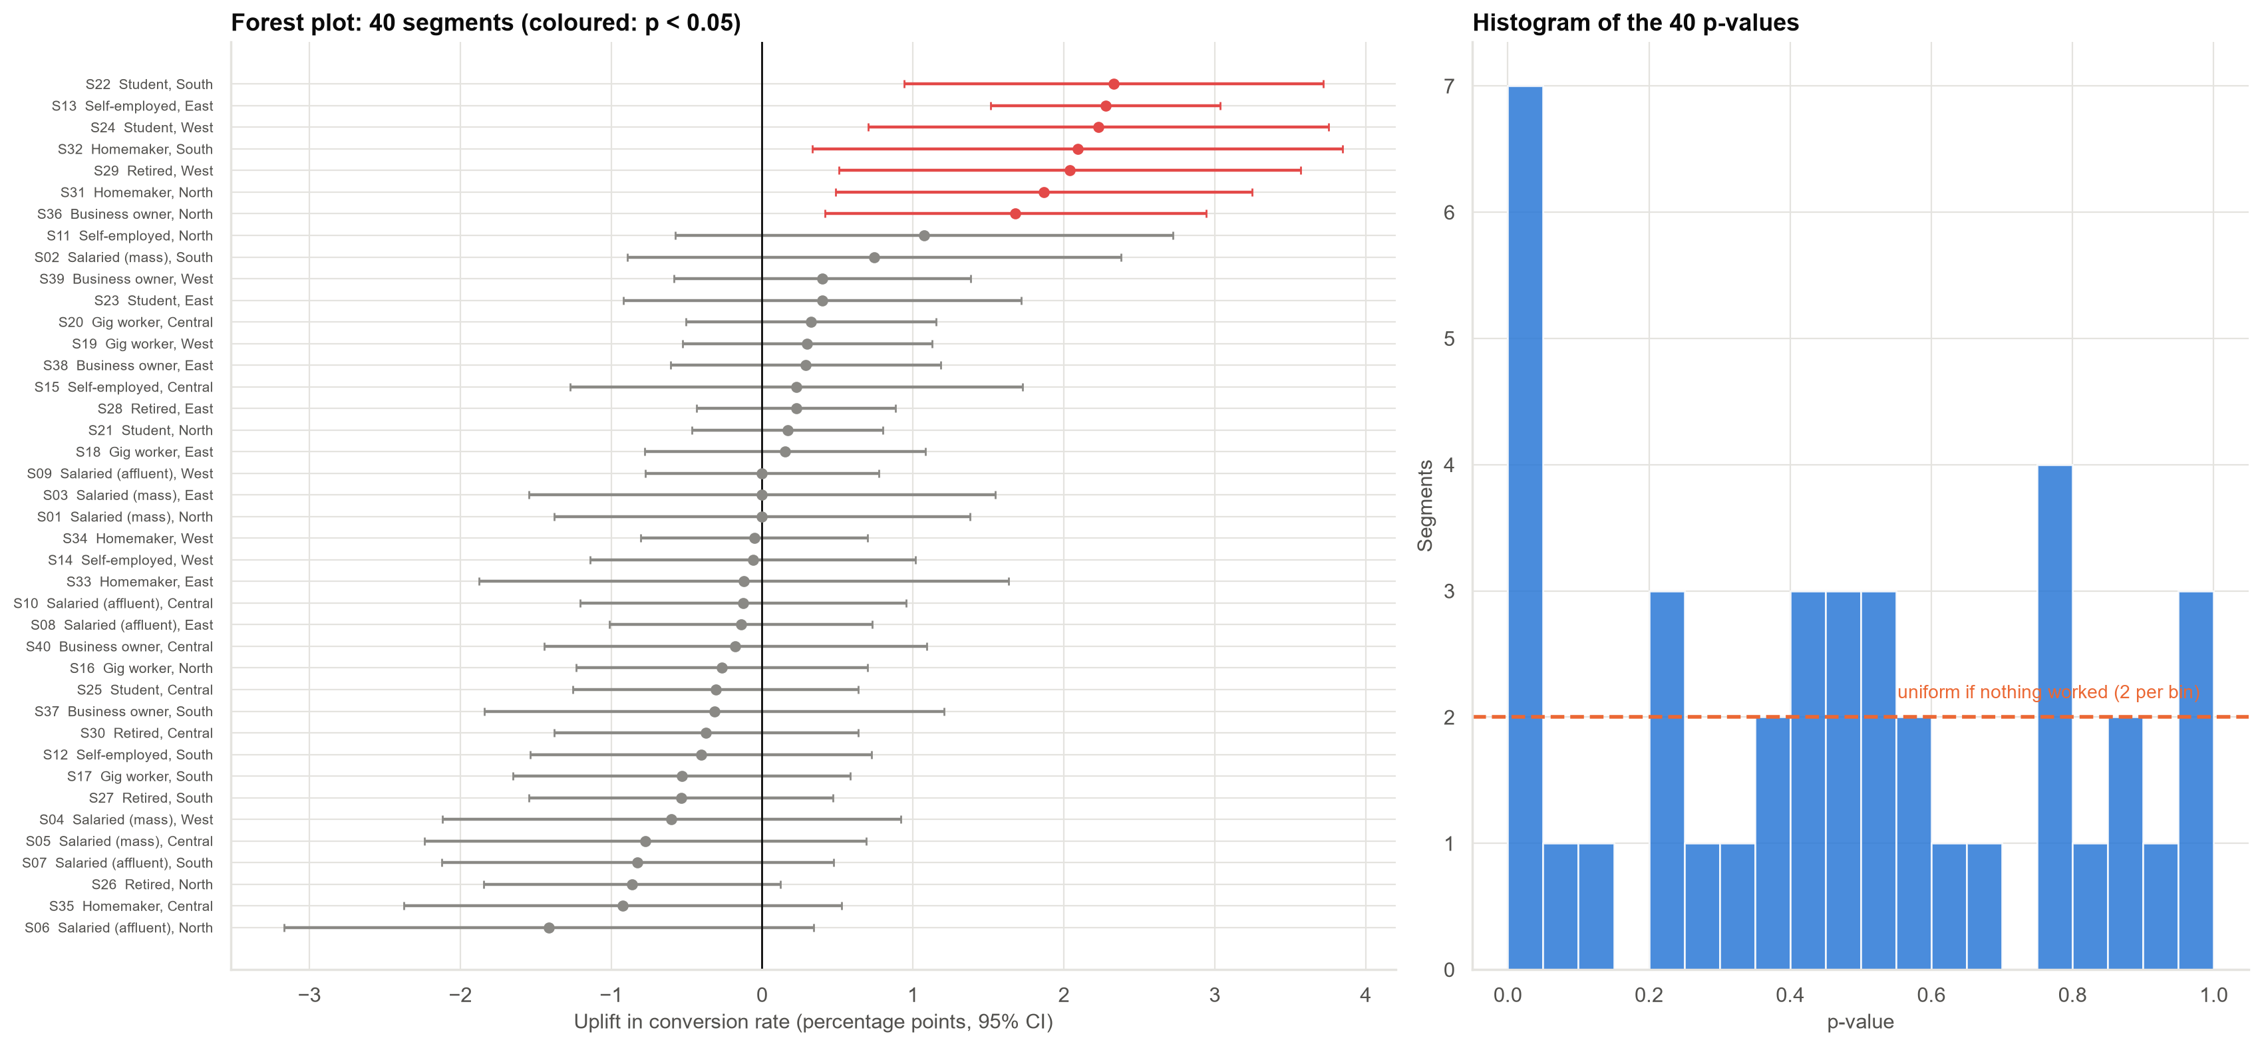
Forest plot: seven segments cross the line, but with 40 tests that is not surprising
Red intervals (left) are the seven segments with p < 0.05. The spike of small p-values (right) says some segments truly respond; the flat part says many do not.
Case 19 · Testing a campaign across 40 segments · synthetic data
3

Slide 4
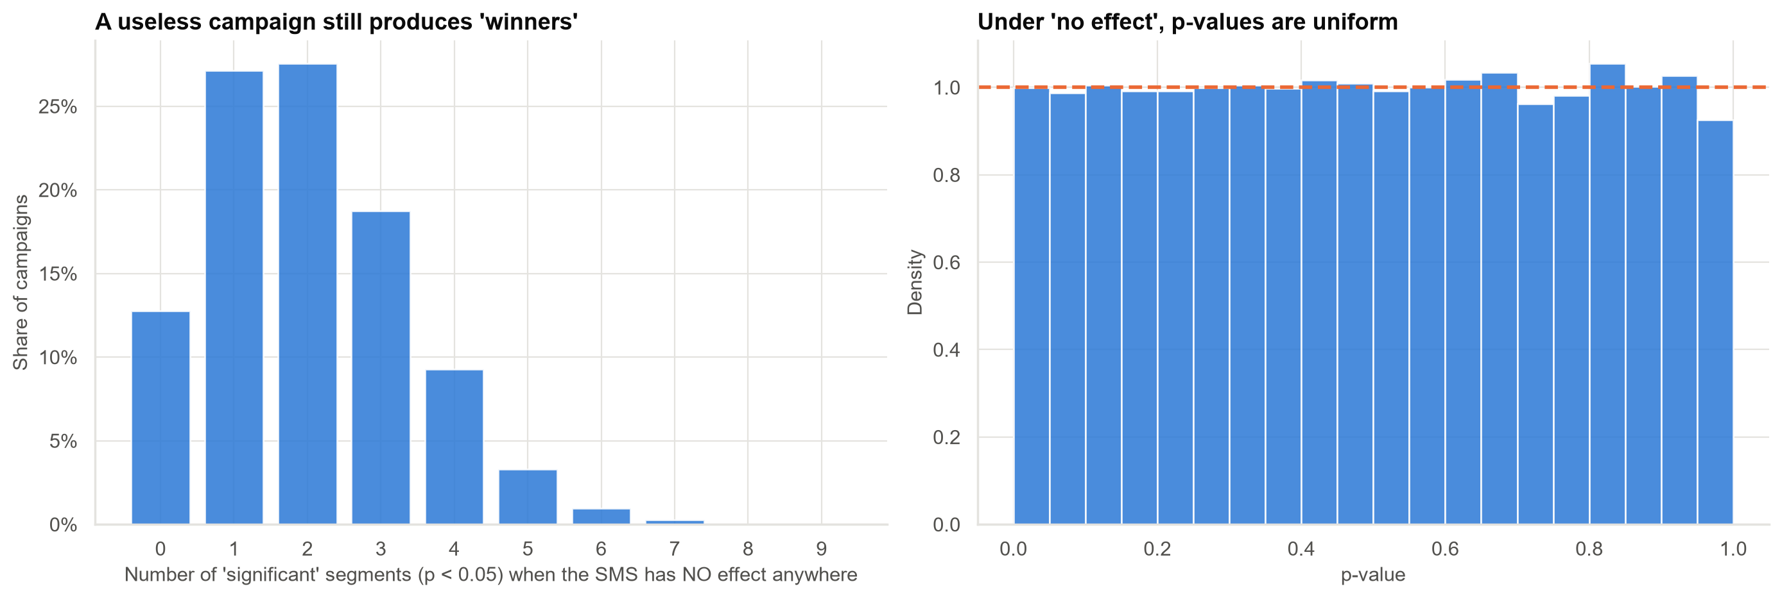
If the campaign did nothing, we would still see 'winners'
Left: the number of 'significant' segments in 5,000 simulated campaigns with no effect anywhere.
Case 19 · Testing a campaign across 40 segments · synthetic data
4

Slide 5
Correcting for 40 looks changes the list
Rule | Declared winners | What it controls
p < 0.05, no correction | 7 | nothing
Bonferroni (strict, any false alarm) | 2 | chance of ANY false winner
Holm (strict, more power) | 2 | chance of ANY false winner
Benjamini-Hochberg, 5% false discoveries | 2 | share of false winners among winners
Strict corrections protect against any false winner but miss real responders. The strict rules found only 2 of the 8 real responders; a 10% false-discovery screen finds 4 but with 2 false entries, so it feeds a confirmation wave.
Case 19 · Testing a campaign across 40 segments · synthetic data
5

Slide 6
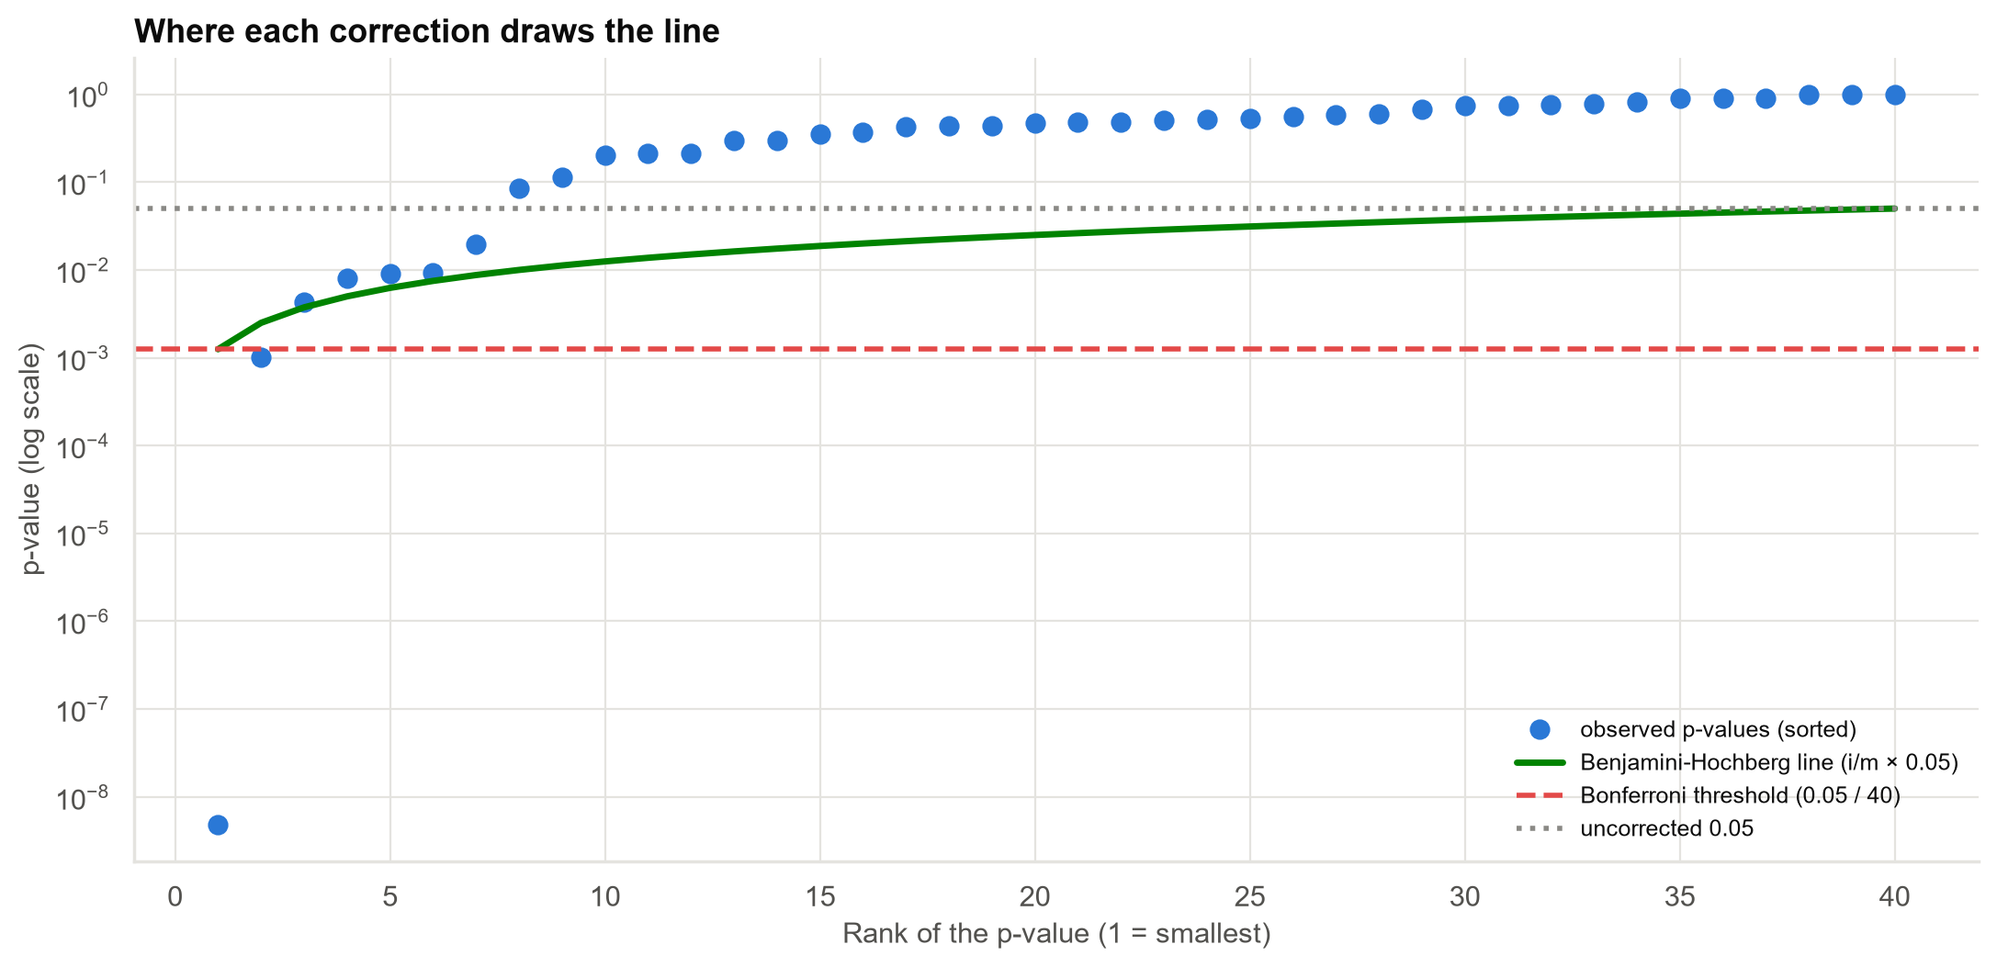
Where each correction draws the line
Points under the green line are discoveries at a 5% false-discovery rate; points under the red line survive the strictest rule.
Case 19 · Testing a campaign across 40 segments · synthetic data
6

Slide 7
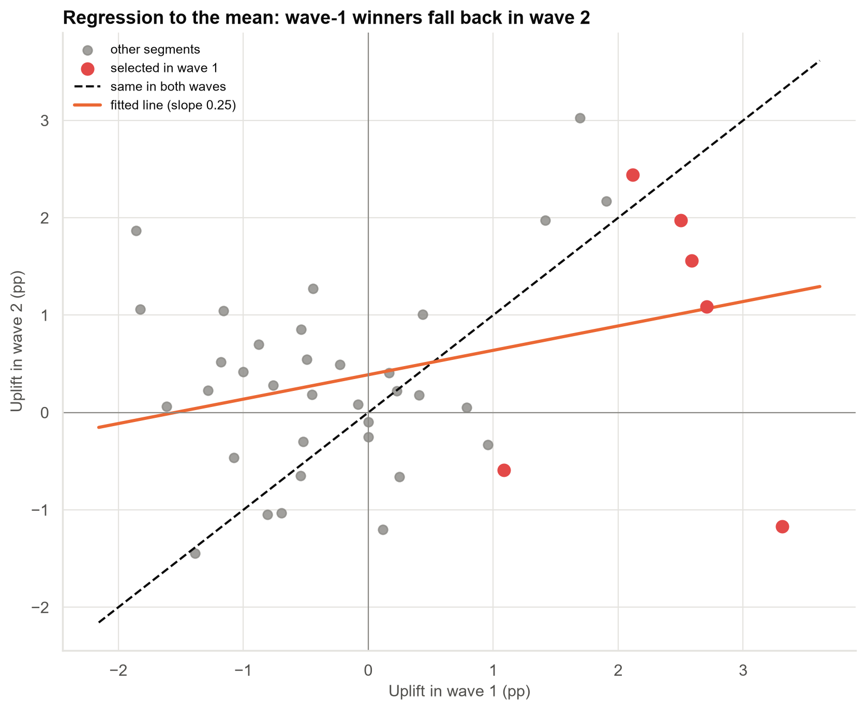
The winner's curse: wave-1 winners fall back in wave 2
Selecting the best-looking segments selects partly for luck. Their average uplift fell from +2.4 to +0.9 points in fresh data.
Case 19 · Testing a campaign across 40 segments · synthetic data
7

Slide 8
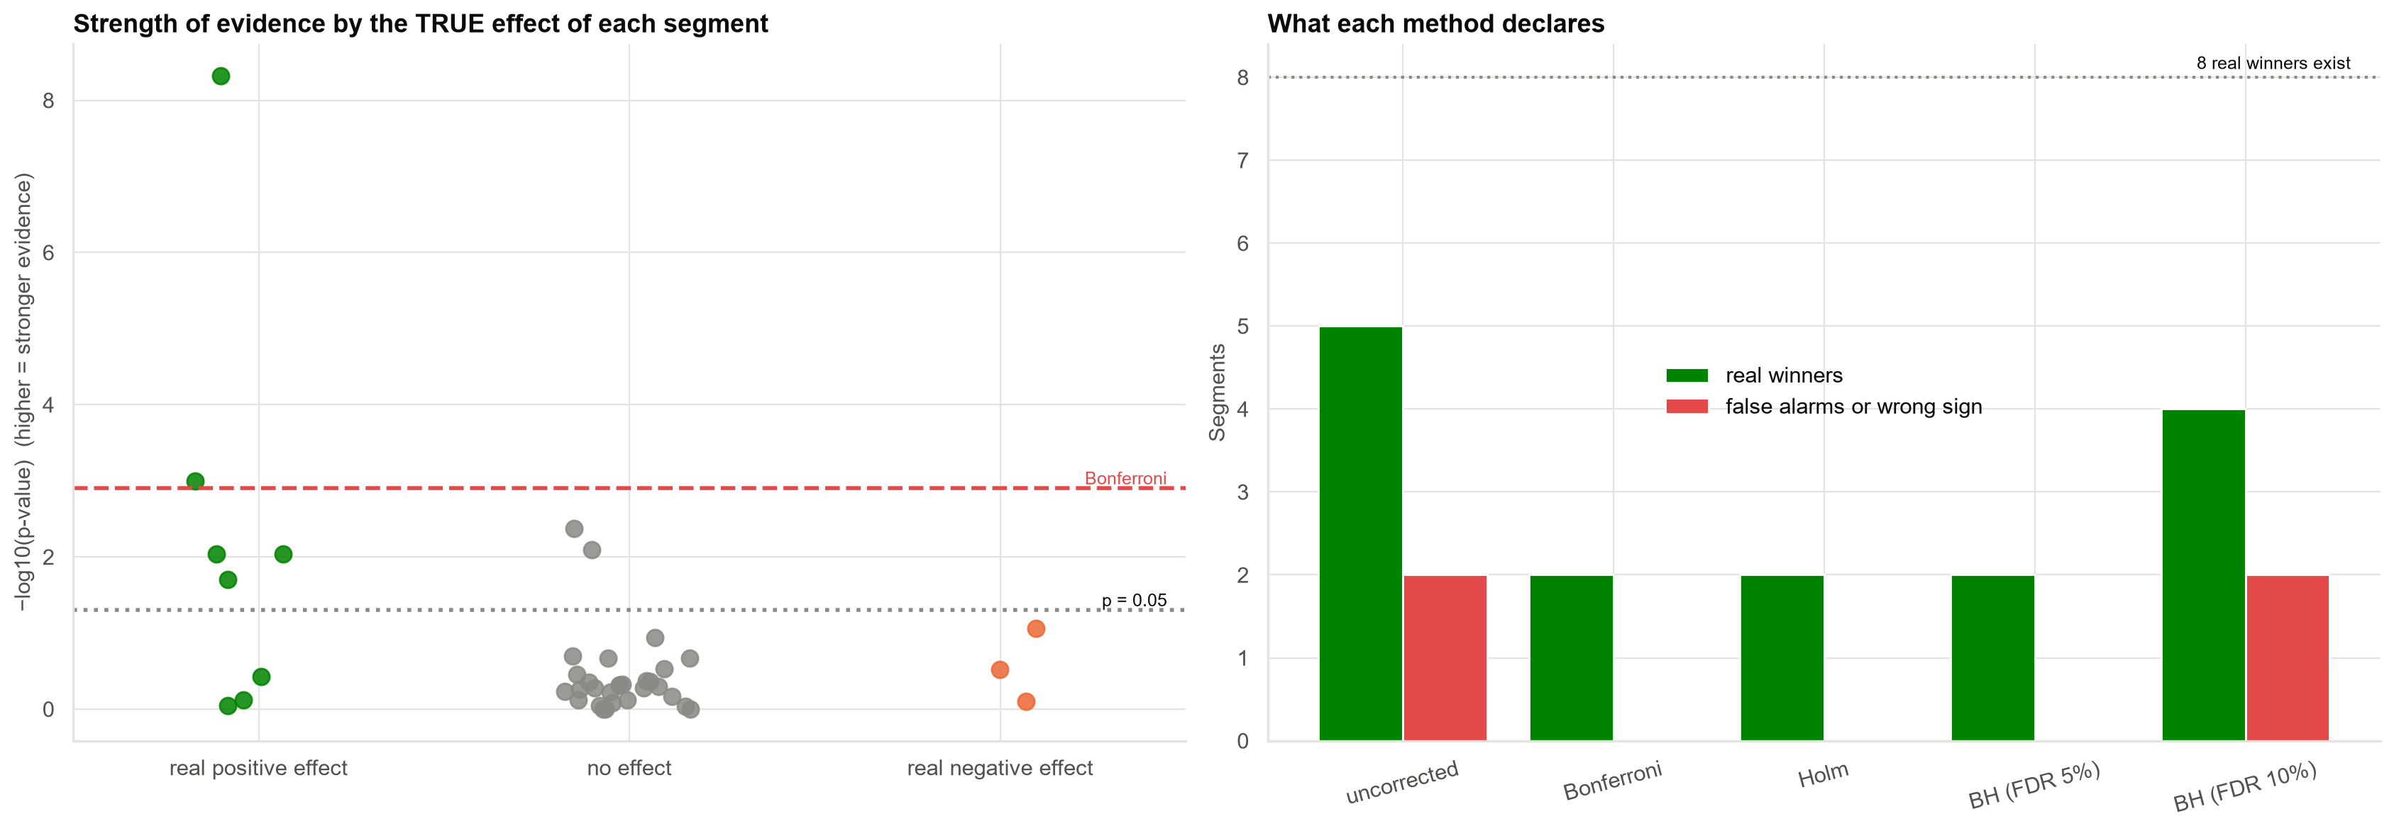
Checking against the truth: evidence strength and what each method declares
Uncorrected: 5 real and 2 false winners. Holm: 2 real, none false. BH 5%: 2 real, 0 false.
Case 19 · Testing a campaign across 40 segments · synthetic data
8

Slide 9
A tiered segment list instead of seven circled winners
Tier | Segments | Average uplift | Action
Confirmed (survives Holm, FWER 5%) | 2 | +2.3 pp | Target now
Promising (BH q < 0.10): confirm in wave 3 | 4 | +2.0 pp | Confirm in wave 3, then target
Not supported by the data: default campaign | 15 | +0.4 pp | Keep the default campaign
Negative or none: do not target | 19 | −0.5 pp | Do not target; investigate
Budget with shrunken uplifts, not the raw wave-1 numbers.
Case 19 · Testing a campaign across 40 segments · synthetic data
9

Slide 10
Recommendations
• Keep the campaign broad. Its overall effect is positive; nothing justifies dropping 34 segments.
• Target the 2 confirmed segments now and re-test the 4 promising ones in a confirmation wave.
• Budget with shrunken uplifts. Raw winners' effects are overstated.
• Declare the analysis plan in advance: primary test = overall effect; segment tests = a pre-defined family of 40.
• Show corrected values (BH q-values) next to p-values in every experiment report.
Decision needed: approve the tiered list and the confirmation wave.
Case 19 · Testing a campaign across 40 segments · synthetic data
10

Slide 11
Limitations and next steps
Limitations
Next steps
• Segments overlap in practice, so error rates are approximate.
• Wave 2 has the same power limits as wave 1.
• Segment tests are underpowered for modest effects.
• Confirmation wave sized for the promising segments.
• Hierarchical model across type and region.
• Individual-level uplift modelling.
Case 19 · Testing a campaign across 40 segments · synthetic data
11

