Slide 1
Does Cashback Cut Churn by Two Thirds?
Association, selection and what a randomised pilot says · Cards retention analytics
20,000 self-selected customers and a randomised pilot of 16,000. Synthetic data created for training. Not actual customer data.

Slide 2
Summary: the 19-point gap is mostly who signs up, not what cashback does
• Enrolled customers churn 7% against 26%, a −19.4-point gap. That is an association, not an effect.
• Enrolled customers were already different: more engaged, spending more, with a rising spend trend. Adjusting for what we can see cuts the gap to −7.0 points and weighting to −6.2.
• The randomised pilot says: offering cashback cuts churn by 2.3 points, and enrolling by about 4 points (CI 2 to 6).
• At current costs, break-even needs 7.5 points, so cashback loses money on the real effect and only looks profitable on the naive number.
Recommendation: do not push cashback to the whole base; keep it voluntary and test cheaper variants with a randomised offer.
Case 21 · Does cashback reduce churn? · synthetic data
2

Slide 3
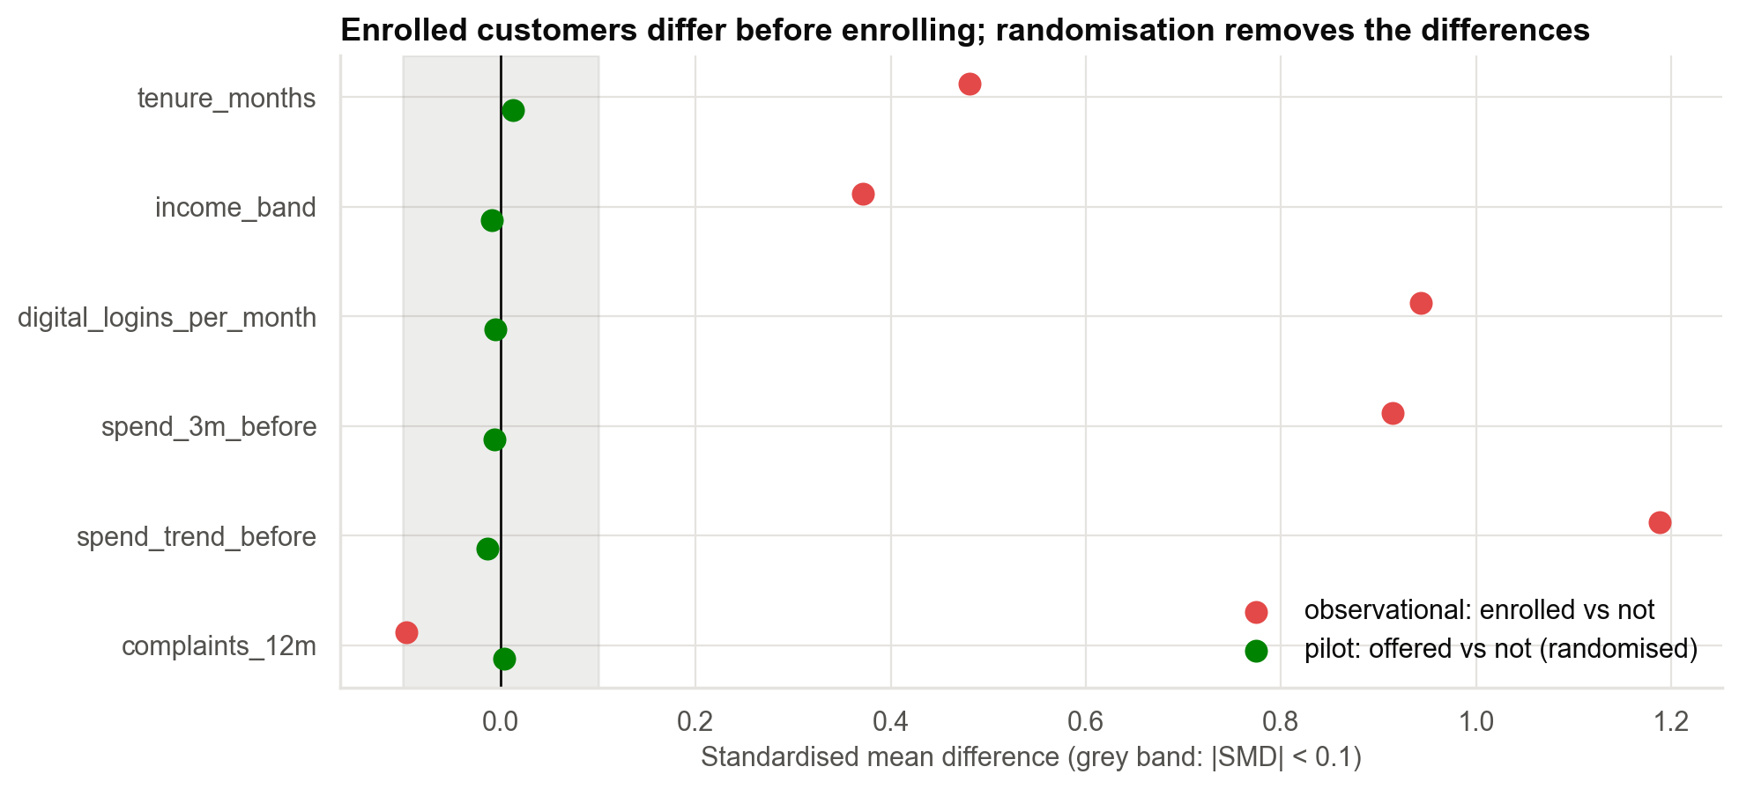
Who signs up? Engaged customers, before they ever enrol
Enrolled customers differ strongly on logins, spend and spend trend. In the randomised pilot those differences disappear.
Case 21 · Does cashback reduce churn? · synthetic data
3

Slide 4
Adjusting for what we can see: the estimate shrinks, then stalls
What we compared | Churn effect (pp)
Enrolled vs not (no controls) | −19.4
+ tenure, income, complaints | −16.1
+ spend and logins | −9.6
+ spend trend before decision | −7.0
Propensity weighting | −6.2
Every row has a narrow confidence interval, and none of them contains the true effect. Adjustment cannot remove what we cannot measure.
Case 21 · Does cashback reduce churn? · synthetic data
4

Slide 5
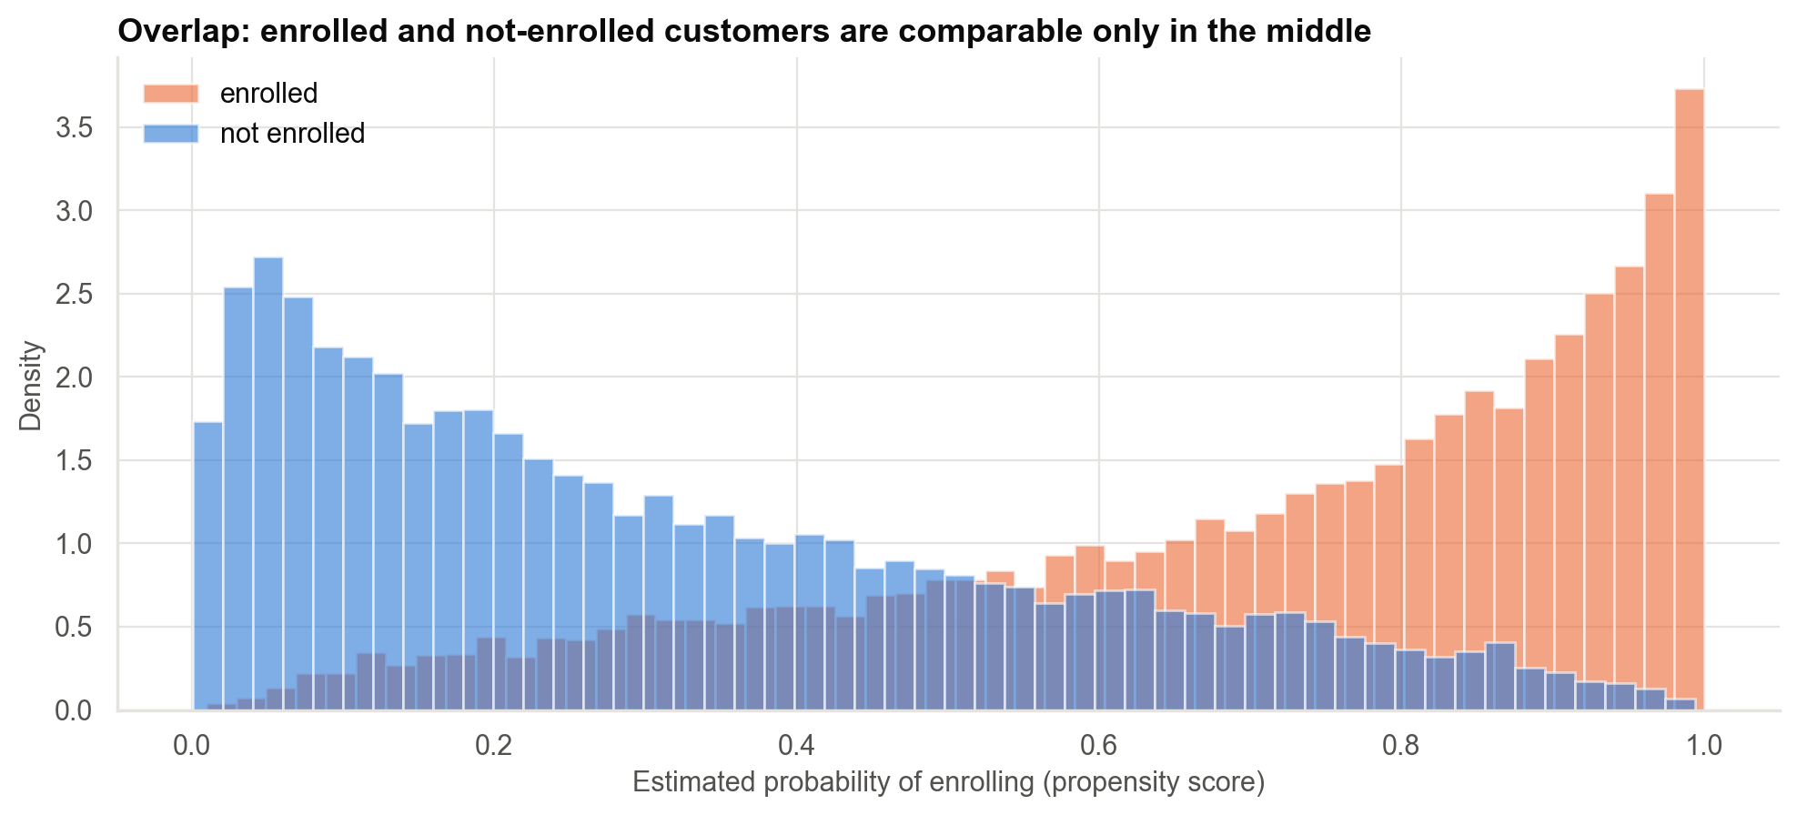
Overlap: the customers most likely to enrol have few look-alikes among non-enrolled customers
Weighting balances measured variables only.
Case 21 · Does cashback reduce churn? · synthetic data
5

Slide 6
What the randomised pilot says
−2.3
Effect of the OFFER
95% CI −3.4 to −1.1; whole offered group
55.8%
Take-up
share of offered customers who enrolled
−4.1
Effect of ENROLLING
95% CI −6.1 to −2.0; offer effect ÷ take-up
−13.7
Invalid in-pilot comparison
enrolled vs not: selection again
Only the first, second and third numbers are protected by the lottery.
Case 21 · Does cashback reduce churn? · synthetic data
6

Slide 7
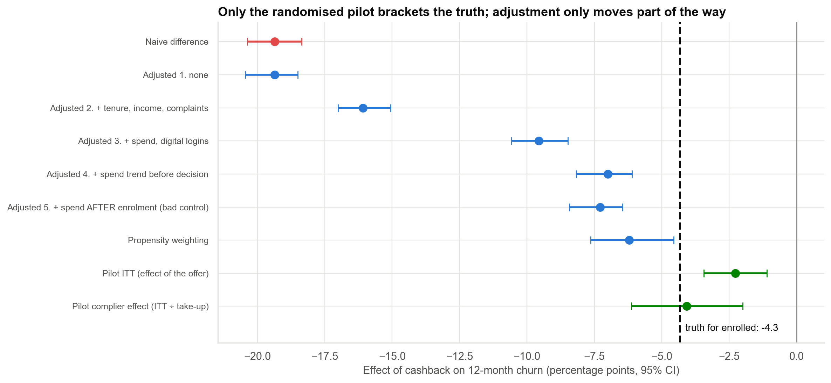
Which estimates bracket the truth? Only 2 of 8 adjusted or pilot intervals do
True effect among enrolled customers: −4.3 points. The pilot's complier estimate contains it; the adjusted estimates miss it.
Case 21 · Does cashback reduce churn? · synthetic data
7

Slide 8
How strong would a hidden factor have to be?
• The naive result would need a hidden factor with a risk ratio of about 7 with both enrolment and churn.
• The adjusted result would need only about 3.4.
• Engagement and intention to leave plausibly clear that bar: spend trend alone differs by more than a full standard deviation between enrolled and not.
The E-value measures how much hidden bias a claim must survive. It does not remove the bias.
Case 21 · Does cashback reduce churn? · synthetic data
8

Slide 9
The wrong estimate flips the decision (assumes ₹450 cost, ₹6,000 per churner, break-even 7.5 points)
Basis | Churn reduction (pp) | Net per enrolled customer (₹)
Marketing's naive number | 19.4 | +712
Pilot complier effect | 4.1 | −205
Truth (answer key) | 4.3 | −190
Costs and margins are assumptions for Finance. On the real effect cashback does not pay at today's cost.
Case 21 · Does cashback reduce churn? · synthetic data
9

Slide 10
Recommendations
• Do not move retention budget into cashback on the observational numbers.
• Keep it voluntary and cut the cost per customer or find a cheaper design.
• Randomise the offer in any further test or rollout, with a holdout.
• Describe results precisely: 'associated with' for the observational gap, 'reduces' only for the pilot.
• Look for who benefits with a larger, segmented test.
Decision needed: approve a randomised follow-up test of cheaper cashback levels.
Case 21 · Does cashback reduce churn? · synthetic data
10

Slide 11
Limitations and next steps
Limitations
Next steps
• Costs and margins are assumptions.
• The complier effect covers customers who enrol when offered.
• 12-month follow-up only.
• Synthetic data with a known hidden confounder.
• Multi-level cashback test.
• Heterogeneous effects from the pilot.
• Permanent holdout group.
• Quasi-experimental designs where randomising is impossible.
Case 21 · Does cashback reduce churn? · synthetic data
11

