Slide 1
p = 0.0001 and p = 0.25: Which Experiment Should We Back?
Statistical vs practical significance · Digital Product analytics
Two synthetic A/B tests (a checkout redesign and a fee-waiver offer). Synthetic data created for training. Not actual customer data.

Slide 2
Summary: the p-values point to exactly the wrong decision on both tests
• A (redesign): p = 0.0001, but the lift is 0.10 points (95% CI 0.05 to 0.15). Break-even is 0.20 points, so the entire interval is below it: net value about ₹17 lakh a year lost.
• B (fee waiver): p = 0.25, but the lift is +2.0 points (95% CI −1.4 to +5.4) against a break-even of 1.3 points. The pilot had only 21% power: a miss was likely even if the offer works.
• Probability the offer beats break-even: 65% (flat prior), 54% (cautious prior). Buying more data is worth about ₹78 lakh a year more than launching now.
• Significant results from small tests exaggerate: significant pilots average 4.2 points, about twice the true +2.0.
Decide on the confidence interval against break-even, not on the p-value.
Case 22 · Significant but irrelevant, non-significant but promising · synthetic data
2

Slide 3
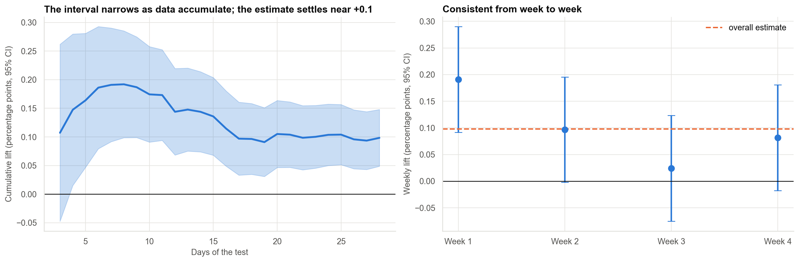
A: a large, clean test finds a tiny lift
3 million visitors make a 0.10-point lift statistically clear (p = 0.0001); that is a 2% relative change.
Case 22 · Significant but irrelevant, non-significant but promising · synthetic data
3

Slide 4
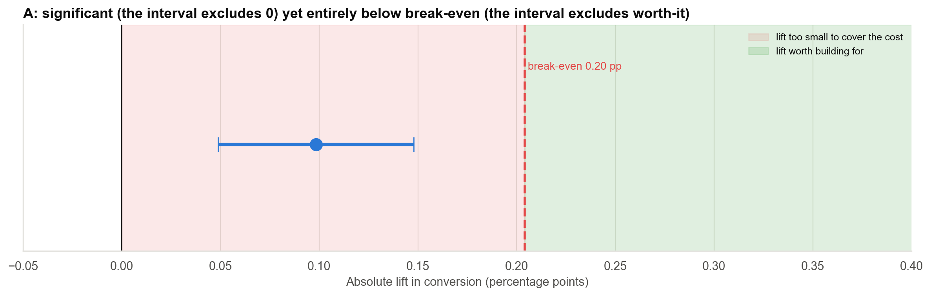
A vs break-even: the whole interval sits below what the redesign must earn
Break-even 0.20 points; the upper CI limit is 0.15. Even in the best case the redesign loses money.
Case 22 · Significant but irrelevant, non-significant but promising · synthetic data
4

Slide 5
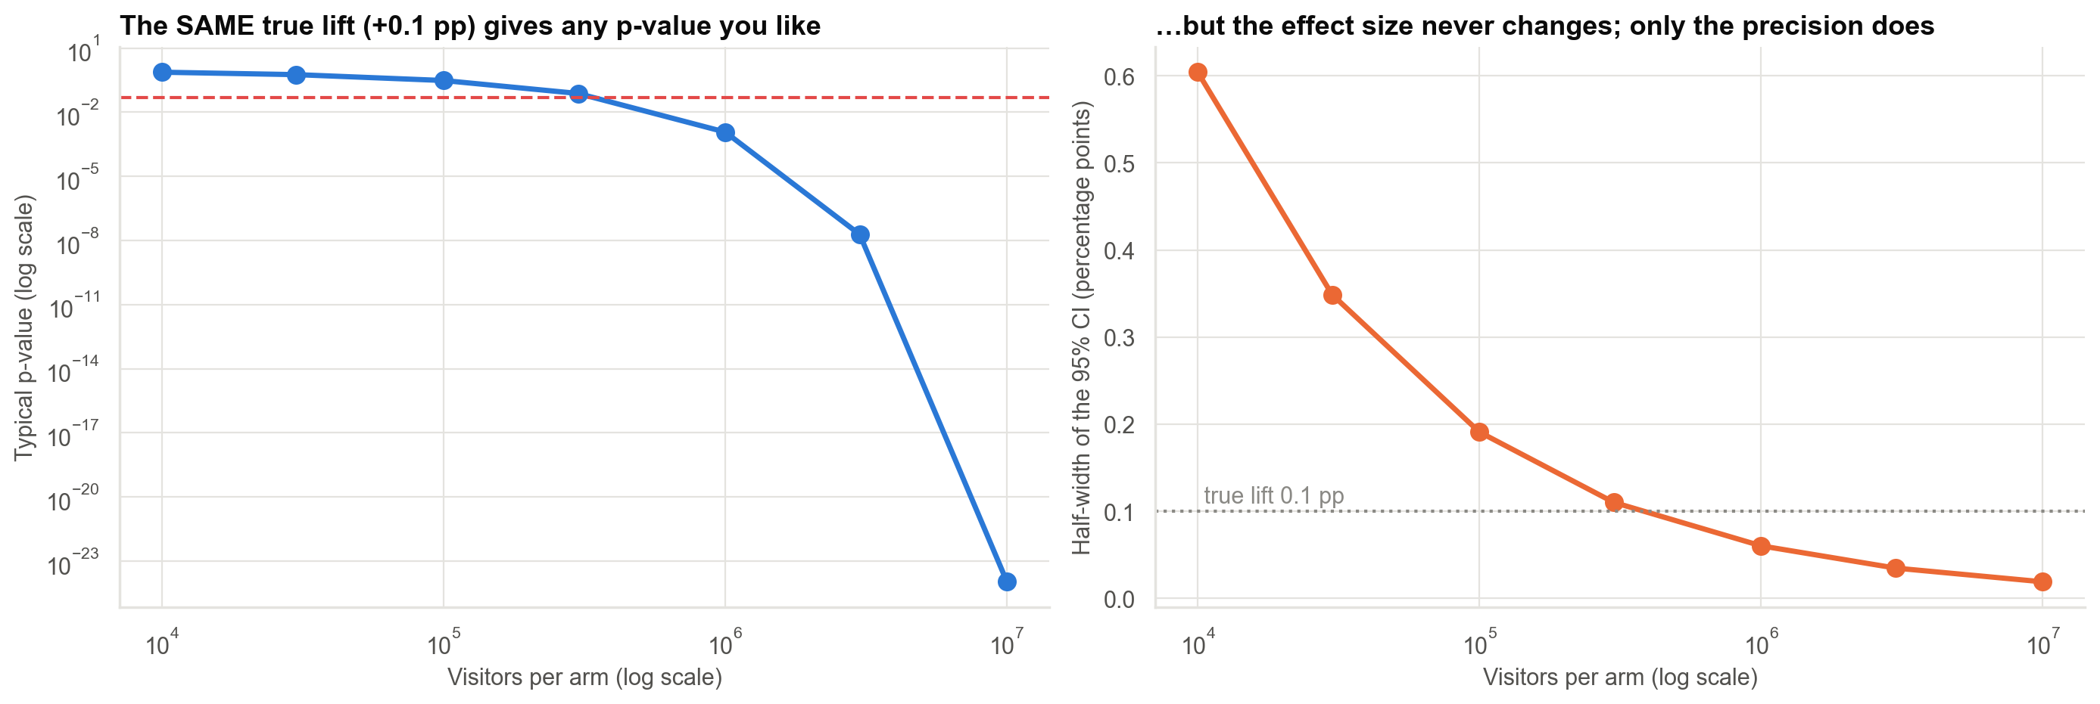
Why p-values mislead: the same tiny effect becomes 'significant' with enough visitors
Significance tracks sample size; business value tracks effect size relative to cost.
Case 22 · Significant but irrelevant, non-significant but promising · synthetic data
5

Slide 6
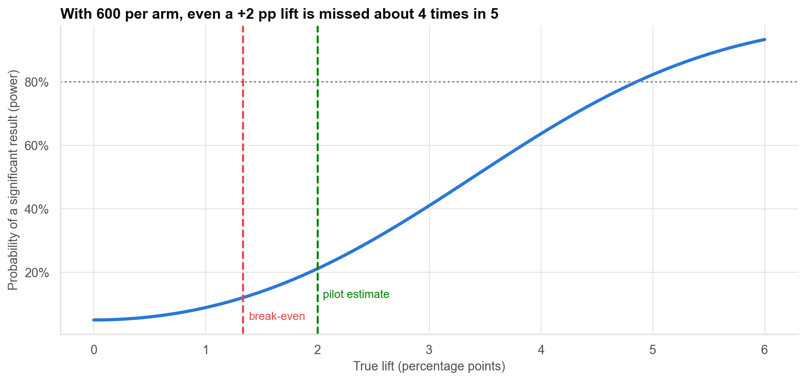
B: the pilot was too small to find even a valuable effect
A non-significant result from a study with 21% power says little. Look at the interval (−1.4 to +5.4 points).
Case 22 · Significant but irrelevant, non-significant but promising · synthetic data
6

Slide 7
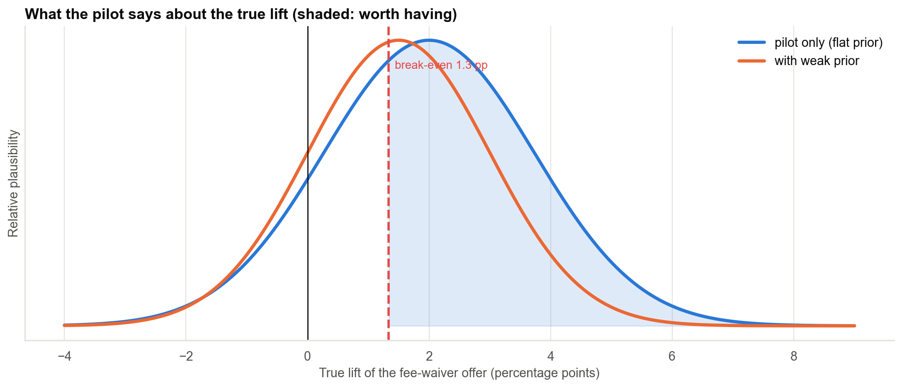
B: what the pilot implies for the decision
P(lift above break-even) is 65% to 54%: more likely than not worthwhile, far from certain.
Case 22 · Significant but irrelevant, non-significant but promising · synthetic data
7

Slide 8
Value of information: a follow-up test beats both launching and dropping
Option | Expected value (₹ lakh / year)
Launch now | 30
Drop now (the p-value advice) | 0
Bigger test, then decide | 107
Perfect information (upper bound) | 123
When the plausible range spans worthless to valuable and the test is cheap, buy the evidence.
Case 22 · Significant but irrelevant, non-significant but promising · synthetic data
8

Slide 9
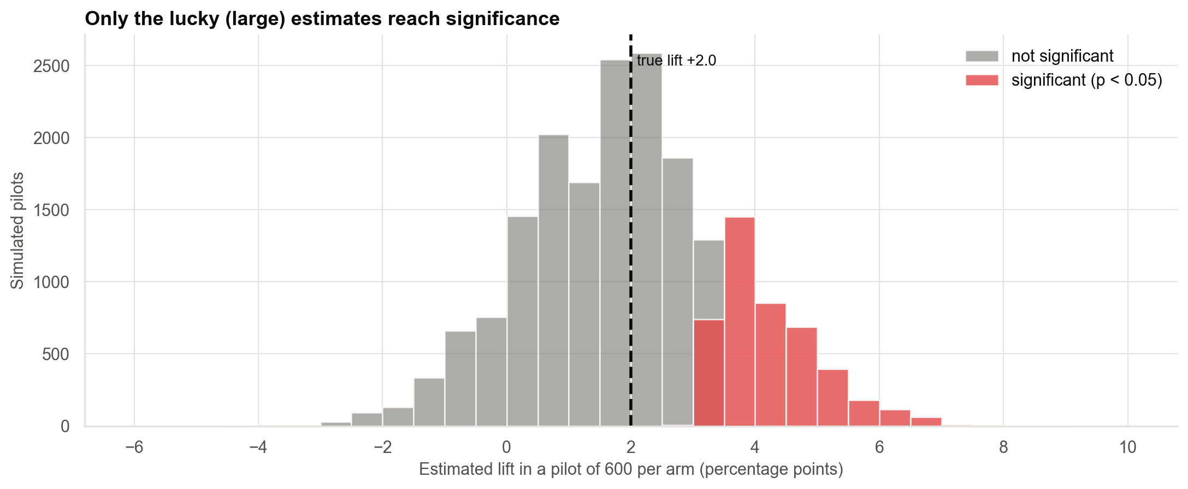
Significant results in small studies are exaggerated (Type M) and sometimes wrong-signed (Type S)
Only 23% of pilots reach p < 0.05; those that do average 4.2 points against a true 2.0.
Case 22 · Significant but irrelevant, non-significant but promising · synthetic data
9

Slide 10
Grading against the truth: the p-values were wrong twice
Test | True lift (pp) | Estimated (pp) | True net value (₹ lakh / yr) | Right call
A: checkout redesign | 0.10 | 0.10 | −16 | Do not build
B: fee-waiver offer | 2.00 | 2.00 | +120 | Test further / launch
CIs compared with break-even pointed the right way both times.
Case 22 · Significant but irrelevant, non-significant but promising · synthetic data
10

Slide 11
Recommendations
• Do not build the checkout redesign: the whole CI is below break-even.
• Run a follow-up test of the fee waiver rather than dropping it: about 7,000 per arm to detect the break-even lift (4,000 per arm detects only 1.8 points).
• Define the break-even lift before the test and report CIs against it.
• Report power with every non-significant result.
• Replicate before acting on a significant result from a small test.
Decision needed: stop A; fund the B follow-up.
Case 22 · Significant but irrelevant, non-significant but promising · synthetic data
11

Slide 12
Limitations and next steps
Limitations
Next steps
• Margins, costs and horizon are assumptions from Finance.
• Visitor split in A is slightly unbalanced (p = 0.004): investigate.
• Lift in A fades after week 1: possible novelty effect.
• Repeat A's economics with a range of margins.
• Run the B follow-up test.
• Add a holdout to measure long-run effects.
Case 22 · Significant but irrelevant, non-significant but promising · synthetic data
12

