Slide 1
The Rule Catches 85% of Fraud. So Why Are 88% of Its Alerts Wrong?
Base rates, Bayes' theorem and small-group estimates · Fraud Operations analytics
150,000 synthetic card and UPI transactions with two screens and a confirmed outcome. Synthetic data created for training. Not actual customer data.

Slide 2
Summary: an alert is a probability, not a verdict
• The rule catches 85% of fraud, but when it fires only 12% of alerts are fraud (95% CI 11% to 13%). Fraud is 0.42% of transactions, so false alarms from the 99.6% genuine outnumber true alerts about 7 to 1.
• Where the alert fires matters: the same rule has a PPV of 6% for card-present, 12% for UPI and 17% for card-not-present, because the base rate differs about 6-fold.
• When both screens fire, fraud is 87% likely; one alone gives about 2.5%. The two screens are independent here, so their evidence multiplies.
• Blocking every rule alert costs ₹71 lakh and blocks 3,950 genuine customers. A probability-based policy costs ₹19 lakh and blocks 68.
Recommendation: investigate single alerts where the probability clears 2.5%, block only on combined evidence.
Case 24 · A fraud alert fired · synthetic data
2

Slide 3
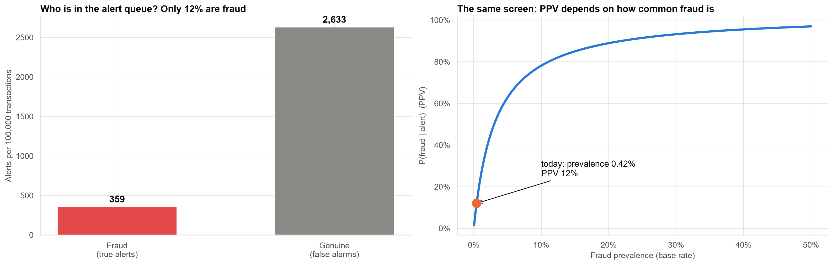
Out of every 100,000 transactions, who is in the alert queue?
About 360 true alerts and 2,630 false ones. The PPV rises with the base rate: 12% today, 50% only if fraud were about 3% of transactions.
Case 24 · A fraud alert fired · synthetic data
3

Slide 4
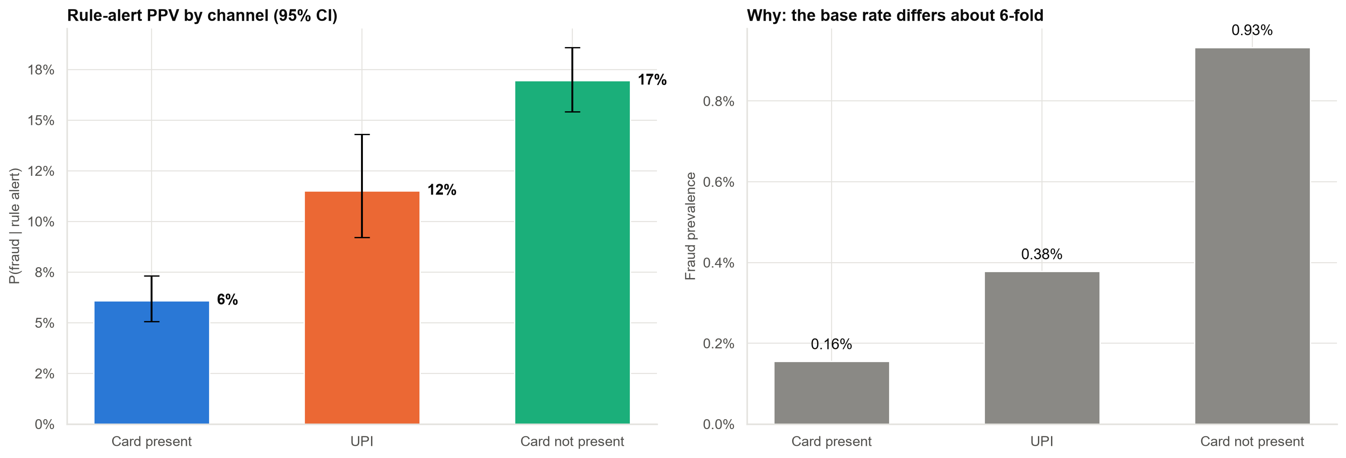
The same rule means different things in different channels
Card-present transactions generate 39% of all alerts at the lowest PPV.
Case 24 · A fraud alert fired · synthetic data
4

Slide 5
A second alert multiplies the evidence
Alert pattern | Transactions | Fraud rate | Predicted by Bayes
Neither | 142,474 | 0.01% | 0.01%
Rule only | 3,980 | 2.46% | 2.51%
ML score only | 3,037 | 2.50% | 2.56%
Both | 509 | 86.64% | 84.58%
The prediction from multiplying the screens' likelihood ratios matches what was observed. This holds only because the screens are independent.
Case 24 · A fraud alert fired · synthetic data
5

Slide 6
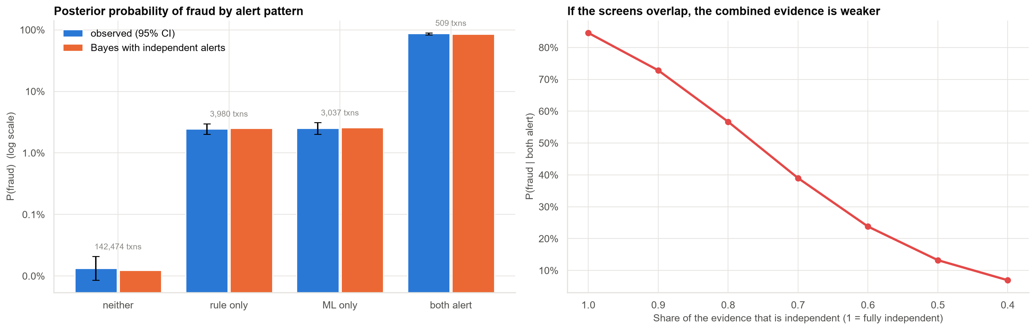
What if the screens overlap? The combined evidence shrinks fast
If only 70% of the evidence is independent, P(fraud | both alert) falls from 85% to 39%. Test independence before chaining screens.
Case 24 · A fraud alert fired · synthetic data
6

Slide 7
Decisions from probabilities: investigate above 2.5%, block above 11%
Policy | Cost (₹ lakh) | Frauds stopped | Genuine blocked
Pass everything (no screening) | 76.1 | 0 | 0
Block every rule alert (the operations head's plan) | 70.7 | 539 | 3,950
Investigate every rule alert | 24.9 | 539 | 0
Probability-based (investigate above p*, block above block threshold) | 18.8 | 555 | 68
Costs are assumptions (₹300 per investigation, ₹12,000 per fraud, ₹1,500 per wrongly blocked customer). Policy thresholds were set on the same data, so its edge is somewhat optimistic.
Case 24 · A fraud alert fired · synthetic data
7

Slide 8
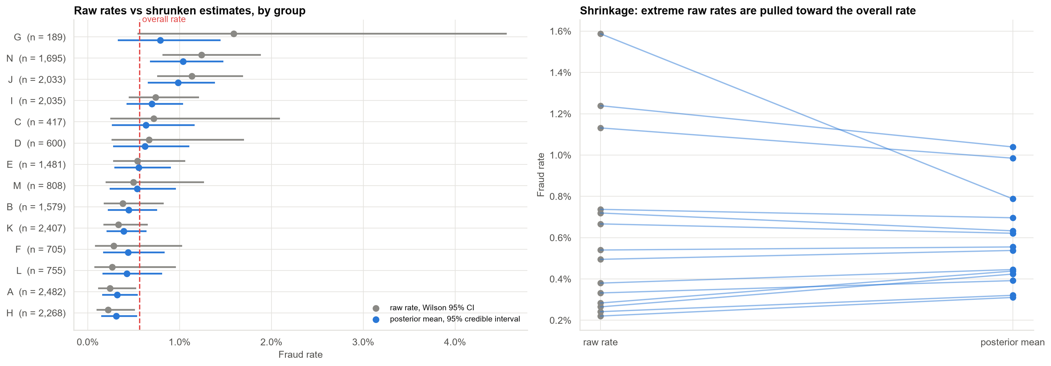
Small merchant groups: raw rates are mostly noise
Group G (3 frauds in 189 transactions) has the highest raw rate, 1.6%, but its estimate falls to 0.8% once it borrows strength from the other groups.
Case 24 · A fraud alert fired · synthetic data
8

Slide 9
Which groups are really worse than average?
• Probability each group exceeds a 1% fraud rate: N 55%, J 44%, G 21%. No group is beyond reasonable doubt.
• The prior matters for tiny groups: for G a flat prior gives 88% probability of exceeding 1%, the data-based prior 21%.
• Shrinkage is better on average, not always: on this one set of 14 groups it did not beat the raw rates (squared error 5.6 for shrinkage vs 3.1 for raw rates, ×10⁻⁶). Over 3,000 simulated sets it won 71% of the time.
Report probabilities and intervals for small groups, not a raw league table.
Case 24 · A fraud alert fired · synthetic data
9

Slide 10
Recommendations
• Report the PPV and alert volume to operations, not just the catch rate.
• Do not block on a single alert. Investigate in card-not-present, and block when both screens agree.
• Use channel-specific thresholds: the base rate differs about 6-fold.
• Check independence before chaining screens; track PPV and base rate monthly.
• Monitor merchant groups with posterior probabilities, not raw rates.
Decision needed: approve the investigate-then-block policy for a pilot.
Case 24 · A fraud alert fired · synthetic data
10

Slide 11
Limitations and next steps
Limitations
Next steps
• Costs are assumptions; blocking costs include hard-to-measure attrition.
• Fraudsters adapt, so rates drift.
• Labels arrive after about 60 days.
• Real screens usually share signals.
• Build a calibrated model that outputs P(fraud) directly.
• Monitor base rate and PPV monthly.
• Model both alerts jointly with channel.
• Hierarchical model for merchant groups.
Case 24 · A fraud alert fired · synthetic data
11

