Slide 1
Is 'Last Year Plus 20%' a Good Forecast?
Describing a time series and building an honest baseline · Payments Finance
108 months of synthetic payment-volume history. Synthetic data created for training. Not actual company data.

Slide 2
Summary: growth is slowing, seasonality is stable, and a simple model beats the fancy ones
• Volume grew from about 20 to 390 million a month, but growth is slowing: trend growth fell from 52% to 19% a year.
• Seasonality is stable: October runs 9% above an average month, February 13% below (a short month).
• Best baseline: trend plus seasonal-dummy regression (rolling MAPE 4.2%). SARIMA was much worse (9.8%, biased high); seasonal naive 21%.
• The 20% rule gave 4,880 million for 2025, within 1.2% of the 4,822 actual, but it has no way to reflect slowing growth.
Recommendation: use a model-based baseline with an interval, and a growth scenario range instead of one percentage.
Case 25 · Monthly digital-payments volume · synthetic data
2

Slide 3
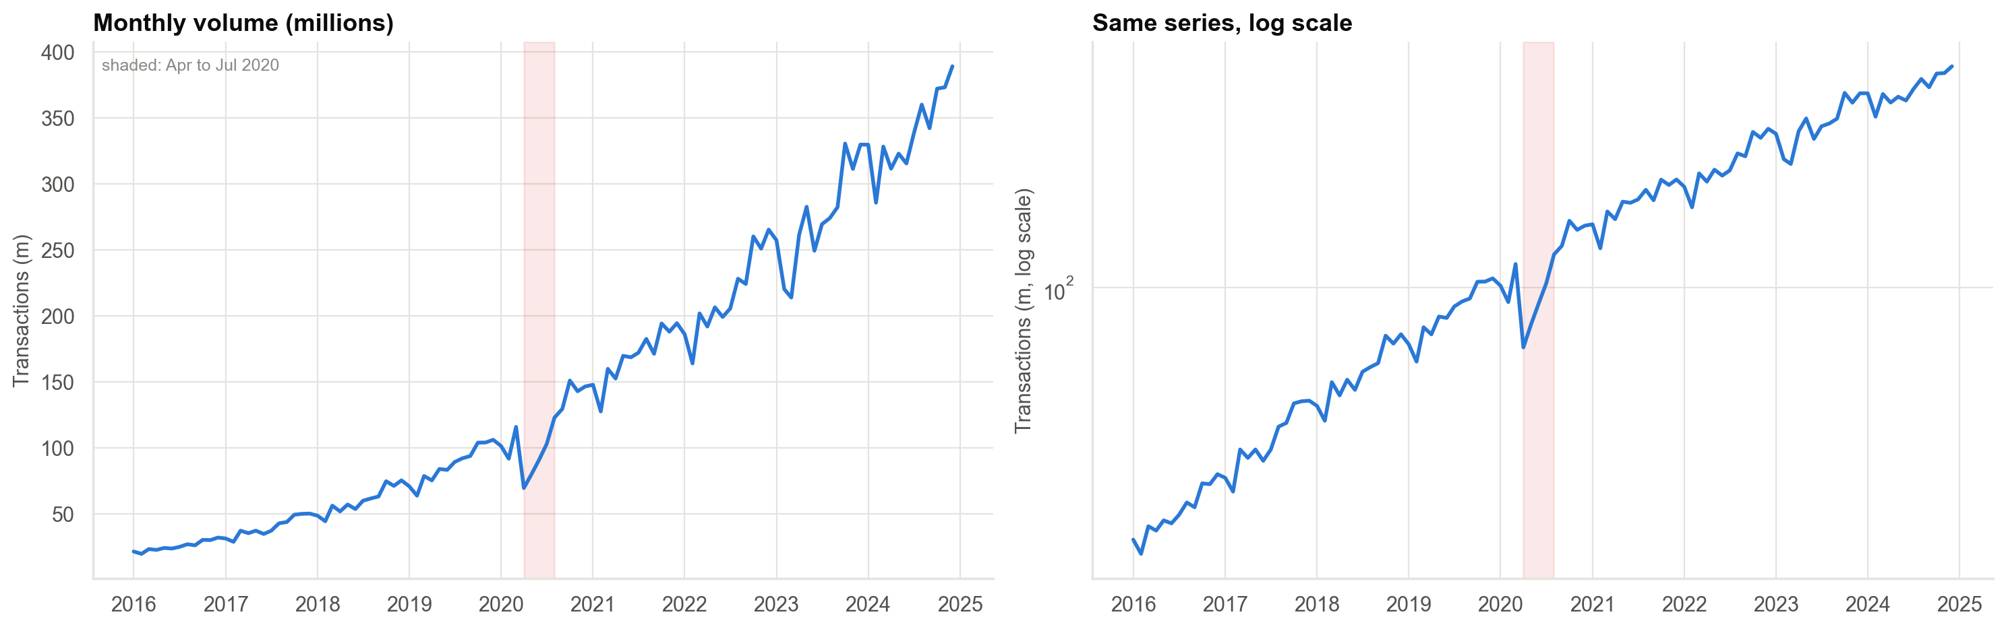
The history: a slowing exponential trend, a COVID dip and a one-month outage
On the log scale growth is close to a straight line that flattens. Shaded: April to July 2020.
Case 25 · Monthly digital-payments volume · synthetic data
3

Slide 4
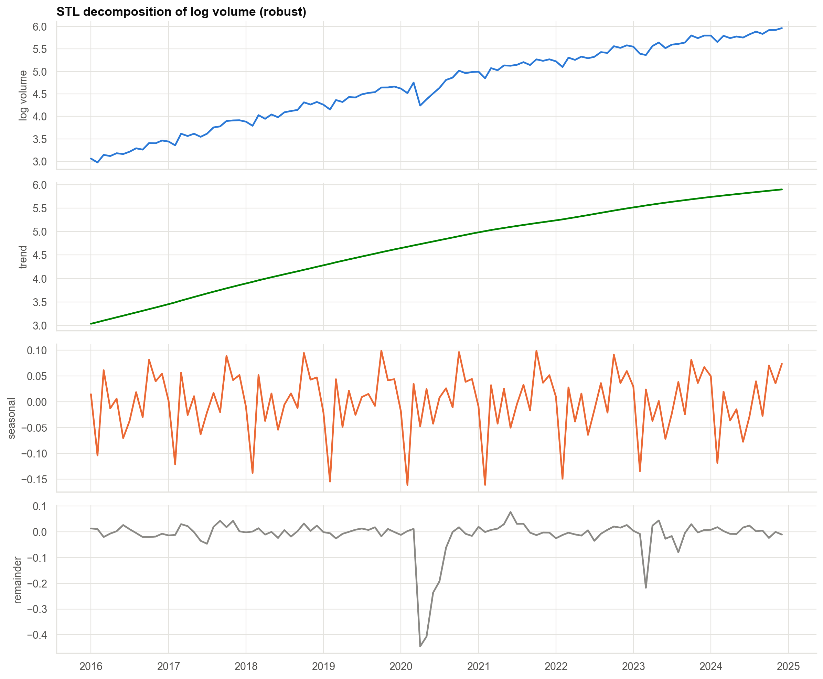
Trend, seasonal pattern and remainder
The seasonal pattern repeats each year; the remainder is small except for 2020 and March 2023.
Case 25 · Monthly digital-payments volume · synthetic data
4

Slide 5
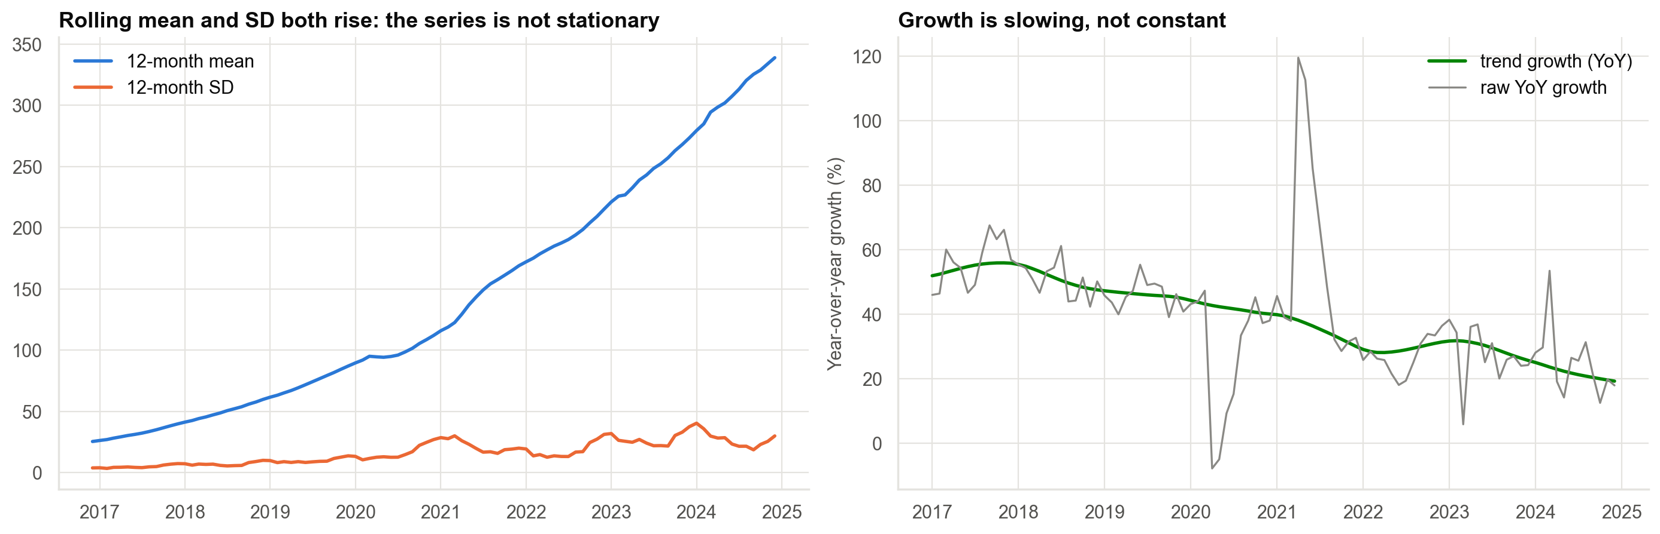
Growth is not 20%: it fell every year after the 2021 rebound
Calendar-year growth: 57%, 50%, 46%, 29% (COVID), 51%, 27%, 27%, 24%.
Case 25 · Monthly digital-payments volume · synthetic data
5

Slide 6
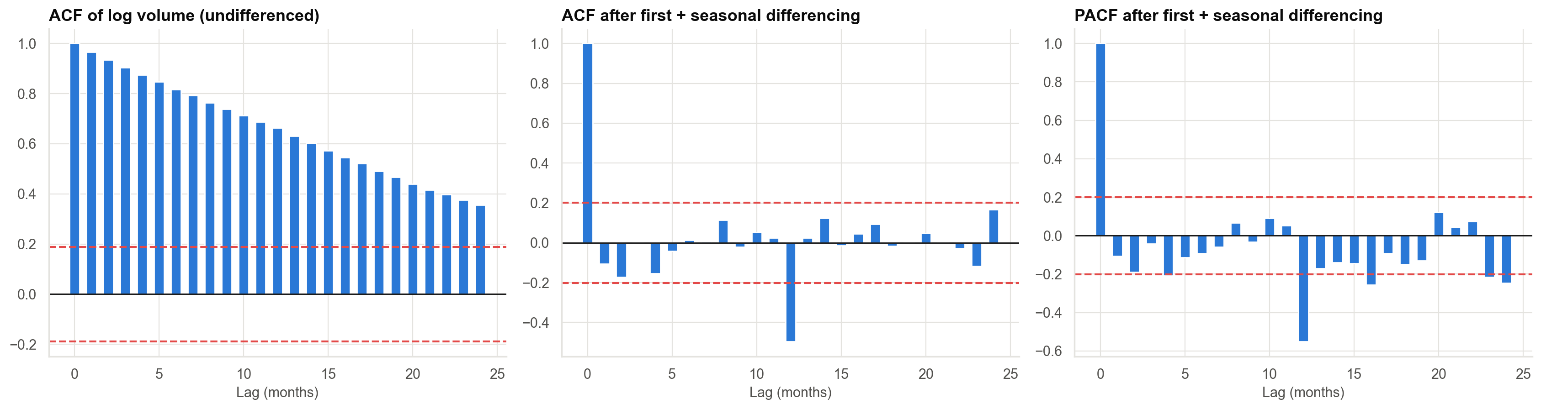
Why ordinary statistics fail: autocorrelation after differencing
The raw series is non-stationary (ADF p = 1.00). After first and seasonal differencing it is stationary (p = 0.0002). Months next to each other are correlated, so split by time.
Case 25 · Monthly digital-payments volume · synthetic data
6

Slide 7
Rolling-origin test: forecasting 12 months ahead from 9 different starting points
Model | MAPE (%) | MASE | Bias (%)
Trend + season regression | 4.2 | 0.34 | +1.4
Holt-Winters (damped) | 6.7 | 0.57 | −1.3
Seasonal naive + drift | 8.7 | 0.70 | +5.0
SARIMA | 9.8 | 0.84 | +8.0
Naive | 14.4 | 1.28 | −12.1
Seasonal naive | 21.4 | 1.85 | −21.4
MASE below 1 beats the seasonal naive forecast made on the history. Seasonal naive ignores growth and loses badly.
Case 25 · Monthly digital-payments volume · synthetic data
7

Slide 8
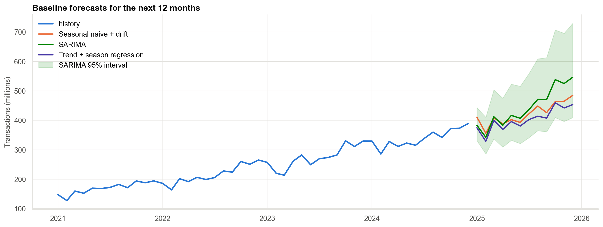
Forecast for the next 12 months
Forecast totals for the year range from 4,827 million (regression) to 5,331 million (SARIMA). The 20% rule gives 4,880.
Case 25 · Monthly digital-payments volume · synthetic data
8

Slide 9
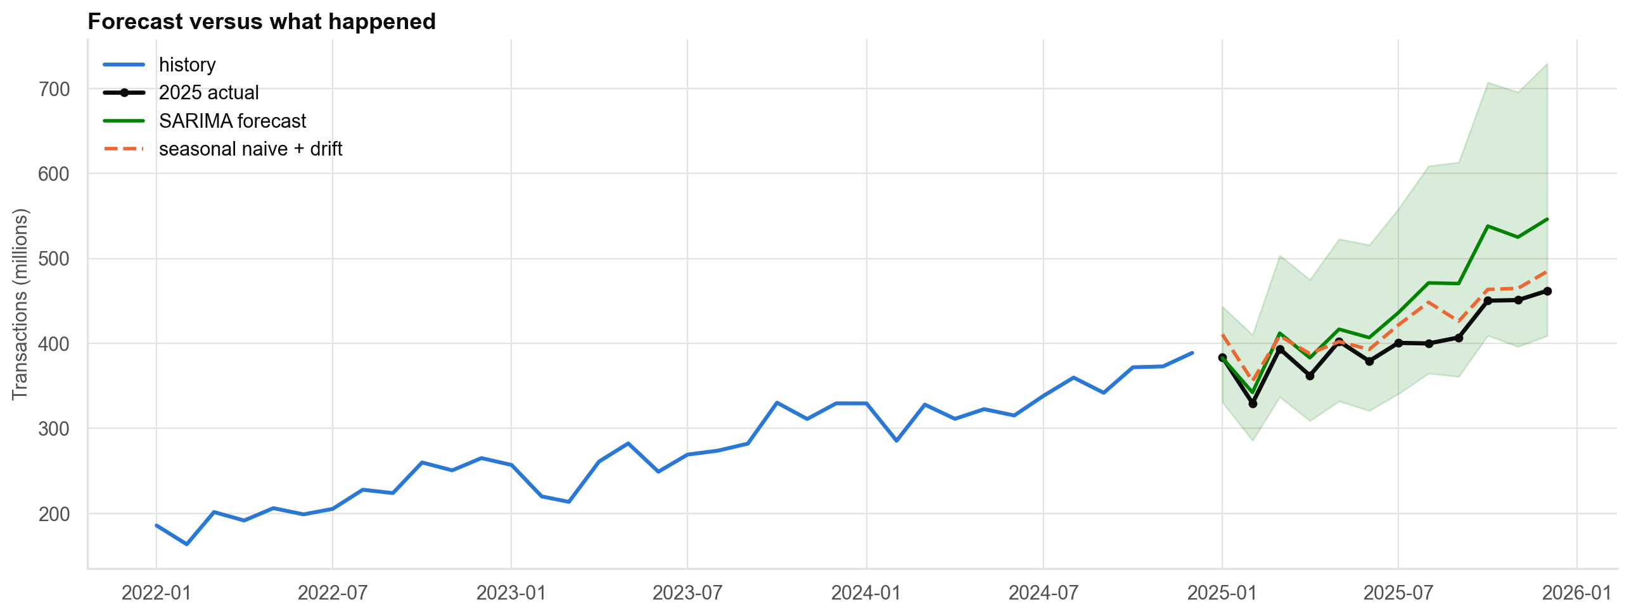
What happened in 2025
Actual +18.6%. Regression +0.1% on the total, SARIMA +10.6%. The SARIMA interval contained every month, but it was wide and biased high.
Case 25 · Monthly digital-payments volume · synthetic data
9

Slide 10
Grading against the revealed 2025 actuals
Forecast | 2025 total error | Monthly MAPE
Naive | −3.2% | 7.3%
Seasonal naive | −15.7% | 15.6%
Seasonal naive + drift | +5.1% | 5.2%
Holt-Winters (damped) | +0.5% | 2.5%
SARIMA | +10.6% | 10.1%
Trend + season regression | +0.1% | 1.5%
Last year + 20% rule | +1.2% | n/a
The ranking from the backtests held in the real unseen year. A wide interval that contains the truth is not an accurate forecast.
Case 25 · Monthly digital-payments volume · synthetic data
10

Slide 11
Recommendations
• Plan on a trend-plus-seasonal baseline with its 95% interval; expect about 4% typical monthly error.
• Staff for the October-December peak and the February trough.
• Replace 'last year + 20%' with scenarios (for example 12%, 18%, 24% growth).
• Treat outages and pandemics as scenarios, not trend.
• Backtest every new model with rolling origins and compare it with the baseline.
Decision needed: adopt the baseline model and quarterly review for the capacity plan.
Case 25 · Monthly digital-payments volume · synthetic data
11

Slide 12
Limitations and next steps
Limitations
Next steps
• Nine usable years of seasonality.
• Rolling windows overlap, so backtests are not independent.
• Synthetic data with a simple, known process.
• Add explanatory drivers.
• Forecast by channel and reconcile to the total.
• Build explicit shock scenarios.
Case 25 · Monthly digital-payments volume · synthetic data
12

