Slide 1


Tech Instagram Influencer Analysis
Dhyanesh Khakharodiya
Data Analyst Intern

Slide 2
Business Problem :
Atliq Technologies’ Social Media Analytics team is initiating a pilot project focused on a tech-focused Instagram influencer.
The analysis will utilize three database tables containing detailed Instagram activity data. The objective is to explore the data, answer key business questions, and uncover actionable insights.
Insights from this analysis will support data-driven decision-making and strategy refinement.

Slide 3
Methodology :
MySQL: Utilized to write and execute SQL queries for extracting and analyzing data in response to stakeholder-defined business questions.
Power BI: Employed to design and develop interactive visualizations and dashboards for effective data presentation and insight communication.

Slide 4
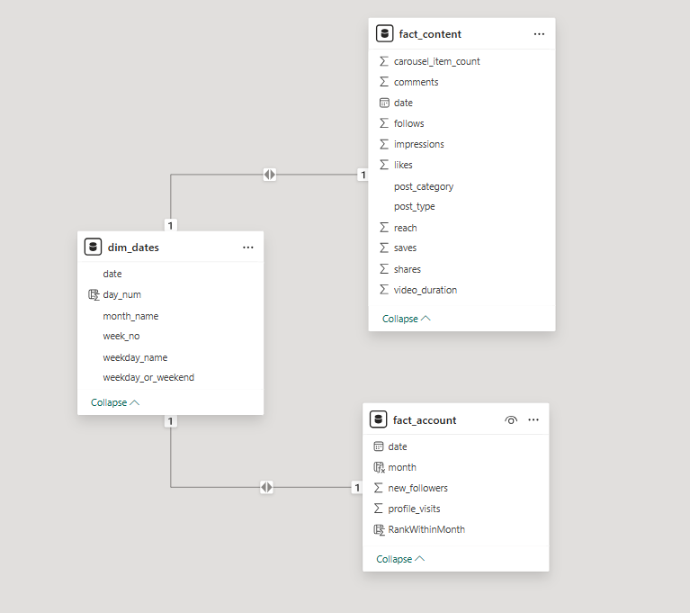
Data Overview :
The data model is structured using a simple star schema to facilitate efficient querying and analysis.
It consists of the following tables:
dim_dates
fact_content
fact_account

Slide 5
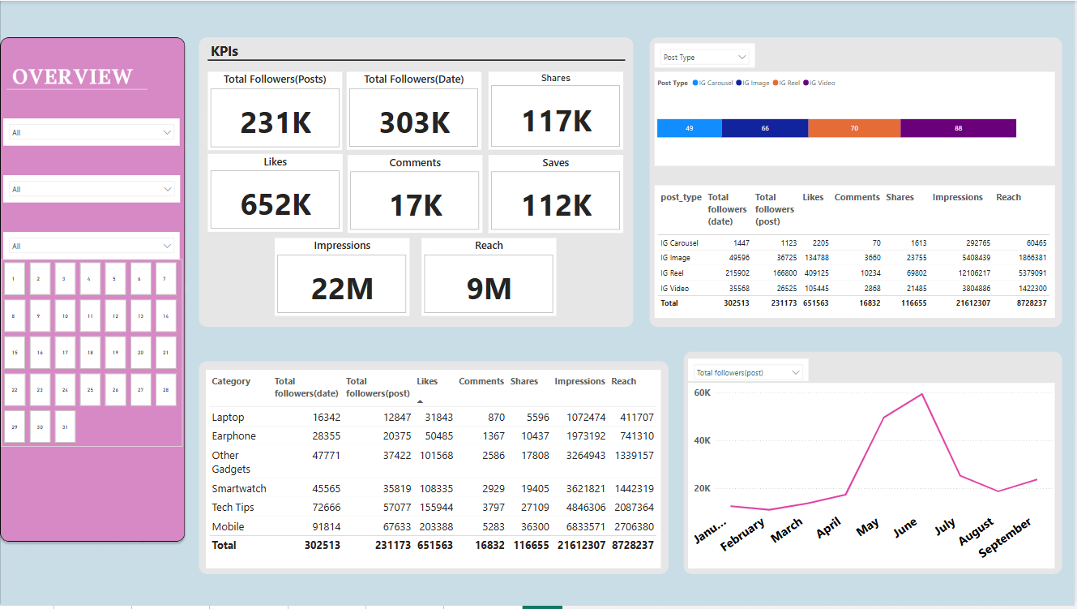
Pilot Overview dashboard :

Slide 6
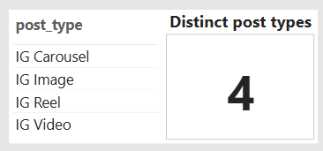
1. Unique Post types in fact_content table.
There are 4 unique post types identified in the dataset:
IG Carousel
IG Image
IG Reel
IG Video

Slide 7
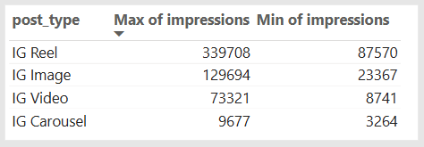
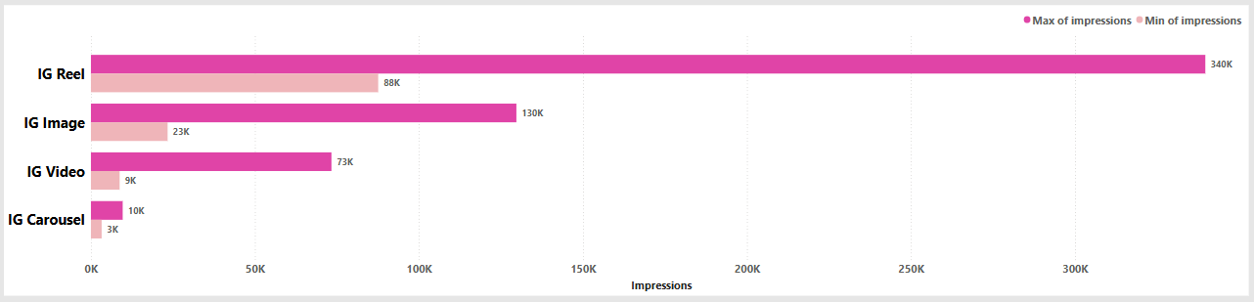
2. Highest & Lowest impressions for each post type.
IG Reels recorded both the highest maximum and highest minimum impressions among all post types.
IG Carousels recorded both the lowest maximum and lowest minimum impressions.
This indicates that Reels consistently reach a larger audience and are more frequently viewed by Instagram users.

Slide 8
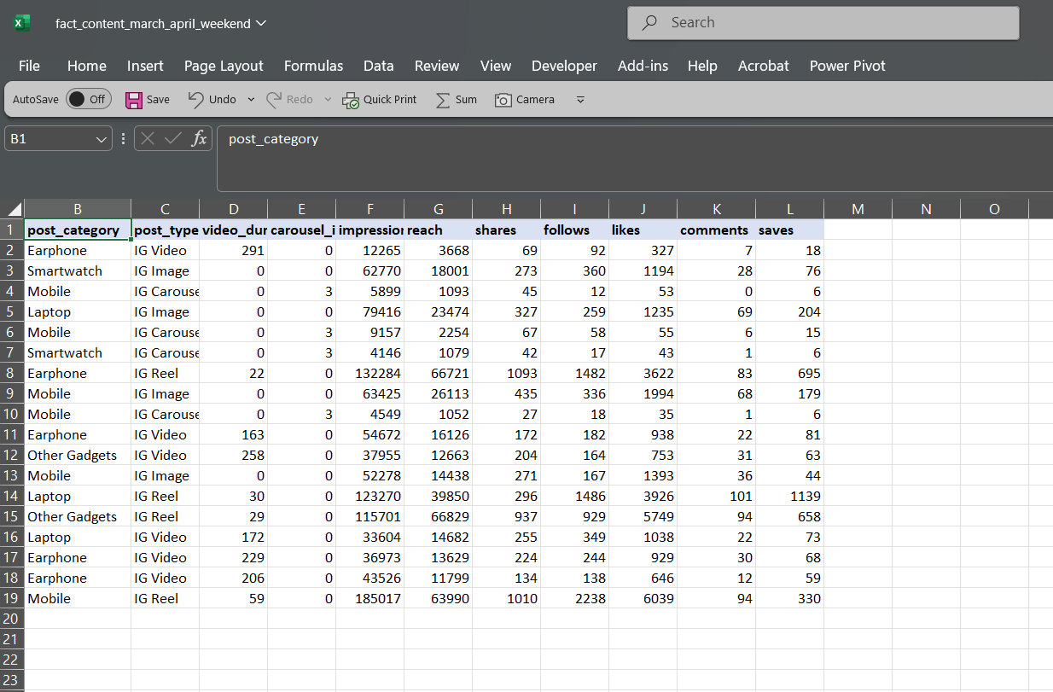
3. Creating a separate .csv file for all posts in March & April on weekends.

Slide 9
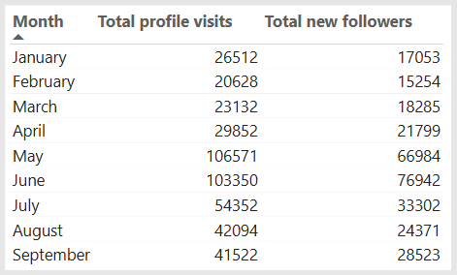
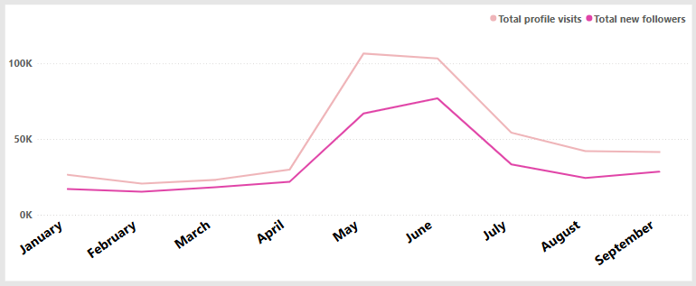
4. Statistics of the account: Total profile visits & Total new followers gained.
May recorded the highest number of profile visits with 106,571 visits.
June had the highest count of new followers gained, totaling 76,942.
A noticeable decline in both profile visits and new followers occurred after June.

Slide 10
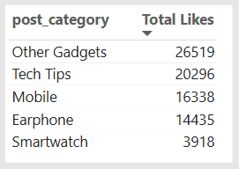
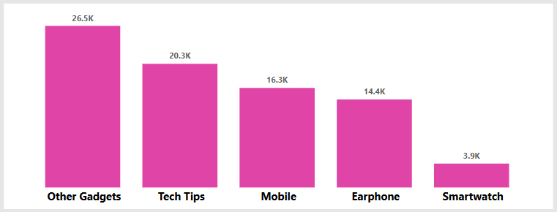
5. Total likes by post category in the month of July.
July showed a decline in both profile visits and new followers.
Analysis of total likes by post category revealed "Other Gadgets" had the highest engagement (26,519 likes).
"Smartwatch" posts had the lowest engagement, with only 3,918 likes, indicating a shift in audience interest.

Slide 11
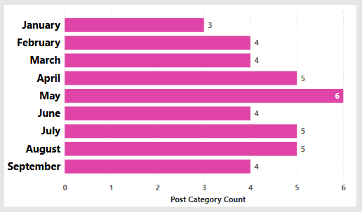
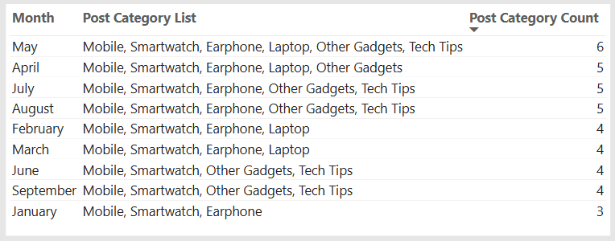
6. Unique post_category names alongside their respective counts for each month.
May featured the highest variety, with 6 unique post categories.
January had the lowest diversity, with only 3 categories posted.
"Mobile" and "Smartwatch" content were posted consistently across all months.

Slide 12
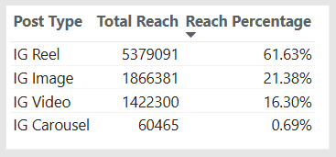
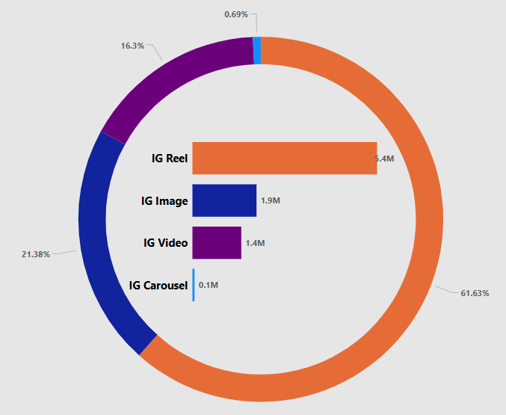
7. Percentage breakdown of total reach by post type.
IG Reels achieved the highest reach at 5.4 million and the highest reach percentage at 61.63%.
IG Carousels had the lowest reach, totaling 60,465, with a reach percentage of 0.69%.
These results reinforce that Reels are the most effective post type for reaching a wider Instagram audience.

Slide 13
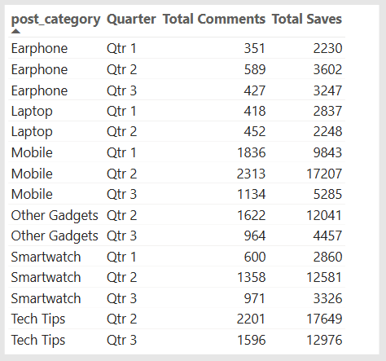
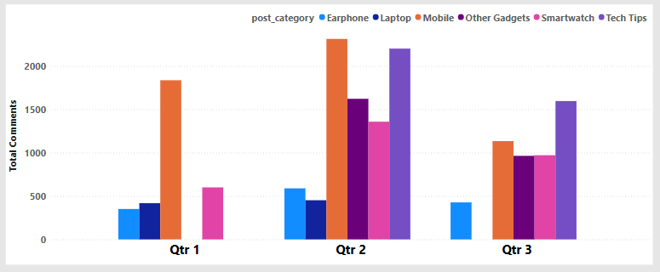
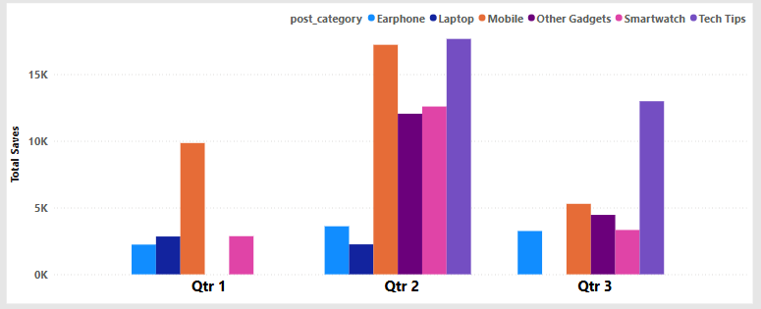
8. Quarter, Total Comments, and Total Saves recorded for each post category.
"Mobile" and "Smartwatch" categories have shown consistent engagement across all quarters in terms of comments, and saves.
The "Tech Tips" category, introduced in Q2, has demonstrated strong performance in saves and comments.

Slide 14
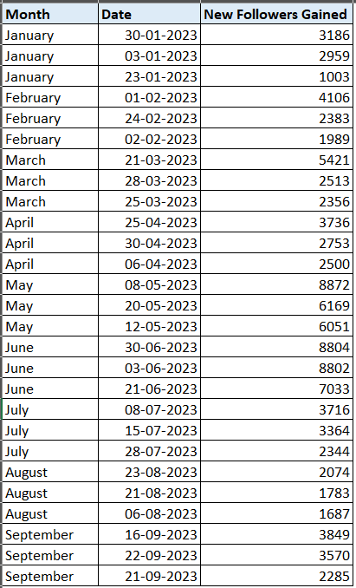
9. Top three dates in each month with the highest number of new followers.
Analysis of the top 3 follower-gain dates for each month reveals strong performance in May and June.
These months consistently recorded high spikes in new followers gained.
However, subsequent months show a sharp decline, indicating reduced audience acquisition post-June

Slide 15
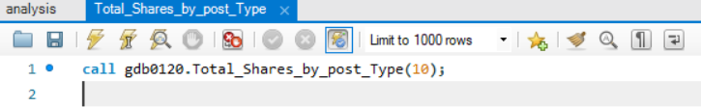

10. Creating a stored procedure that takes the 'Week_no' as input and generates a report displaying the total shares for each 'Post_type'.
Calling the procedure:
Output for week number “10”:

Slide 16
Thank
You
We appreciate your time and attention.
Questions or feedback are welcome.
Dhyanesh Khakharodiya
dhyaneshpk999@gmail.com

